Slide 1
AREDN
Amateur Radio for the 21’st Century

Slide 2
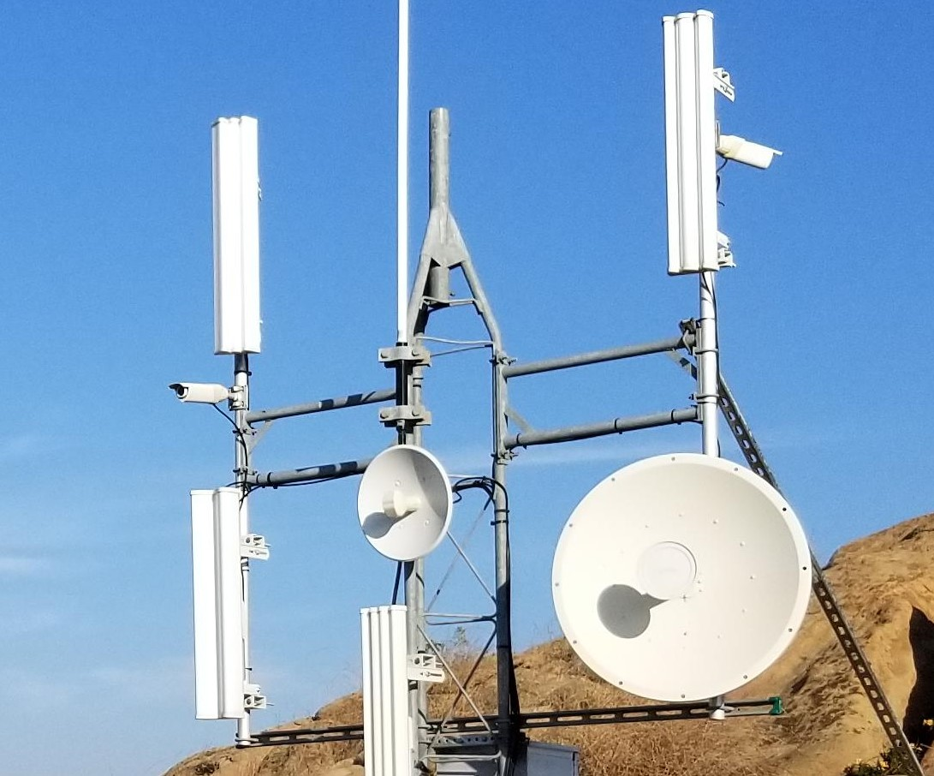
What is AREDN?
AREDN is the Amateur Radio Emergency Data Network. It is made up of nodes that form a self healing mesh. This creates a stable working computer network much like the internet, but does not rely on existing infrastructure and repairs itself if some nodes in the system drop out.

Slide 3
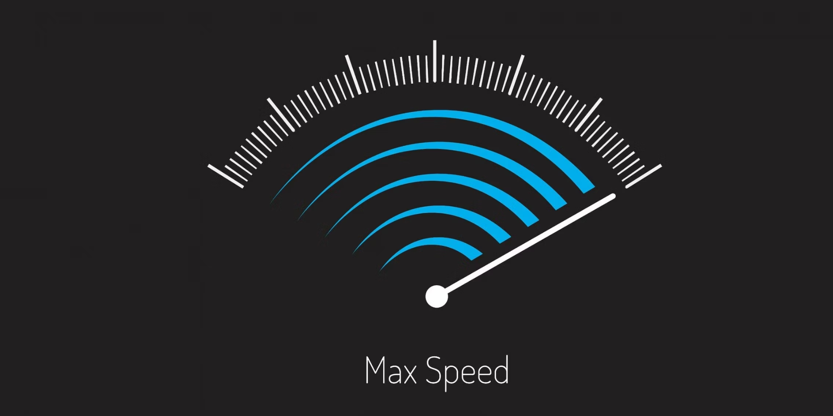
Digital Communications
Served agency communications are increasing more data intensive pushing more communications toward digital modes over voice.
Packet - up to 1.2 kbits/second
VaraFM - up to 25 kbits/second
AREDN - up to 1000 Mbits/second

Slide 4
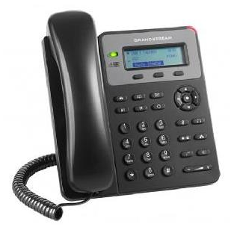


Tools served agencies use daily

Slide 5
Where AREDN fits in?
First, it is just another tool in the tool box.
It provides capacity similar to what served agencies are using daily.
Today’s ham radio experience is often quite hybrid using the internet where available as part of its infrastructure. AREDN can be Internet independent or be tunneled through the internet bringing the assets of the entire AREDN network to each user. All assets in a mesh network are available to all stations.

Slide 6
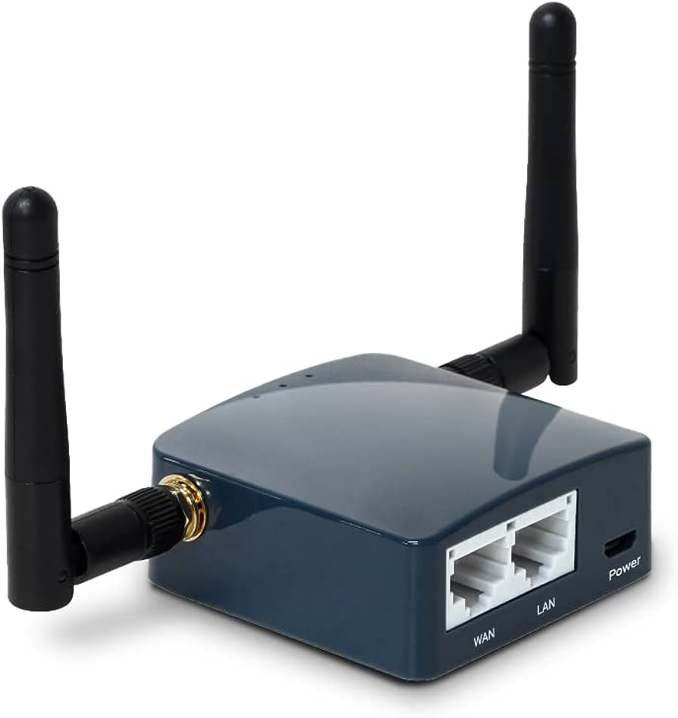
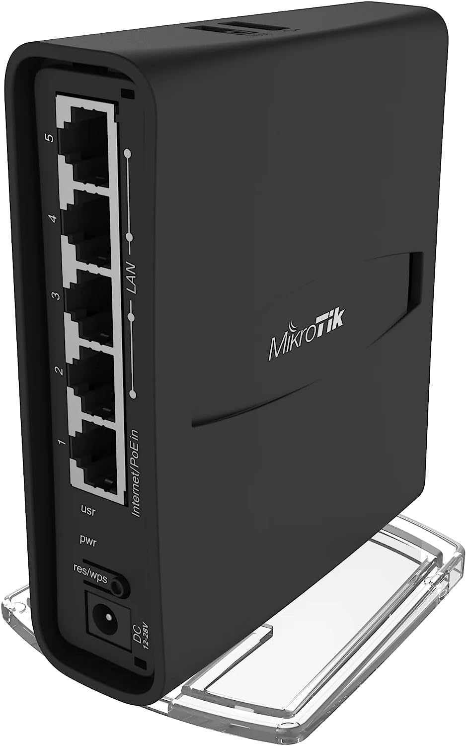
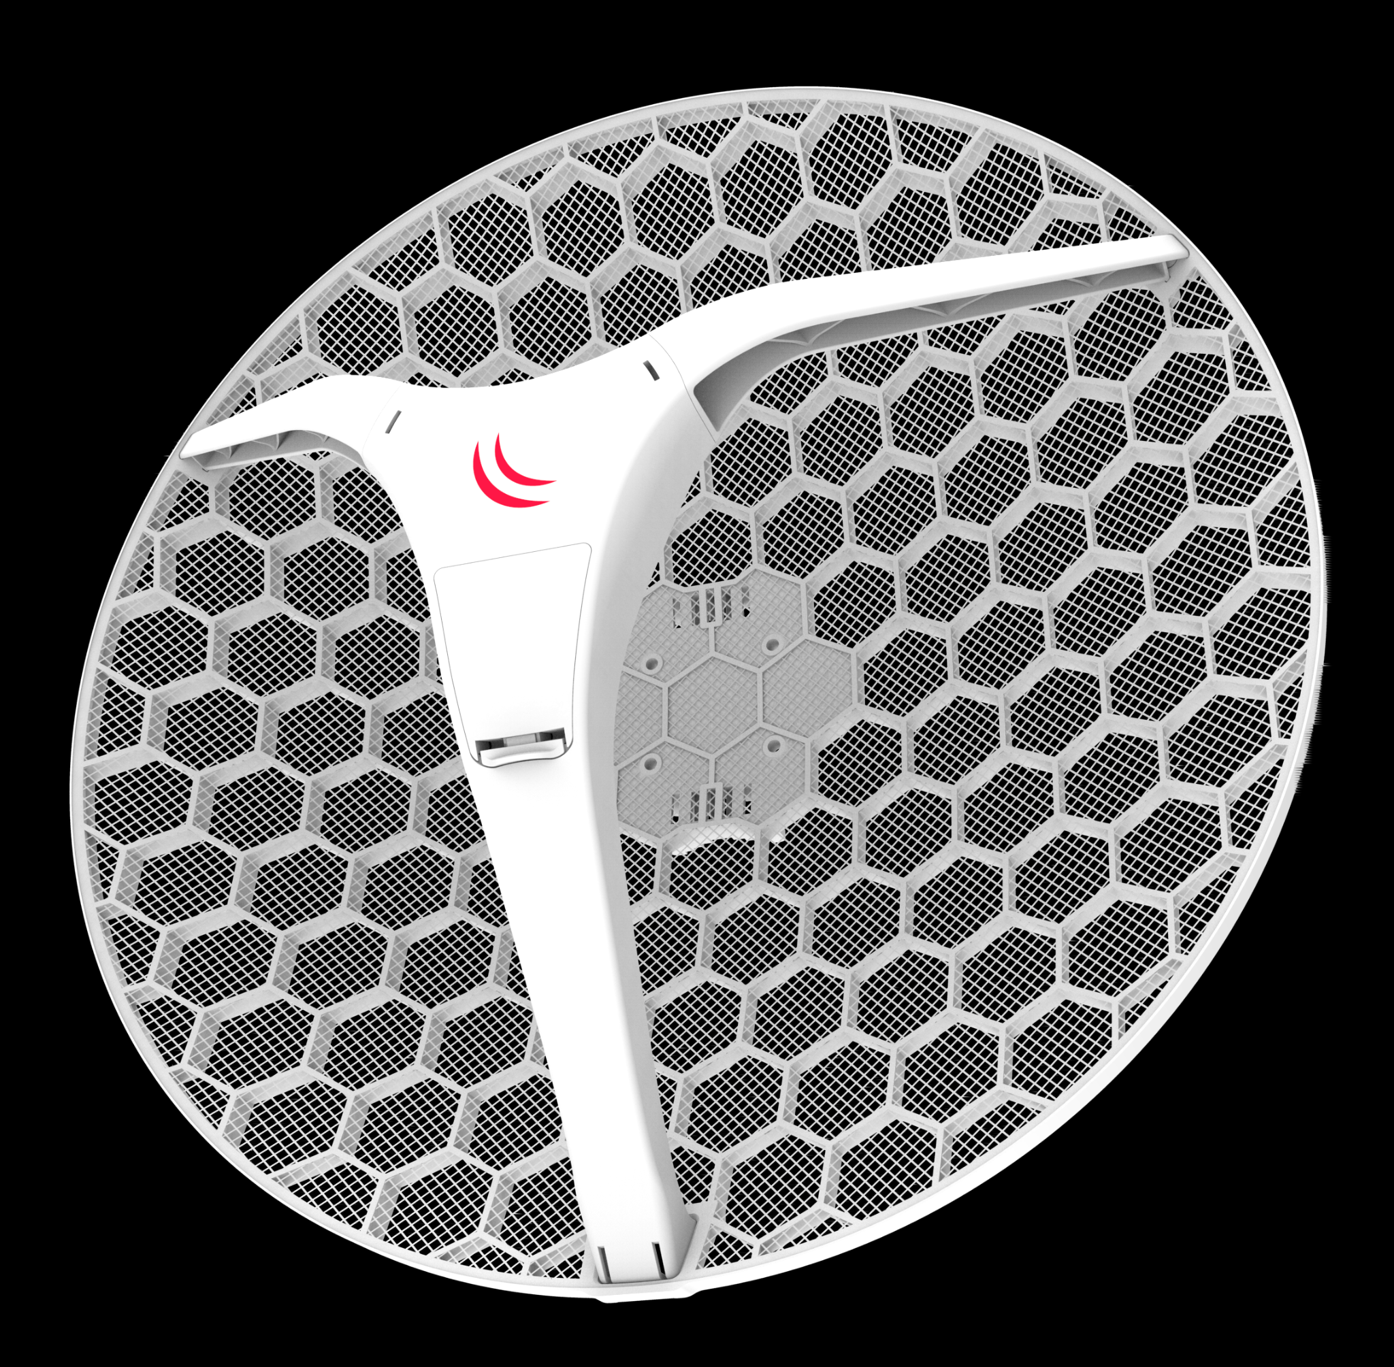
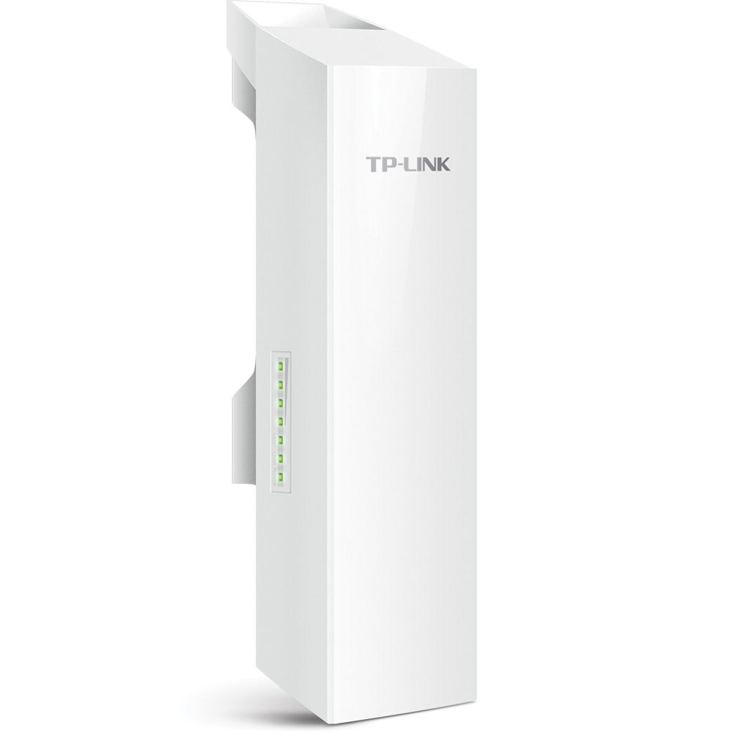
What equipment is used?

Slide 7
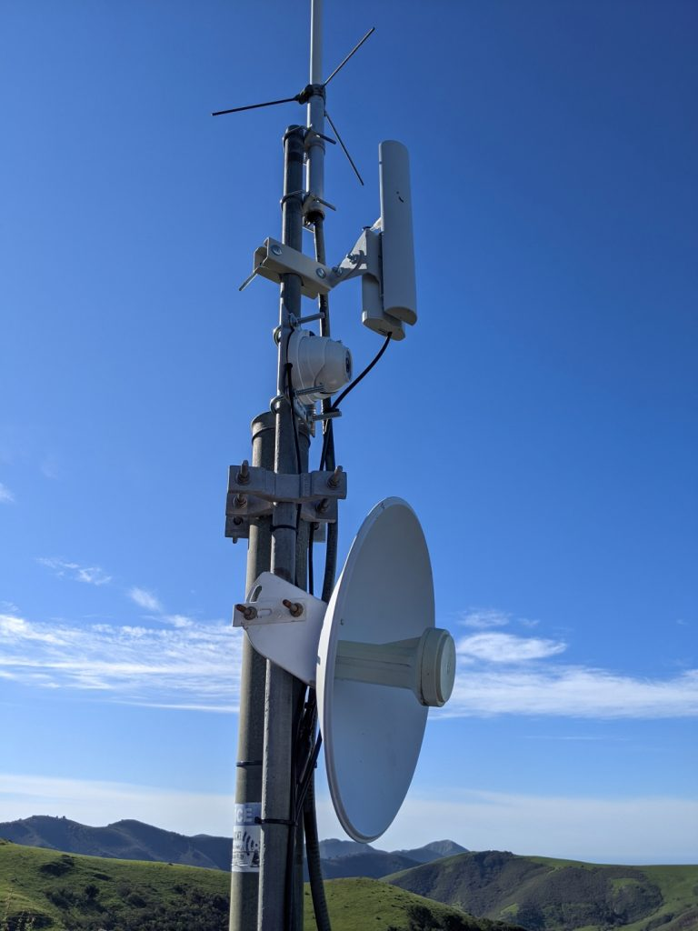
Equipment Considerations
A broad selection of popular devices can be flashed with AREDN firmware for use with a data network
  MikroTik
  Ubiquiti
  TP-Link
  GL-iNet
Consider if you are needing local or long haul use
  Local equipment uses omnidirectional antennas or 120 degree sector antennas.
  Long-haul antennas can be very focused and very strong. A simple MikroTik LDF-5 can be focused by a discarded satellite dish yielding 1000W ERP! Other purpose-built dish antennas like the PowerBeam-M5-620 carry a line of site up to 20 miles!
  Like most antennas it is…Location, Location, Location!

Slide 8
Working AREDN Network
Let's take a look at a typical off-grid application. I have assembled a go-kit with the basic features helpful in a deployment.
They include:
  VoIP phones with a PBX
  Video surveillance
  Access to the larger southeastern AREDN network
  local mail server and access to the internet.
Keep in mind that HTTPS traffic is forbidden on Part 97 networks as it is encrypted. Access to Winlink via the CMS is a perfectly acceptable use for AREDN. Of course this would require internet tunneling.

Slide 9
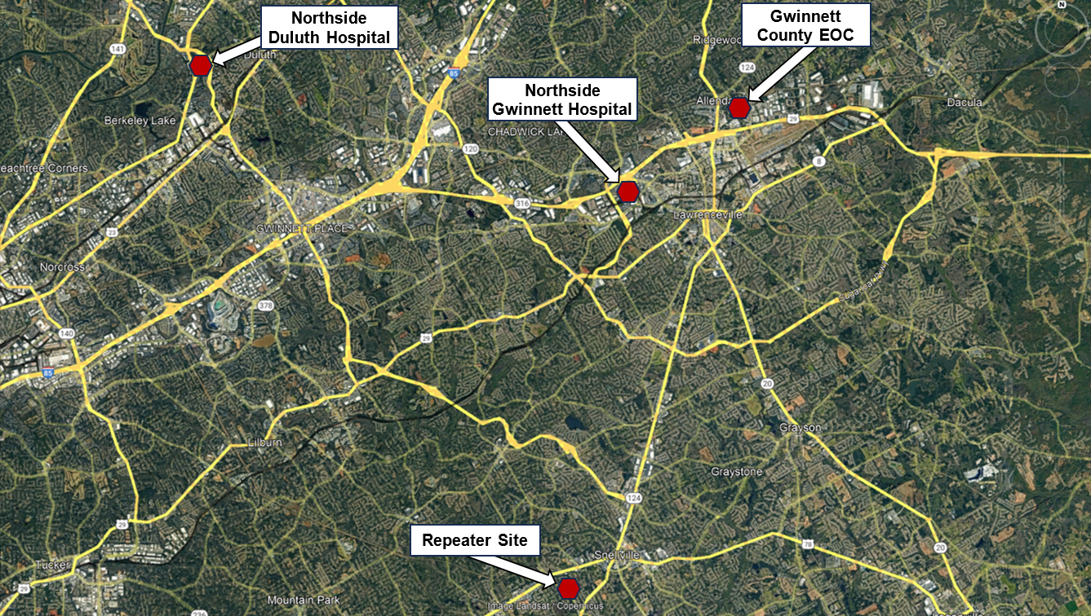
Proposed Infrastructure:

Slide 10
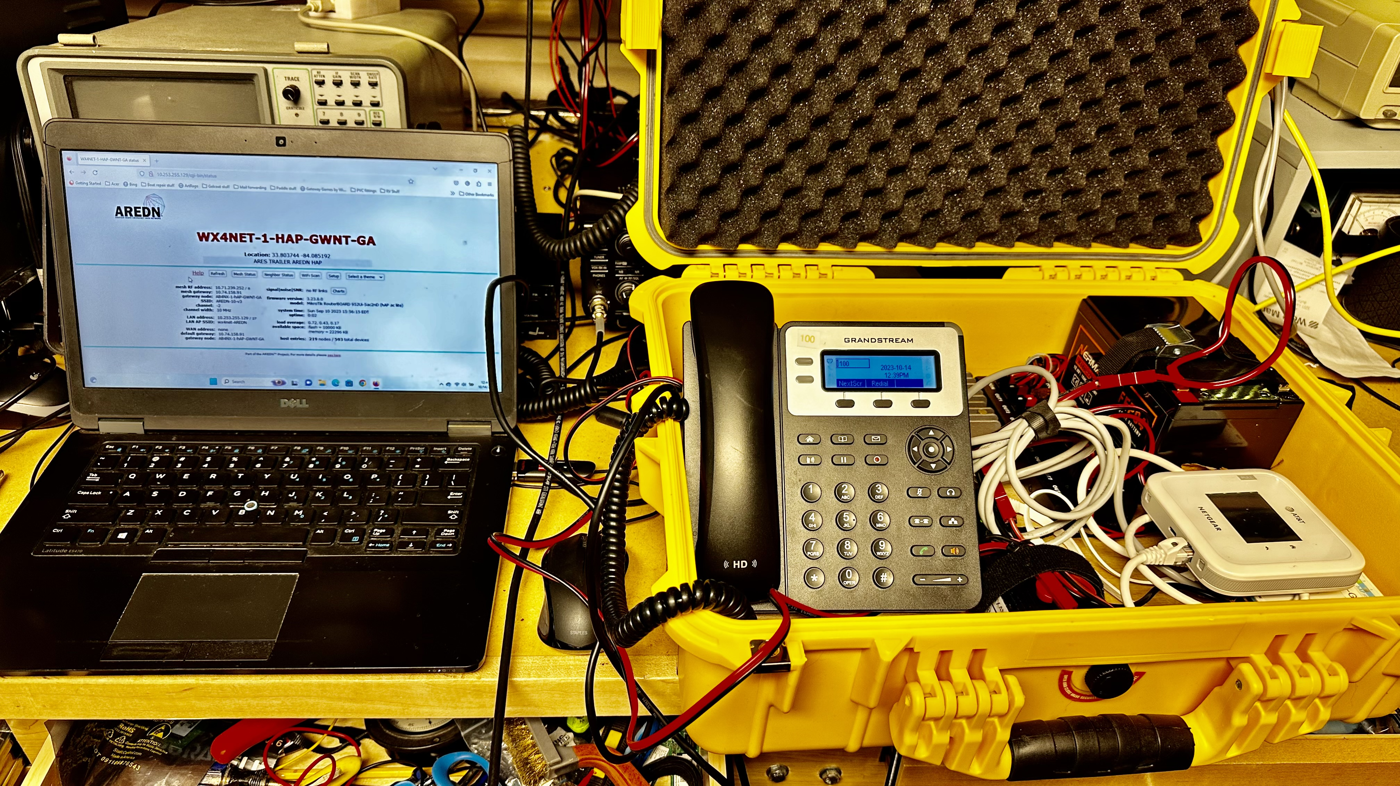
Field Deployment:

Slide 11
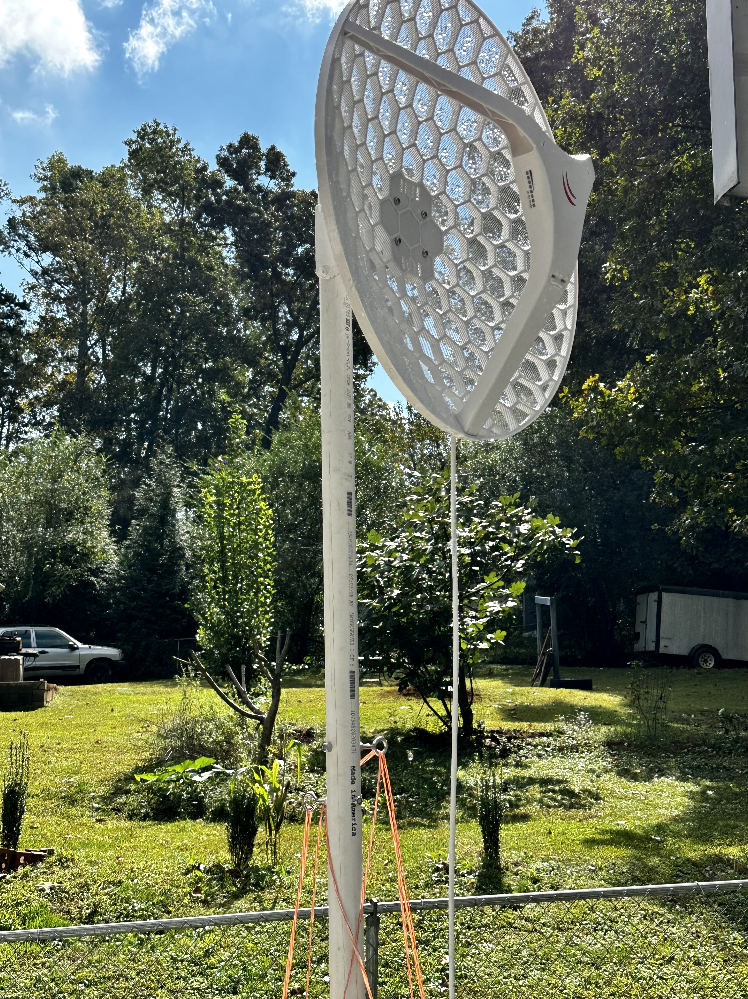
Long Haul Radio

Slide 12
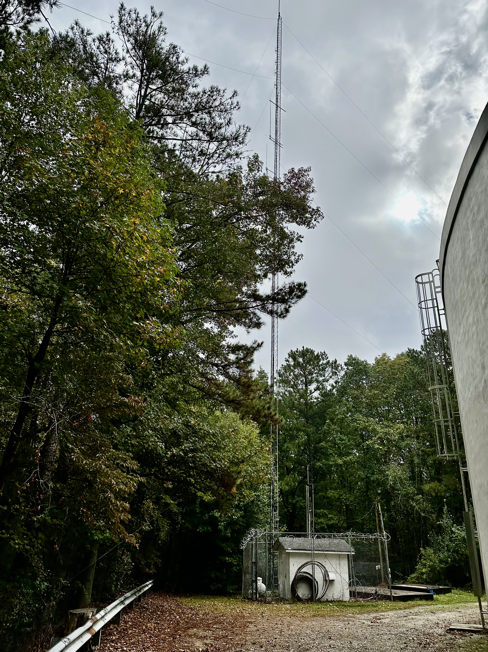
Snellville Repeater Site:
All our assets belong to our served agencies.

Slide 13
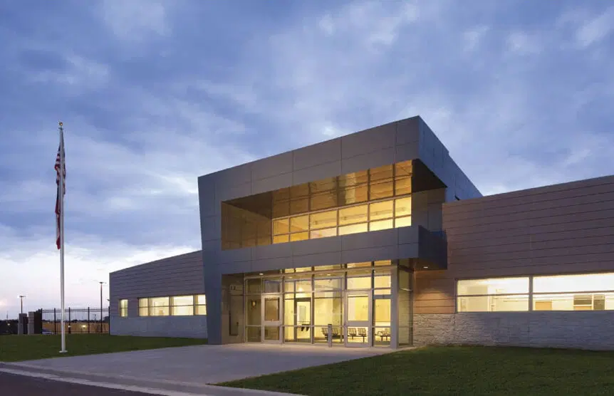
Gwinnett County EOC

Slide 14
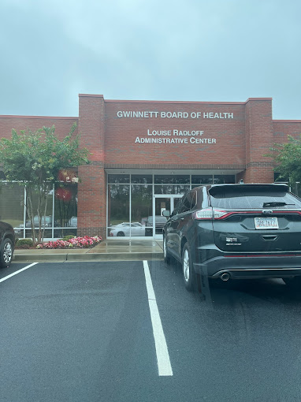
GNR District 3-4 Health Department Headquarters.

Slide 15
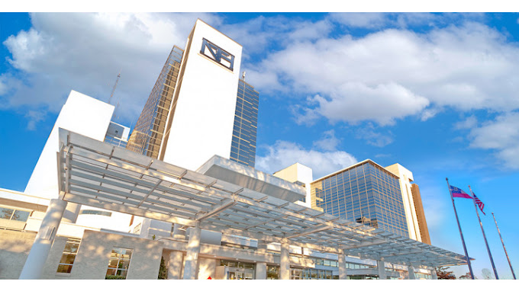
Northside Gwinnett Hospital.

Slide 16
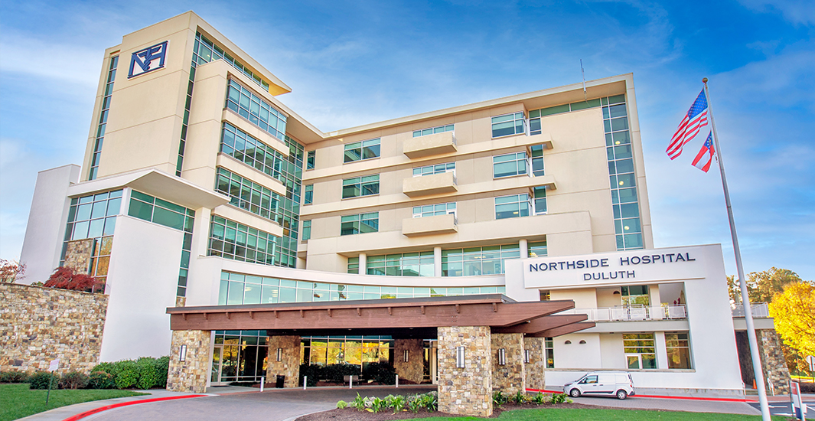
Northside Duluth

Slide 17
Simulated Deployments
JOTA
  Provided Point To Point connect between ARES trailer and pavilion
  Deployed two VoIP phones and two IP cameras
  Access to broader mesh via tunneling
Stone Mountain Hamfest
  Multiple point to point connections

Slide 18
Proposal Deployments / Tabletop Exercises
Memorial Day Parade
  Provide camera support for assembly point at church and high school to parade director
  Potential VoIP communication between parade director and assembly point
GA Death Race / GA Jewel
  Both are ultramarathons in N GA Mountains
  Provide camera support to ensure runner check-ins aren't missed
  Provide race status / communication to aid stations to allow them to self-serve
  Balance workload among operators

Slide 19
How do we benefit:?
Tools in the toolbox.
Our own communications system for pleasure and for grid down.
We serve our served agencies and thereby have access to a feature packed system.
We can connect by tunneling to the rest of Georgia, the Southeast, and the USA.

Slide 20
Where do we start?
Learn to flash a router. Example, MikroTik or Gl-inet.
Build a go-kit.
Build a network.
Practice independent deployment.
Add mail, chat, phones, server, IP cameras etc.

Slide 21
Getting Started
http://www.arednmesh.org is the go-to site for AREDN
  Supported Devices: http://downloads.arednmesh.org/firmware/html/SUPPORTED_DEVICES.md
  Current Software: https://www.arednmesh.org/content/current-software
YouTube videos
  Overview - https://www.youtube.com/watch?v=zXEV18FuruM
  Flashing Mikrotik Nodes - https://www.youtube.com/watch?v=B3LEAAsIWEA

Slide 22
Remember, we would not have repeaters, let alone frequencies to operate on without our commitment to communications in emergencies.
These served agencies will provide us with the connections. We will in turn be there for our fellow citizens when emergencies happen.

Slide 23
How Much Would the AREDN Infrastructure Cost?
Expect something on the order of $3000-4000 for 5-6 sites.
  Adding battery and solar would be a very good idea. This would make the sites fully independent of commercial power.
We could reasonably make a proposal for grant money from ARDC for this project.
We would need a solid proposal with buy-in from our served agencies.
Further development would be ad hoc and incremental involving mostly members own links.

Slide 24
DEMO

Slide 25
Questions?
Kevin Igarashi-Ball, W4KIB
kevin@w4kib.com
Larry Whited, AB4NX
Technical Specialist, Georgia Section
404-277-4864
lwhited1@msn.com

