Slide 1
GARS October 2023
Show and Tell

Slide 2
Presenters
Paul Kelley – W4KLY
Bill Cohron – WD4AMC
Kevin Igarashi-Ball - W4KIB
Mark Prichard – KN2TOD
Kevin Scott – K4GTR

Slide 3
Paul Kelley – W4KLY
Fold-up support system for POTA or other operations

Slide 4
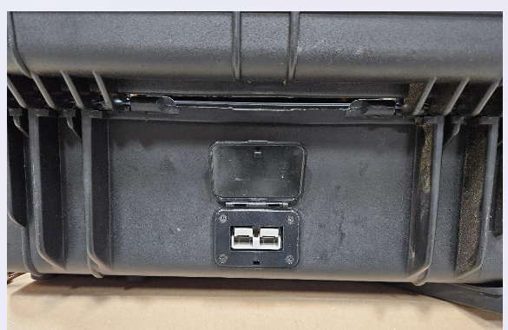
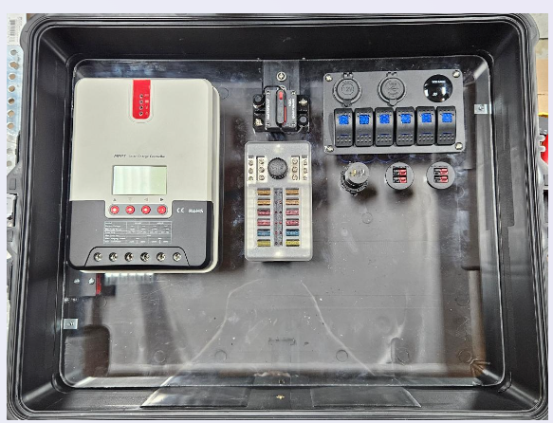
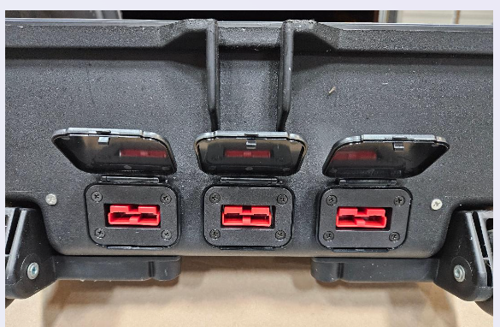
Bill Cohron – WD4AMC
Portable Solar Power Distribution Kit

Slide 5
DIY LiFePo4 Battery Box
Kevin Igarashi-Ball / W4KIB

Slide 6
Problem
I’m an avid camper, hiker, and backpacker
I’m a ham
I’ve got a lot of USB chargeable devices
I have 12 volt compressor fridges for overlanding and camping

Slide 7
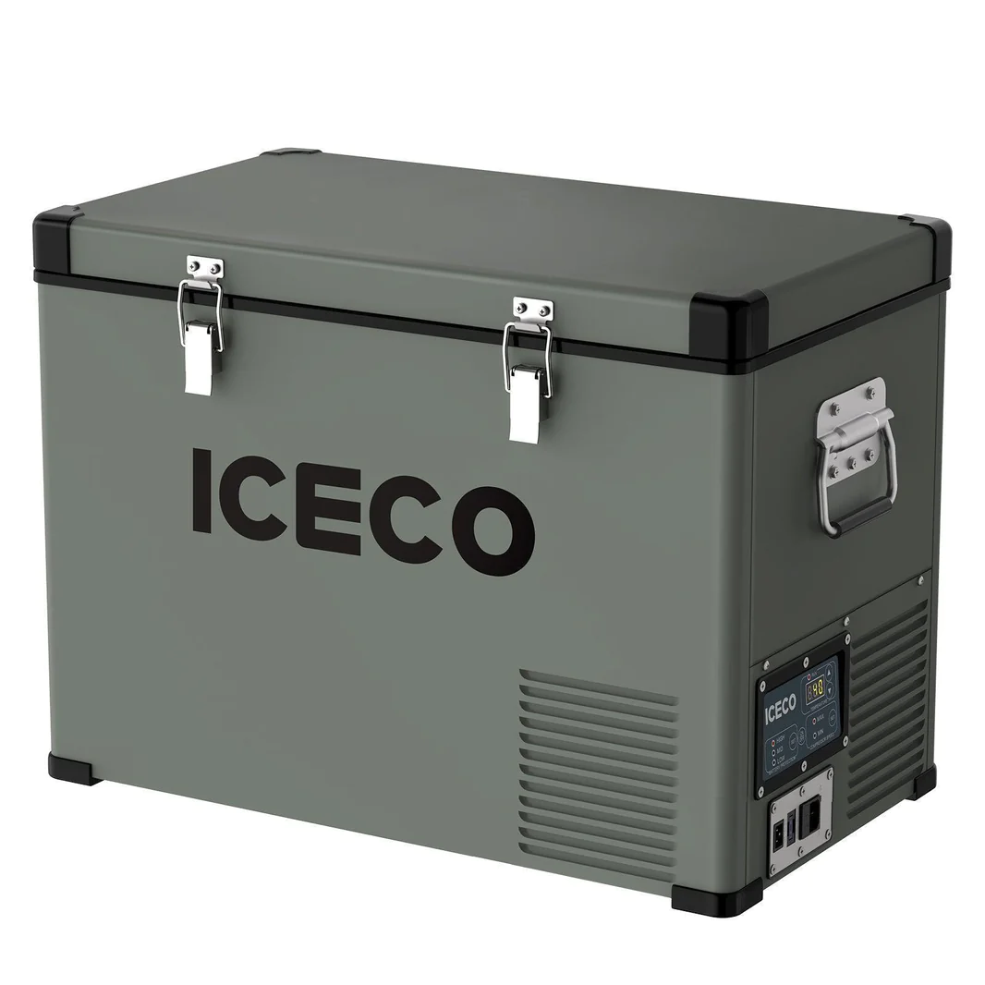
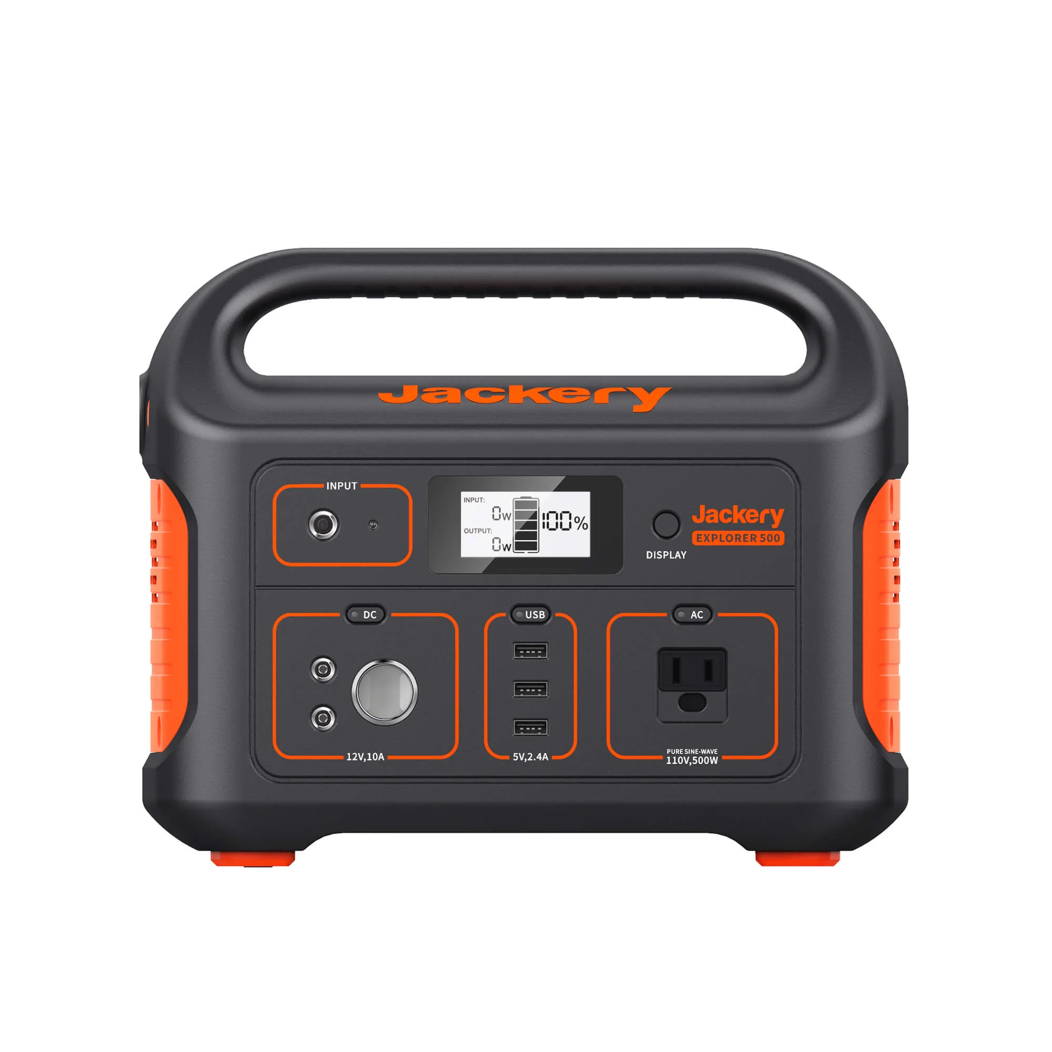
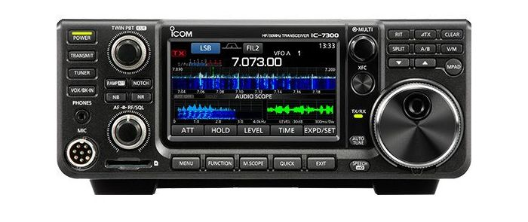

Slide 8
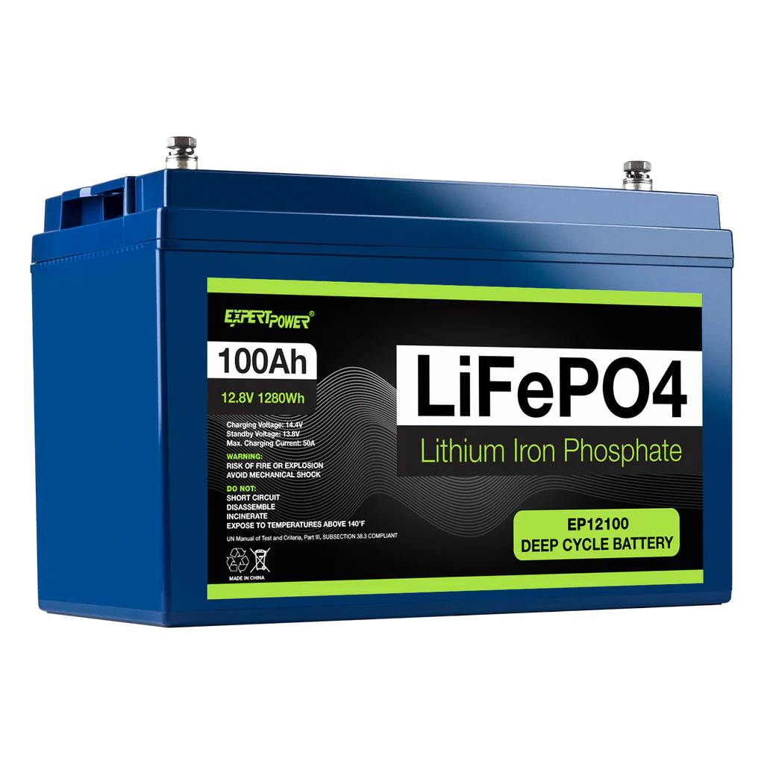
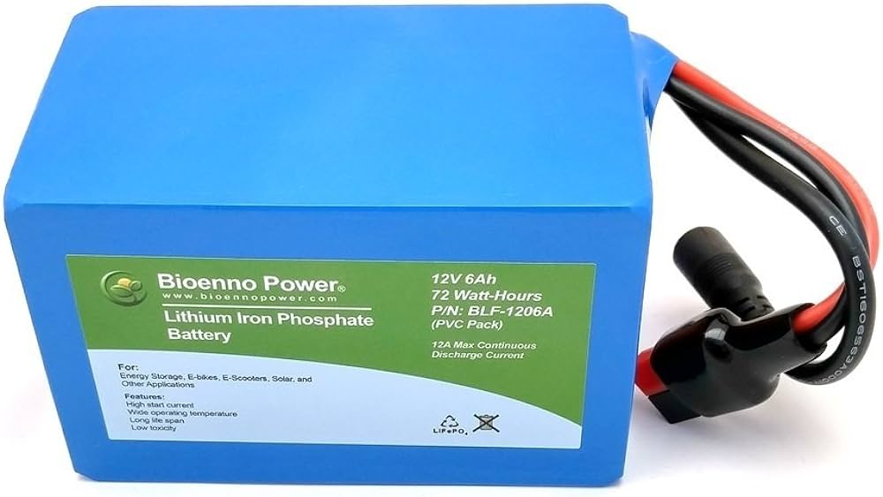

Slide 9
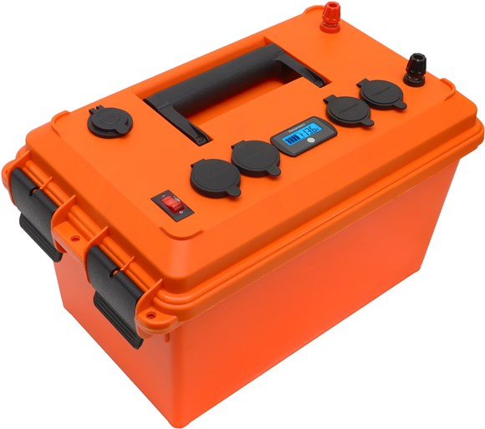
**Premade batteries generally have additional padding and follow standard sizes

Slide 10
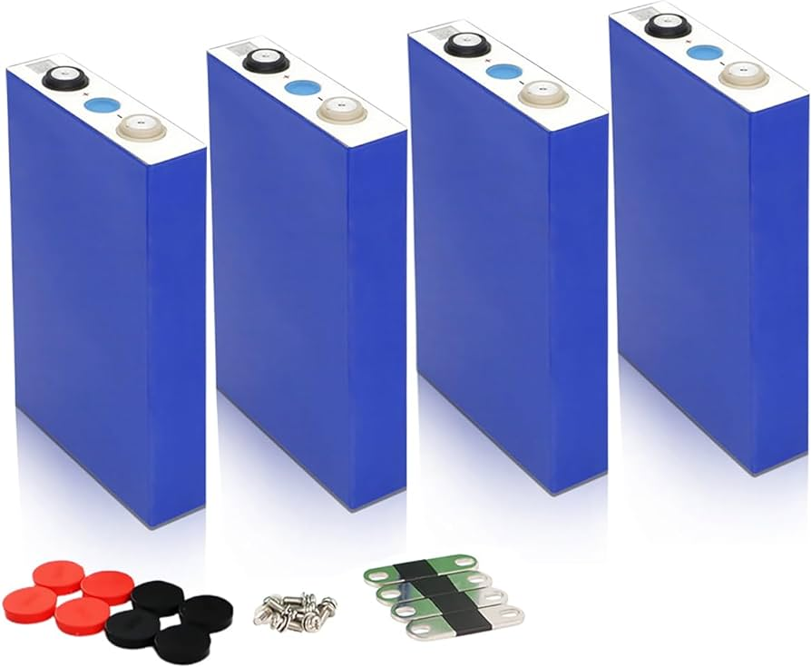

Slide 11
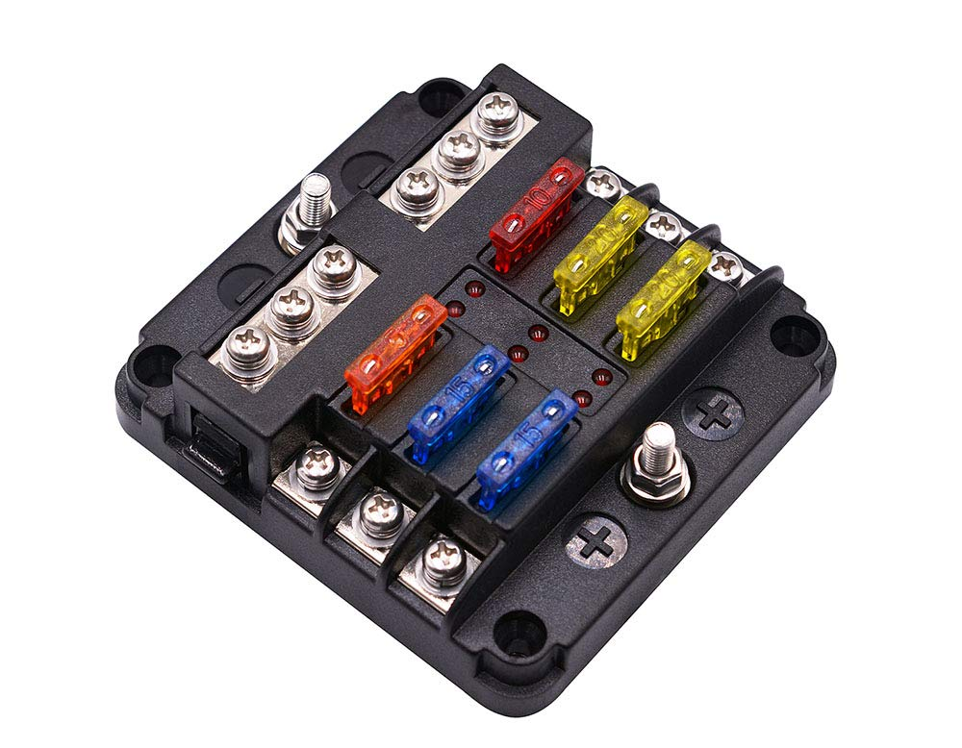
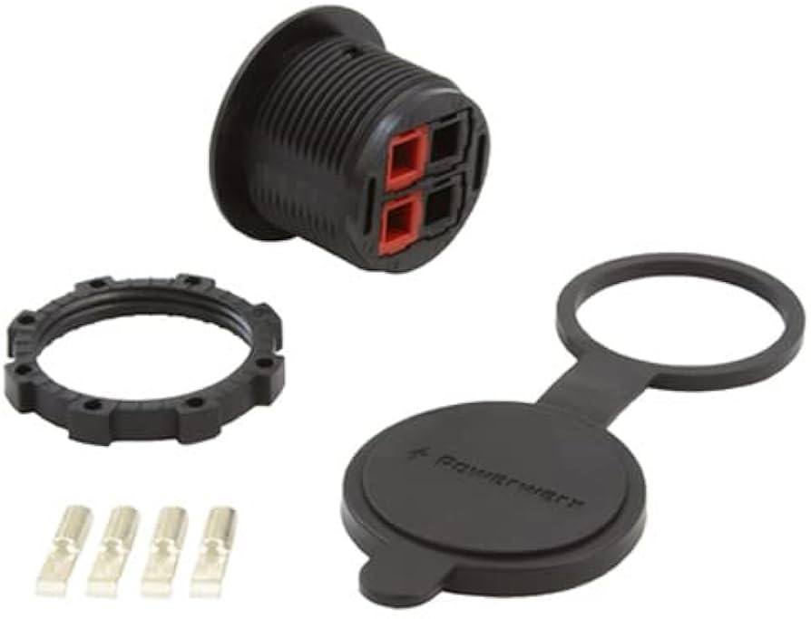
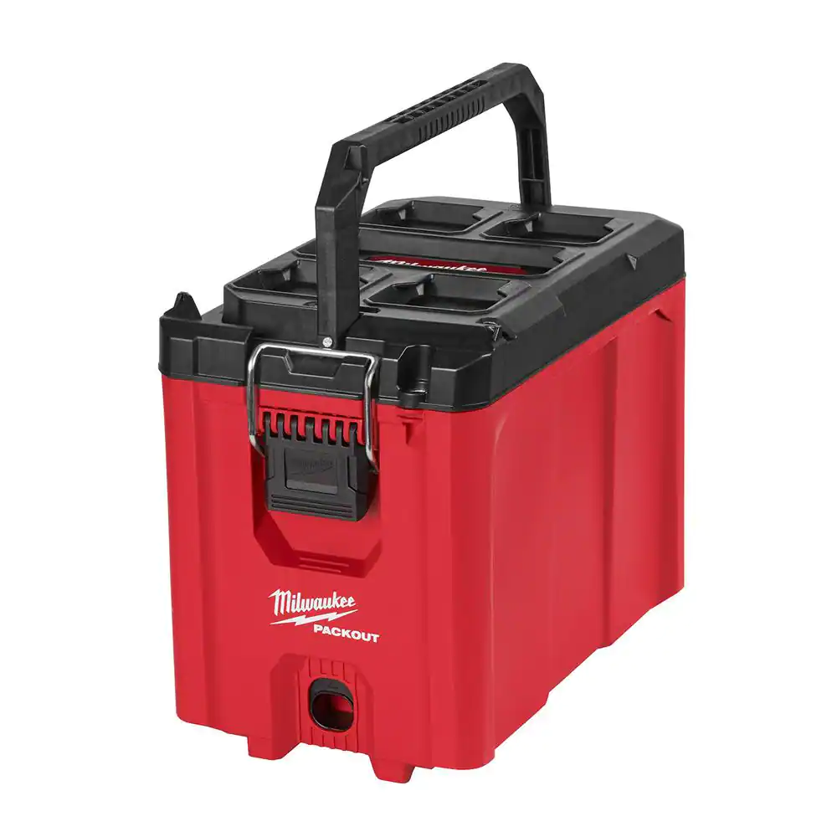
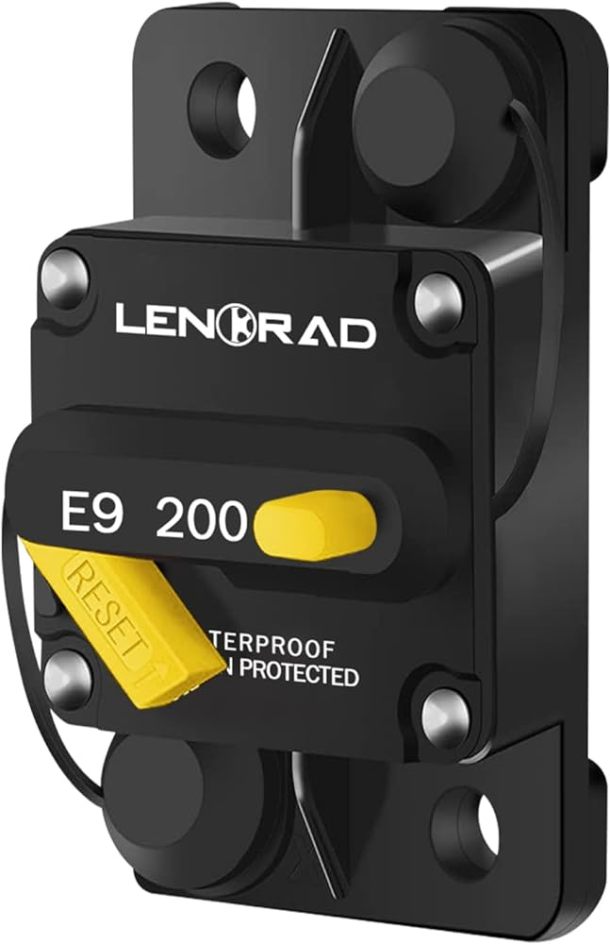
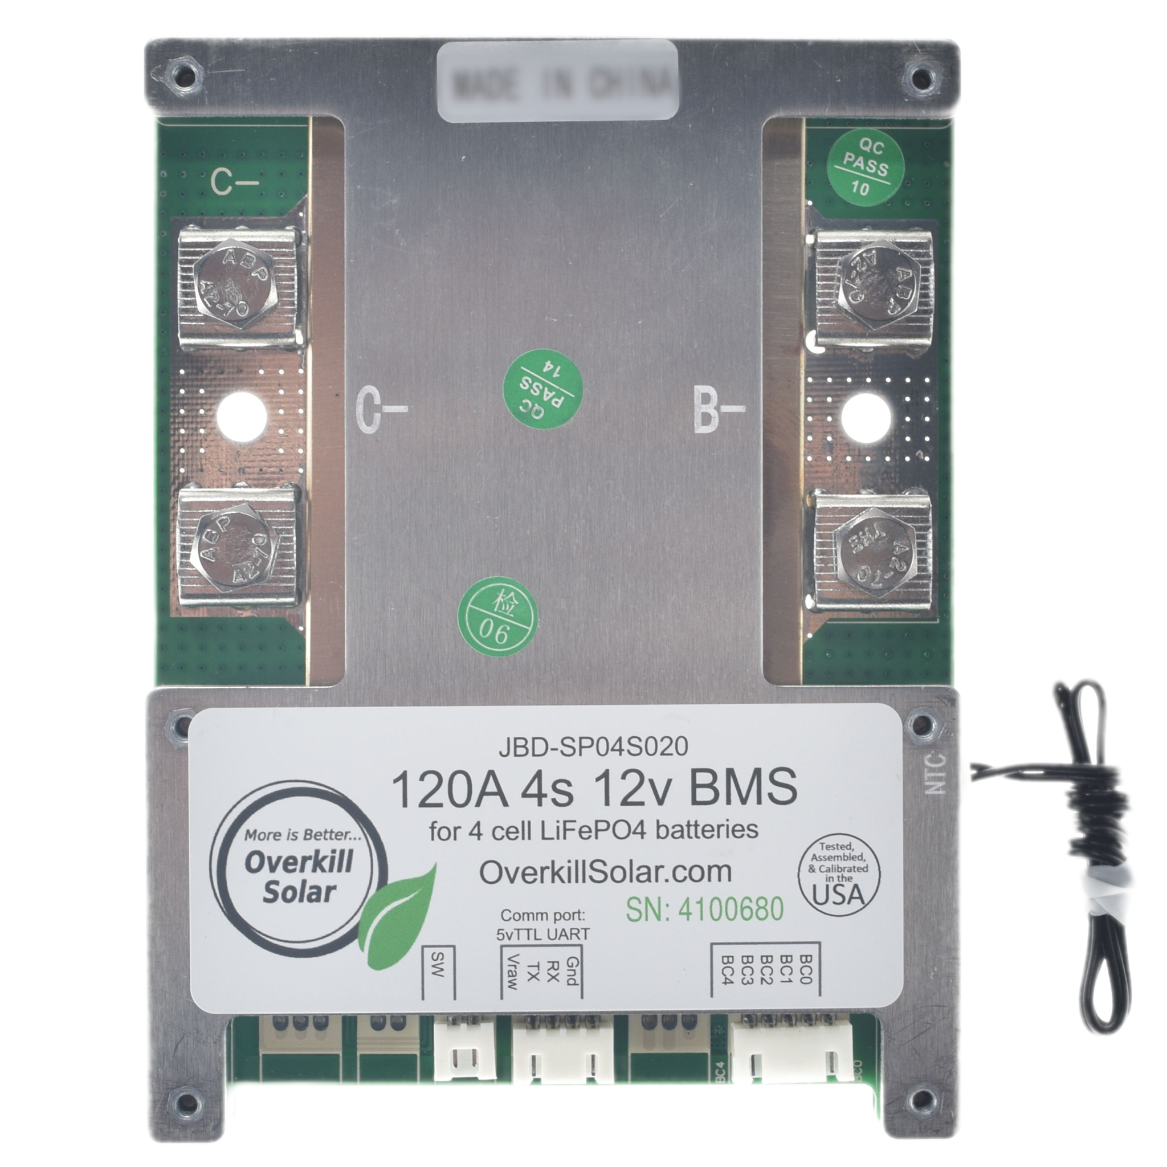
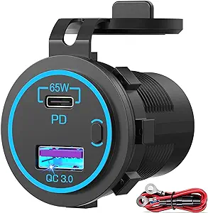
My battery box
**Mine is 100 amp

Slide 12
Pros
Cons
More capacity in same package size
Additional safety feature - overall circuit breaker and individually fused circuits
Customized - USB outlets and powerpoles are sized for my exact needs
Show off factor
Minimal to zero cost savings (if buying Grade A cells)
You need to know what you are doing; you are dealing with electricity after all
Minimal
Understand series vs parallel and how to top-balance
Consult a wire size / amp chart and oversize

Slide 13
Resources
Suppliers
https://www.18650batterystore.com/ - LiFePo4 cells (local - Stockbridge)
https://batteryhookup.com/products/12v-lifepo4-smart-bms-w-low-temp-cutoff - BMS (get the optional bluetooth module
https://www.amazon.com/65W-12V-USB-Outlet-Laptop/dp/B09YTWNCM2 - 65w USB PD Panel Mount
https://powerwerx.com/panelpole-panel-mount-powerpole-black-dual - Powerpole Dual Panel mount
Videos
https://youtu.be/uN1h0XIpfTg?si=xaRvXBZFP7wMOJbD - Building a DIY LiFePo4 Battery Box
https://www.youtube.com/@WillProwse - One of the go to YouTubers on batteries and solar

Slide 14
Mark Prichard – KN2TOD
Pi-Star Mods

Slide 15
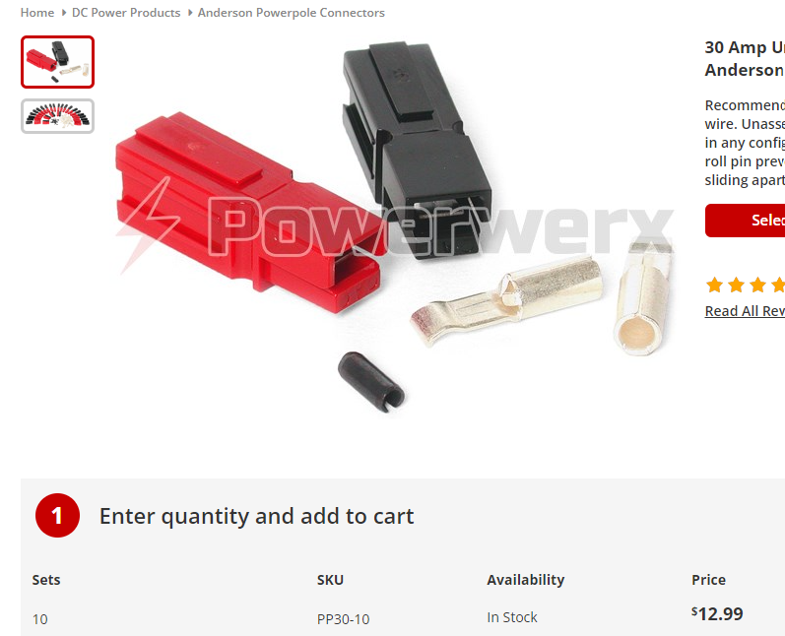
Kevin Scott – K4GTR Five Output DC Switch with Anderson PowerPoles
Plastic box - $5
16 Gauge Zip Cord - $6
Grounding Clamp - $4

Slide 16
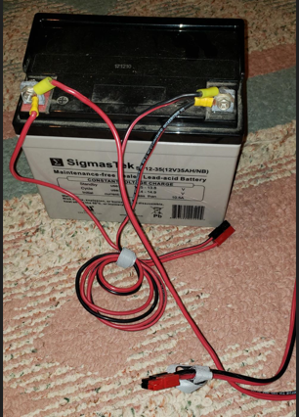
Plus a lot of Accessories
Y-cables
Extension cables
12 Volt Lights
Battery adapter cables
All batteries have two sets of Anderson PowerPoles; one for charging, one for discharging

Slide 17
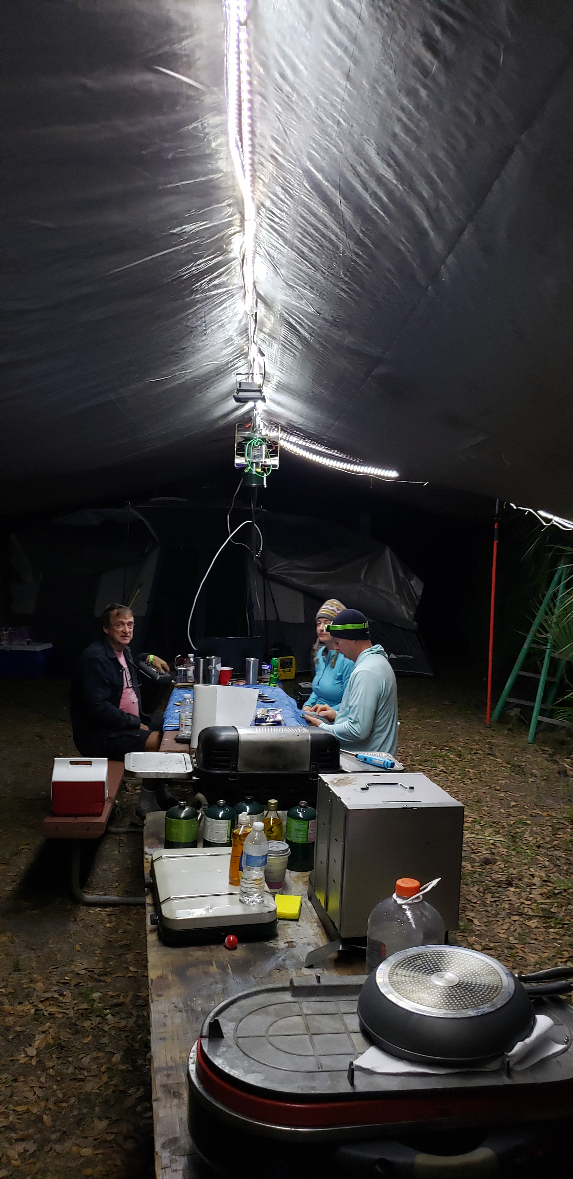
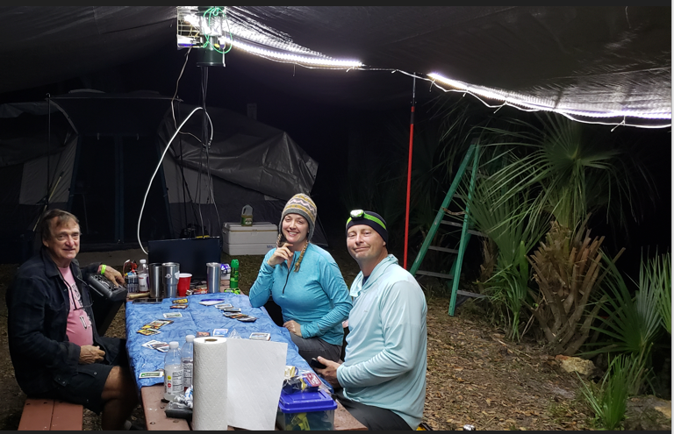
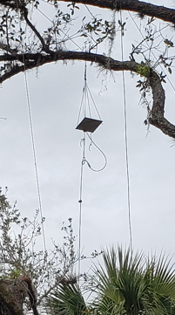
Actual Use

Slide 18
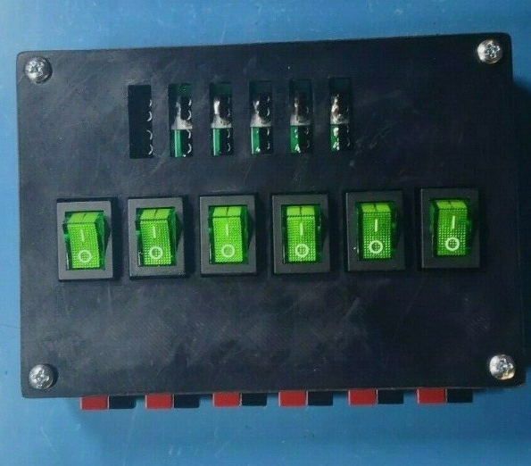
Six Output DC Switch with Anderson PowerPoles
Or if you prefer to buy:
From ebay - $60
https://www.ebay.com/itm/185348739074?hash=item2b27a55002:g:HJcAAOSwLf9iNp98&amdata=enc%3AAQAIAAAA0GPJMDZT7jL2QpIfbLigEql8za5nClL5ybJ3Qk%2Fm%2Bn7kN%2FrKSsyuyUdM9YK%2Ftv%2FpaLN3j2O20tx%2BKf7SAvbvx9z1VWVHTM%2F6gktU40n8l4v%2BQxCPlvnFqLiRFjEPjmzewnTT4ugSOB5vxsZiOAdeJ3dsa4hDCOlAkcDFBovM8aEzkAUEFIv%2Bt0qQE%2BqOcX%2FYq1E5jRJivIVjJrr5GujRJhi9dNzGBRVWK0cLeNaZiFKqL4ou9kMapoQBXYqSQ%2FdJBumSy1ODEZKQ0Jof7SRDOko%3D%7Ctkp%3ABk9SR6TSi5HgYg

Slide 19
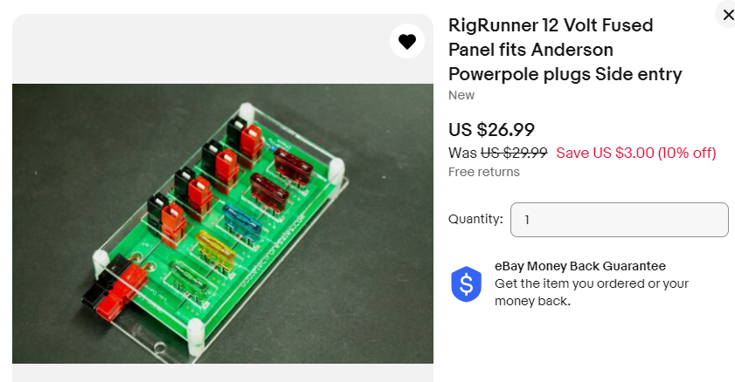
Or if you prefer a non-switched coupler
https://www.ebay.com/itm/153147334217?hash=item23a84ade49:g:WlwAAOSwhhFbe3cD

