Slide 1
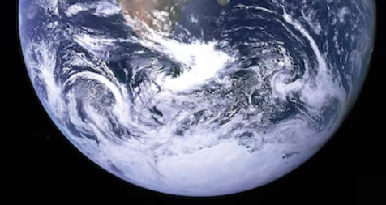
The World Below 160 Meters
Including Two New Ham Bands
Kevin Scott
K4GTR
kevindscott@bellsouth.net

Slide 2
The Spectrum at and Below 160
160 Meters is in the upper portion of the Medium Frequency (MF) or Medium Wave (MW) Band
Sub-bands:
High Frequency (HF or SW) 3 – 30 MHz
Medium Frequency (MF or MW) 300 kHz - 3 MHz
Low Frequency (LF or LW) 30 – 300 kHz
Very Low Frequency (VLF) 3 – 30 kHz
Ultra Low Frequency (ULF) 300 Hz – 3 kHz
Super Low Frequency (SLF) 30 Hz to 300 Hz
Extremely Low Frequency (ELF) 3 to 30 Hz

Slide 3
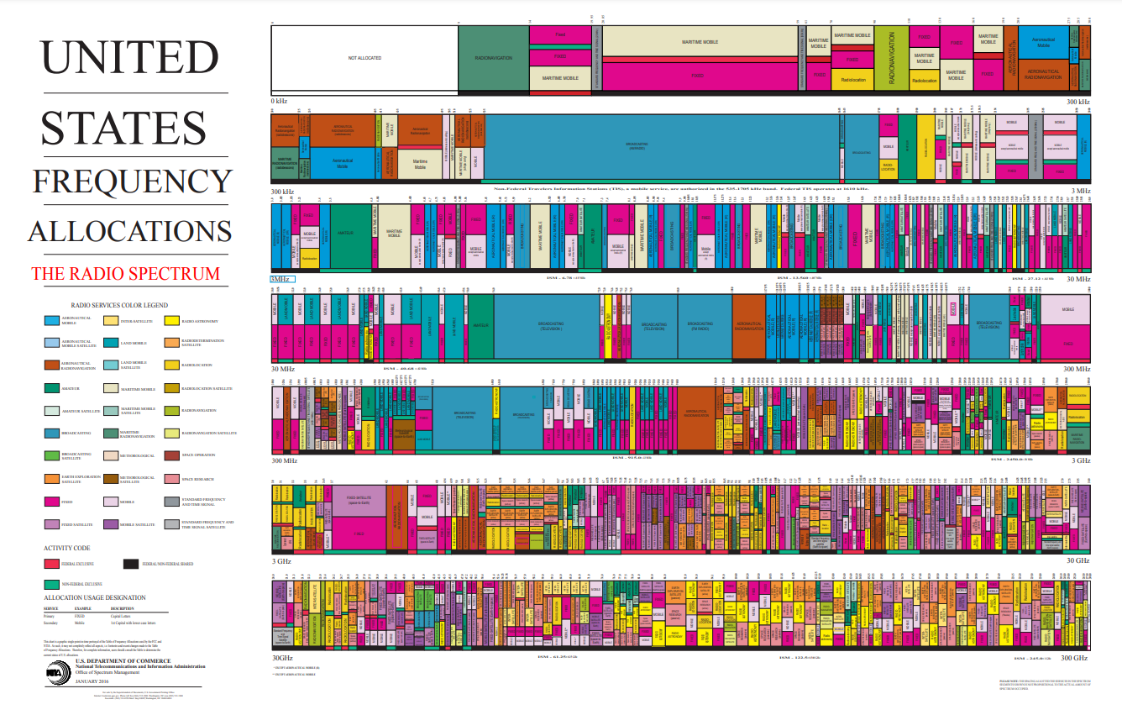

Slide 4
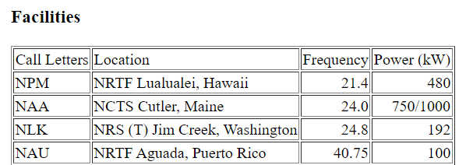
0 Hz to 300 kHz
WWVB
60 kHz
2200 Meters
135.7 – 137.8 kHz
Older ELF comms:
USN 76 Hz
Russia 82 Hz
India - ?Hz
China - ?Hz
Submarine Comms
LowFERs
NDB’s

Slide 5
2200 Meters
135.7 to 137.8 kHz (2.1 kHz of spectrum)
Max 1 Watt EIRP
General Class and higher
Permissible Modes CW, RTTY, Data, Phone and Image
Must inform power company prior to operation. Must prevent interference to existing PLC systems on their electric power transmission lines
https://utc.org/plc-database-amateur-notification-process/
Max antenna height 60 meters (197 feet)

Slide 6
2200 Meter Band Plan
135.7–136.0 kHz
Station Tests and transatlantic reception window
136.0–137.4 kHz
Telegraphy
137.4–137.6 kHz
Non-Telegraphy digital modes
137.6–137.8 kHz
Very slow telegraphy centered on 137.7 kHz
JT9/FST4/WSPR/FST4W – 136.0 kHz

Slide 7
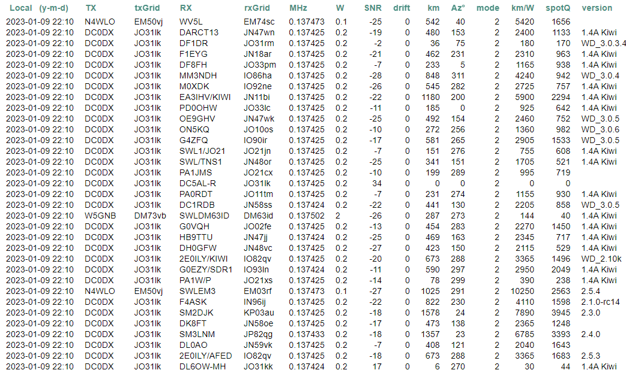
WSPR Contacts on 2200 Meters

Slide 8
300 kHz to 3 MHz
TIS
530 kHz
TIS
1610 kHz
630 Meters
472 - 479 kHz
160 Meters
1.08 – 2.0 MHz
AM Broadcast Band
NDB’s

Slide 9
630 Meters
Why? Because it is there. Long ground wave propagation. Different from HF skywave propagation
472 to 479 kHz (7 kHz of spectrum)
Max 5 Watt EIRP
General Class and higher
Permissible Modes CW, QRSS CW, RTTY, Data (JT9, WSPR, FST4, FST4W, FT8), Phone and Image
Must inform power company prior to operation. Must prevent interference to existing PLC systems on their electric power transmission lines
https://utc.org/plc-database-amateur-notification-process/
Max antenna height 60 meters (197 feet)
472 kHz.org - Great resource website: https://www.youtube.com/watch?v=tIpoJl_I8Gc

Slide 10
630 Meter Band Plan
CW calling frequency - 474.2 kHz
WSPR/FST4W – 475.7 kHz or 474.2 kHz
JT9/FST4 – 474.2 kHz

Slide 11
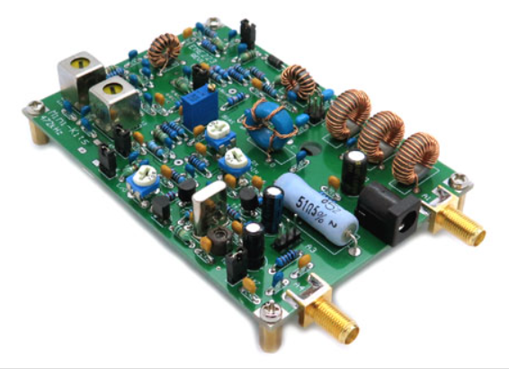
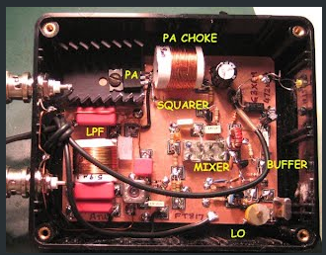
Transmitters/Transverters
https://www.minikits.com.au/eme223
https://sites.google.com/site/g3xbmqrp3/mflf/472khz_tvtr

Slide 12
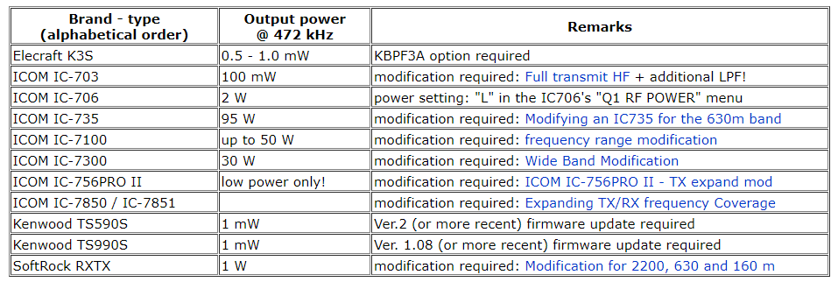
Transmitters/Transverters
A limited number of commercial HF transceivers will transmit on 630 m, but most of them with low power, so you might stilll need a power amplifier:

Slide 13
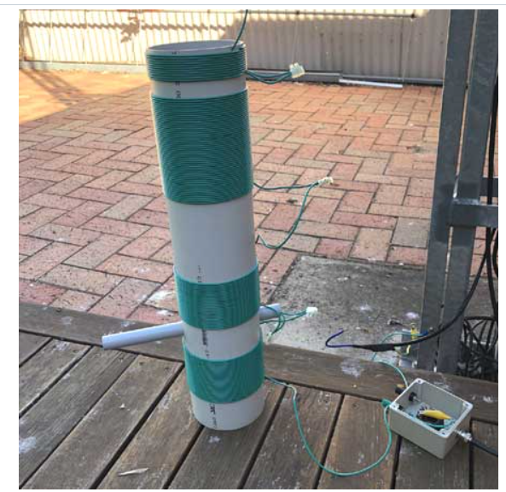
630 Meter Antennas
Loaded 160, 80 or 40 meter antenna
The vertical section is the main radiator; the horizontal wires of the antenna are the capacitive hat for loading a physically short antenna
In my case, I have a 160 meter doublet. The vertical section of 450 ohm ladder line is 85 feet with each top hat measuring 130 feet
The impedance of this antenna is around 75 ohms with around 900 pF of capacitive reactance. This should not be difficult to match to 50 ohms
Large loading coils will likely be needed for shorter antennas
A good ground radial system is required

Slide 14
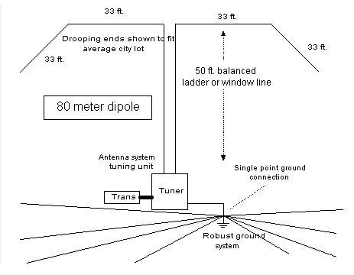
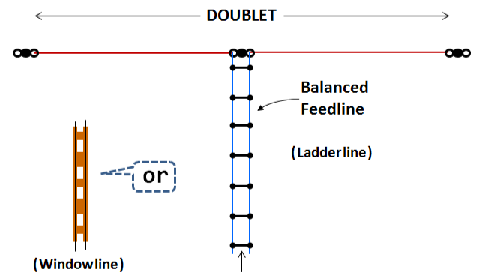
630 Meter Antennas
Come to the Workshop

Slide 15
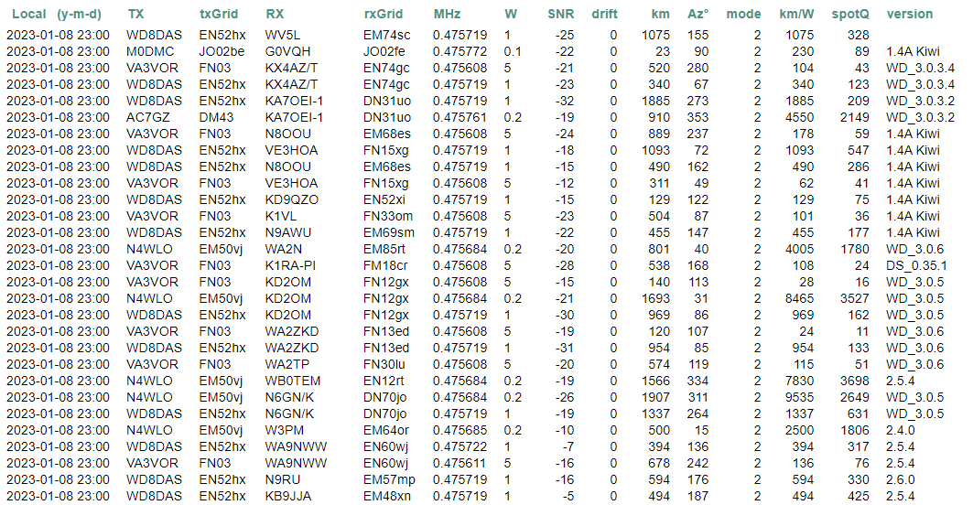
WSPR Contacts on 630 meters

Slide 16
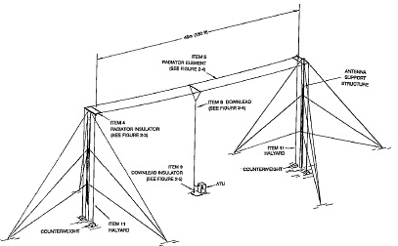
Non Directional Beacons 190 – 535 kHz
Used for aircraft navigation. Very old omnidirectional system. Single antenna location usually 5 miles downrange from the main runway. Large airports are phasing them out. Still very useful for smaller airports
Beacon List: https://www.dxinfocentre.com/ndb.htm
Some recordings include:
JA – Jacksonville, FL 344 kHz (400W)
CH – Charleston, SC 329 kHz (400W)
TX – Briscoe Field 419 kHz (25W)
EMR – Augusta, GA 385 kHz (400W) – no recording
EOE – Newberry, SC 278 kHz (25W)
OUK – Calhoun, GA 323 kHz (25W)

Slide 17
WWVB – Time Signal Station 60 kHz
Because of its low frequency, propagation is primarily ground wave
Time code is purely digital, no voice like WWV and WWVH
There are coverage variations due to time-of-day. Refer to some of these maps
Link to what WWVB sounds like https://www.youtube.com/watch?v=tIpoJl_I8Gc

Slide 18
Travelers Information Service (TIS)
These are predominantly on 1610 kHz and 530 kHz
Maximum power of 10 Watts
Talking ONLY…No music!
Buford Dam has a TIS on 1610 kHz for the dam release times
Others are located in the expanded AM band from 1620 to 1700 kHz
Still others, like Hartsfield-Jackson International Airport has parking information on 830 kHz
Antennas are vertically polarized and are about 15 feet long for the higher frequencies and 25 feet long for 530 kHz
During the 1996 Summer Olympics, there were several 530 kHz TIS transmitters on various Interstate highways including a few on I-85
During the I-985/85 expansion, there was a temporary TIS station on a trailer with a solar panel on 530 kHz. It was located at the old I-85 northbound rest area (now a GSP station). Coverage was from I-85/Old Peachtree to past the Mall of GA

Slide 19
LowFERs – Low Frequency Experimental Radio
https://en.wikipedia.org/wiki/LowFER
Unlicensed experimenters
160 to 190 kHz
Max power output from transmitter – 1 Watt
Max transmission cable and antenna length combined – 15 meters or 49.2 feet
Most common modes are CW and digital
AM and SSB voice communications are allowed
MedFER – license free operation on the AM BCB
Power 100 mW
Antenna length 3 meters maximum

Slide 20
Natural Phenomenon
Lightning (a type of spheric) – static crashes that we are all too familiar with. These impulses create other phenomenon such as:
Whistlers – caused by lightning
Dawn Chorus – believed to be caused by magnetic storms
Sunspots and their effect on propagation (geomagnetic storms)
Earth-Ionosphere Waveguide
ELF and VLF frequencies propagate efficiently between the D layer and ground
Hams use this feature between the E and F layers to achieve long-distance communications or “skip”
This waveguide produces resonances
Schumann Resonance

Slide 21
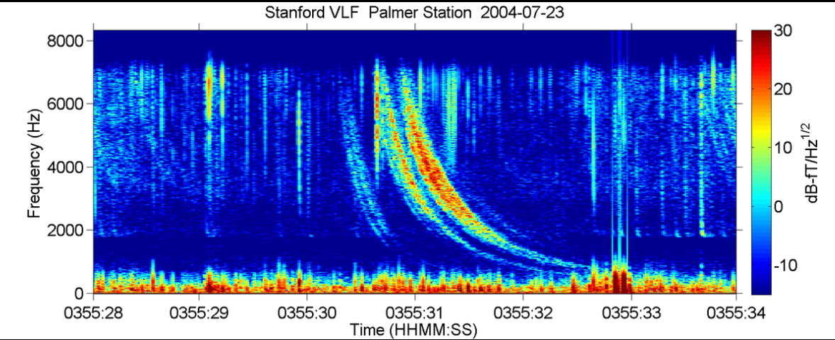
Whistlers
Caused by lightning
Found from 1 to 30 kHz with peaks between 3 and 5 kHz
Lightning impulse travels along the Earth’s magnetic field lines from one hemisphere to the other
Impulse slows down through the plasma environments of the ionosphere and magnetosphere
Voyagers 1 and 2 discovered whistlers during their Jupiter flybys
https://www.youtube.com/watch?v=FeuI8AJMIxU&t=3s

Slide 22
Sunspots Effect on Low Frequencies
Higher incidence of solar flares, CMEs, etc.
Geomagnetic storms
Auroras
Radio blackouts
Higher RF background noise level

Slide 23
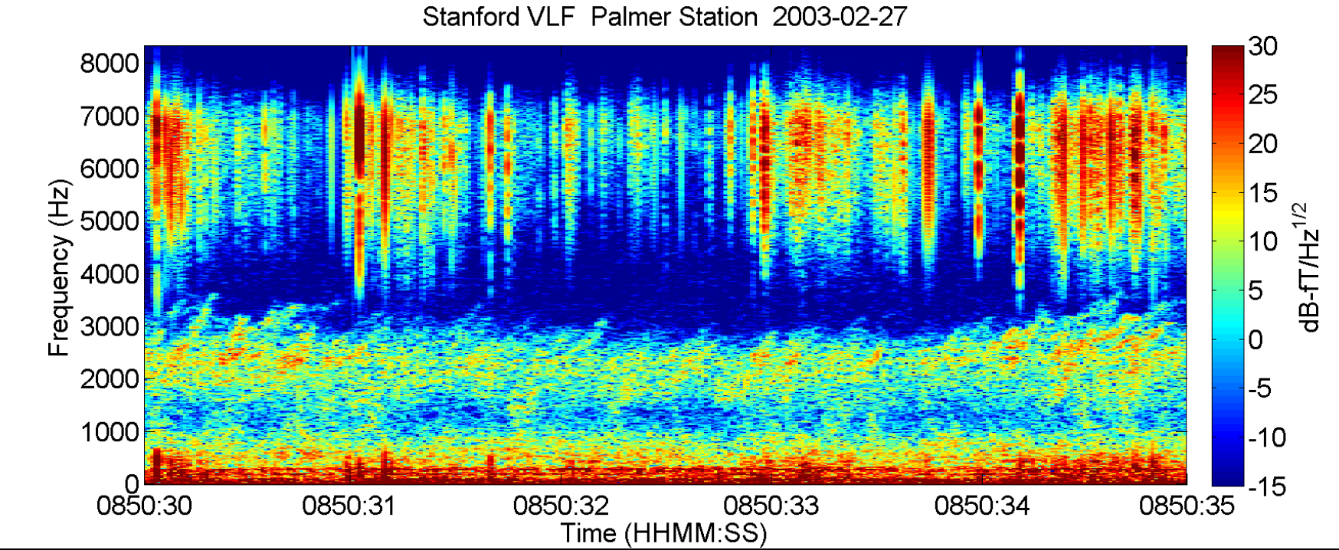
Dawn Chorus
Occurs during magnetic storms
Related to Auroral Chorus
Typically between 1000 and 3000 Hz
Believed to be an interaction between high energy electrons and ambient background VLF noise
Sounds like bird’s dawn chorus
https://www.youtube.com/watch?v=KD3CBY2CnXg

Slide 24
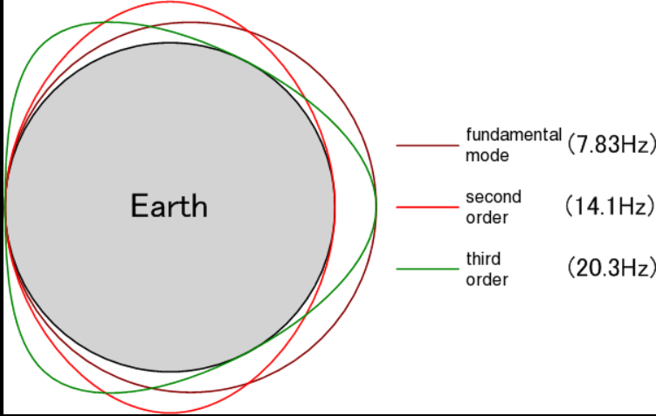
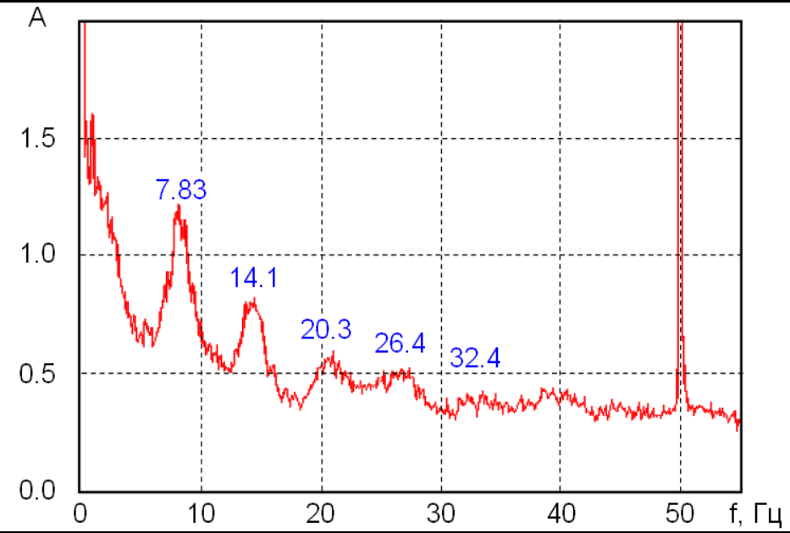
Schumann Resonances
Occurs at ELF frequencies
Generated by lightning activity in the Earth-Ionosphere Waveguide
Animation of this phenomenon is in this link:
https://en.wikipedia.org/wiki/Schumann_resonances
See ELF spectrum analysis screenshot

Slide 25
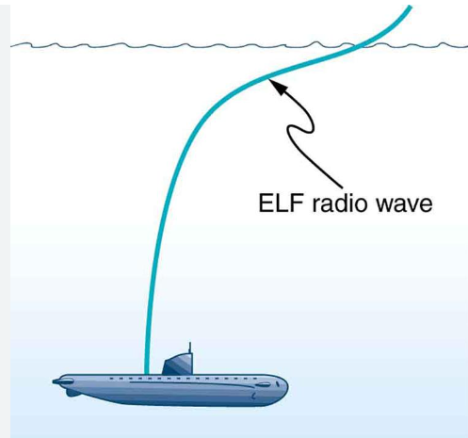
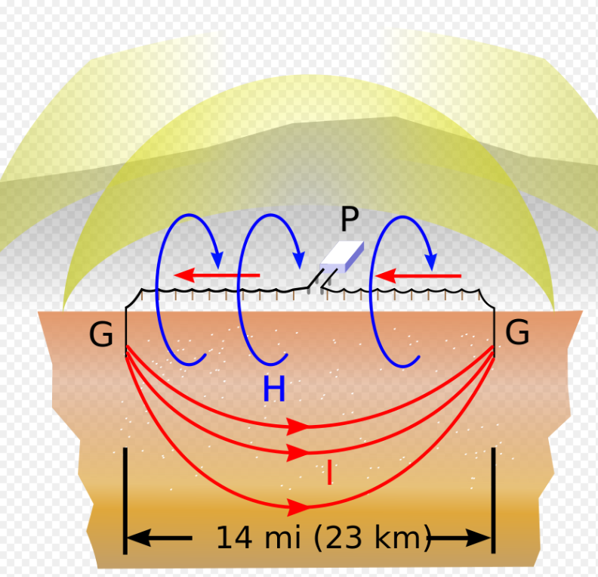
Extremely Low Frequency Phenomenon
Schumann Resonances (already covered)
50 & 60 Hz Power Grid
16.7 Hz Euro Railway Grid
ELF communications

Slide 26
References
FCC Frequency Allocation Chart https://ntia.gov/sites/default/files/publications/january_2016_spectrum_wall_chart_0.pdf
New Bands https://www.arrl.org/news/new-bands-fcc-issues-amateur-radio-service-rules-for-630-meters-and-2-200-meters
VLF Submarine Operations https://nuke.fas.org/guide/usa/c3i/vlf.htm
WWVB https://www.nist.gov/pml/time-and-frequency-division/time-distribution/radio-station-wwvb/help-wwvb-radio-controlled#:~:text=WWVB%20broadcasts%20on%20a%20frequency,which%20stands%20for%20low%20frequency.
WWVB Sounds Like https://www.youtube.com/watch?v=tIpoJl_I8Gc
WWVB Coverage https://tf.nist.gov/stations/wwvbcoverage.htm
NDB List https://www.dxinfocentre.com/ndb.htm
472kHz.org http://www.472khz.org/pages/about-472-khz/getting-started.php
630 band Info: https://www.amateurradio.com/getting-started-on-the-new-lf-and-mf-bands/
More 630 band info:
https://www.qsl.net/ve7sl/gettingstarted.html
http://www.wb4jwm.com/
630 Meter transverters: https://www.minikits.com.au/eme223
Utility Registration: https://utc.org/plc-database-amateur-notification-process/
2200 meter band: https://en.wikipedia.org/wiki/2200-meter_band
WSPR Reporter: https://www.wsprnet.org/drupal/
DX Summit: http://dxsummit.fi/#/?include=LF

Slide 27
More References
LowFER https://en.wikipedia.org/wiki/LowFER
Schumann Resonances https://en.wikipedia.org/wiki/Schumann_resonances
ELF Receiver https://www.celnav.de/hamradio/ELF.htm
ELF https://en.wikipedia.org/wiki/Extremely_low_frequency
Whistlers https://en.wikipedia.org/wiki/Whistler_(radio)
Dawn Chorus (VLF) https://en.wikipedia.org/wiki/Dawn_chorus_(electromagnetic)
Spherics https://en.wikipedia.org/wiki/Radio_atmospheric_signal
Earth-Ionosphere Waveguide https://en.wikipedia.org/wiki/Earth%E2%80%93ionosphere_waveguide
Schumann Resonances https://en.wikipedia.org/wiki/Schumann_resonances

