Slide 1
Winlink Email via Amateur Radio
Mark Bell – N7GRB

Slide 2
Agenda
What is Winlink Email
Winlink.org User Account
Winlink Infrastruture System Components
What is Required to Operate
Express Operating Modes
Winlink Clients
Winlink Express Overview
Odd’s and End’s
Lets Play

Slide 3


What is Winlink Email?
Formally known as Winlink Global Radio Email®️
As quoted from Winlink.org:
  ...is a network of amateur radio and authorized government stations that provide worldwide radio email using radio pathways where the internet is not present.
Supported and maintained by the Amateur Radio Safety Foundation, Inc. (ARSF) primarily using volunteer help and donations
Foundation days in the 1980’s with a DOS based Aplink application (Amtor-Packet link)

Slide 4
What is Winlink Email?
Mature, well tested system
  99.99% service reliability
  100% accurate message transmissions
  Hosted by Amazon Web Services (AWS) since 2018 with two AWS servers providing system redundancy
Standard e-mail format with features to include:
  Message templates
  Binary file attachments (pictures, pdf, spreadsheets)
  Automatic message compression/decompression
Several Winlink system compatible client applications

Slide 5

What is Winlink Email? - Users
Off-grid amateur radio adventurers needing email or text message service
  Messaging and position reports
  Sailors at sea using amateur radio HF
  Special Event support such as Georgia Jewel and Death Race
  Isolated campers, RVer’s, POTA operators
Governmental organizations
  May operate on SHARES or amateur radio frequencies
  SHARES (SHAred RESources) HF Radio network operates on Federal frequencies allowing encryption of data
  DHS, National Guard, Emergency Management Agencies and more …
Non-Governmental Organizations (NGOs)
  May operate on SHARES or amateur radio frequencies
  American Red Cross, Southern Baptist Disaster Relief, FedEx and more …

Slide 6
Caution on Winlink System Usage
As US amateur radio operators our message traffic is public, no encryption (Part 97)
RF based traffic is cached 21 days at Winlink.org for public view
Messages can be sent between Winlink CMS and conventional email services
  Your email address: [call sign]@winlink.org
  //WL2K start of subject line convention (used to block spam, advertisements)
  A user sending an email message to your Winlink address needs to be advised on open, public nature of the service; no sensitive info (e.g., HIPPA, financial data and/or inflammatory language … )

Slide 7
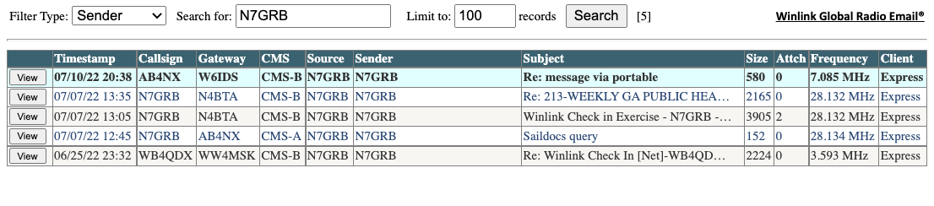
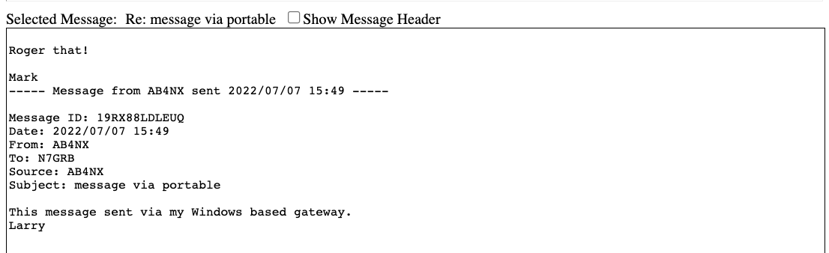
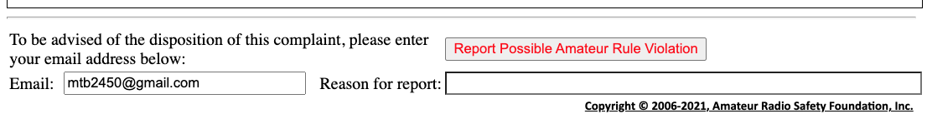

Slide 8
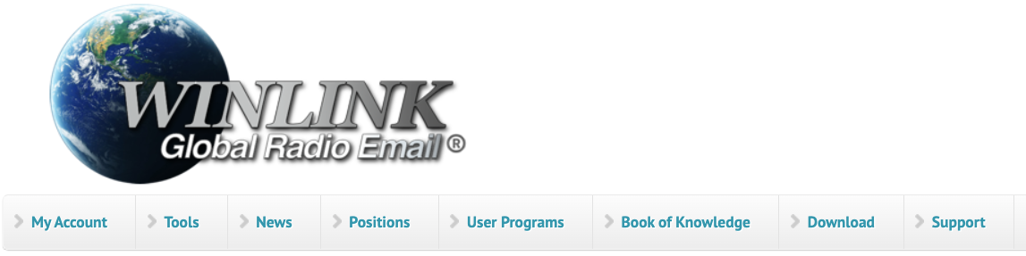
Winlink.org User Account
To use the Winlink system, you must have a Winlink account
Requires a current radio license from a recognized authority
Account is automatically created on first use of the system
While a free service, ARSF requests a registration fee donation ($24)
Users are highly encouraged to access their account at Winlink.org

Slide 9
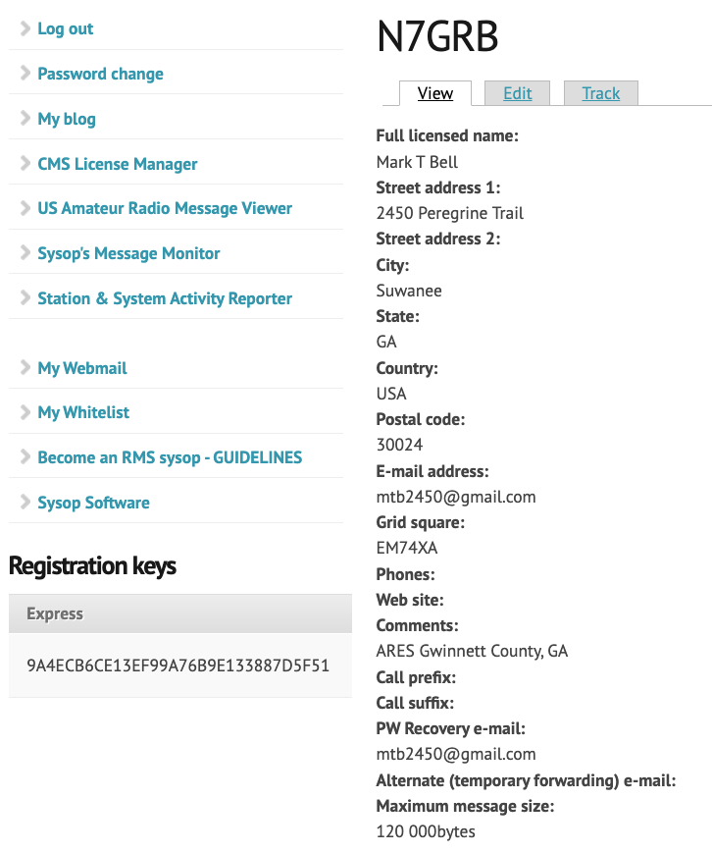
Winlink Account
Provide / update password recovery email address
Full contact information
Manage account password
Establish email whitelist
Temporary forwarding email address (be careful on its use)
SYSOP related functions
  Used by RMS gateway owners

Slide 10
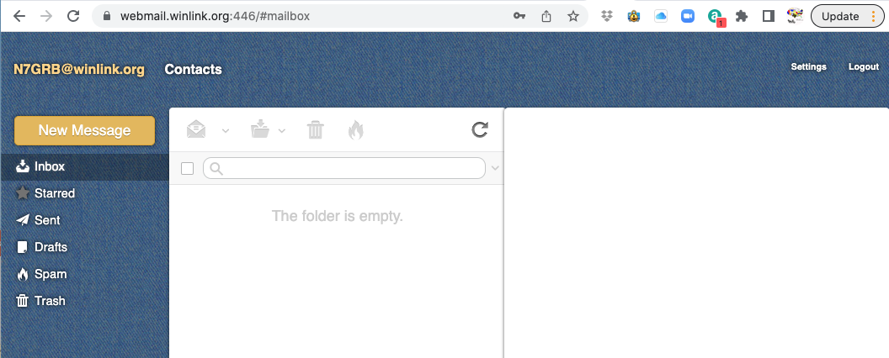
Winlink Webmail Client Interface
Simple Web HTML based interface
Link to Web interface in your Winlink.org account

Slide 11

Winlink Clients
Comparison table: https://winlink.org/ClientSoftware
Winlink Express
  Windows based (Win 7 or later), closed source
  Well maintained by ARSF (Winlink.org development team)
  Best choice for EMCOMM related communication
  Download: https://winlink.org/WinlinkExpress
Pat
  Cross-platform to include Linux, Mac OS and Windows
  Community based open-source project
  Now supports Winlink.org standard message templates
  Download: https://getpat.io/

Slide 12
Winlink Infrastructure – System Components
Client system
  Radio, computer with Winlink software, TNC (or sound card) and the operator
Radio Message Server (RMS)
  Radio gateway between the client (end-user) and the Winlink CMS system
  In “conventional” usage the RMS has Internet access to the CMS server
  Limited number of RMS gateways support a radio-only mode (Hybrid system)
Common Message Server (CMS)
  The “conventional” AWS server system used for normal operations
  Store and forward service
  Accessed via Internet

Slide 13
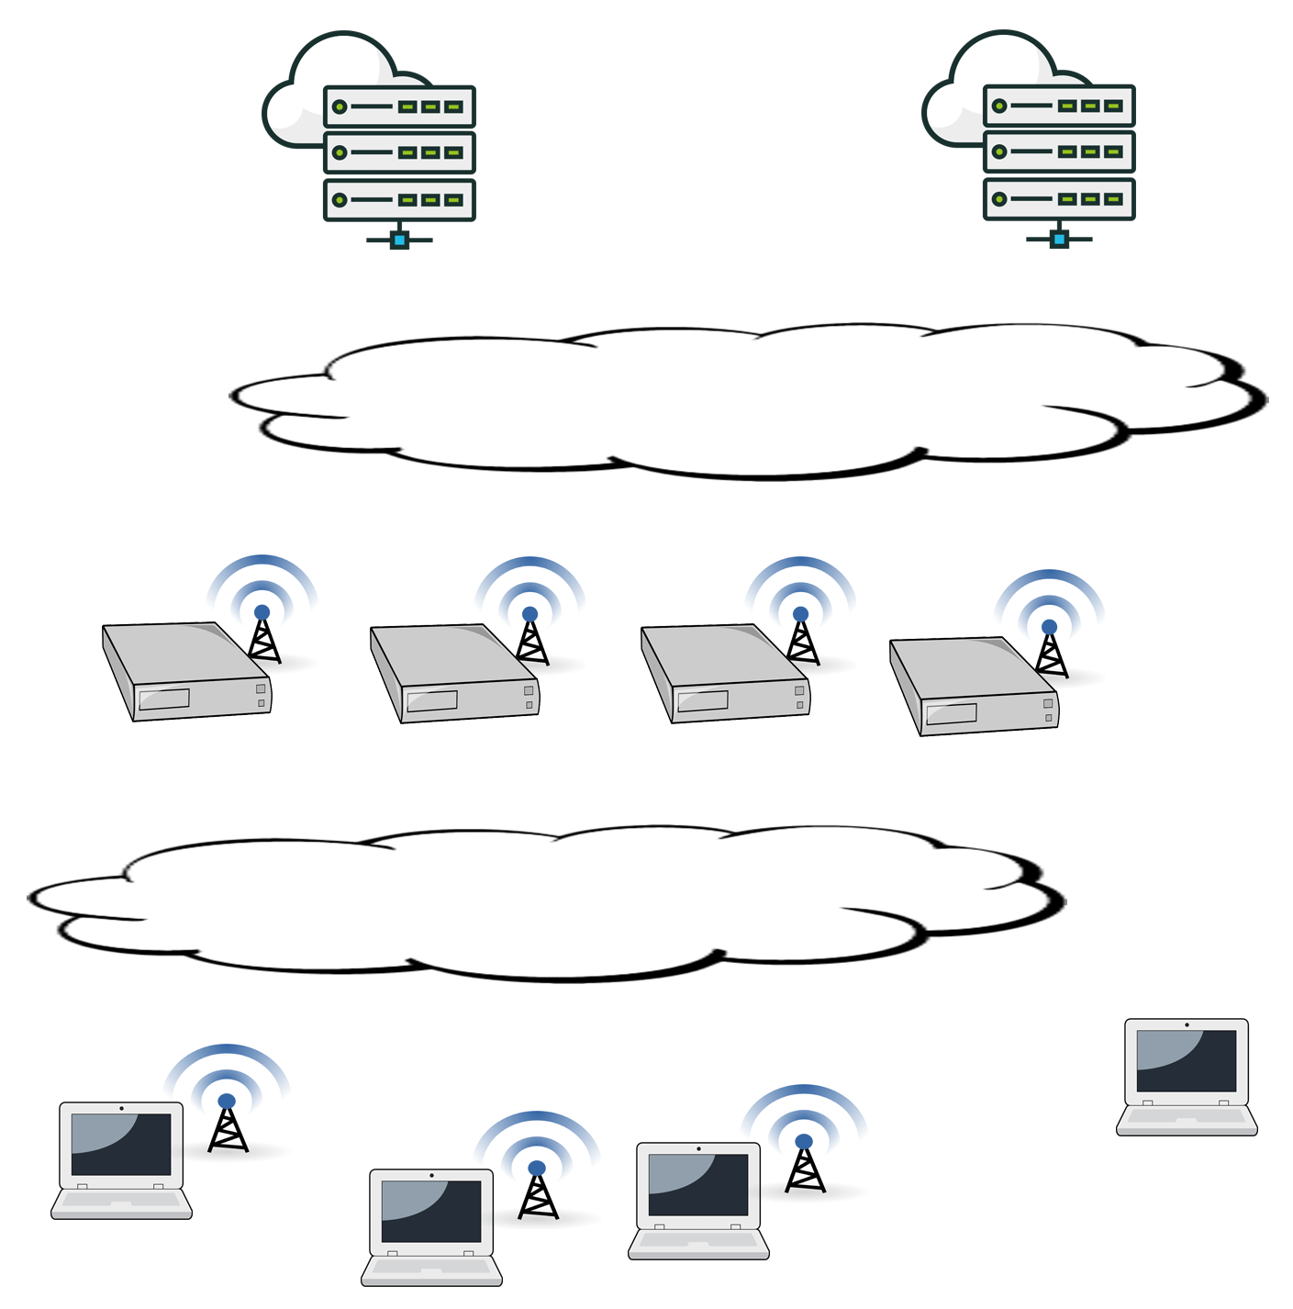
Conventional Use Architecture
CMS Servers
Internet
RMS Gateways
Telnet
HF: Pactor, ARDOP, VARA
VHF/UHF: Packet
Winlink Client (You)

Slide 14
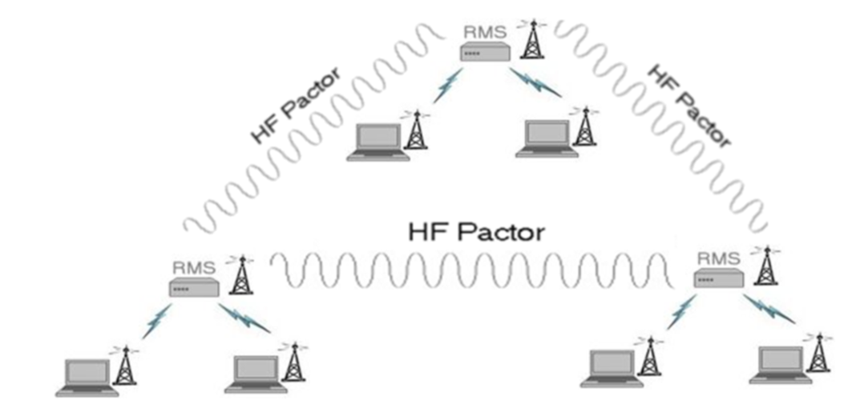
Hybrid Network Use Architecture
No Interaction with CMS
Not dependent on Internet
Requires pre-registration with up to 3 hybrid RMS gateways
Limited number of RMS systems support hybrid radio-only operation

Slide 15
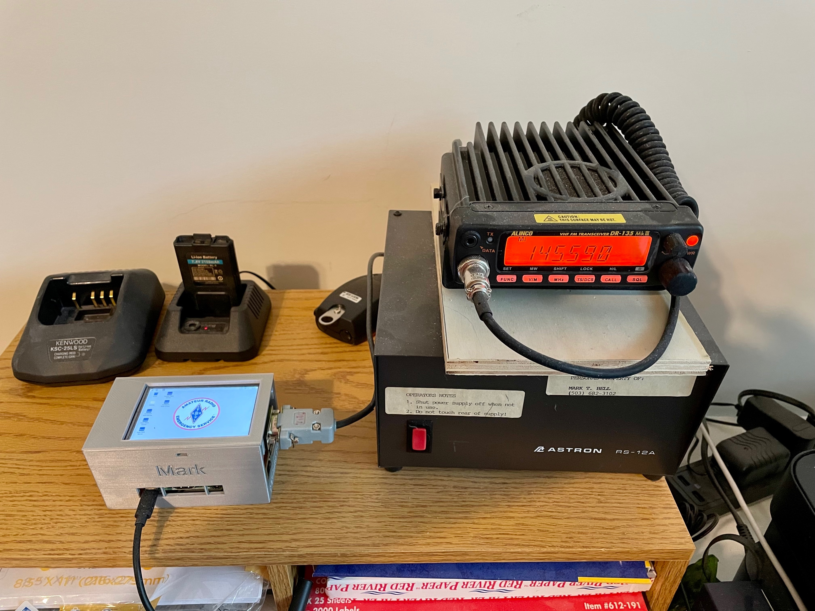
VHF RMS Gateway
N7GRB-10
Alinco DR135 MkIII 2m radio
Copper tubing based Slim Jim antenna
Raspberry Pi host
TNC-Pi HAT (KISS TNC)
LCD touch screen
PiGate RMS Pi image
AX.25 Packet based

Slide 16
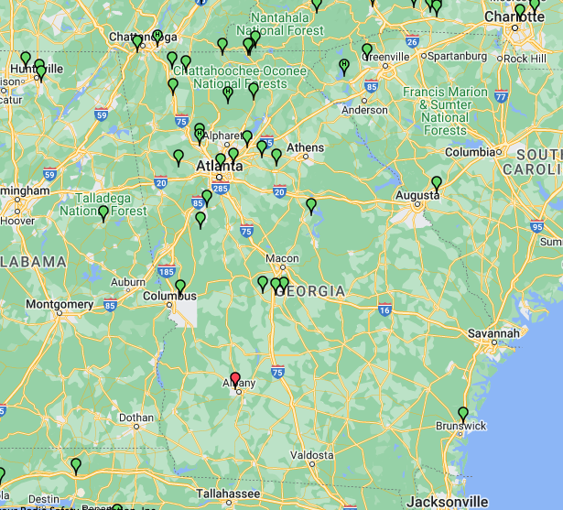
Georgia Packet RMS Gateways

Slide 17
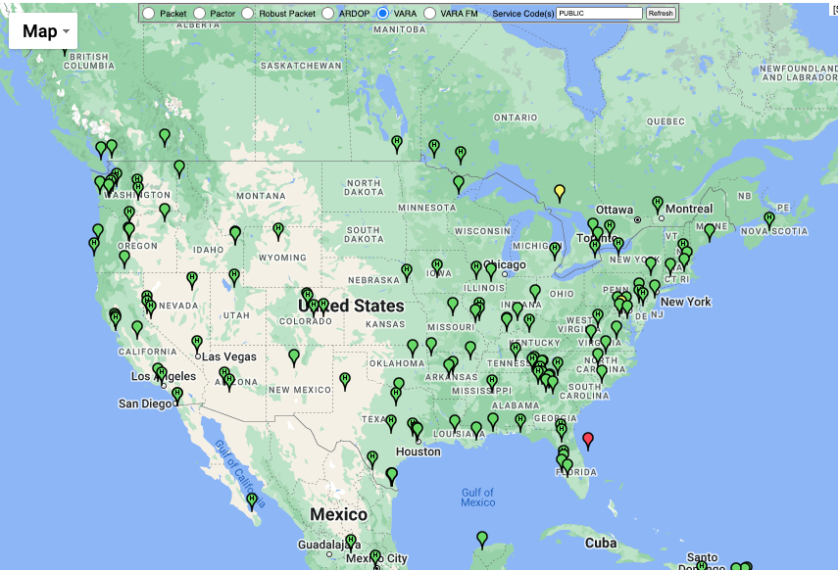
VARA HF RMS Gateways

Slide 18
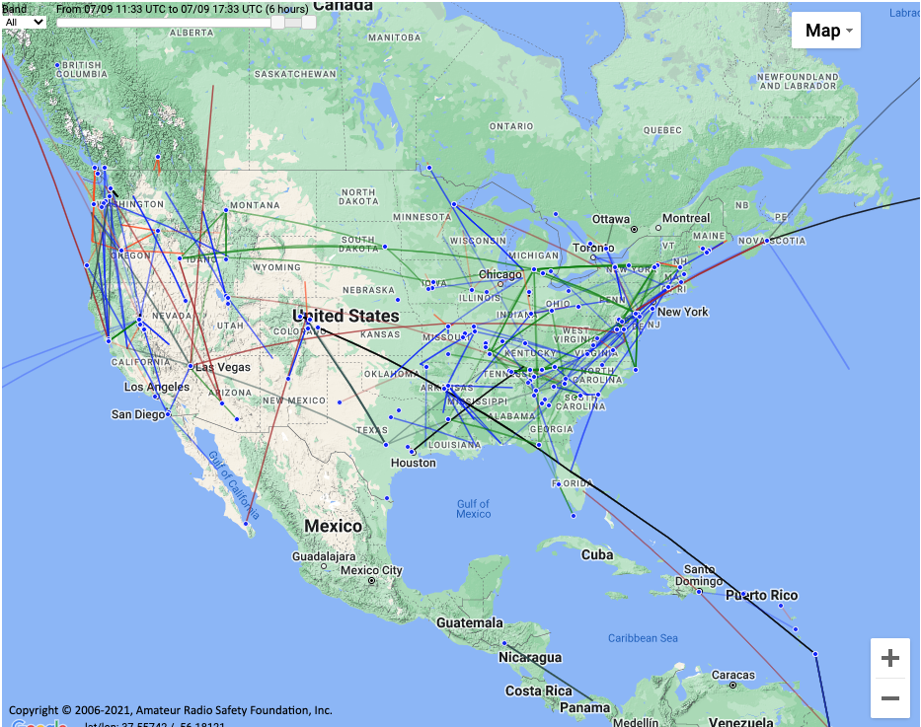
Recent QSOs
(7/9/22)

Slide 19
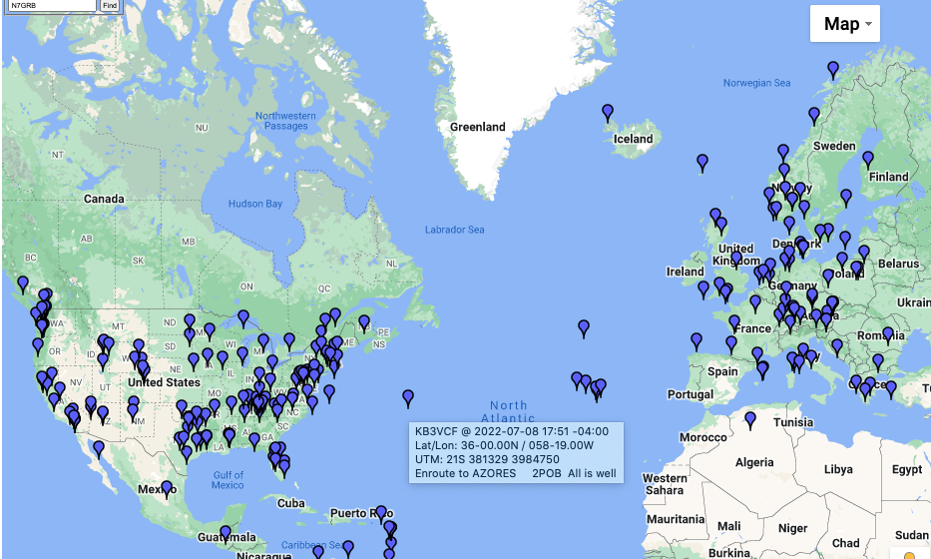
Position Reports

Slide 20
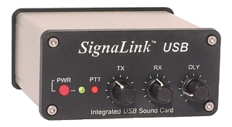
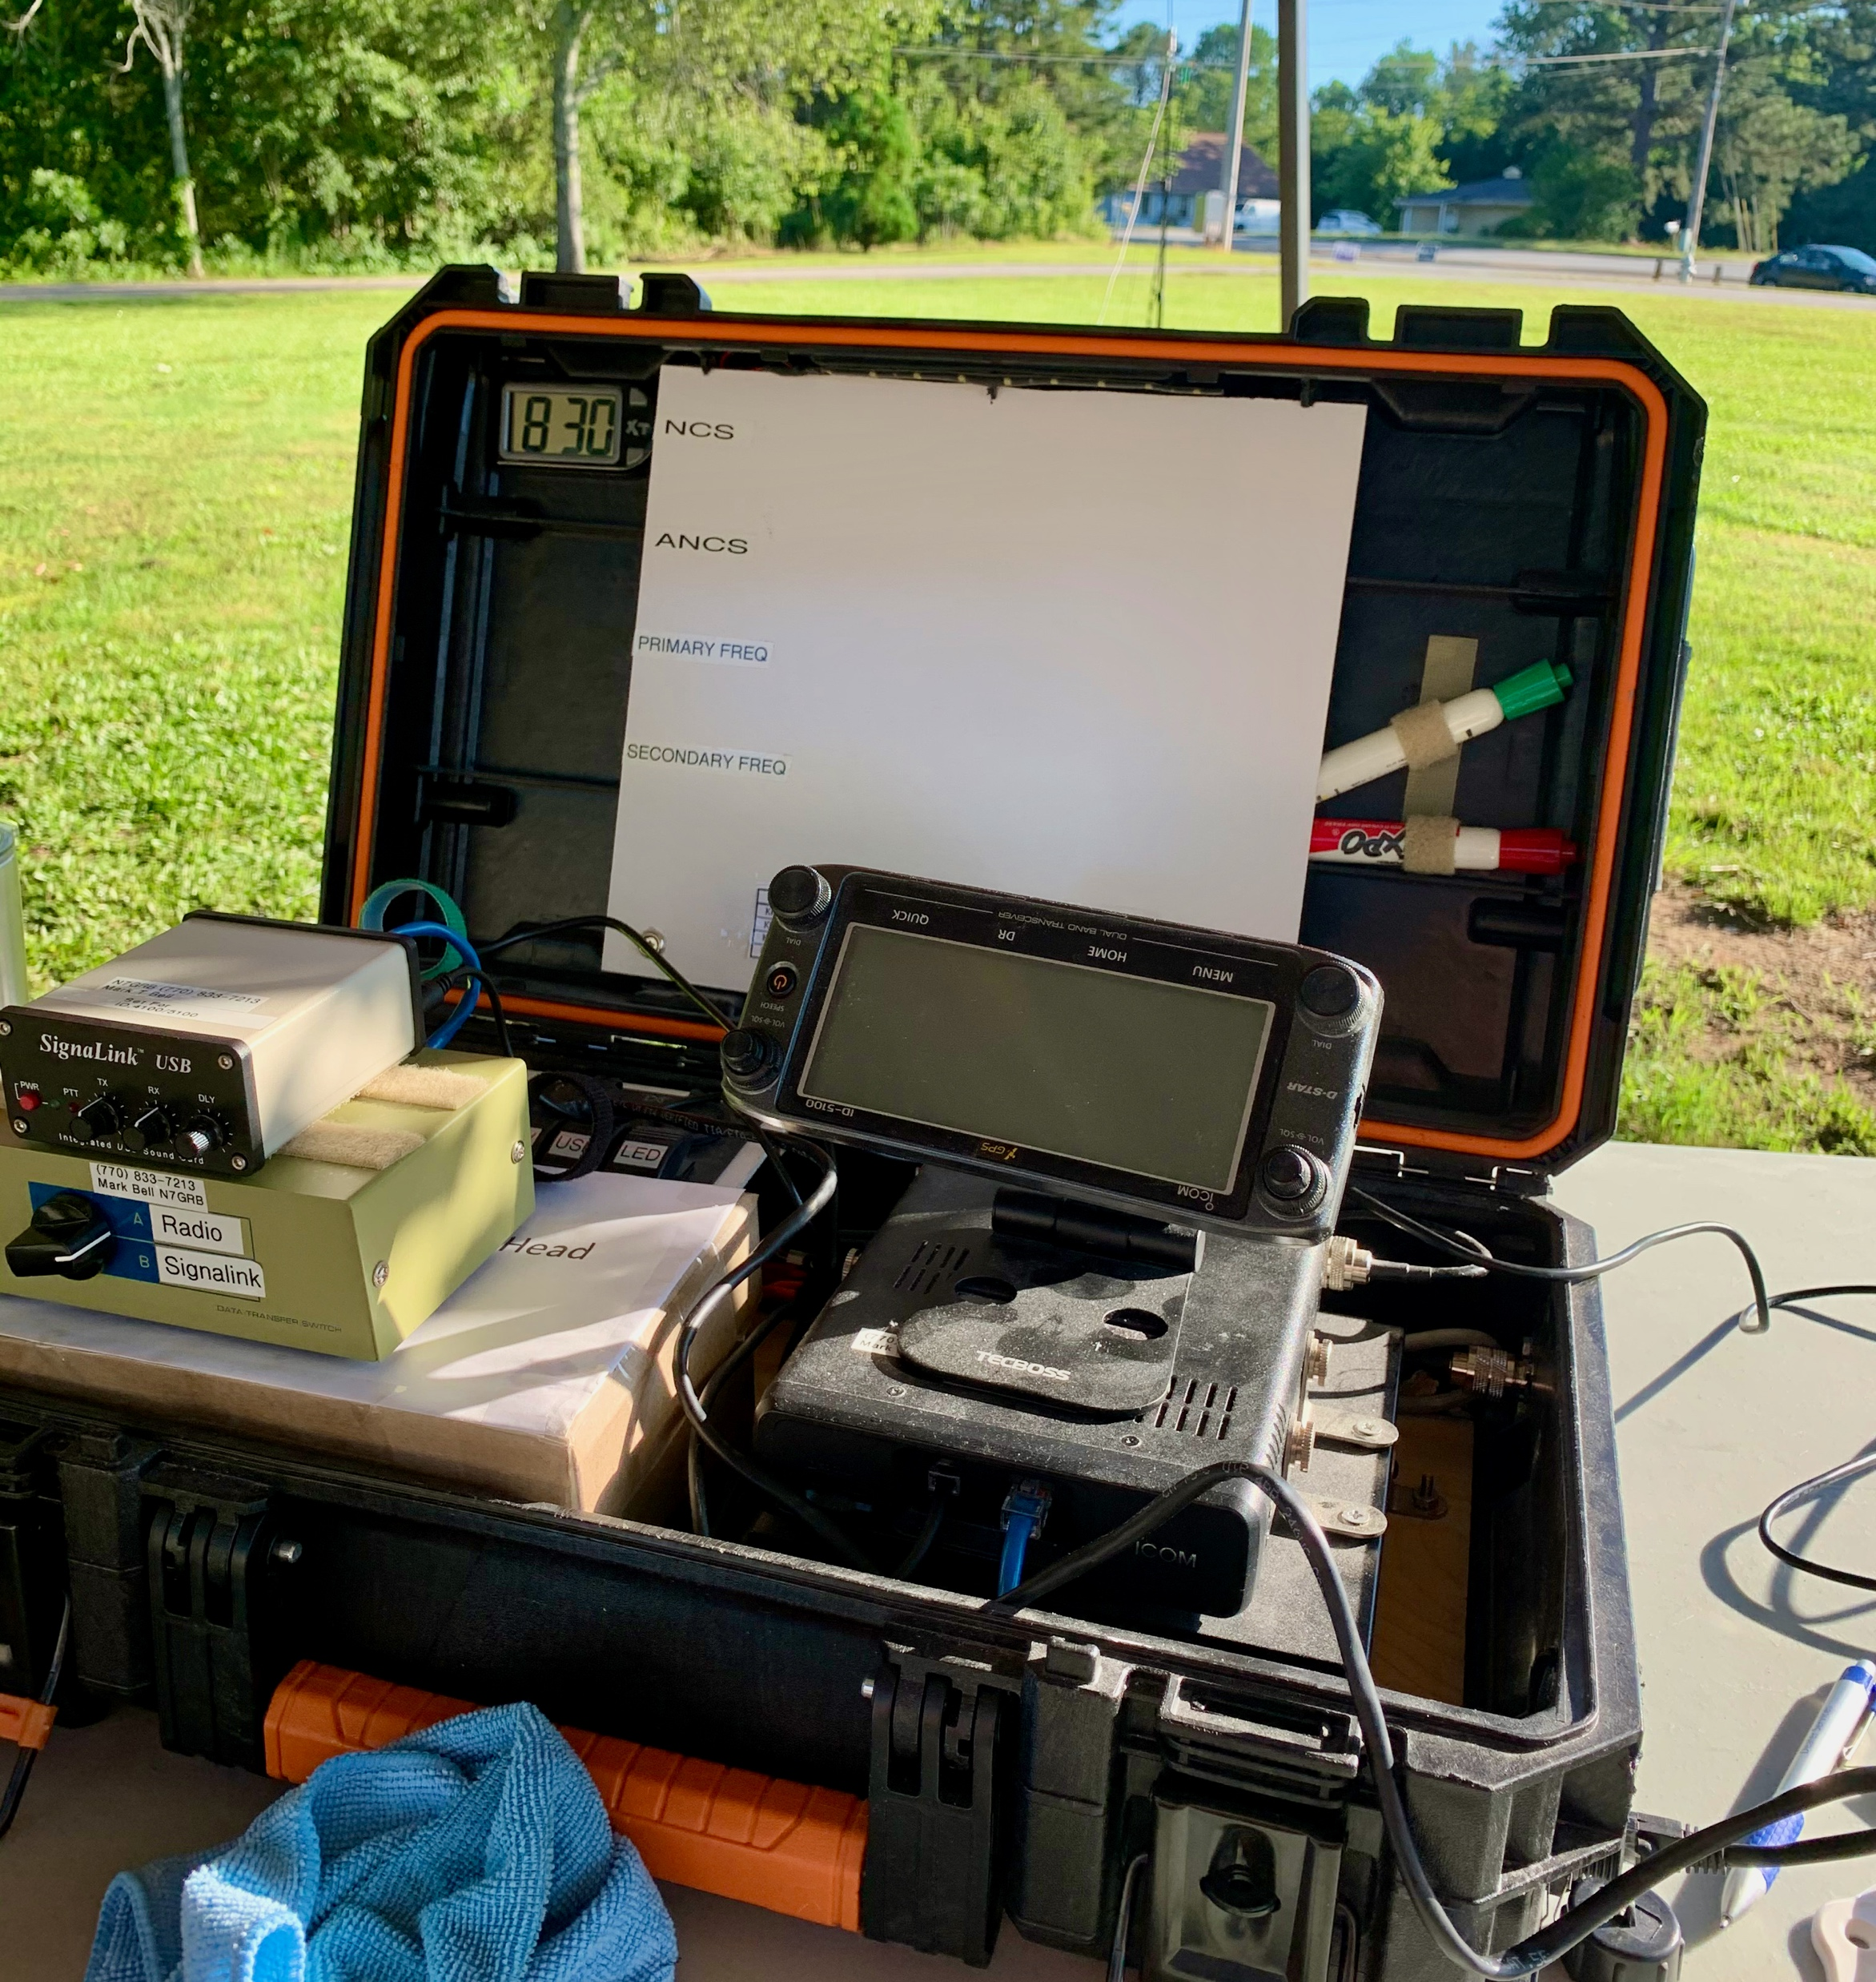
What is Required to Operate?
Windows 7 or newer PC / laptop
Software drivers / cables for hardware interface
Winlink client and account
For Packet based sessions:
  TNC, KISS TNC or sound card
  If sound card based, need UZ7HO soundmodem SW (virtual TNC)
For HF based sessions:
  Pactor modem and/or sound card
  Registered VARA HF or ARDOP (virtual HF modems)

Slide 21
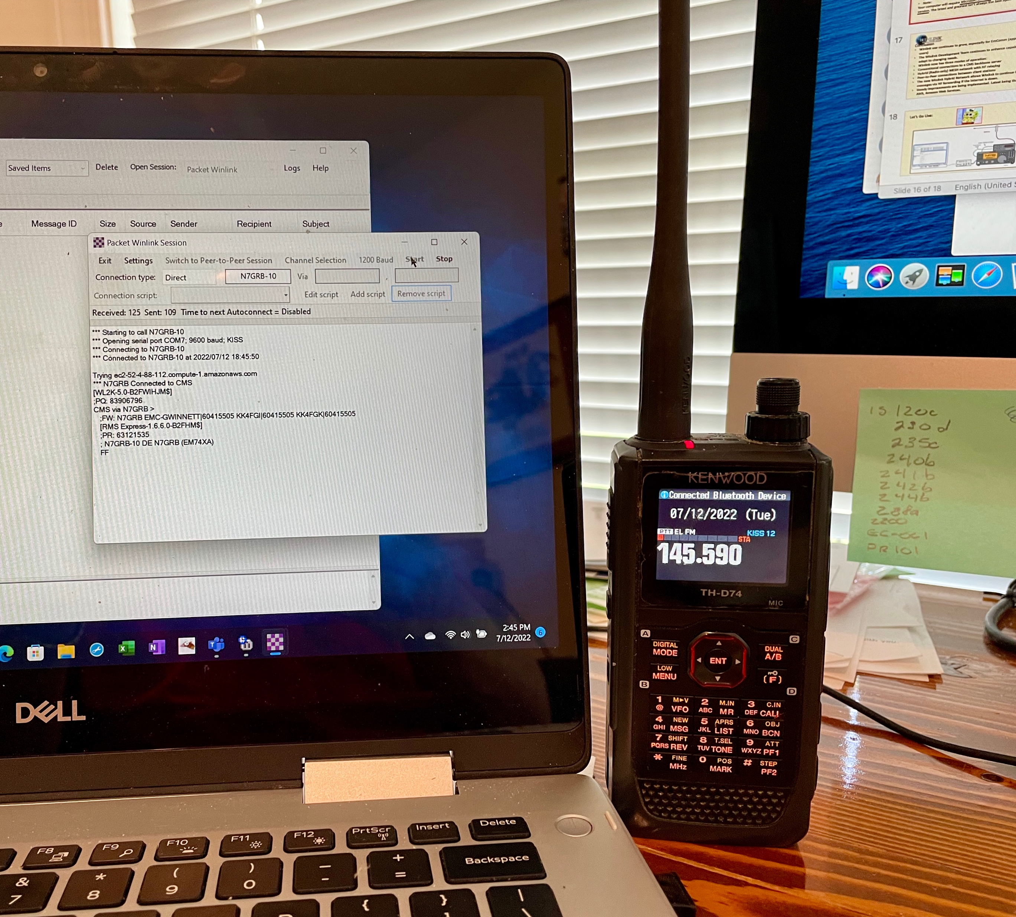
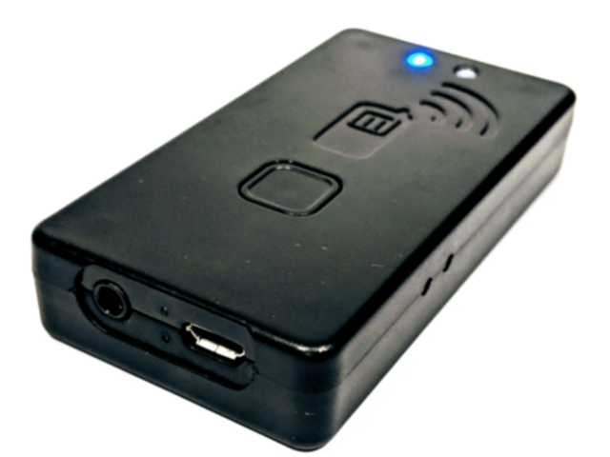
Example Bluetooth connected KISS devices
Examples include:
Kenwood TH-D74
Mobilinkd TNC3
  Requires cable interface to radio
  TNC2 version insufficient buffer for reliable by-directional traffic

Slide 22
Winlink Express Client Overview
Coming up in an overview:
Main Window
Setting Window
Message Menu
Session Types
Packet Session Example

Slide 23
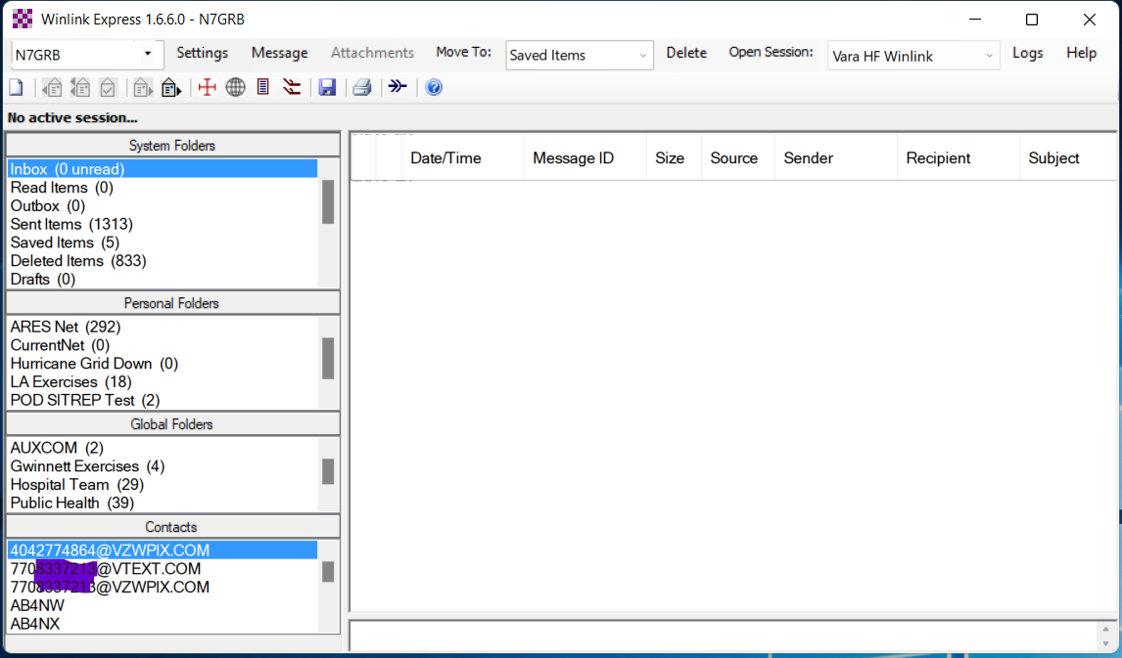
Winlink Express Client Interface
Primary Call Sign
Folders Associated with Primary Call Sign
Folders Associated with All Configured Call Signs

Slide 24
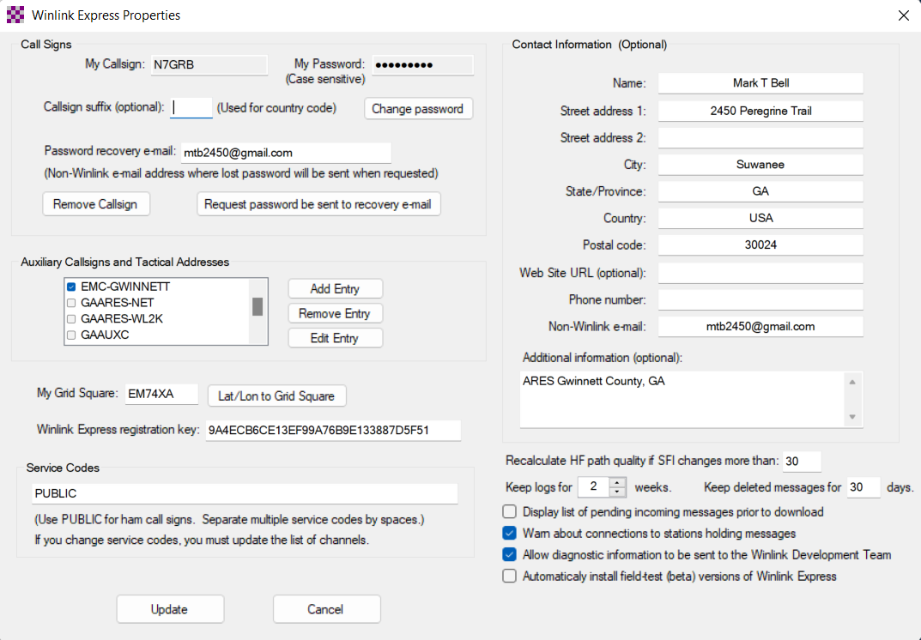
Account Password
Primary Call Sign
Your Current Grid Square

Slide 25
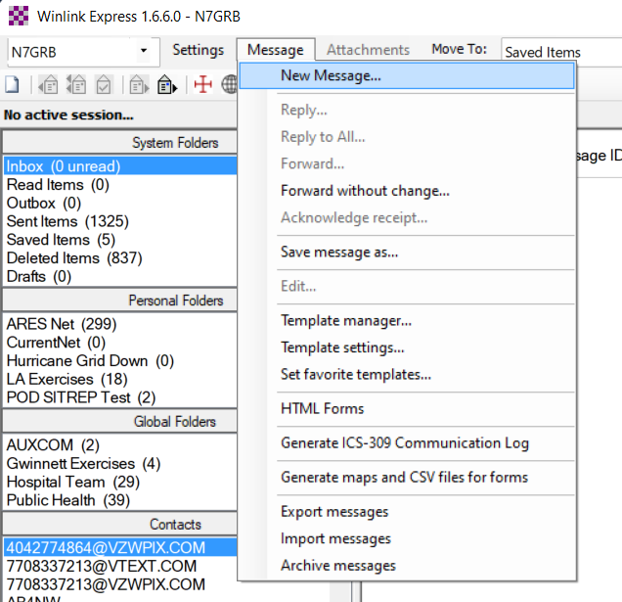
Message Menu offers several functions:
Create New Message Window
Reply, forward, acknowledge
Template management
Maps of GIS enabled messages
Export/Import/Archive messages
Create ICS-309 message log

Slide 26
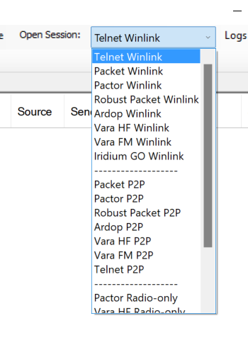
Four types of sessions:
Conventional Winlink system
  Stores messages on CMS servers
  Uses Internet between RMS and CMS
Peer-to-Peer (P2P)
  Direct connection between two client systems
  No use of Internet or Winlink infrastructure
Hybrid HF network
  Radio-only network not dependent on Internet
MESH Network
  Peer-to-peer through MESH between two Winlink Express clients
  Post office server hosted by RMS Relay

Slide 27
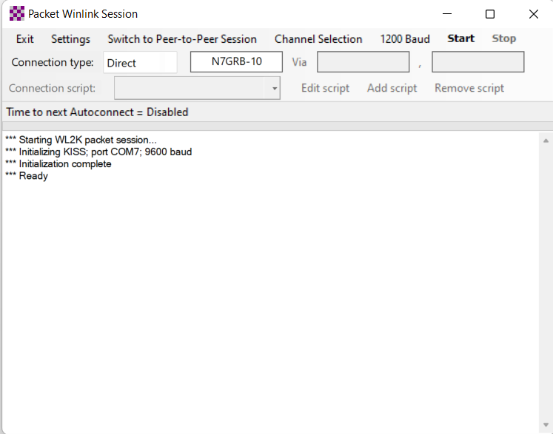
Winlink Express Packet Session Example
Session type “Packet Winlink”
When session opened will connect to configured device
Settings menu provides access to:
  TNC connection setup
  TNC parameters (packet length, timings and more …)

Slide 28
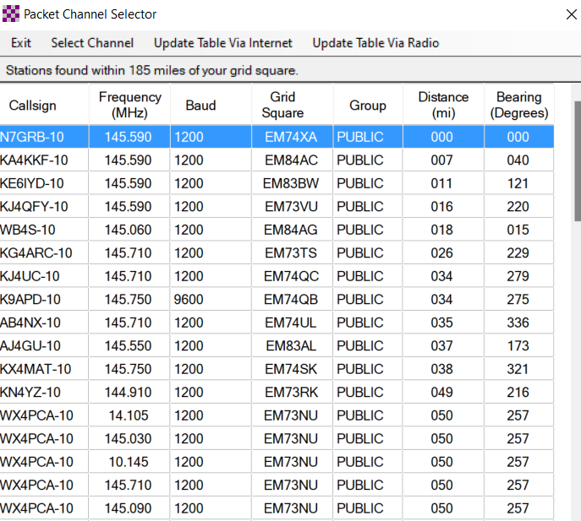
Packet Session Channel Selector
List of available RMS gateways
RMS frequency
Maidenhead Grid Square
Distance/bearing based on the center of your own grid and RMS’s grid
When radio has rig control simply double-click RMS of interest

Slide 29
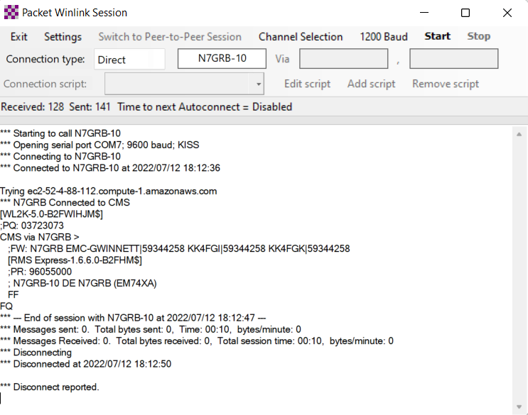
Client Handshake through RMS to CMS
Select connection type
Enter target RMS station ID and if needed digipeater ID
Start the session: “Start”
Session will connect with the RMS which in turn connects to the CMS
Messages in your outbox are uploaded and pending messages are received
Connected to RMS
Connected to CMS
Request for Messages
Message Stats

Slide 30
Odd’s and End’s
UZ7HO Soundmodem (virtual packet modem)
VARA and ARDOP HF Performance Example
Want to Practice Using Winlink Express?

Slide 31
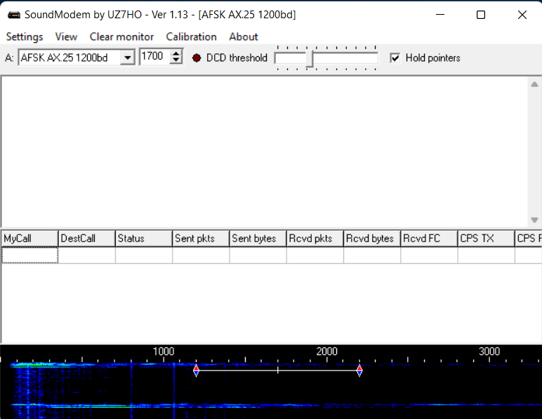
No TNC Hardware for Packet?
Use UZ7HO Soundmodem virtual TNC
Main window allows viewing all packet traffic on current frequency
http://uz7.ho.ua/packetradio.htm

Slide 32
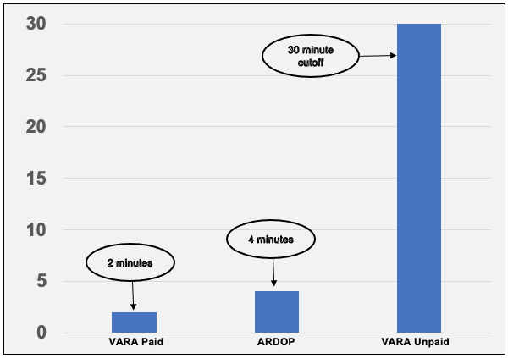
ARDOP vs VARA HF Performance
HF RMS Gateway, 10 meters, 35 miles line-of-sight, 50 watts to eliminate propagation and power factors
Simple Winlink message , empty message body with image attachment, total size 39,600 bytes
Modem | Average Speed | Time
VARA HF Registered | 18,663 KB/min | 2.09 mins
ARDOP | 9,954 KB/min | 4.31 mins
VARA trial | 1,129 KB/min | 35.1 mins

Slide 33
Want to Practice Using Winlink Express?
There are several opportunities to practice using Winlink Express, a few include:
Georgia ARES Sunday Winlink Net, see the Net Schedules section at:
  https://gaares.org/frequencies-gaares.php
  Check in currently uses Winlink Check In standard template.
Emcomm Training Organization Winlink Thursdays
  Excellent training opportunity that in addition to message traffic through an RMS gateway periodically has peer-to-peer HF sessions.
  http://www.EmComm-Training.org

Slide 34

It’s Showtime!
Let’s go play with Winlink Express

Slide 35
Questions?

