Slide 1

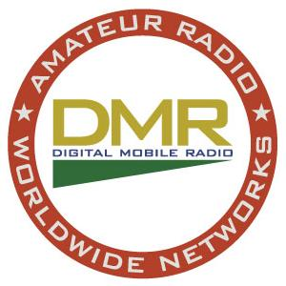
DMR by
Bob Hoffmann K4CQO

Slide 2
What is DMR?
DMR (Digital Mobile Radio) is:
Changes voice / tones into a digital stream
  Digital signals carry voice without static, or noise
  Digital signals have a longer distance for reception
Used for communication to repeaters or unit to unit
Uses VHF and UHF frequencies

Slide 3
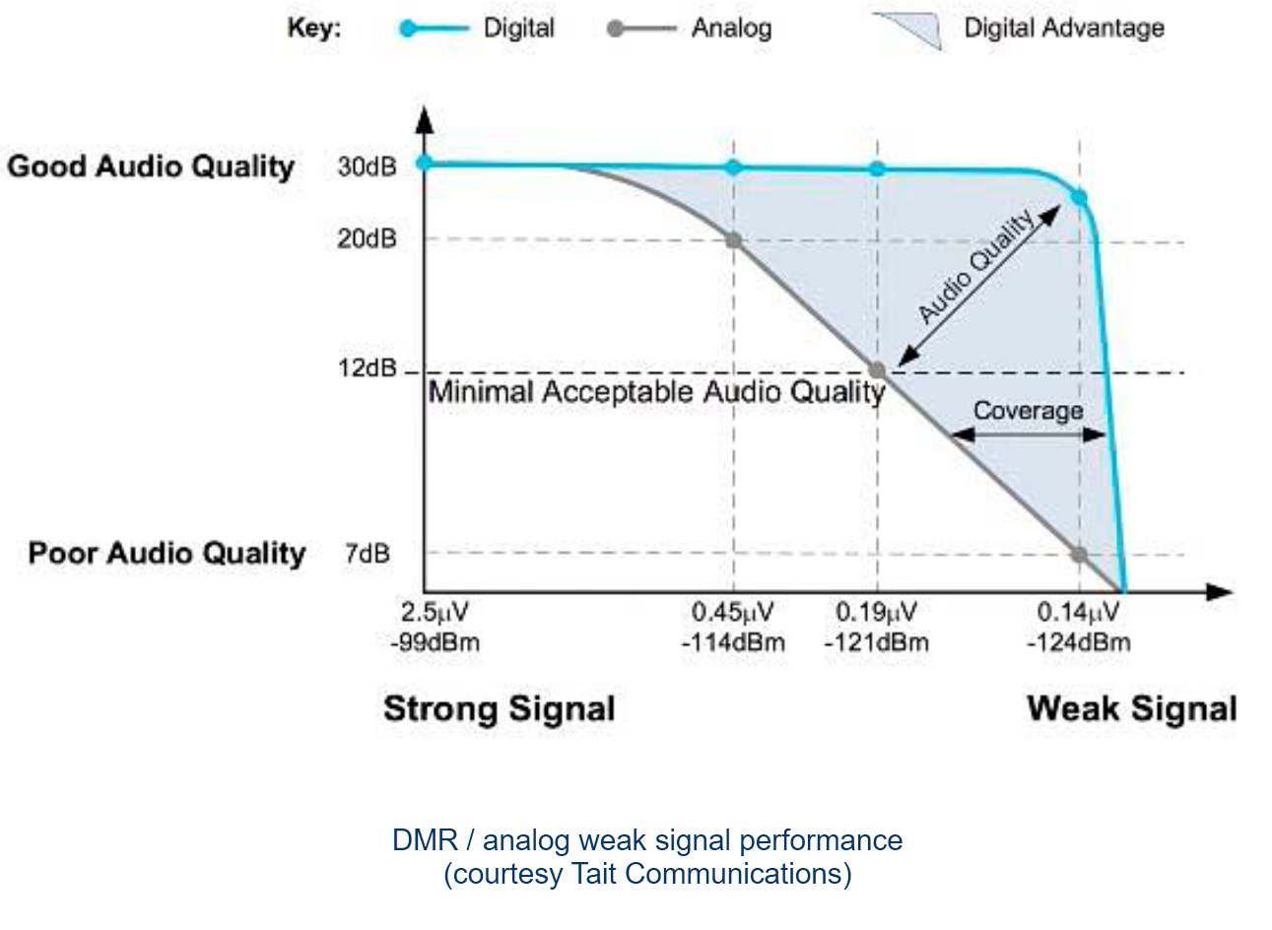
What is DMR? (cont.)

Slide 4
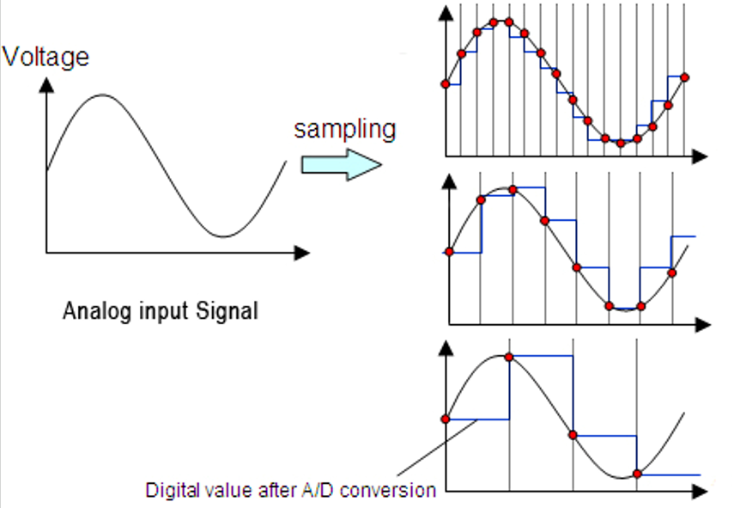
DMR Processing
How does DMR get your voice into a digital signal?
Sampling:
How does DMR get your voice into a digital signal?
Sampling:

Slide 5
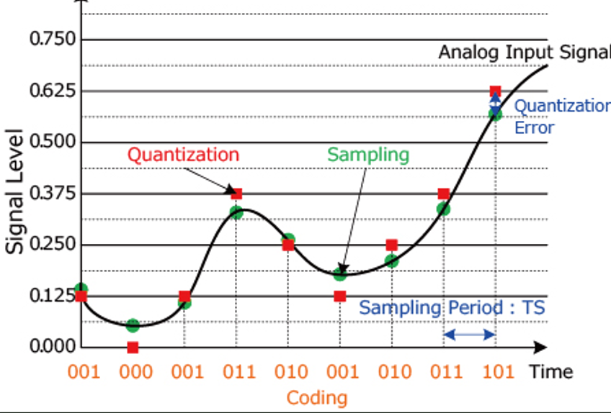
DMR Processing (cont.)
DMR uses a vocoder (DVSI's AMBE+2™)
same as used for Fusion & D-Star
provides an 8 Khz sample rate, noise cancelation, and compression of 30 ms speech to 216 bits

Slide 6
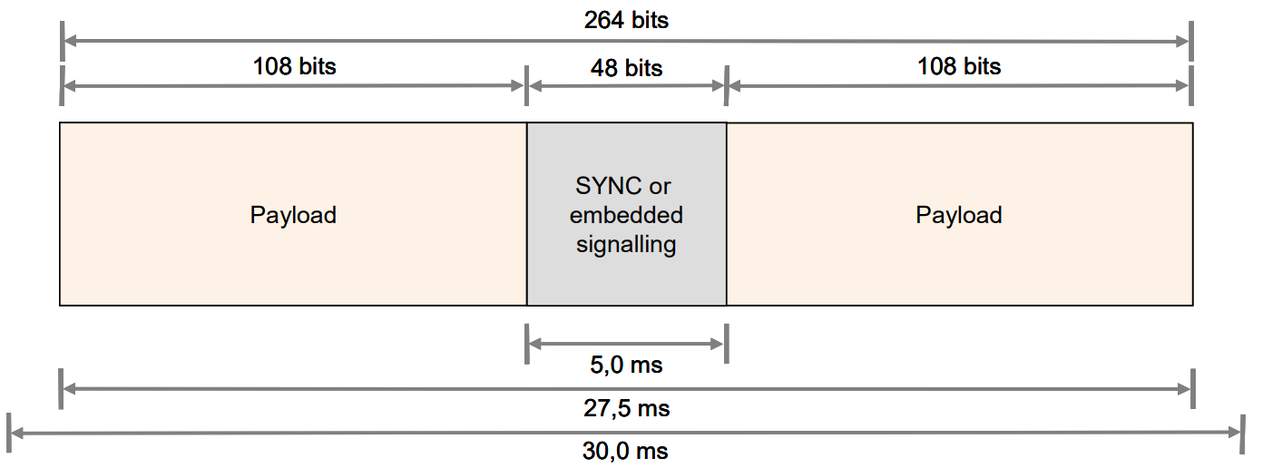
DMR Processing (cont.)
DMR vocoder takes 30 ms of samples and compresses them

Slide 7
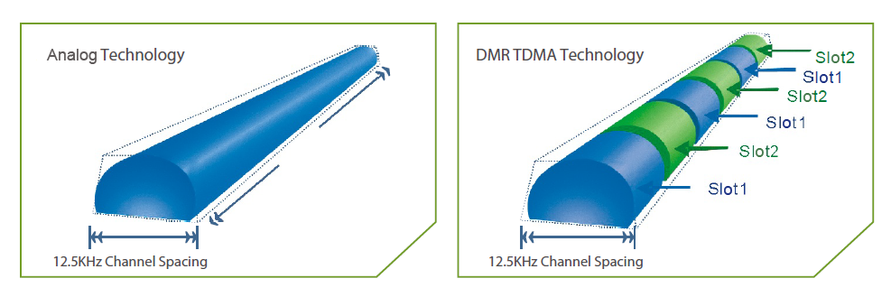
DMR Processing (cont.)
It uses TDMA (Time Division Multiplexing)

Slide 8
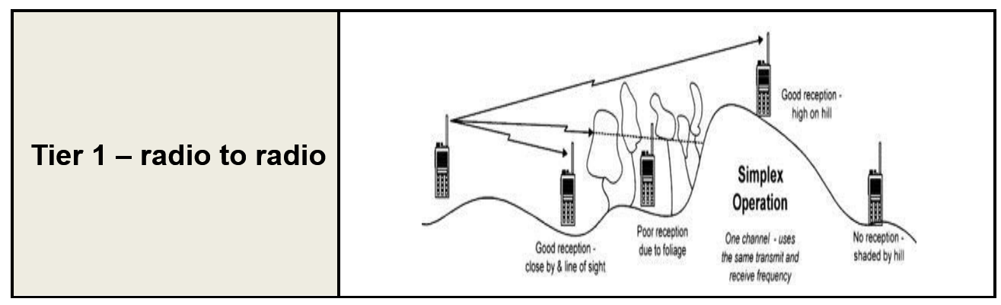
DMR Protocol
3 Tiers of protocol (Ham radios use Tier 1 & Tier 2)

Slide 9
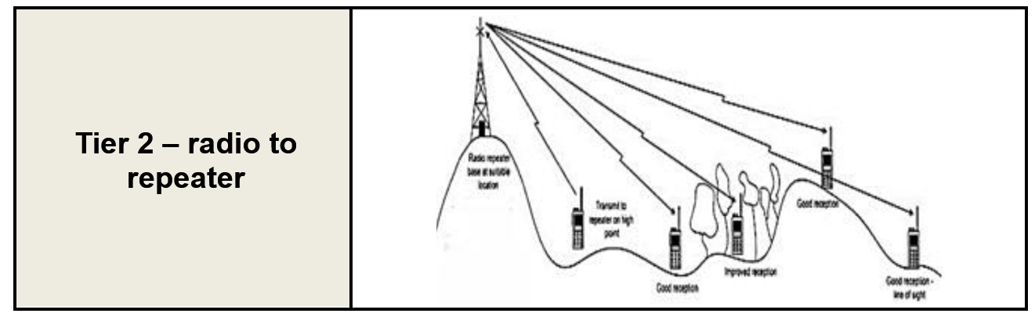
DMR Protocol (cont.)
How does DMR get your voice into a digital signal?
Sampling

Slide 10
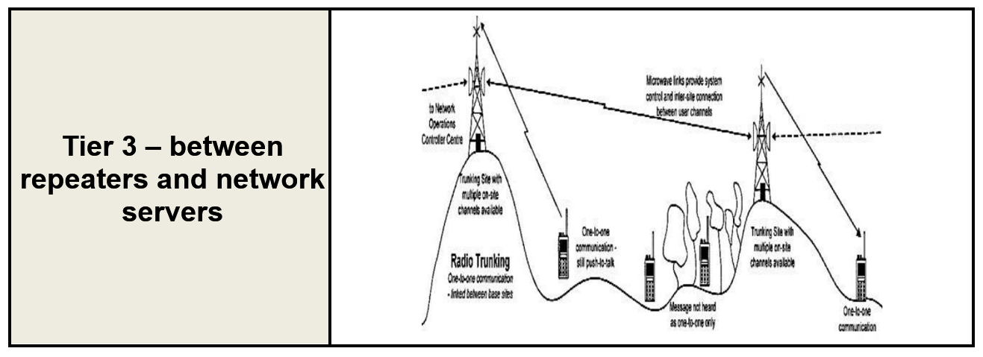
DMR Protocol (cont.)

Slide 11
What are TGs
TGs are numbers are defined by the network server. Some of the Network Servers providing DMR traffic:
  Brandmeister
  K4USD
  DMR+
  FreeDMR
  TGIF
Most of the GA repeaters use the K4USD network, some are Brandmeister

Slide 12
What are TGs (cont.)
Talk Groups represent areas / groups that would have common communication
TG defines where like minded operators are likely to reside
There is no restriction who can subscribe / select / talk on a TG
  a person in MN can just as easily joint the GA TG as the MN TG
Anybody can connect to any TG as long as the repeater / server provides that TG

Slide 13
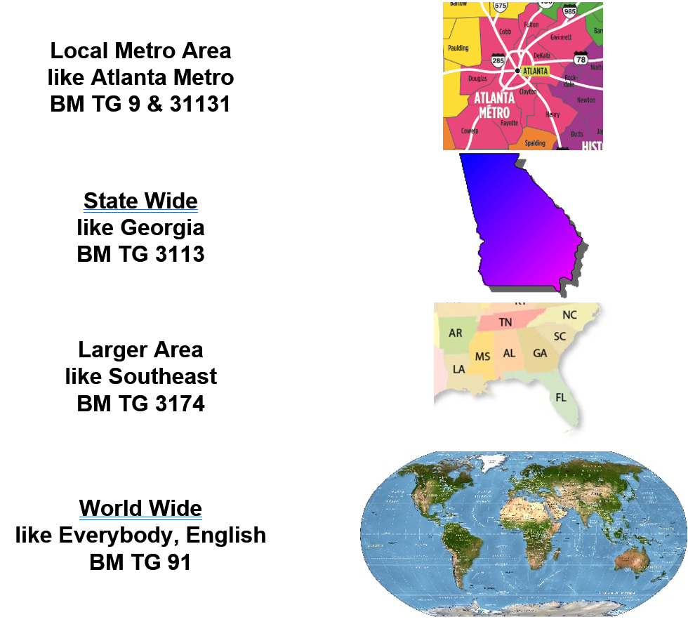
Some TG Designations

Slide 14
TG Designations (cont.)
Not all Network Servers use the same TG number for a DMR Talk Group
Certain TGs are shared – meaning that traffic on one network server is also available on a different network server
  Example – TG 3113 (GA State) traffic appears on both K4USD and Brandmeister
  This is a cooperation between the 2 networks, and at times, can be interrupted
  In general, TG on one network cannot be guaranteed to be on another network
So, Georgia State TG 3113 on GA DMR repeaters (K4USD) is simultaneously on BM 3113 for access to Hotspots

Slide 15
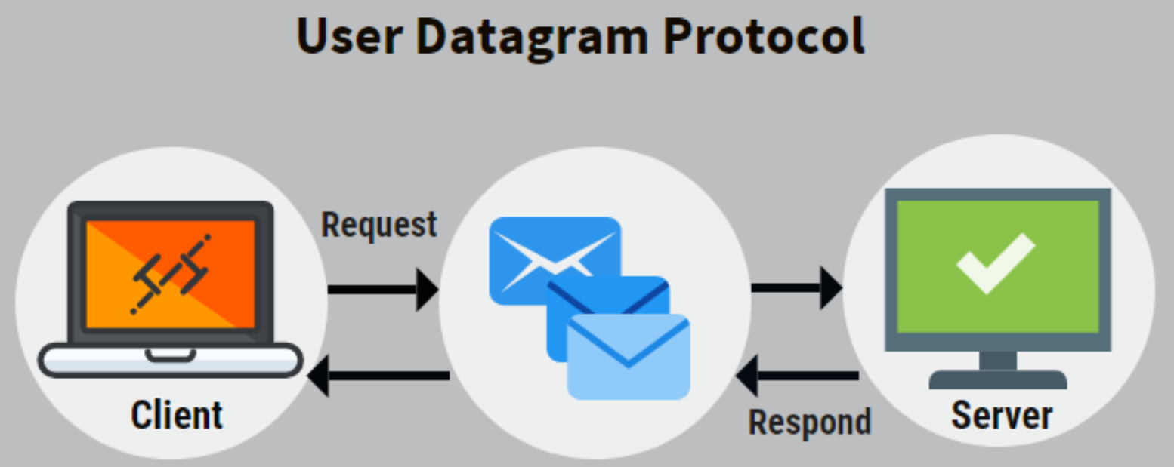
TGs use UDP
UDP is a subscription system
Request sent to the server – gets connected

Slide 16
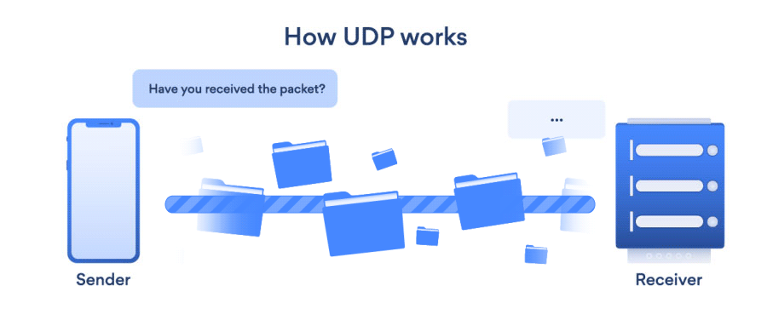
TGs use UDP (cont.)
Server sends the DMR TG stream
Stream sent to Requester – a repeater, hotspot or radio requesting TG subscription number

Slide 17
How TGs are selected
There are 2 types of TG selection:
  Static – all traffic on the TG is sent without need to initiate a subscription
  PTT (Part Time TG) – traffic only sent after the TG subscription is initiated
Setting up a static TG
  Repeaters have local or state TGs as static
  Hotspot can set the static TGs by configurations – done depending on the network connected to
  Static TGs are assigned to a TS

Slide 18
TG Sending
All radios receive the same traffic that are connected to the repeater – it is not radio specific
Radios can show TS has traffic – receiving light indicator
  They will hear traffic if “tuned” to the TG being sent

Slide 19
TG Switching
When a TS does not have TG traffic, it can be switched to a different TG – using PTT (Part Time TG connection)
Allowed PTT TGs are assigned by a repeater and are assigned to a particular TS
PTT connections have time limits – set by the repeater or server
PTT is started and the timeout is initiated when a radio sends on the TG
PTT time interval is reset whenever a radio sends on the repeater PTT TG
Once a PTT TG is selected, there is a timer preventing another PTT TG from being selected … like 5 minutes
  Also a length timer for PTT – PTT TG traffic ends

Slide 20
Radios can Select when to transmit
Radios have controls on what to allow the radio to transmit to a repeater (every radio calls these controls different names)
Transmit only if both TSs are free of traffic (eg: Same Color Code)
Transmit only if the TS is free of traffic (eg: Channel Free)
Transmit even if there is traffic from a different repeater (eg: Different Color Code)
Transmit without restrictions (eg: Always) – this is also considered “Impolite Mode”

Slide 21
Repeater vrs Hotspot
Repeater
Uses both TS
Only allows TGs that it wants – selection of ones provided by the Network Server it uses
Specifies the TS the TG is assigned to
Hotspot
Can connect directly to network servers
Can access any TG network server supports
You have control over static and PTT TGs
2 versions – Simplex and Duplex

Slide 22
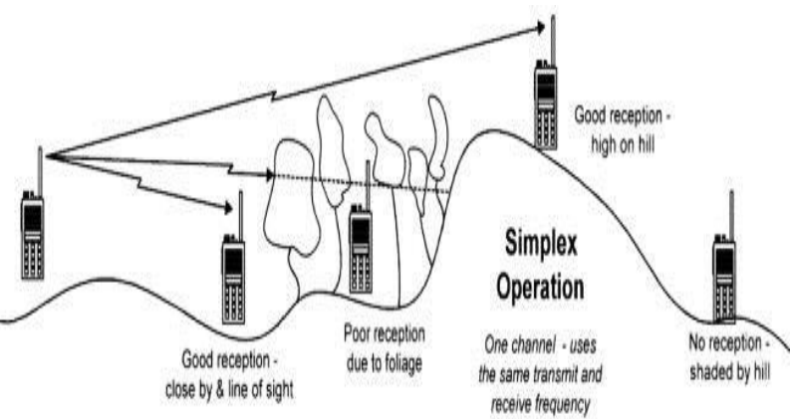
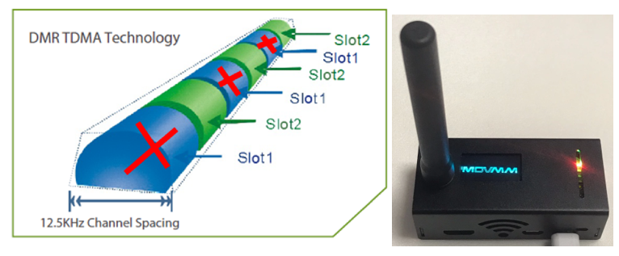
Simplex?
Means HT to HT communication – there are specified frequencies for 2m and 70cm
Means a Hotspot that only uses 1 of the TSs (TS 2) … only has 1 antenna

Slide 23
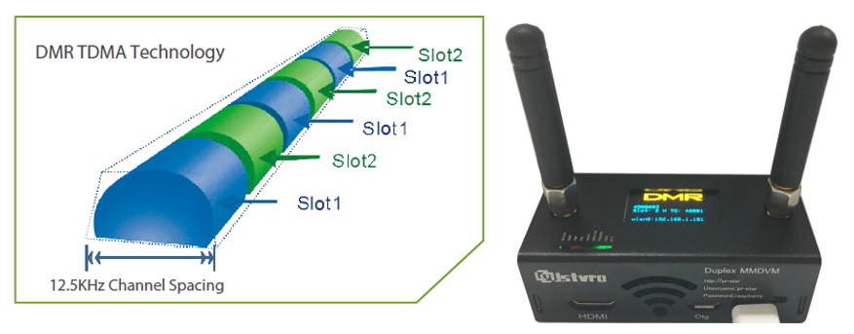
Duplex Hotspot
Hotspot usus both TSs
Has 2 antennas
Can always have a TS free

Slide 24
Using CPS (Customer Programming Software)
Simplified codeplug Workflow (in order):
a. Populate User info (DMR ID, Name, Cal Sign)
b. Create Group Call List (Talkgroup list)
c. Create Channels (also Analog channels in this step)
d. Create Zones
e. Customize buttons, tones, display
f. Save finished codeplug
g. Write to radio

Slide 25
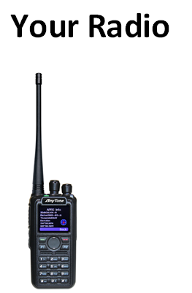
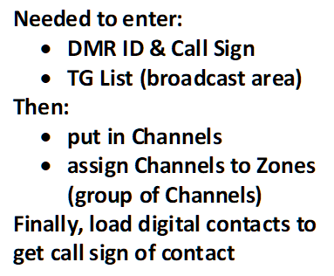
CPS (cont.)

Slide 26
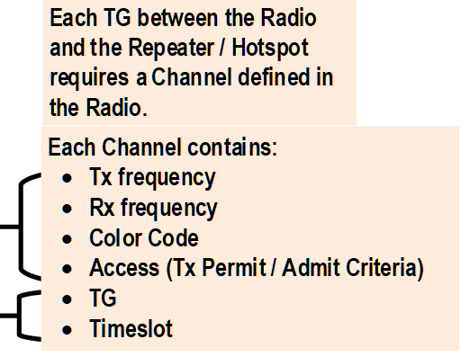
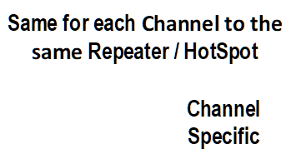
CPS (cont.)

Slide 27
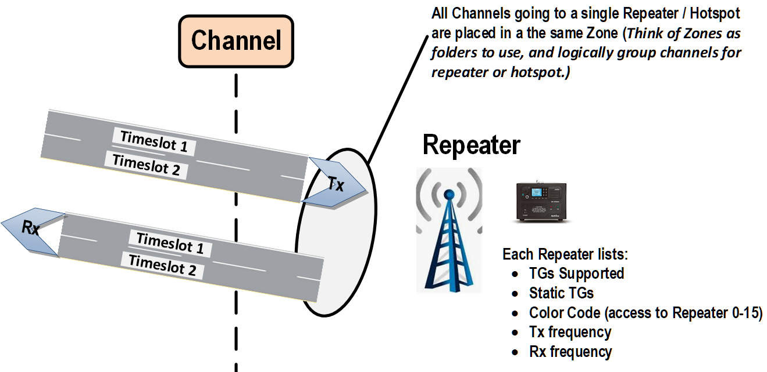
CPS (cont.)

Slide 28
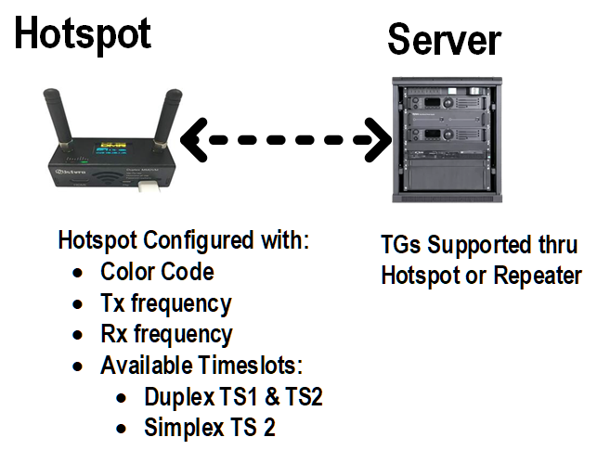
CPS (cont.)

