Slide 1
GARS Workshop February 15,2022
Digital Modes for Amateur Radio (Part-1)
Bob Hensey K4VBM
Dallas’ Notes on installing Meinberg

Slide 2
Meinberg – Network Time Protocol
Download and Configuration
https://www.meinbergglobal.com/english/sw/ntp.htm
Scroll down until you find this:
NTP for current Windows versions (Windows XP and later), with IPv6 support
ntp-4.2.8p15-v2-win32-setup.exe (4.29 MB) 24 February 2021 NTP package with IPv6 support for Windows XP and newer
After the file is downloaded, click on it to start the install

Slide 3
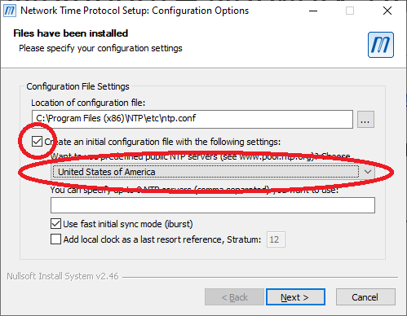
Take the defaults until you get to this screen
Make sure the Check Box is checked
(MANUALLY) Select united States of America
Click Next

Slide 4
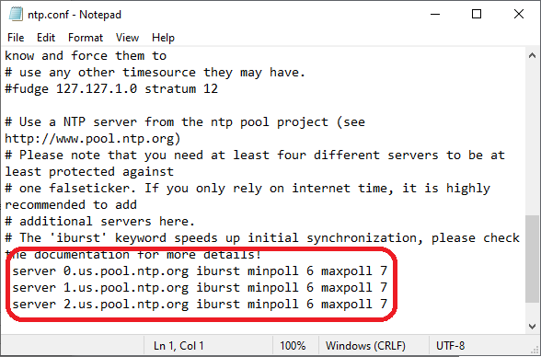
Review the “ntp.config” file
Scroll down, check that 3 NTP servers are there
Then close Notepad

Slide 5
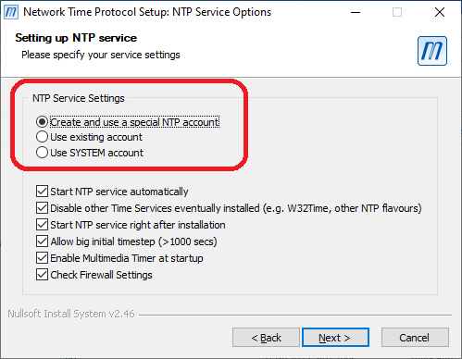
Bob recommended changing this
Select Create and use a special NTP account
Then hit Next

Slide 6
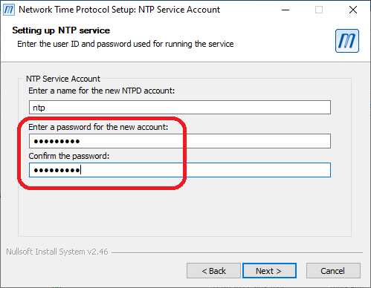
NTP Service Account
Enter a password, write it down… You might need it later…

Slide 7
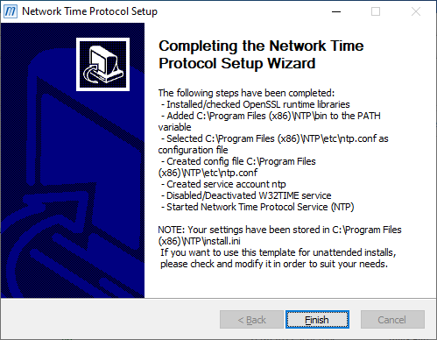
Finish
Click on Finish
But there is more…

Slide 8
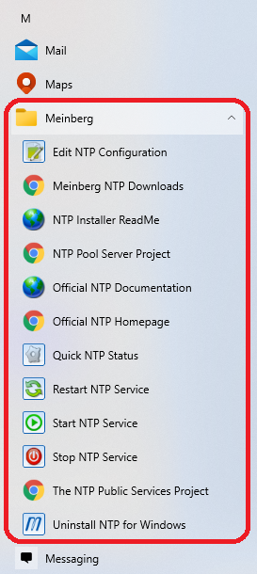
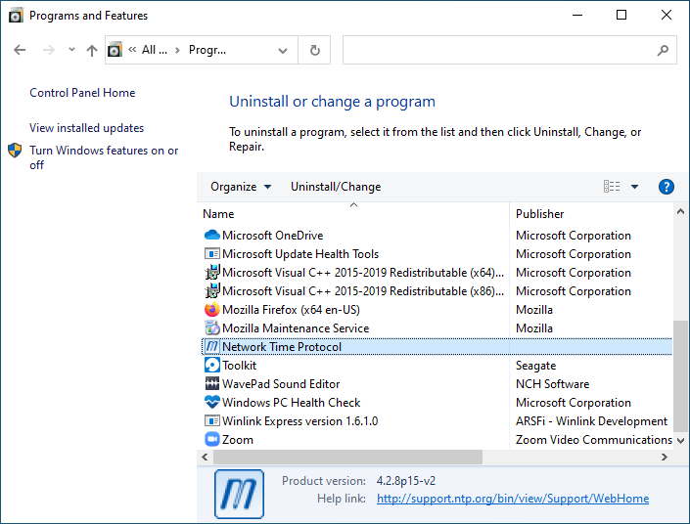
Hint and Tips about Meinberg
If you need to uninstall Meinberg it is listed as Network Time Protocol

