Slide 1
Radio Scouting & JOTA
Presented By
Steve Back
WB2OGY
GARS Workshop
August 17, 2021

Slide 2

Radio Scouting Emblem

Slide 3
Radio Scouting Resources
KK4BSA Northeast Georgia Council Radio Club
  Camp Rainey Mountain Repeater
  JOTA & Special Events
  https://kk4bsa.info
K2BSA
  K2BSA Amateur Radio Association National BSA
  BSA Nation all Jamboree & Special Events
  https://k2bsa.net
ARRL
  http://www.arrl.org/amateur-radio-and-scouting

Slide 4
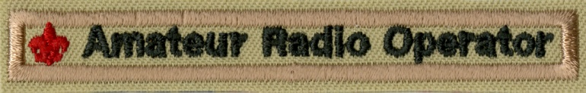
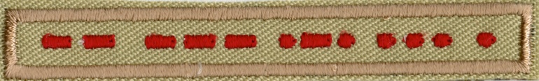
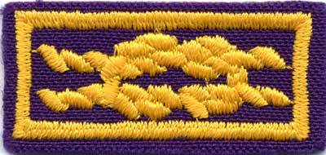
Boy Scouts of America Radio Scouting
Jamboree On The Air
  Introduction for Scouts
Scouting Advancement
  Radio Merit Badge
Licensing and Morse Code
  Uniform Badges
Leader Recognition
  ARRL Service to Scouting

Slide 5
JOTA Organization
World Organization of the Scout Movement
  Started in 1957
  Owns and Operates the World-Wide Event
  Boy Scouts Primarily and Girl Scouts Invited
Boy Scouts of America
  Responsible for National Operation
  BSA International Department
  Local Council International Representative

Slide 6
Supporters
ARRL
  Promotes Event
  Encourages Clubs and Members
  Education, Youth, Public Relations
K2BSA Amateur Radio Association
  Communication Program
  Resource Clearing House
  Jamboree Operation
GARS
  Provides JOTA to Gwinnett Youth

Slide 7

Sponsors
Icom America
  Jamboree on the Air Promotion
  Official Transceiver Supplier for the National Scout Jamboree (2013 and 2017)
  Installed 3 Repeaters at the Summit Scout Reservation
  Provided Transceivers for 2015 NOAC and for 2016 Philmont Scout Ranch activation

Slide 8
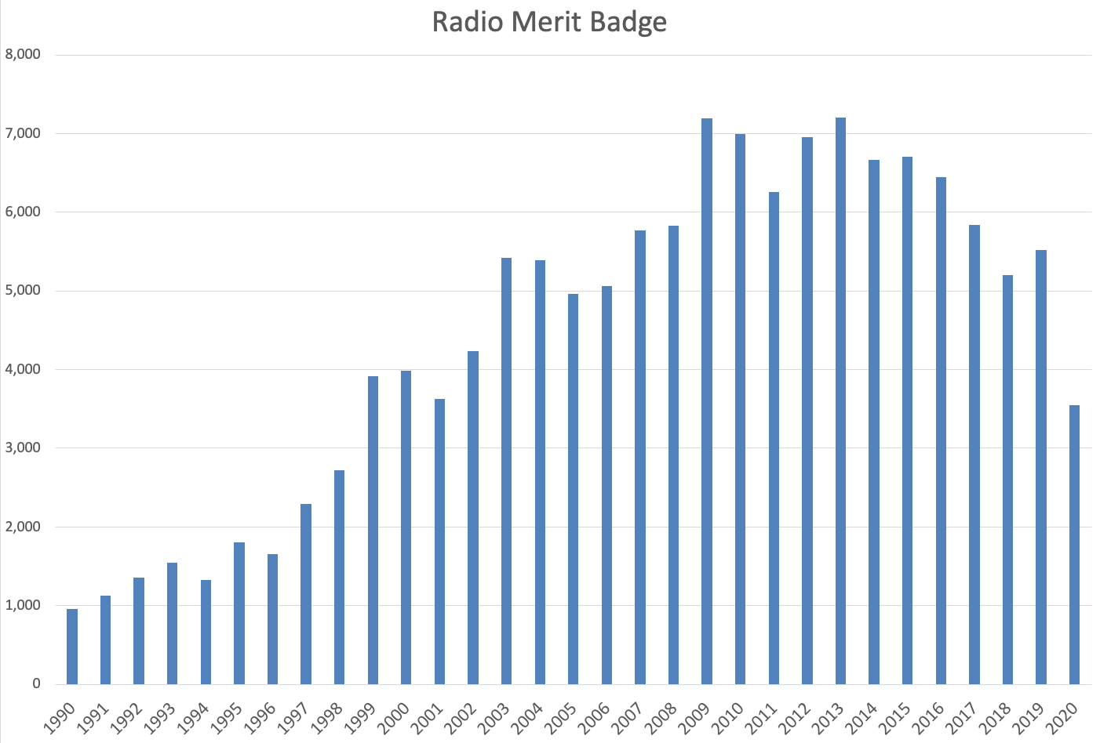
Radio Merit Badge
We need to do better marketing Radio to Youth.

Slide 9
Jamboree On The Air (JOTA)
JOTA-JOTI is the largest Scouting Event in the WORLD, with over 1 million Scouts participating across 150 countries? This past year in the USA we had a little over 7,000 Scouts participate from 148 of our 273 Councils at 346 stations.
JOTA is the 3rd weekend in October every Year.
GARS will participate in JOTA this year on October 16 at the VFW Hall in Lawrenceville

Slide 10
JOTA Objectives
Increase the participation of Scouts, Leaders, Councils and the public
Increase the level of communication and support for events
Increase the awareness of Radio Scouting throughout Scouting
Improve Station reporting of their events activities
Participate
Increase the fun

Slide 11
Suggested JOTA Frequencies
80 m | 3.920 – 3.940 3.670 – 3.690 (1)
40 m | 7.180 – 7.200 7.270 – 7.290
20 m | 14.270 – 14.290 14.320 – 14.340
17 m | 18.140 – 18.150
15 m | 21.360 – 21.400
12 m | 24.960 – 24.980
10 m | 28.350 – 28.400
6 m | 50.160 – 50.200
D-Star | REF033A h
DMR | Talk group 907 JOTA

Slide 12
JOTA 2021
Third weekend in October every year
GARS will support JOTA at the 5255, 368 Grayson Highway, Lawrenceville on October 16th October 16th
I will be behind the VFW building setting up at about 8:15 AM
I will supply one station and antenna and hope to have at least one additional HF station and VHF/UHF/DMR/D-STAR
Radio Merit Badge will be taught

Slide 13
What I need
Operators and people to explain Amateur Radio to the Scouts
Help with Merit Badge Class
Additional stations with at least one additional portable antenna
Hopefully GARS can provide Lunch for staff and Scouts and help serving it
General support

