Slide 1
Talking Through The Birds
Ruth Willet, KM4LAO
August 10, 2021

Slide 2
Presentation Scope
Types of Satellites
Low Cost OTA
Satellite Pass Checklist
Connecting Off Satellites
Awards

Slide 3
From Sputnik I to OSCAR Satellites
https://amsat-uk.org/2018/01/26/ao-92-open-for-amateur-radio-use/
https://www.nationalgeographic.com/science/2018/10/news-sputnik-world-space-week-soviet-union-russia/

Slide 4
AMSAT
https://www.amsat.org/

Slide 6
Orbital Period = Time to complete one trip around the earth
All current satellites in LEO
Orbital period: 88-127 minutes

Slide 7
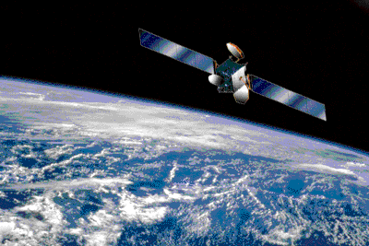
QSOs occur when we are in a satellite’s footprint
Footprint varies per pass due to earth’s rotation
One satellite can have ~8 passes per day at varying times & elevations

Slide 8
Types of Satellites
Digisats
FM Satellites
Linear Transponders

Slide 9
Digisats
Digital Modes
2m Simplex
Equipment: 1 HT & Directional Antenna

Slide 10
Digipeater Available on the ISS

Slide 11
FM Satellites
5 active FM satellites
Some only active on a schedule
Orbiting Repeaters
Cross-Band Repeaters
U/V: TX on 2m, RX on 70cm
V/U: TX on 70cm, RX on 2m
Transmit = uplink,
Receive = downlink
CTCSS Tone Required
SO-50: 145.850 MHz
SO-50: 145.850 MHz

Slide 12
SO-50
AO-91
Mode U/V
TX on 2m, RX on 70cm
Mode V/U
TX on 70cm, RX on 2cm

Slide 13
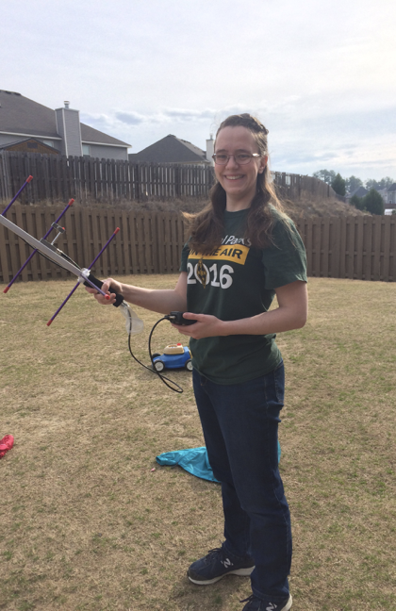
FM Satellites are great to start with and fun to operate on!

Slide 14
Linear Transponders
Cross-band QSOs
USB, LSB, CW, Digital
Built for entire range of frequencies
A satellite passband
Passbands range from 20-100 kHz

Slide 15
FM Repeater vs Linear Transponder

Slide 16
Types of Linear Satellites
Non Inverting
TX USB High End Passband
RX USB High End Passband
Inverting
TX LSB Low End Passband
RX USB High End Passband
Courtesy of Emily, W0EEC

Slide 17
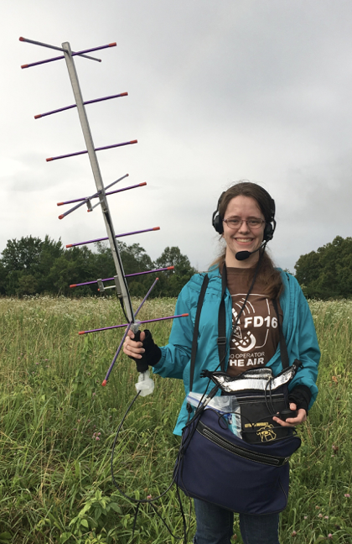
Linear Transponders are an upgrade from FM sats due to generally greater footprints and more space for QSOs in the passband

Slide 18
Why I Like Satellites
Bounce signals of moving target
Talk anywhere in constantly changing footprint
Multi-task to TX/RX with multiple radios and track satellite
Communicate accurately at fast pace
Doppler Effect challenge

Slide 19
Doppler Effect: A characteristic of a moving signal

Slide 20
Doppler Effect on SO-50

Slide 21
Doppler Effect on Linear Transponders

Slide 22
Situational Awareness is Imperative
FM Pass: Don’t call CQ
Linear pass: Spread out in passband, free to call CQ

Slide 23
Satellites Gear Checklist
Item | Options | Price
Directional Antenna | Yagi - Arrow, Elk | $152
VHF/UHF Radios | Any brand | $25 - $400 Entry level
Low Loss Coax | RG58, Wireman #118, HRO, Etc | $5
SMA to BNC Connectors | Multiple | $6
Duplexer (optional) | Arrow, MFJ | $34
Satellite Pass Prediction Software | Multiple | Free
Grid Square Prediction | Multiple | Free
Compass | Physical compass, phone app | Free
Voice Recorder | Separate recorder, phone app | $45
 | Total Cost: | $250 - $600

Slide 24
Directional Antenna: Elk or Arrow Handheld

Slide 25
VHF/UHF Radios
Handhelds or base station
Icom
Kenwood
Yaesu
Baofeng

Slide 26
Operating Full Duplex is CRITICAL

Slide 27
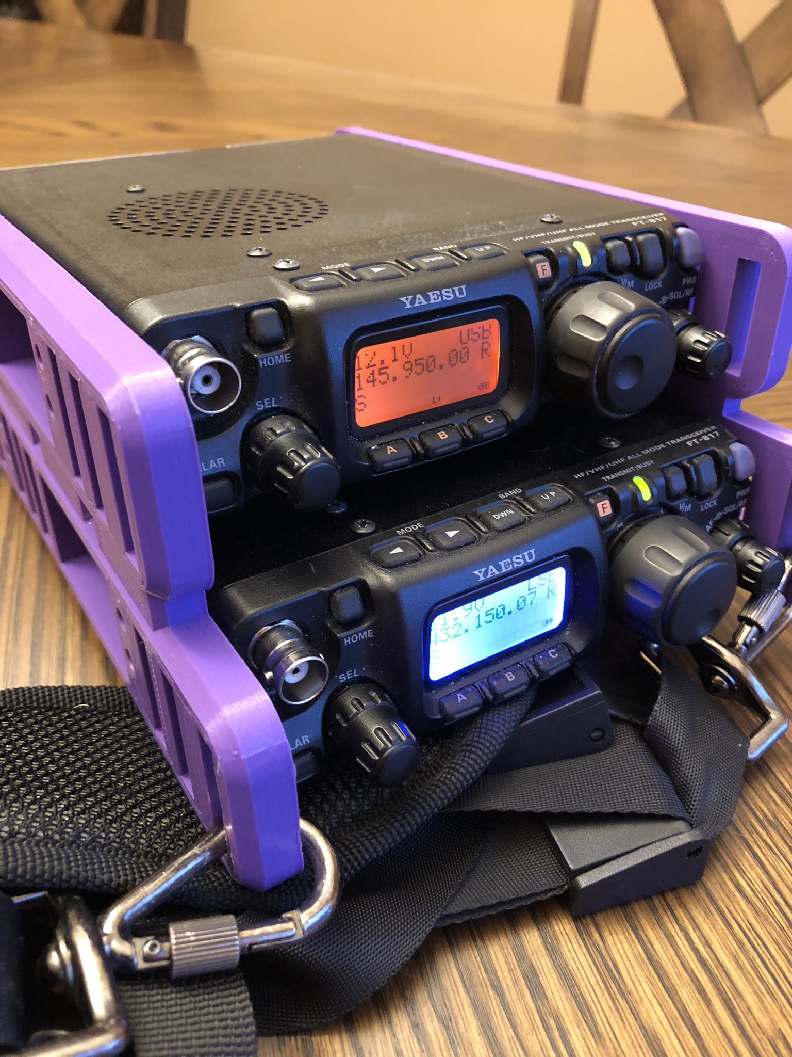
Linear Satellites: Radios with SSB/CW/Digital Capability on VHF/UHF
Yaesu FT817 or FT818
Yaesu FT-847 (full duplex)
Icom 7300 (full duplex)
Icom 910
Icom 705
Mix and match to get full duplex as needed

Slide 28
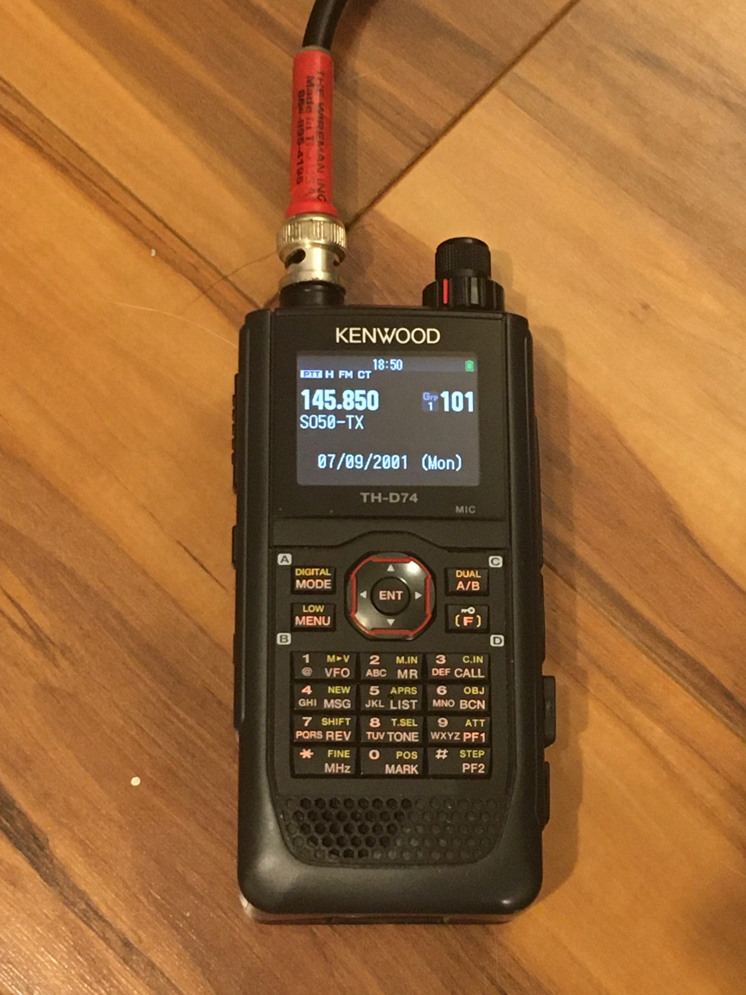
Low Loss Coax, Connectors, Duplexer as needed
Low loss coax like RG58, Wireman #118, HRO Equivalent
Standardize with BNC Connectors
One Radio
Duplexer connects antenna elements to radio
Two Radios
Duplexer + coax
2 lengths of coax

Slide 29
Maidenhead Grids
First two letters :10 degree by 20 degree fields
Sub fields, 00-99 per letter combination: 1 degree latitude by 2 degrees longitude

Slide 30
Determining Your Grid Square

Slide 31
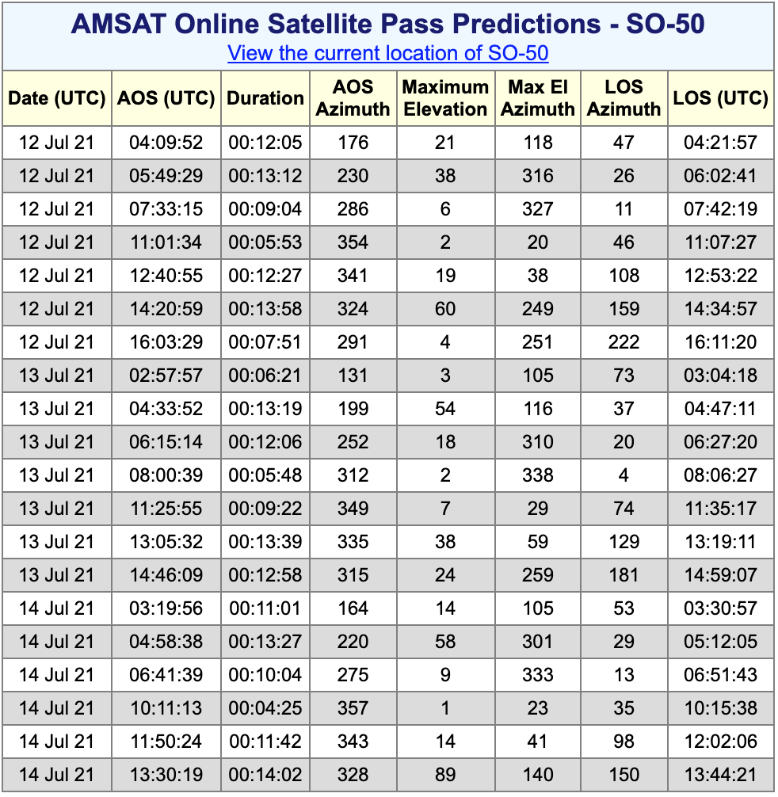
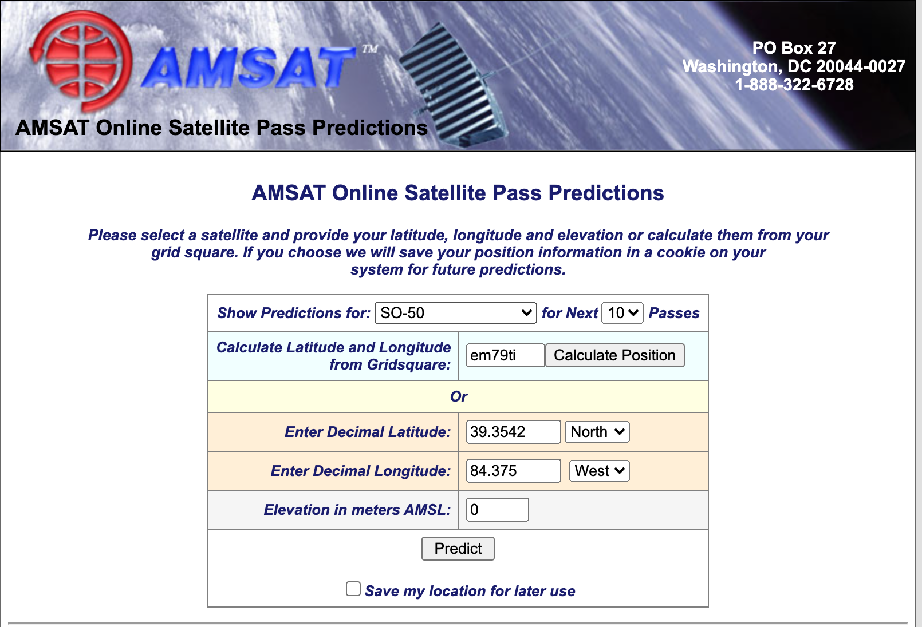
Pass Prediction - AMSAT: https://www.amsat.org/track/index.php

Slide 32
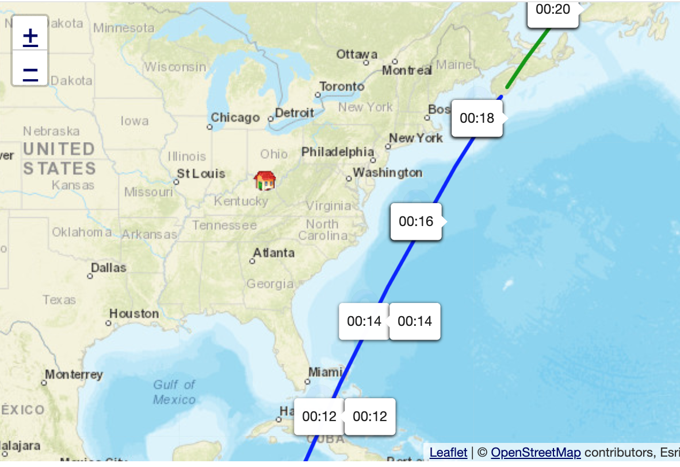
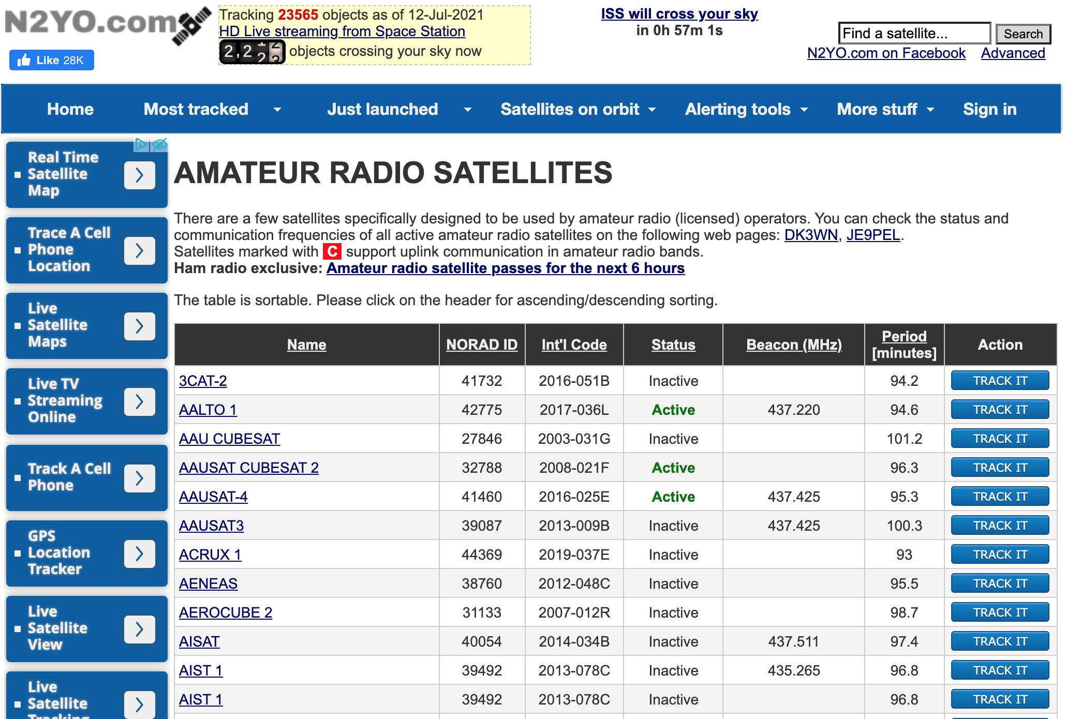
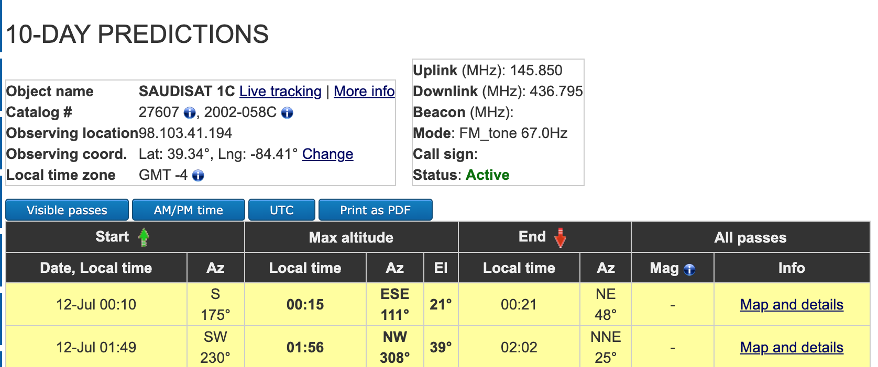
Pass Prediction N2YO: https://www.n2yo.com/

Slide 33
Pass Prediction Software List
AMSAT: https://www.amsat.org/track/index.php
N2YO: https://www.n2yo.com/
Gpredict: http://gpredict.oz9aec.net/
MacDoppler: https://www.dogparksoftware.com/MacDoppler.html
GoSatWatch (iPhone)
AmsatDroid (Android)
ISS Detector (Both)

Slide 34
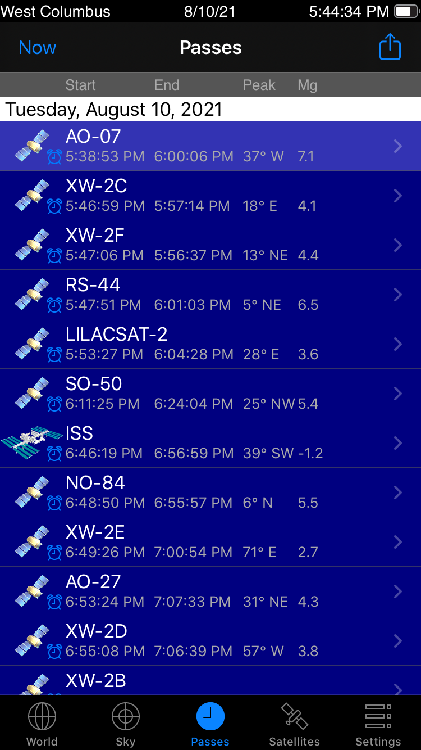
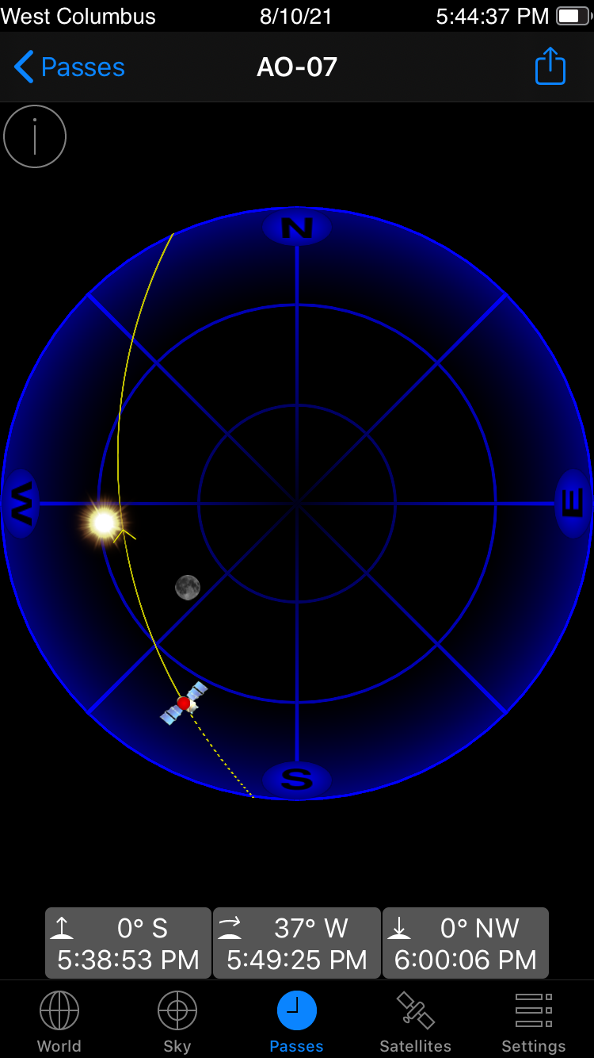
Pass Prediction – iPhone Apps

Slide 35
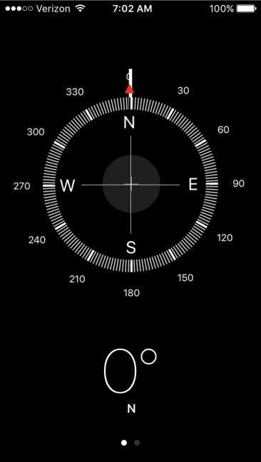
Compass

Slide 36
Voice Recorder

Slide 37
Logging Satellite Passes
TQSL
N3FJP
https://www.magicbug.co.uk/cloudlog/
https://twitter.com/WD9EWK/status/976839455658176513

Slide 38
What do we talk about?
Potential QSO on a busy pass
KX9X, this is KM4LAO
KM4LAO, this is KX9X, EN50
QSL Sean, I’m in EM79!
QSL, Ruth

Slide 39
Home Grid Stations and Rovers
DD1US
Kylee, KE0WPA

Slide 40
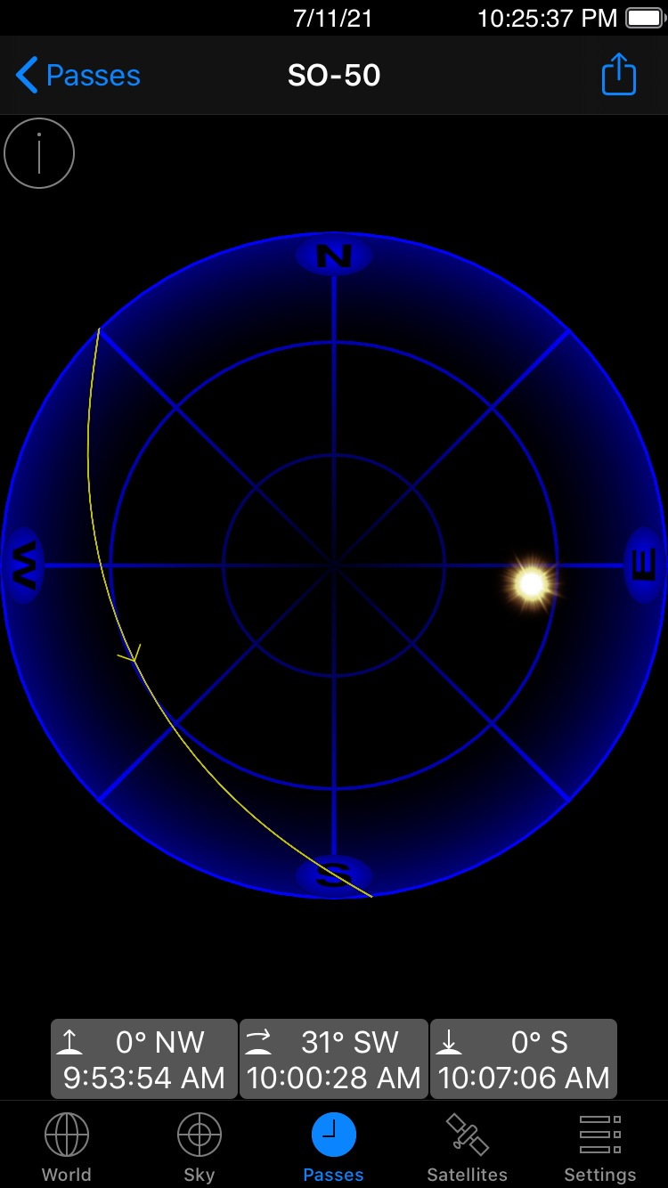
Satellite Pass Checklist Part 1- Pre Pass
Choose a satellite and pass to operate on
Determine operating location based on direction and elevation of pass
Gather equipment and charge radios
Make sure FM frequencies are programmed in radio memory

Slide 41
Satellite Pass Checklist Part 2 - Pre Pass
Walk/Drive to operating site
Assemble antenna and connect radios
Mark AOS, Peak Elevation, and LOS
Start recording, state date and time, grid square, callsign, and satellite

Slide 42
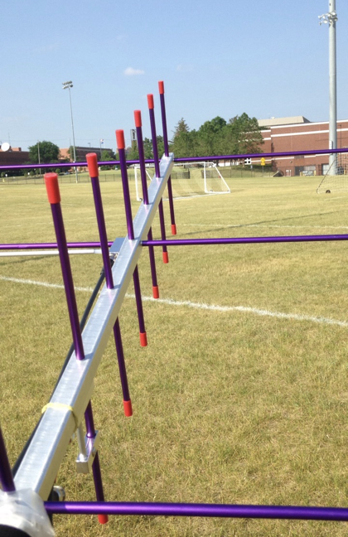
Satellite Pass Checklist Part 3 – Mid Pass
Track where the satellite should until you hear it
Listen until you get the rhythm of pass
Listen for other rovers, special events, try to understand who is on the air
Call someone directly or just transmit your callsign and gridsquare
Repeat for the entire pass

Slide 43
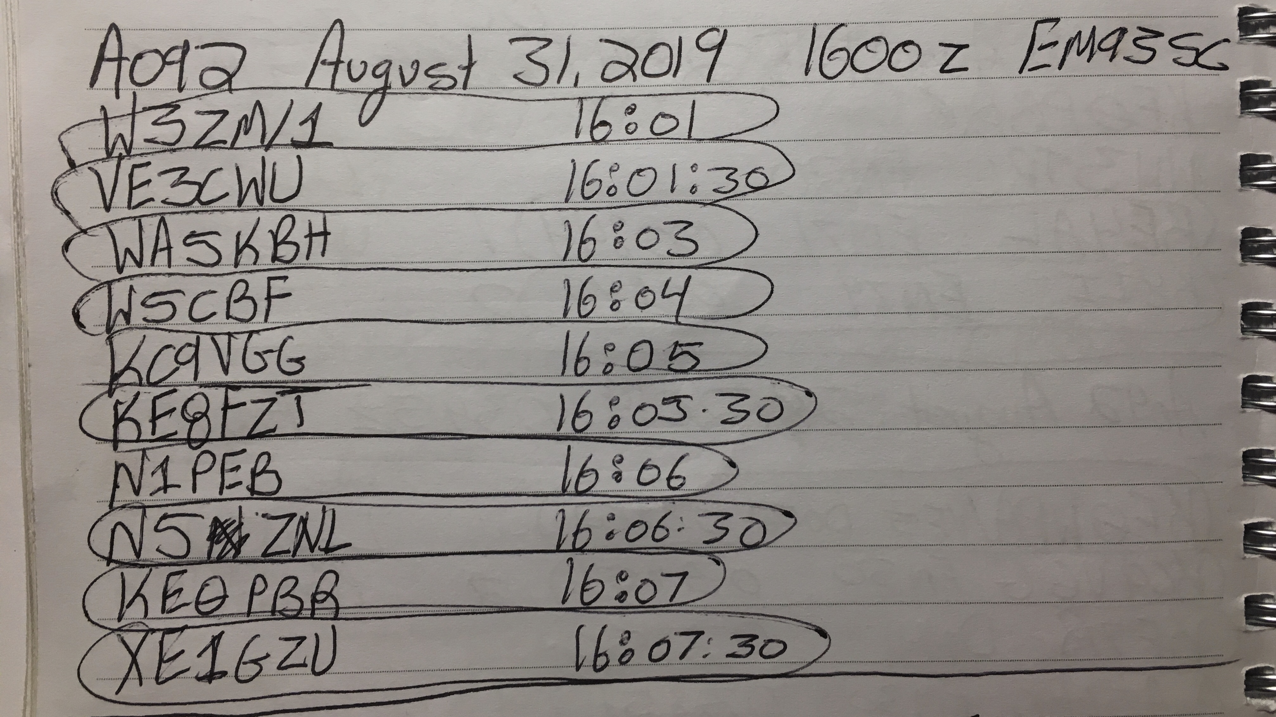
Satellite Pass Checklist Part 4 – Post Pass
Transcribe recording
Log contacts
Upload to LOTW for confirmation and award credit
Send QSL cards as desired

Slide 44
Successful Contact

Slide 46
Satellite Linear Tips
Use KE0PBR Frequency List
Track satellite using app
Often most beneficial to find the beacon first
Pick downlink or uplink on 2m, set that freq on radio, and lock it
Scroll uplink or uplink to corresponding 70cm frequency and be prepared to adjust for Doppler
Find yourself on the passband and try not to step on others
Soft whistles help sometimes, or “testing 1,2,3”
Operators know it can be hard to find yourself, so be patient
If you don’t find yourself, go back to the starting frequency and slowly change the freq until you do
Start calling CQ to make contacts!

Slide 47
Satellites Linear Frequencies

Slide 48
Linear Satellite Pass Video
https://youtu.be/cwtmP1sDL9g?t=115

Slide 49
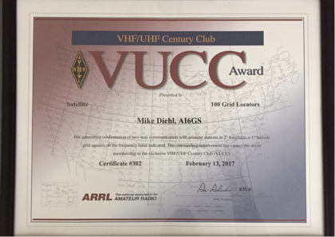
Earning Standard Awards

Slide 50
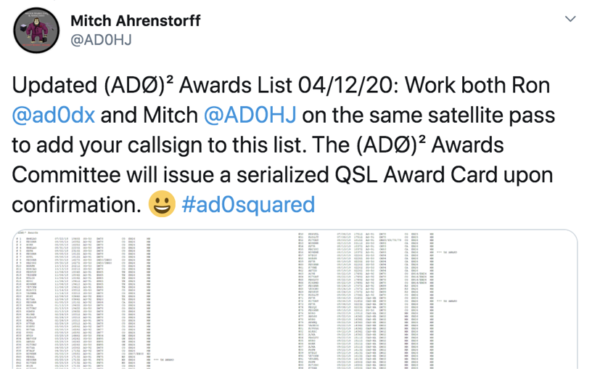
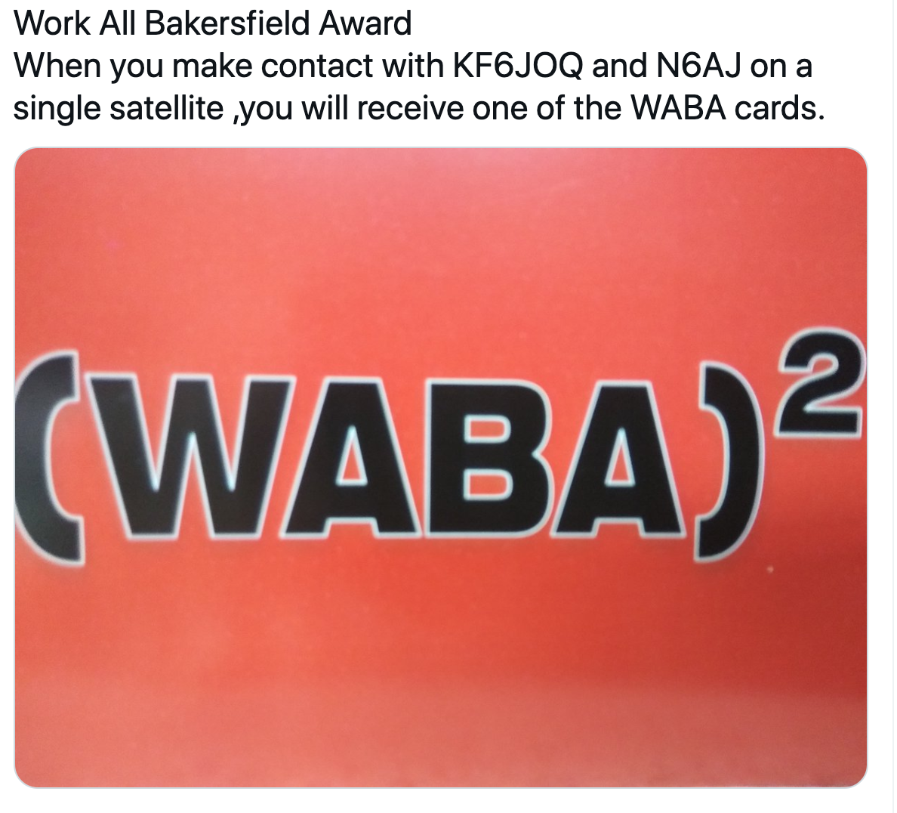
Earning Customized Awards

Slide 51
AMSAT Distance Records

Slide 52
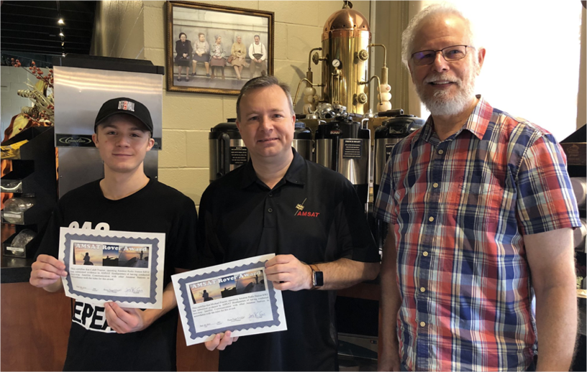
AMSAT Rover Award

Slide 53
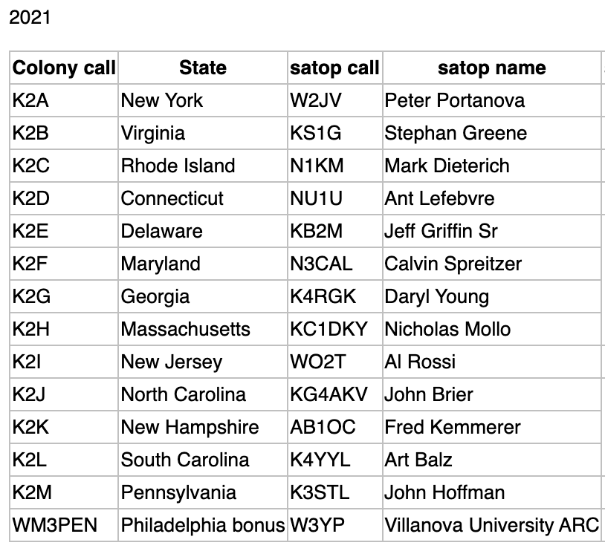

Slide 54
Connections On The Air: AMSAT Net

Slide 55
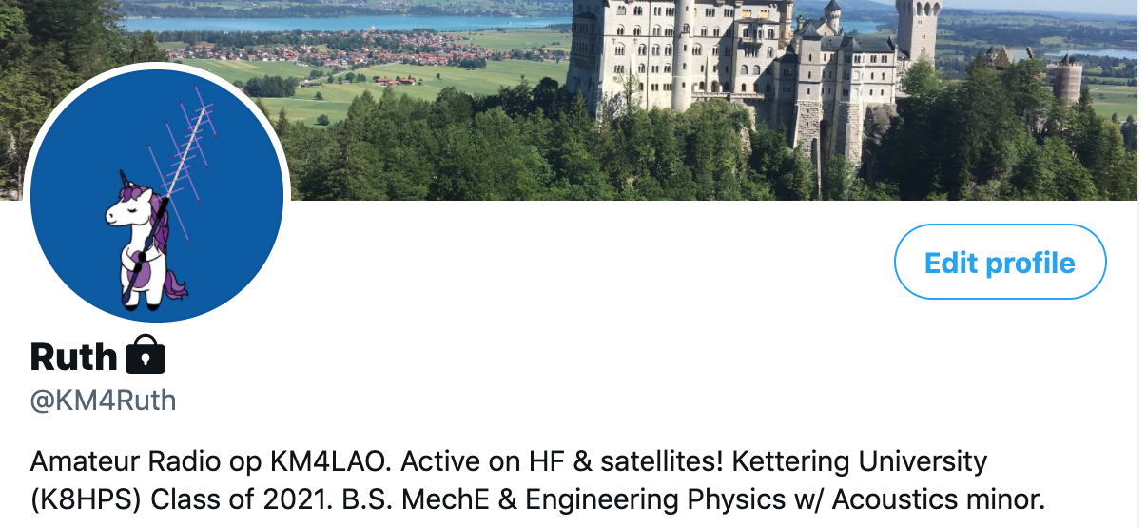
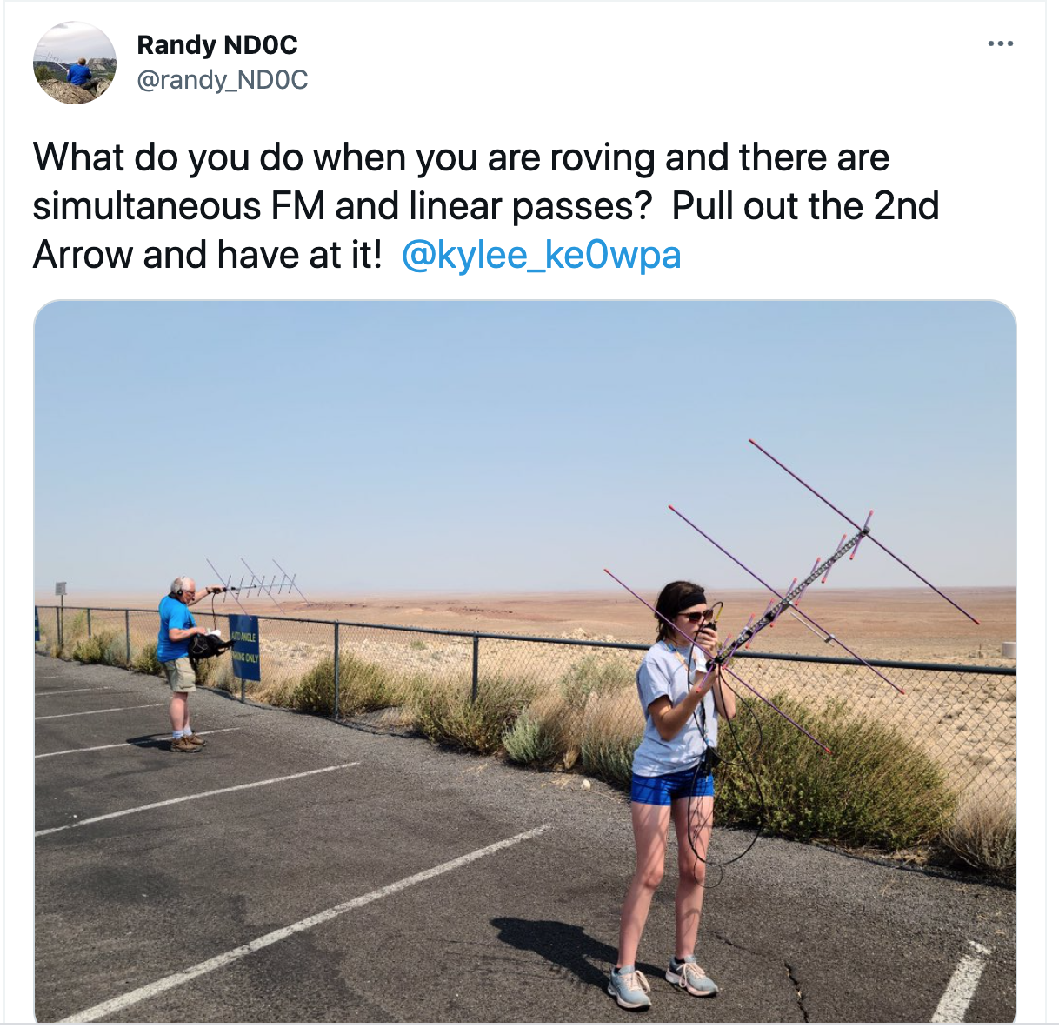
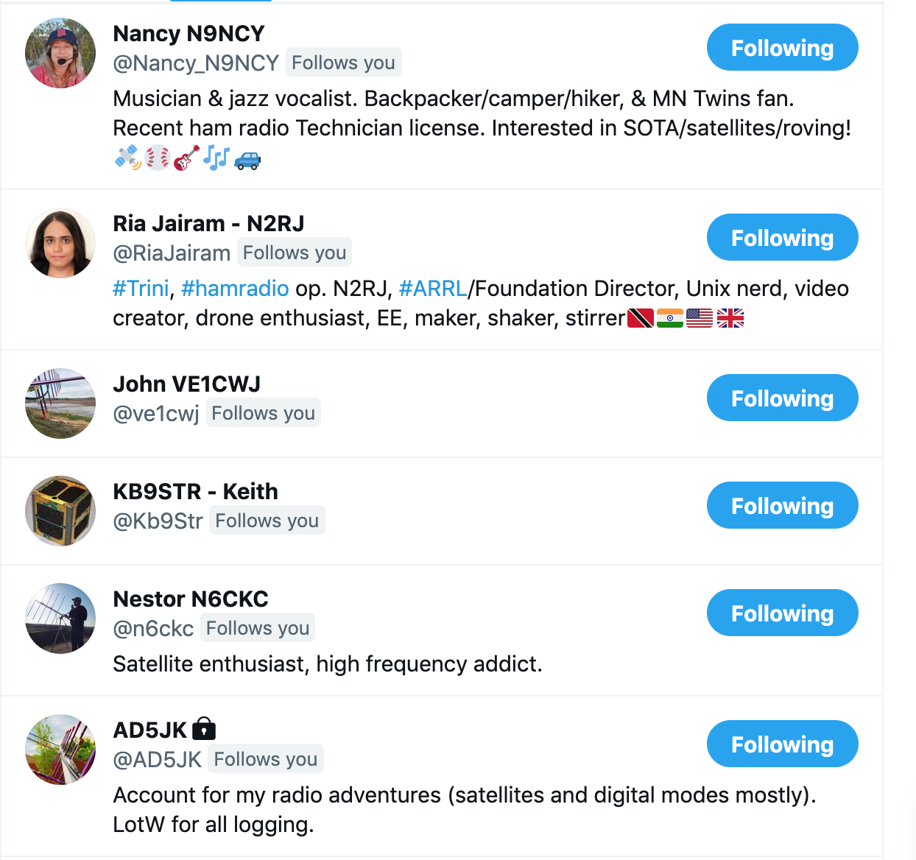
Twitter for Hams

Slide 56
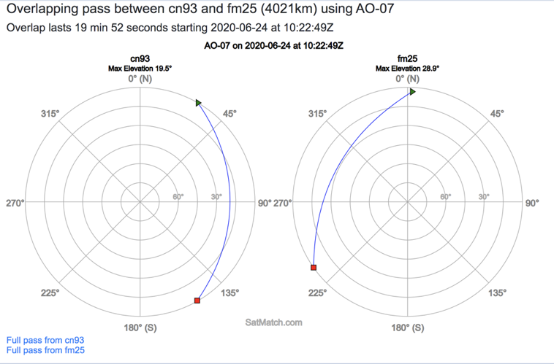
SatMatch

Slide 57
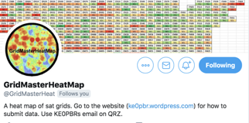
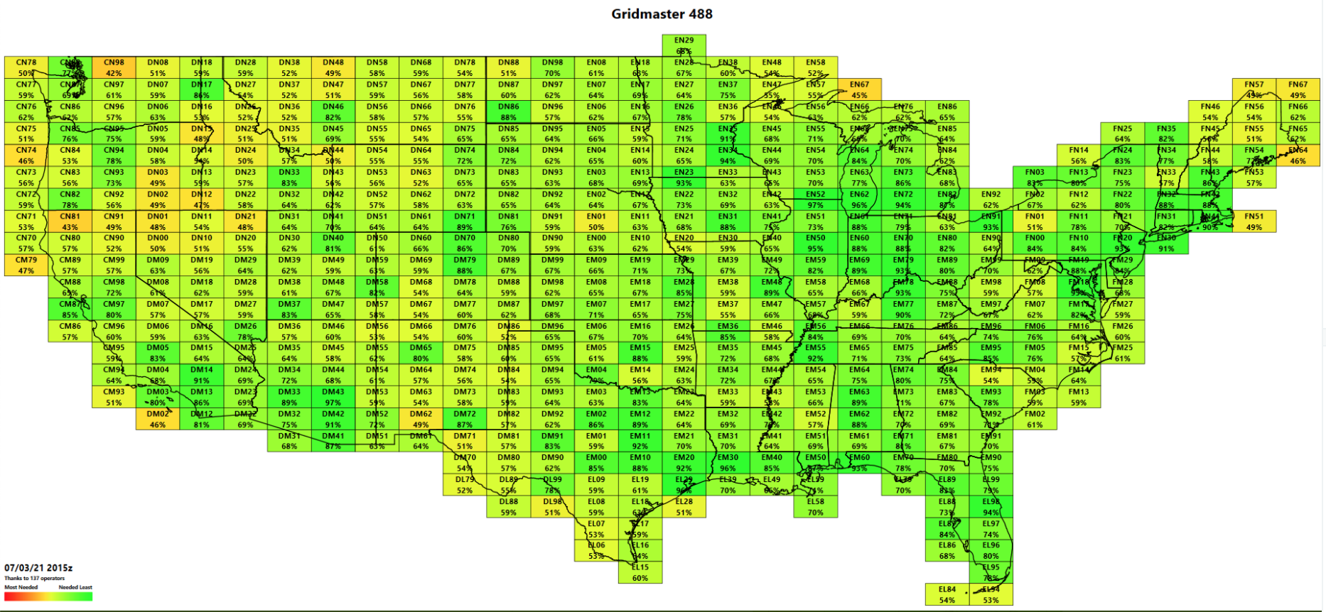
GridMaster Heat Map

Slide 58
General Links
AMSAT Homepage
https://www.amsat.org/
Paul, KE0PBR’s frequency Excel spreadsheet
https://ke0pbr.wordpress.com/2018/12/31/my-frequency-cheat-sheet/
FM Satellite Frequency Summary
https://www.amsat.org/fm-satellite-frequency-summary/
OSCAR Satellite Status Page
https://www.amsat.org/status/
AMSAT UK
https://amsat-uk.org/

Slide 59
Satellites are…
Accessible
Affordable
Fantastically Fun
Challenging
Connecting with Community
Always Providing Learning Opportunities
... for everyone!

Slide 60
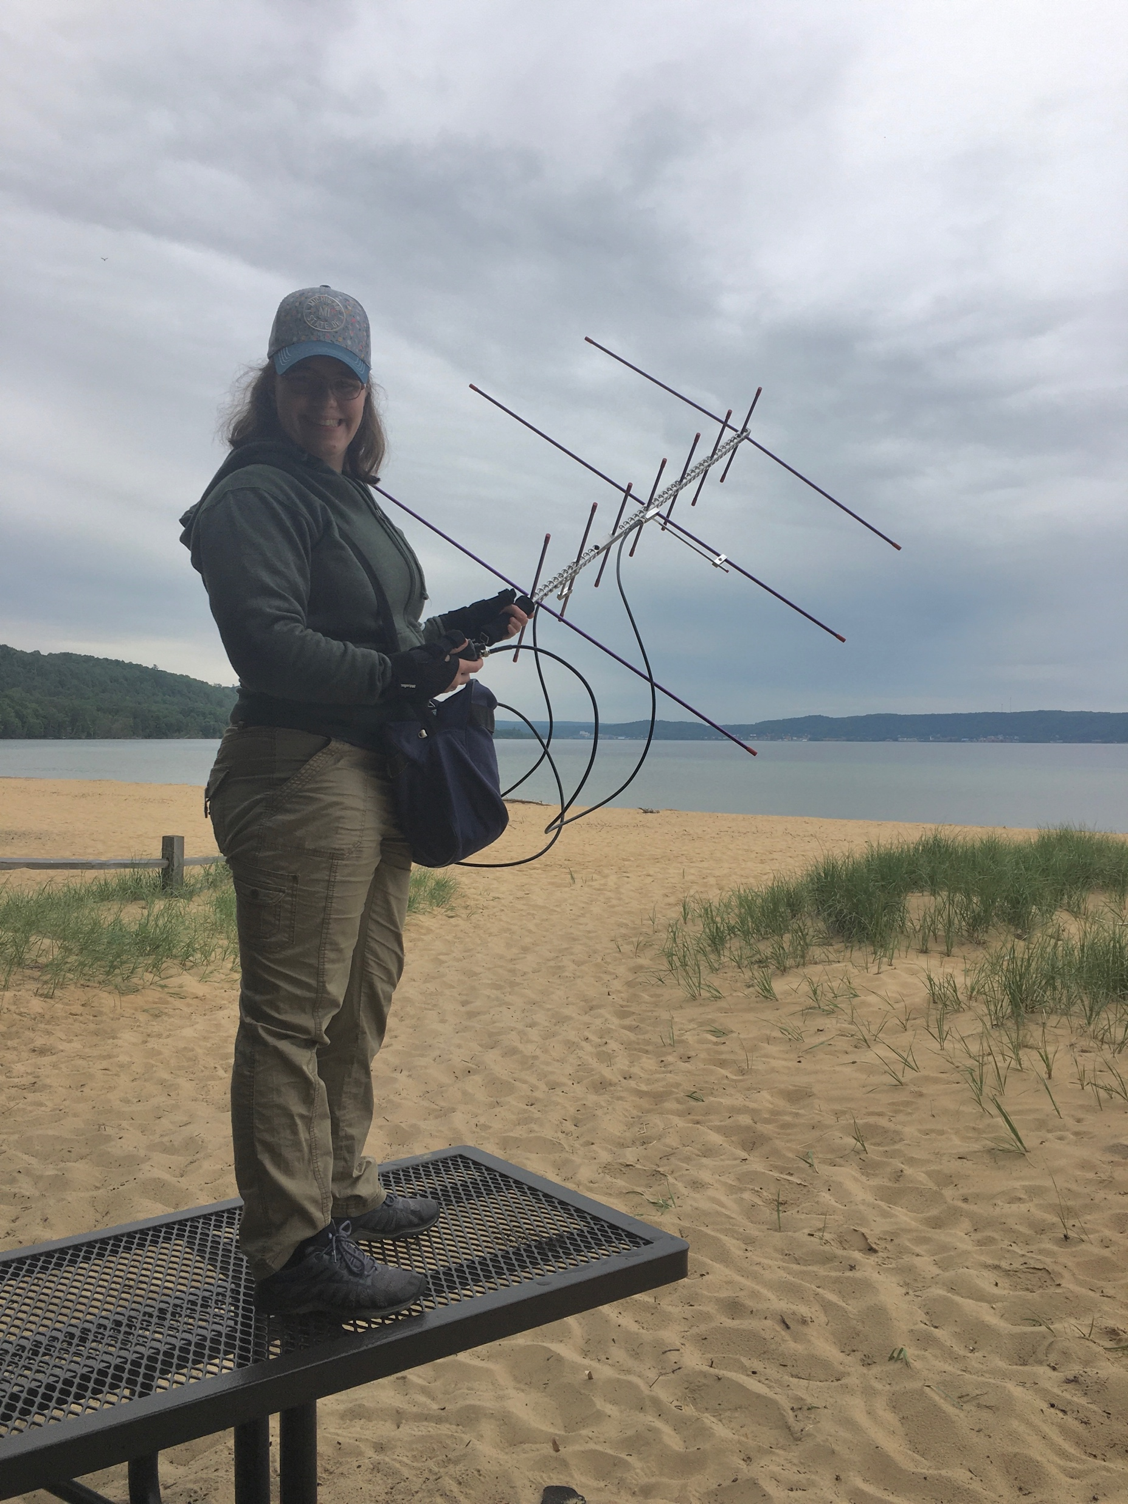
Questions?

