Slide 1
Wi-Fi for Hams
A Practical Explanation
Kevin Scott
K4GTR
kevindscott@bellsouth.net

Slide 2

History of Wi-Fi
Wi-Fi was a pun on “Hi-Fi” and not short for “Wireless Fidelity”
WaveLAN, created by NCR and AT&T to link cash registers was the precursor for Wi-Fi.
Wi-Fi was formalized as 802.11 by the IEEE (Institute of Electrical and Electronics Engineers)
  To fulfill the need for high-speed data communications as an extension of the Ethernet (10/100/1000+ Mbps) protocol through wireless technologies instead
  For portable, mobile and fixed remote applications
All Wi-Fi IEEE specifications fall into the 802.11 standards family
  Compare to FCC Part 97 rules for the Radio Amateur Service
Wi-Fi certification of products is performed by The Wi-Fi Alliance (www.wi-fi.org )
  It is a worldwide network of companies that provide Wi-Fi and related equipment
  Look for this logo on officially certified Wi-Fi devices and equipment

Slide 3
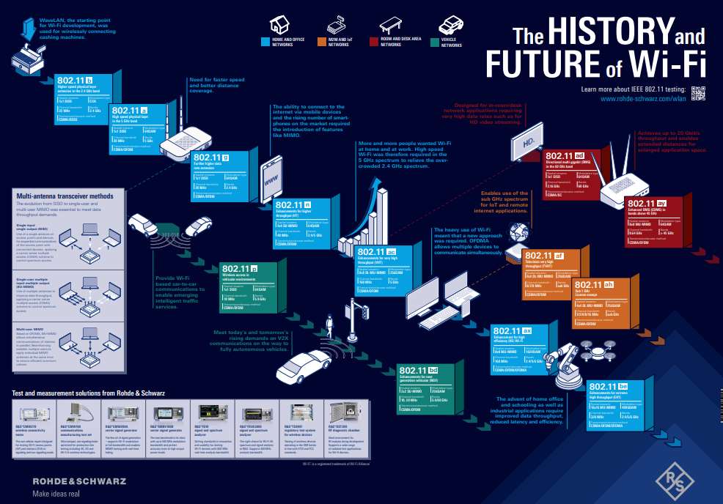

Slide 4
Acronyms and Definitions
Spatial Streams
  A method to use various polarizations and antenna diversity to achieve higher throughput than if using a single frequency/single stream. Common number of streams in current products are 2, 3 & 4 streams and 8, 8+8 and 16 streams for new and future products
MCS – Modulation and Coding Scheme
  Defines spatial streams and data rate
RSSI – Receive Signal Strength Indicator
Modulation Types:
  CCK – Complementary Code Keying
  DSSS – Direct Sequence Spread Spectrum
  BPSK – Binary Phase Shift Keying
  QAM – Quadrature Amplitude Modulation
  OFDM – Orthogonal Frequency-Division Multiplexing
  OFDMA – Orthogonal Frequency-Division Multiple Access
    Allows multiple users due to sub-carriers

Slide 5
Acronyms and Definitions continued
AP – Access Point (this is your home’s Wi-Fi router)
SISO – Single Input/Single Output (single transmission stream)
SU-MIMO – Single User Multiple Input/Multiple Output
DL-MU-MIMO – Download Multiple User MIMO
RU – Resource Units (smaller frequency allocations for each user on a full Wi-Fi channel)
U-NII – Unlicensed National Information Infrastructure radio band
ISM – Industrial, Scientific and Medical; refers to unlicensed bands
DFS – Dynamic Frequency Selection (listen for RADAR before use)
  Used on U-NII-2 and 2e sub-bands
CSMA – Carrier Sense Multiple Access/Collision Avoidance
BER – Bit Error Rate

Slide 6
Wi-Fi Throughput Speeds
Important Note: The maximum network speeds are controlled by:
  Incoming data rate from your Internet Service Provider (ISP) – The “Outside” World
  The Wi-Fi generation of your wireless router
  The capability of your device’s Wi-Fi network card or IC
    2.4/5 GHz
    20/40/80/160 MHz channels
    The number of spatial streams
  Distance from your Wi-Fi router
    MCS level
      MCS0 is slowest
      MCS7, 8, 9 or 11 is the fastest

Slide 7
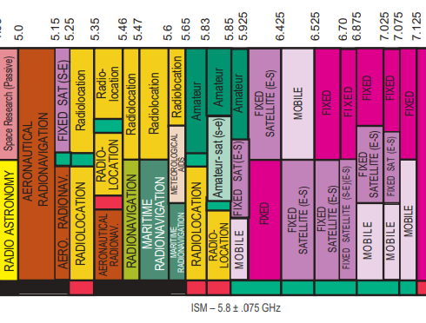
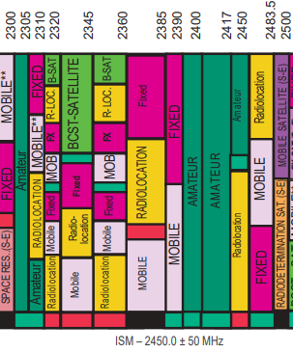
FCC Allocations
Microwave Ovens
2.4 GHz (60 MHz BW)
5 GHz (685 MHz BW) & 6/7 GHz (1190 MHz BW)

Slide 8
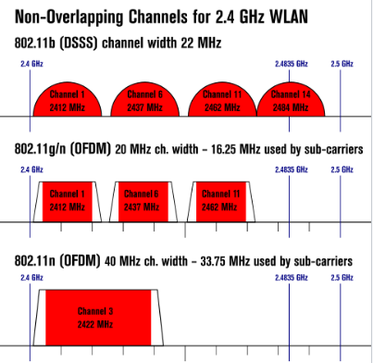
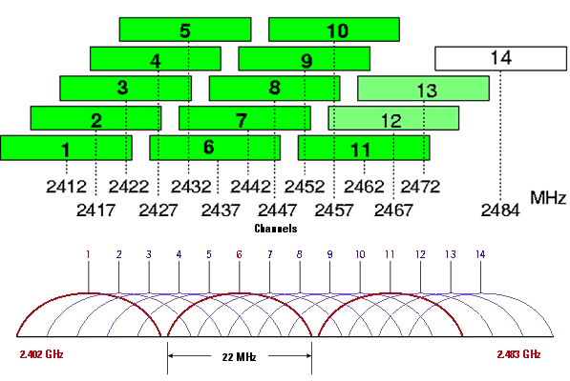
2.4 GHz Channels
Note that you can only have THREE non-overlapping channels
  Most commonly used channels are 1, 6 and 11

Slide 9
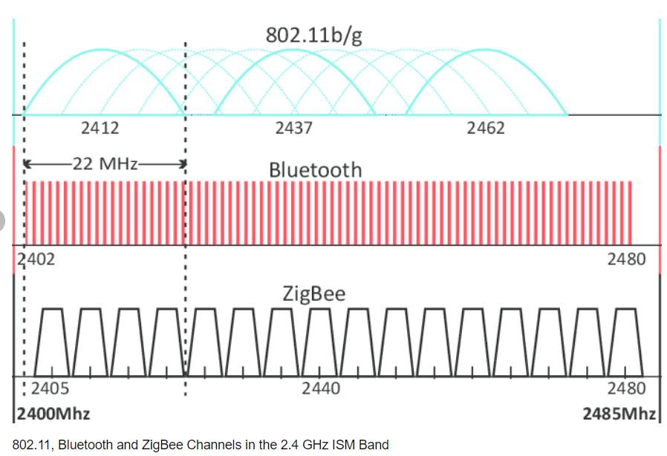
2.4 GHz is CROWDED
Wi-Fi channels
IoT (Internet of Things) devices
Bluetooth
  “Classic” (Seventy-nine 1 MHz channels)
  “BLE” Bluetooth Low Energy (Forty 2 MHz channels)
Microwave ovens ~2.5 GHz

Slide 10
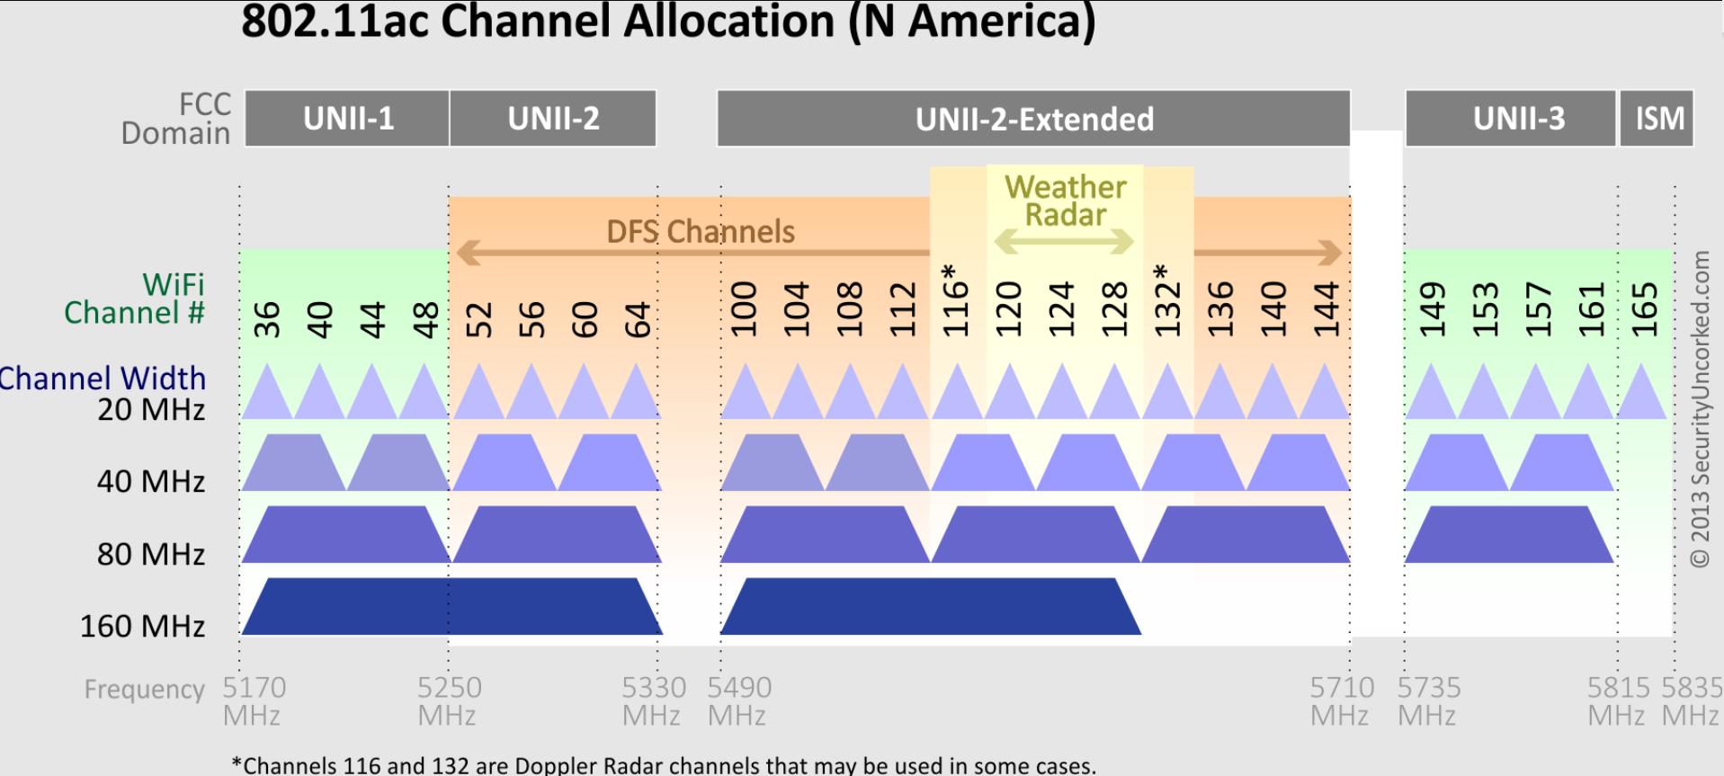
Current 5 GHz Channels

Slide 11
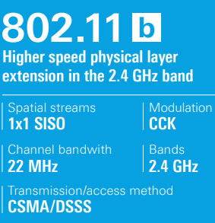
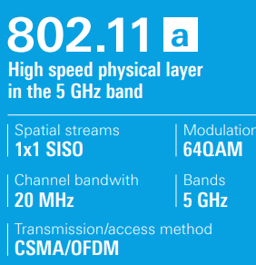
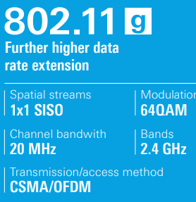
802.11b/a/b Definitions

Slide 12
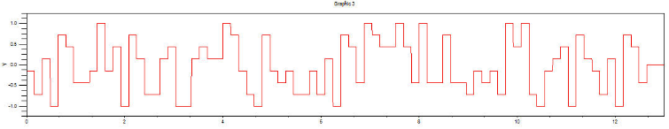
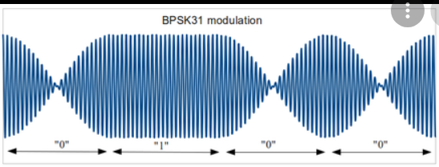
FT8 and PSK31 Modulation (as a comparison)
FT8 (8-GFSK, Eight-State Gaussian Frequency Shift Keying)
PSK31 (Phase-Shift Keying)

Slide 13
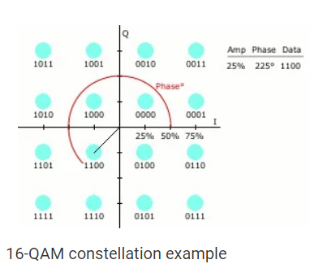
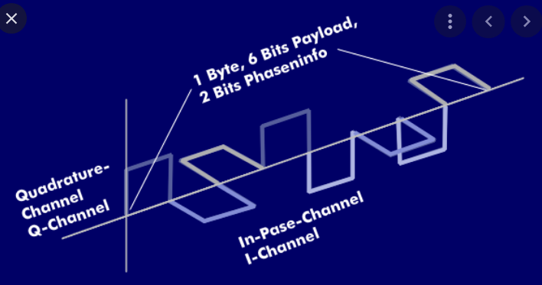
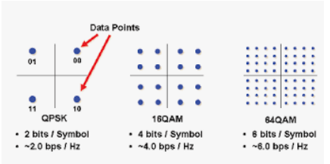
Earlier Wi-Fi Modulation Types (b/a/g/n)
CCK
4 – 64 QAM

Slide 14
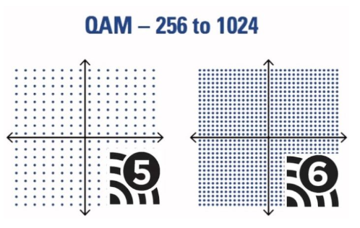
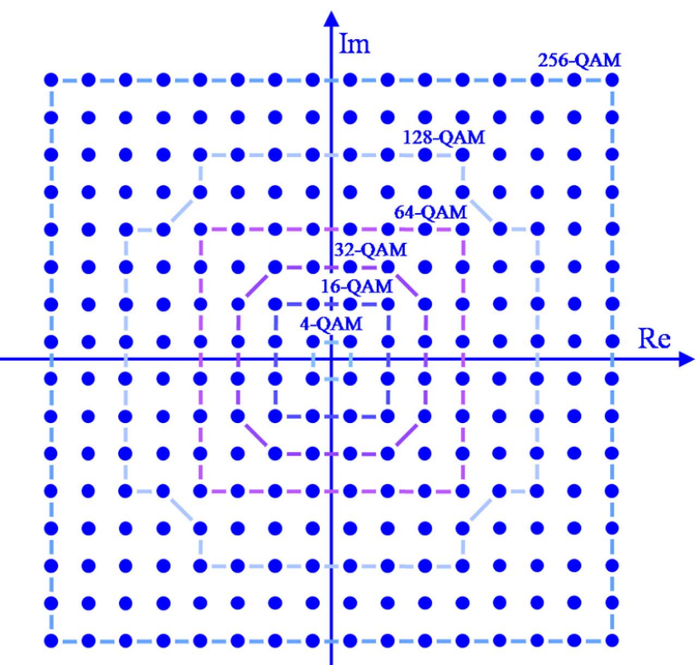
QAM Constellations
4 to 256 QAM

Slide 15
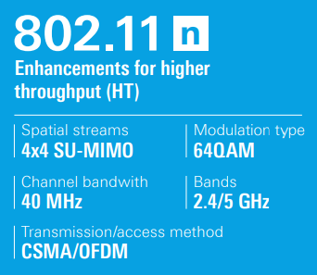
802.11n = Wi-Fi 4
Key Improvements
  Multiple special streams
  Wider bandwidth
    2.4 GHz – 40 MHz
    5 GHz – 40 MHz

Slide 16
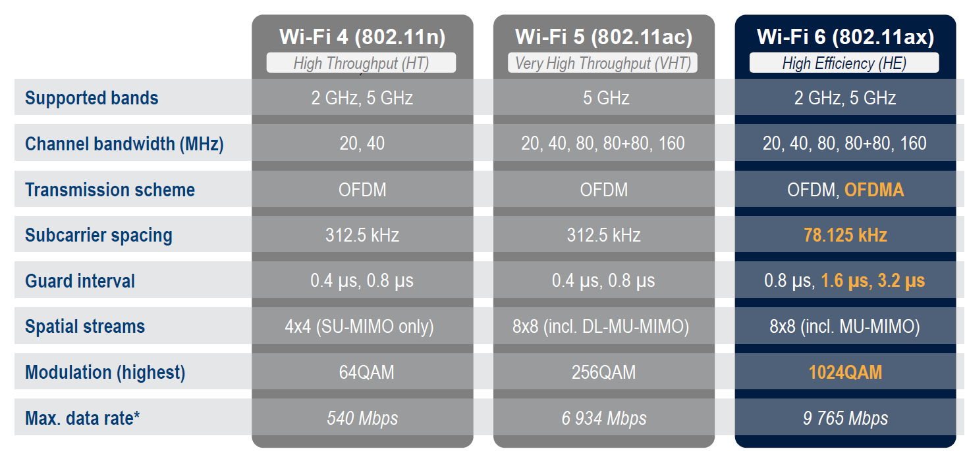
802.11n/ac/ax – Wi-Fi 4 to Wi-Fi 6
Improvements shown by arrows

Slide 17
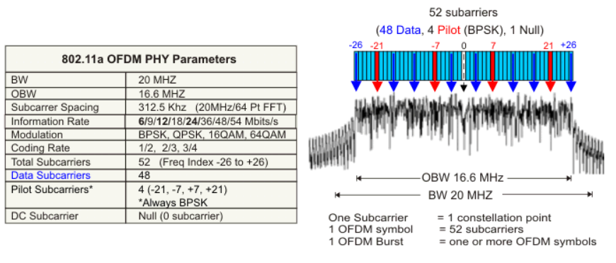
OFDM Modulation (a/g/n/ac – Wi-Fi 4/5)

Slide 18
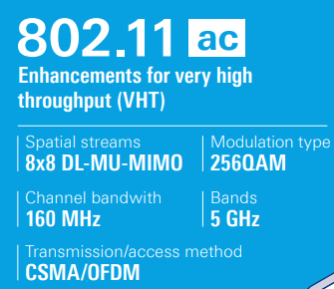
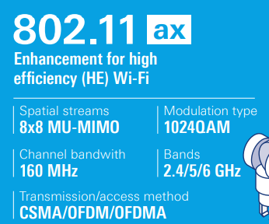
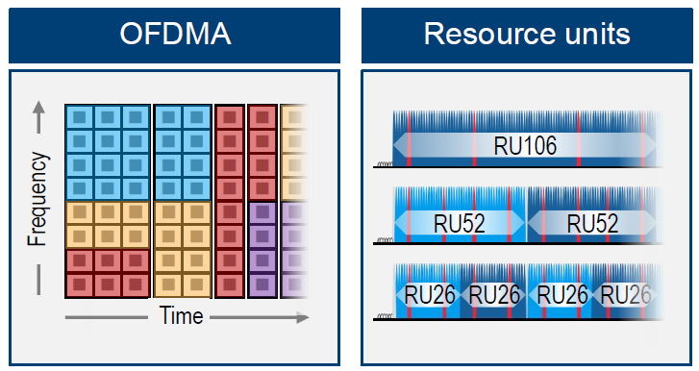
OFDMA Modulation (ax - Wi-Fi 6)
OFDMA uses QAM subcarriers
Can split up subcarriers in multiple sizes for “packing” more users
More Speed

Slide 19
MCS Tables
Lists the potential maximum data rate based on:
  Number of Spatial Streams
    Horizontal polarization
    Vertical polarization
    Orthogonal polarization
    Spatial diversity
      This is more pronounced as the wavelength gets shorter/frequency higher
  MCS Level
    This changes based on bit error rate
    Affected by distance from AP

Slide 20
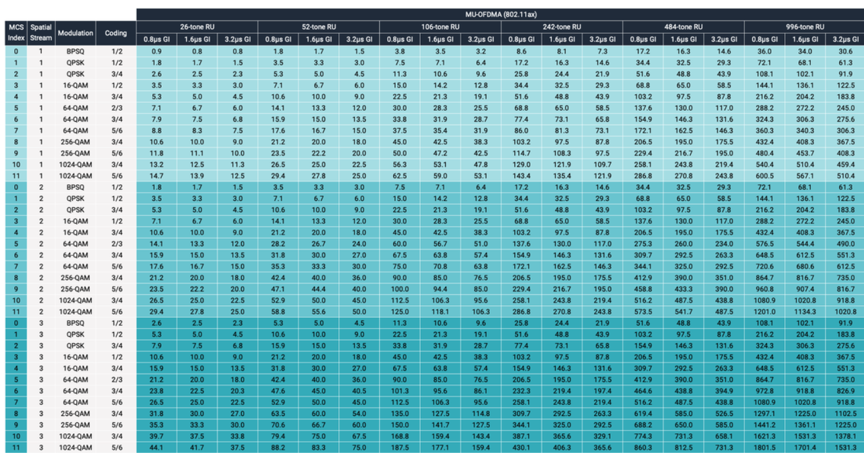
802.11ax MCS Table

Slide 21



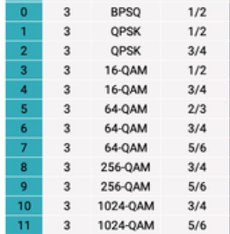
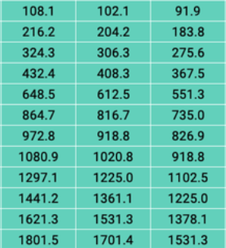
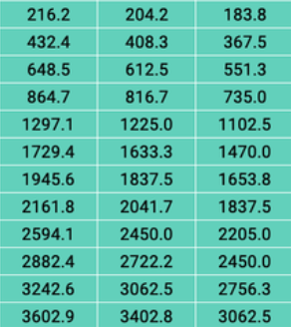
Zoomed MCS Table 11ax Three Streams
Mbps

Slide 22


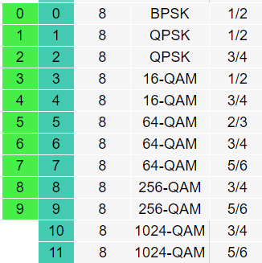
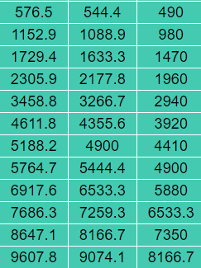
Zoomed MCS Table 11ax
Eight Streams/160 MHz Channel
Mbps

Slide 23
Propagation of 2.4/5/6 GHz
Just like on VHF and UHF, the lower the frequency, the better the range in free space
At microwave frequencies, building materials, water vapor and content, etc. all affect propagation to a larger effect especially as you go higher in frequency
Sources of RF noise at lower frequencies do not affect microwave frequencies to the same degree
  Lightning
  Harmonic content of appliances, lights, power supplies, etc.
Distance from the transceiver still applies

Slide 24
Power Tables 2.4 and 5 GHz
Wi-Fi devices are rated mostly in terms of “dBm”
2.4 GHz
  Max EIRP 36 dBm (4 watts)
    If the antenna gain is increased for more directional range, the transmitter power must be reduced accordingly
5 GHz
  Max EIRP 30 dBm (1 watt)
  U-NII sub-bands have lower power specifications and are based on a special formula.
Refer to these tables for more details: https://www.air802.com/fcc-rules-and-regulations.html

Slide 25
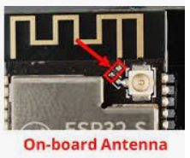
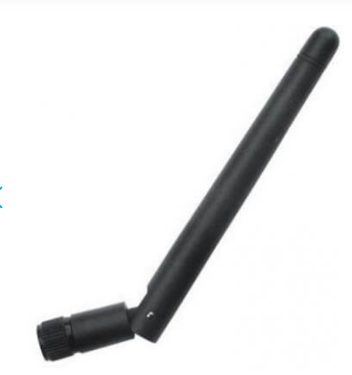
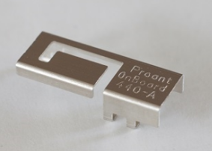
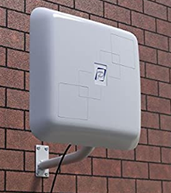
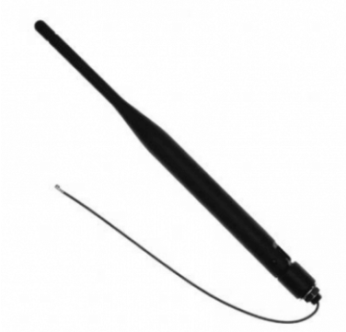
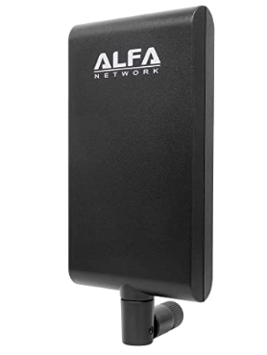
Antenna Types
On-board antennas with 0 dBi gain or less (for more of an omni pattern)
Quarter-wave monopole with a ground plane reference (0 to 2.19dBi gain)
Coaxial dipole (2.19 dBi)
Colinear (5 to 8 dBi)
Panel (10 - 20 dBi)
  Indoor
  Outdoor for Enterprise APs
Most products use designs that cannot be replaced by the end user

Slide 26
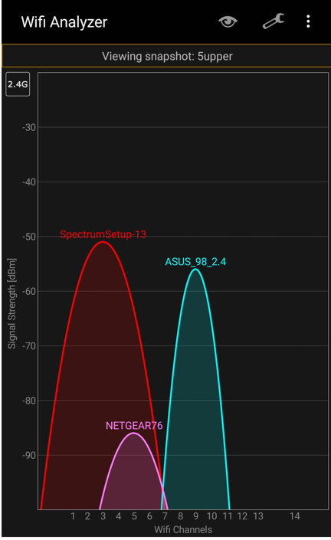
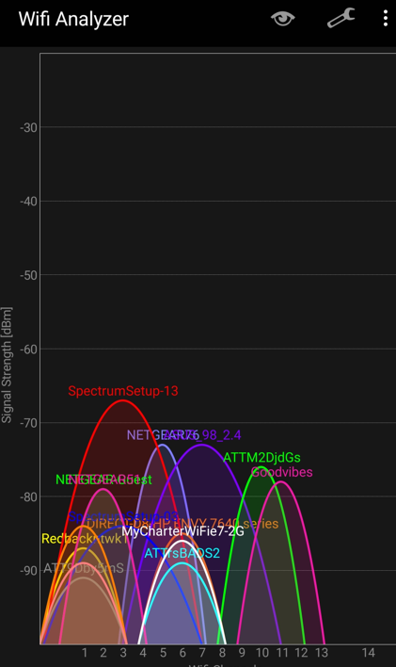
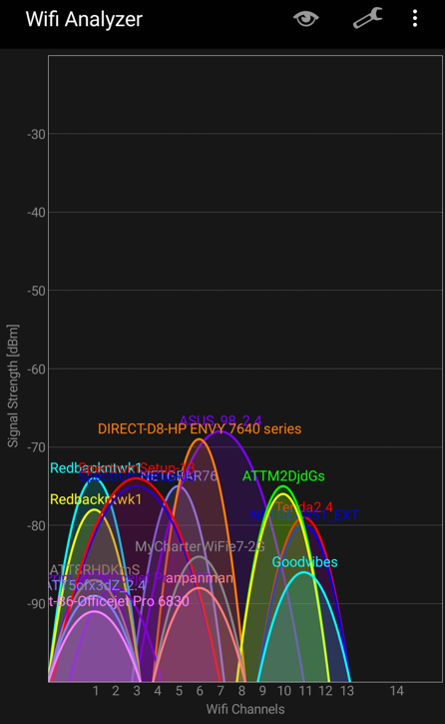
Cool Tools – Wi-Fi Analyzer App (Android)
2.4 GHz
Inside
Outside
Up the Street

Slide 27
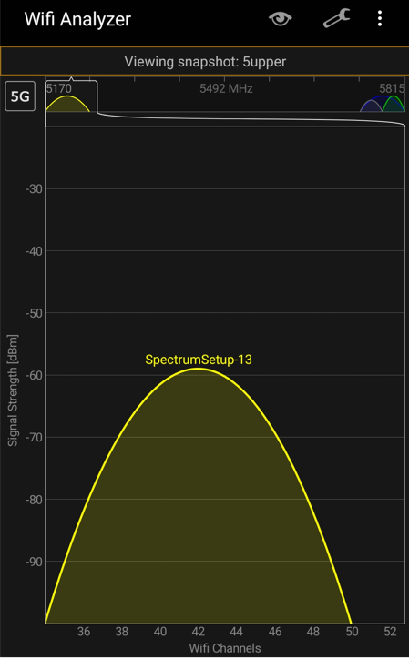
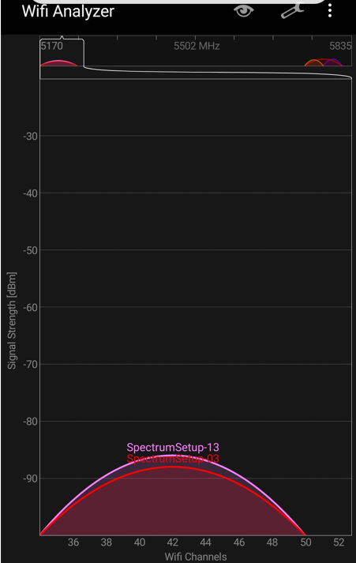
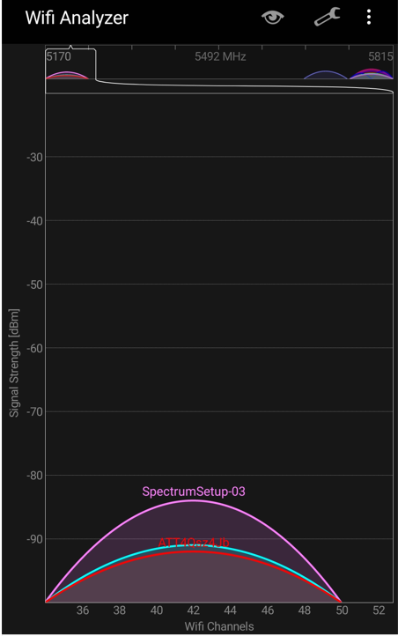
Cool Tools – Wi-Fi Analyzer App (Android)
5 GHz (lower band)
Inside
Outside
Up the Street

Slide 28
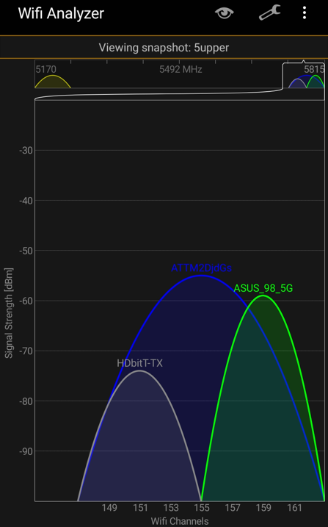
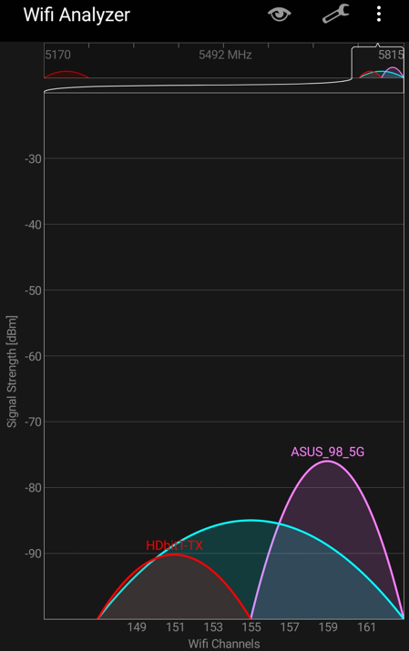
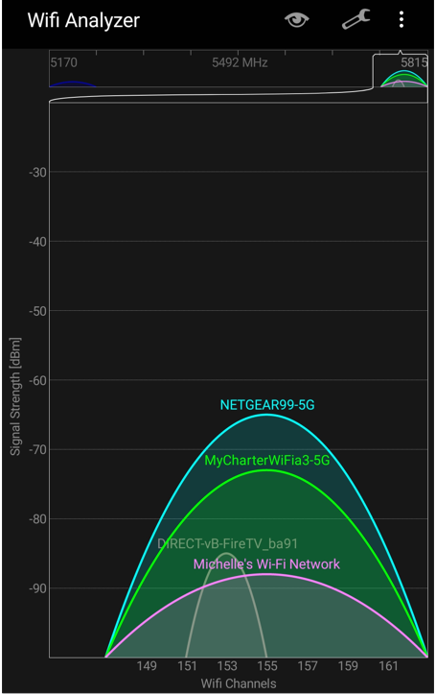
Cool Tools – Wi-Fi Analyzer App (Android)
5 GHz (upper band)
Inside
Outside
Up the Street

Slide 29
Mesh Networks and Wi-Fi Extenders
These are designed to solve one problem: bad signal strength
Mesh networks typically slow down your throughput speed as they “store and forward” data from one AP to the next
Some Wi-Fi Extenders can also slow down throughput by
  Use of 20 MHz channels vs 40/80 MHz
  Operate only on 2.4 GHz, a crowded band
  Operate as “half duplex” devices
For best throughput, use a Wi-Fi Extender that uses an un-used and dedicated 5 GHz channel to continuously stream DUPLEX data (such as a DFS channel in the U-NII2 band)
See this article for really good information on this topic: https://www.pcmag.com/how-to/wi-fi-range-extender-vs-mesh-network-whats-the-difference

Slide 30
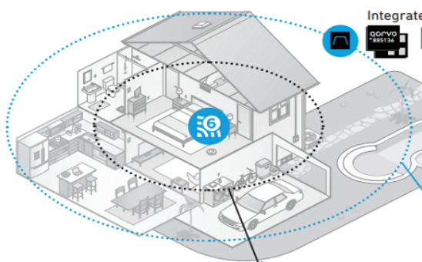
Optimizing Wi-Fi Throughput in your House
Place in a central location in your house
  Not a corner of your house
    Better to run a longer Ethernet cable to your router to get to a better location
  Avoid nearby metal objects
    Mirrors
    Steel wall studs
    Refrigerator, etc.
    Not behind your big screen TV
  Off of the floor
  Not in your attic
    The devices are typically rated for operation below 40 degree C. Extended exposure to the high heat in an attic will reduce the operation life of your Wi-Fi AP
For better coverage, use two AP’s connected via an Ethernet cable and programmed to non-interfering channels

Slide 31
What’s next?
Wi-Fi 6e
In the US, there will be nearly 1200 MHz of new spectrum
Canada & Mexico are following this same bandwidth plan
Includes SEVEN consecutive 160 MHz channels for high-speed capability. These are not overlapped channels

Slide 32
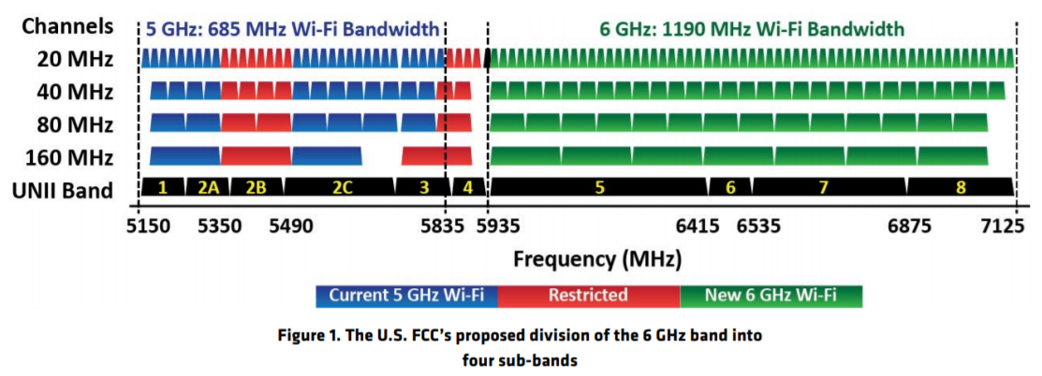
5 & 6 GHz Channels up to 7.125 GHz

Slide 33
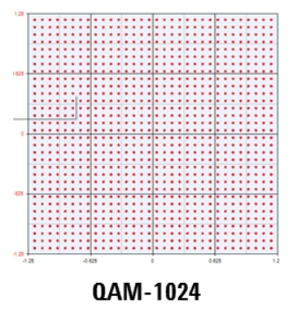
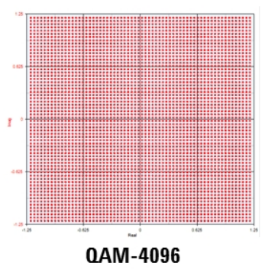
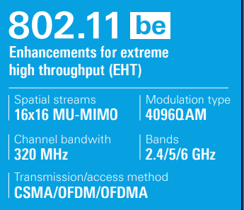
802.11be – Wi-Fi 7
320 MHz Channels
Faster Modulation 4096 QAM
  Compare constellations as shown

Slide 34
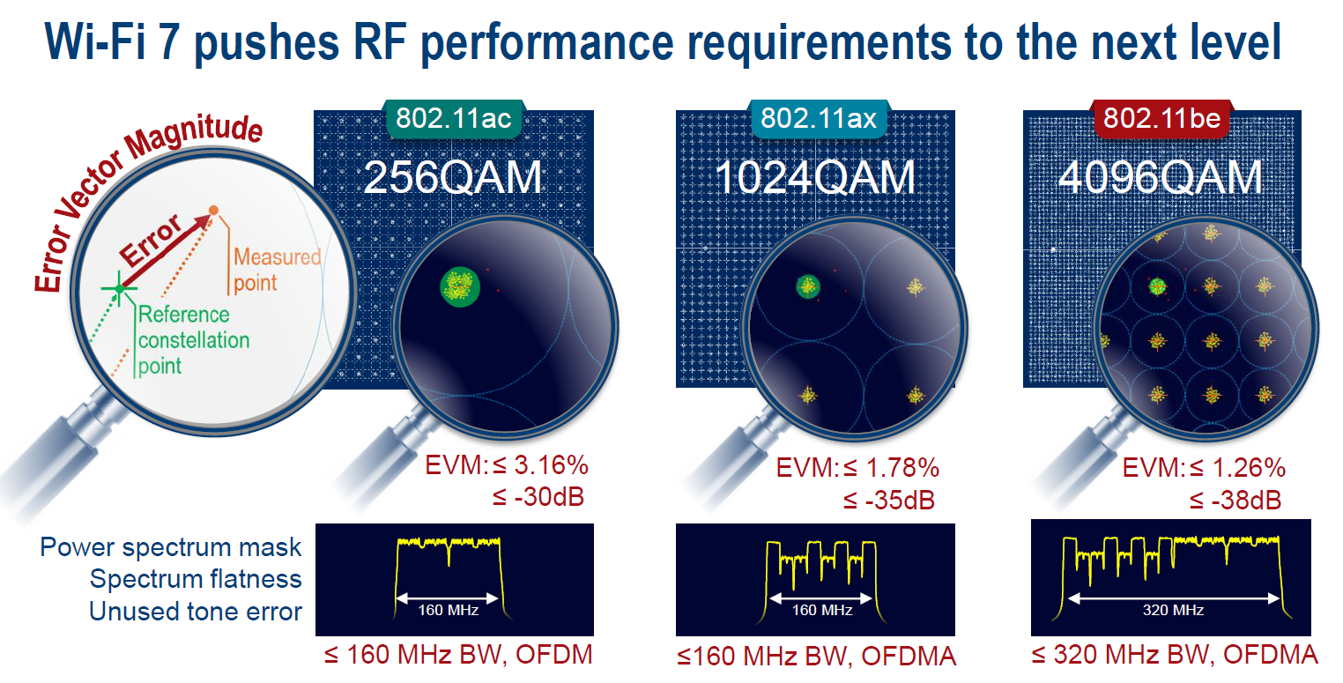

Slide 35

320 MHz Channels

Slide 36


Slide 37

6 GHz Power Tables
For Outdoor AP’s must use frequency coordination called AFC
Other AP types use PSD (Power Spectral Density) formulas to determine EIRP power limits

Slide 38
References
MCS Table (HT/VHT/HE) - Google Drive
U.S. Frequency Allocation Chart (doc.gov)
© Rohde & Schwarz; The history and future of Wi-Fi (rohde-schwarz.com)
https://www.skyworksinc.com/-/media/SkyWorks/Documents/Articles/Next-Generation-WiFi.pdf
https://www.extremetech.com/computing/184685-what-is-802-11ax-wifi-and-do-you-really-need-a-10gbps-connection-to-your-laptop
https://jeremyclark.ca/wp/telecom/wsjt-x-ft8-modulator-scicos-simulation/
https://rfmw.em.keysight.com/wireless/helpfiles/89600b/webhelp/subsystems/wlan-ofdm/content/ofdm_80211-overview.htm
http://www.3kgroup.ee/en/mis-tahendab-wifi6-pikk-sumbol-ja-1024-qam/
mcs-table-complete-v2_orig-1024x672.png (1024×672) (semfionetworks.com)
https://www.argenox.com/library/bluetooth-classic/introduction-to-bluetooth-classic/
https://microchipdeveloper.com/wireless:ble-link-layer-channels
https://www.lairdconnect.com/rf-antennas/wifi-antennas/rubber-duckdipole-antennas/24-55-ghz-dipole-rf-antennas
https://www.air802.com/fcc-rules-and-regulations.html

