Slide 1
Ridgid Pro Organizer toolbox & Cart transformation to vhf/uhf Radio go-box Set

Slide 2
Design objectives
Implement an amateur radio go-box suitable for the following use cases:
Portable deployment
Self-contained system
Manageable weight and mobility
Rapidly deployable with minimum setup time
Emergency power solution safe for indoor use
Digital operations (e.g., Winlink messaging and D-Star)
Home radio shack
Rapid transition from portable use to base station use

Slide 3
Basic Design questions
Case choice
Rack system (e.g., 4U rack travel case)
Pelican case solution
Other case types (e.g., RIDGID)
Integrated and/or external power supply?
Space / weight / ease-of-use
Battery or power supply unit
Closed or open case operation?
Thermal considerations
Moisture considerations

Slide 4
RIDGID Tool Boxes
Heavy-duty construction
Stackable, lockable system
Moisture / dust resistant
Relative cost lower compared with other options (e.g., Pelican)

Slide 5
N7GRB Go-BOX Basic features
RIDGID Pro Organizer case & Tool Cart
Provides dust and moisture protection during transit to/from deployment site
ICOM ID-5100 Transceiver
Dual band VHF / UHF with D-Star Digital voice/data
External connections for power, antenna and microphone
Console with power meter, car style 12v DC receptacle and USB charge ports
20 amp continuous/ 23 amp surge 13.8v DC power supply
Storage area
Signalink, A/B switch, ICOM control head and associated cables

Slide 6
Component wiring plan
Simple DPDT ON-OFF-ON switch selects power source
Rocker switches control power to accessories
Easy access fuse protection on DC circuits
Standard Anderson Power Pole connection (Powerwerx port) to external DC power source (battery box)

Slide 7
Power Distribution Control
Power mgmt console
Car style 12v DC receptacle
USB charge ports
Fuse access
Power monitoring
Led rocker switches
Don’t Look Under the Hood
Automotive style crimp connections
WAGO Lever Nuts
WAGO Lever Nuts
5 Conductor Compact Connectors
Up to 12 AWG
20A 600V UL rating (IEC/EN 32A/450V)

Slide 8
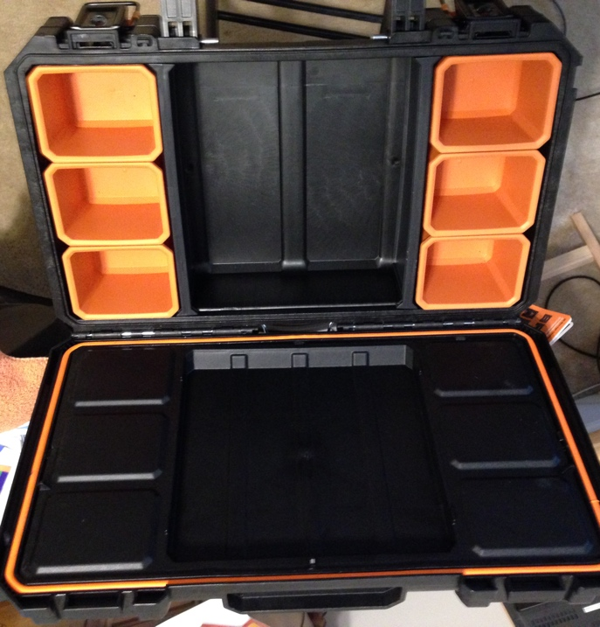
Some AssEMbly Required …
RIDGID Pro Organizer
Inside lid, parts buckets and dividers removable
Parts and more parts … never enough

Slide 9
Foundation
Wood base board
Firm attachment of PSU and radio to base board
Base board attached to case bottom

Slide 10
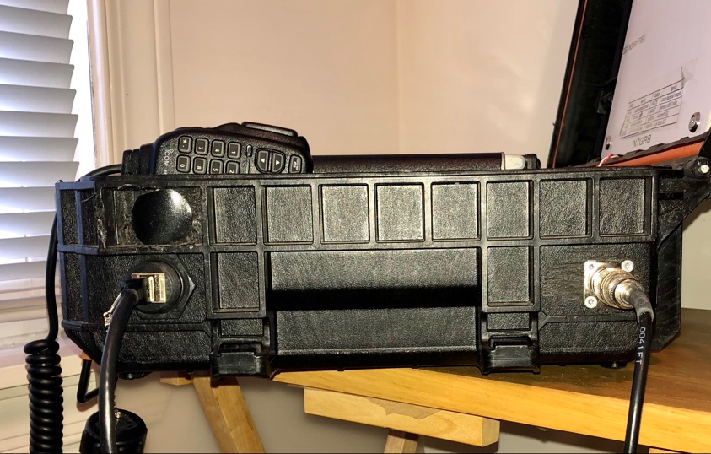
External Connections
A/C and DC Input
(left rear corner)
Mic and Antenna
(right side)

Slide 11
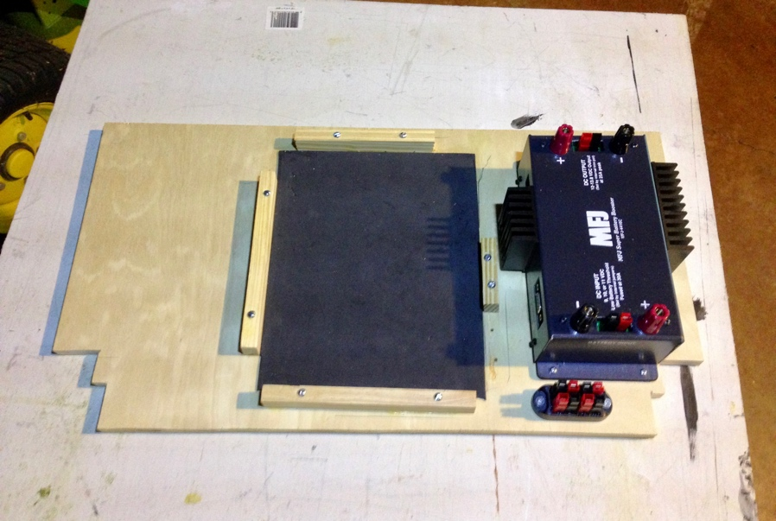
Battery & Storage Box
Bioenno 30 AH battery
Integrated over current / low voltage protection
Shock pad under battery
MFJ-4416C Battery Booster
25 Amps ICAS 30A peak
13.8 Volts at 9-13.8 volts input

Slide 12
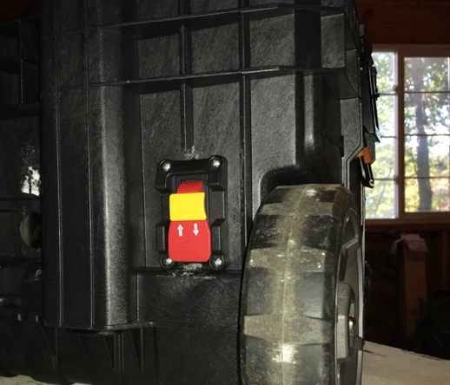
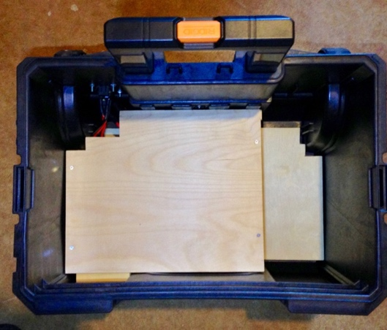
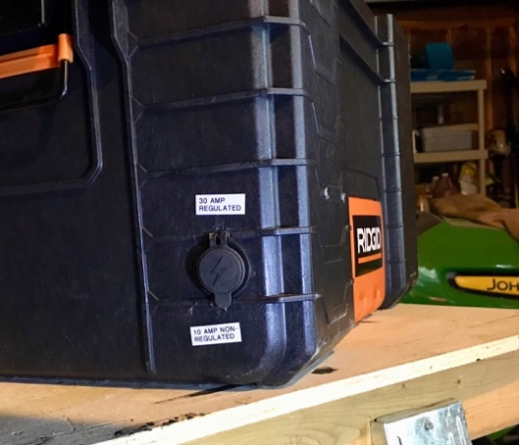
Battery & Storage Box
Master power switch
Lock-out protection feature
Powerwerx Power Pole ports
Charge port
Power port

Slide 13
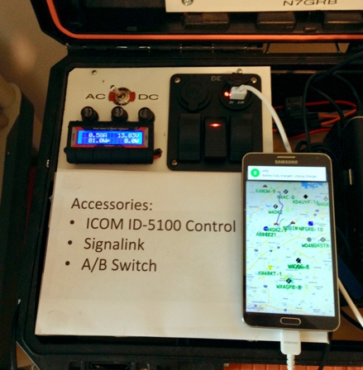
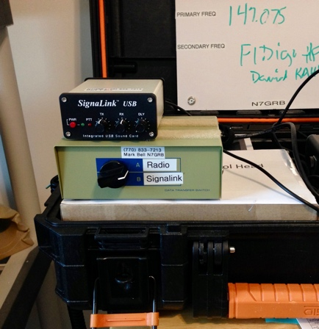
Deployed
Normal operation with lid open for natural air ventilation
Lid has:
Whiteboard for notation of situation info
LED lighting
Large digital clock
ICOM ID-5100 control head mounted on articulating stand
Removable storage box holds Signalink, A/B switch and associated cables

Slide 14
Deployed
Gwinnett Sheriff Jail Break Run
American Red Cross Communications Exercise

Slide 15
Antenna
Slim Jim dual-band VHF / UHF antenna
Slim Jim suspended between PVC pipe arms attached to lightweight collapsible mast
Mast also supports HF Alpha Antenna

Slide 16
N7GRB IC-7100 GO-Box Prototype
RIDGID Tool Box and a Little PVC

Slide 17
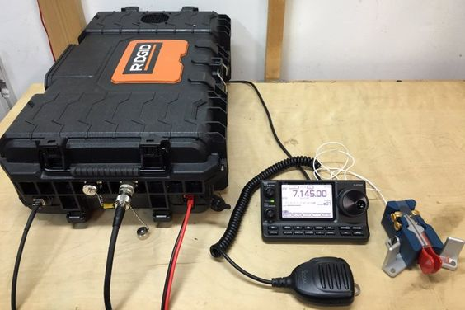
George Zafiropoulos KJ6VU IC-7100 RIDGID Go-Box
Design approach
External power source
Closed case with powered ventilation

Slide 18
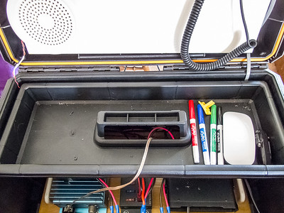
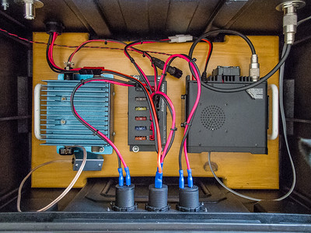
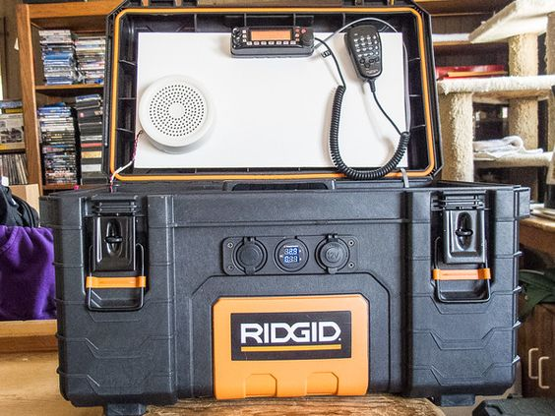
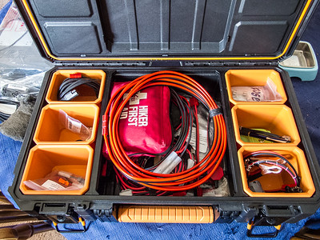
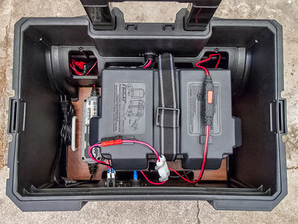
K6CPO RIDGID Based Go-Box Set johnwright.smugmug.com

Slide 19
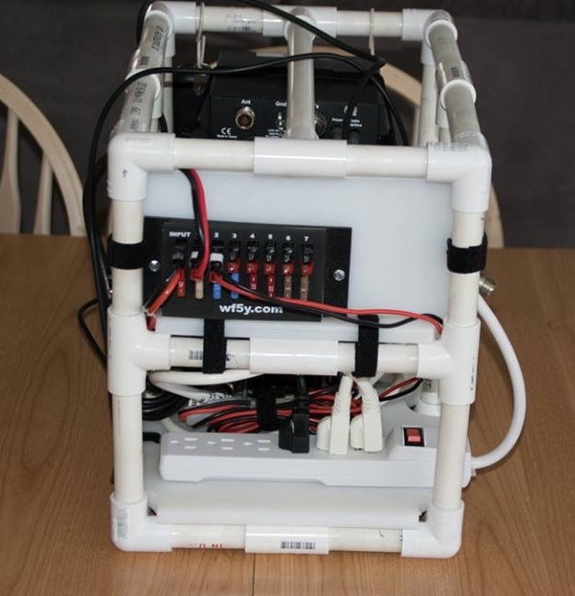
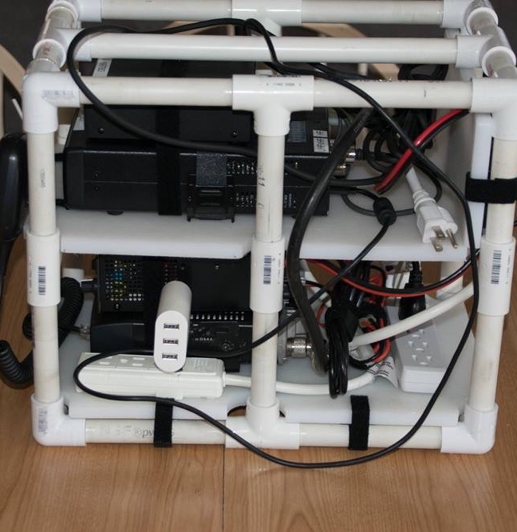
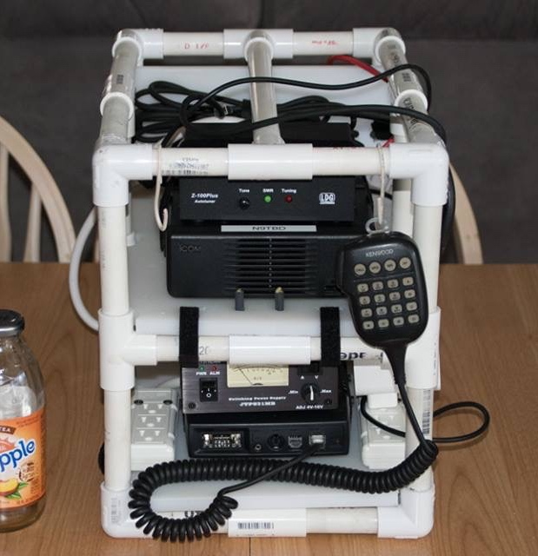
Ridgid Tool Cart – Pvc go-box
Fits in RIDGID Tool Cart
Dual radios VHF/UHF and HF with power supply

Slide 20
Thank You!

