Slide 1

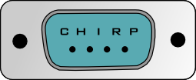
GARS Workshop - May 2020
Dallas KD4HNX
CHIRP Software

Slide 2
The focus of this presentation is for:
New Hams
Elmers
ARES members with a Go Kit
Anybody that goes on vacation or a roadtrip with a radio
Anybody looking to buy a new VHF/UHF radio

Slide 3
What is CHIRP?
Straight from the CHIRP website: https://chirp.danplanet.com/projects/chirp/wiki/Home
CHIRP is a free, open-source tool for programming your amateur radio. It supports a large number of manufacturers and models, as well as provides a way to interface with multiple data sources and formats.

Slide 4
CHIRP is the brainchild of Dan Smith, KK7DS
There are 30+ Developers and 25+ Website/Wiki editors
Manager: Dan Smith
Developer: Aaron P, Alexey K, Angus Ainslie, Ben Weiss, Bernhard Hailer, Bill Crossley, Brian Dickman, Daniel Clemmensen, Derek Chauran, Filippi Marco, Jens Jensen, Jim Unroe, Joseph Scanlan, K. Arvanitis, Keith Williamson, Klaus Ruebsam, Mark Adams, Mathias Weyland, Nathan Crapo, Nicholas Vahalik, Nicolas Pike, Patrick Lang, Pavel Milanes, Rhett Robinson, Richard Cochran, Rick DeWitt, Ron Wellsted, Tim Smith, Tom Hayward, Tony F, Tyler Tidman, Wade Simmons, Windsor Schmidt, Zach Welch
Wiki Editor: Aaron P, Adam Coddington, Brian Dickman, Christof Harper, Daniel Clemmensen, Dave Nathanson, Derek Chauran, Hew Lines, Jason Willebeek-LeMair, Jeff Otterson, John LaMartina, Keith Williamson, Klaus Ruebsam, Mark Dunkle, Mathias Weyland, Neil Katin, Nicholas Vahalik, Nicolas Pike, Pavel Milanes, Predrag Supurovic, Rick DeWitt, Robert Terzi, Ron Wellsted, Thomas Garvey, Tim Smith, Tyler Tidman
Spam Cleaner: Bernhard Hailer

Slide 5
In the past...
I’ve used CHIRP to program those cheap/inexpensive Chinese radios that have attracted so many new hams to the air waves.
AnyTone
Baofeng
Pofung
TYT
Wouxun
Any many more...

Slide 6



Plus CHIRP works with brands we know and love:
Alinco
Icom
Kenwood
Yaesu

Slide 7
CHIRP supports to many radios to list here...
The list of radios CHIRP supports is always changing to see a list follow this link:
https://chirp.danplanet.com/projects/chirp/wiki/Home

Slide 8
The problems CHIRP helps to overcome: #1
The Chinese radios and their many variants MAY come with their own programming software that is very hard to use.
Many of the USB programming cables don’t work because of pirated USB chips.
To program the radios by hand is very complex:
Small buttons
To many menus
To many steps
Nearly impossible to edit a memory channel

Slide 9
The problems CHIRP helps to overcome: #2
It seems that every batch of the inexpensive radios has a new variation that affects how they are programmed.
Software and or cables that worked with one make/model may not work with others of the same make/model which is very frustrating to the new ham and the Elmer trying to help them.
CHIRP gives the Elmer a common interface to program the radios.
Only one software package to learn/master.

Slide 10
The problems CHIRP helps to overcome: #3
The new ham is overwhelmed with stuff like:
Input frequency
Output frequency
Offset (positive or negative)
Tone, PL Tone, CTCSS, Digital Tone, etc…
With a CHIRP file they can SEE a listing of local repeaters and what makes them work.

Slide 11



The problems CHIRP helps to overcome: #4
The CHIRP file can be shared via email, websites, email groups, floppy disk and USB sticks.
They can be discussed over the phone or radio with the new ham sitting at their PC and their Elmer in their ear. It puts them in the driver's seat.
The CHIRP software is FREE so no issues with pirated software.
CHIRP works on Windows 2000 and newer, Linux, and Mac OS.

Slide 12
The problems CHIRP helps to overcome: #5
Even if you have programming software for a radio(s) CHIRP has value because you can see/share what is needed.
Frequency
Callsign
Tone, DTCS, etc
Offset (+/-)
Shift (which is different for each band)
Mode FM, DV, P25
City/Landmark (Stone Mountain, Bank, Hospital, Broadcast Tower)

Slide 13
One of the biggest hurdles of CHIRP
Getting a USB cable for the radio(s) you want to program
Buy from a reputable dealer
I use RT Systems cables

Slide 14
What I learned about CHIRP recently: #1
I’ve heard rumors of those that have bricked* their radio by using CHIRP
Bricked meaning the software has corrupted the radio’s programming so bad it doesn’t work anymore and even doing a reset to factory settings fails.
Almost all radio programming software, including CHIRP stressed READ before WRITING. Read what’s in memory and save that file. What that did was prove that the software could communicate to the radio. If what you read looks like garbage don’t write to the radio
My new install of CHIRP forces me to read before I can write to my radio.

Slide 15
What I learned about CHIRP recently: #2
CHIRP works with RepeaterBook which is a database of repeaters
With a few mouse clicks I was able to download a FREE listing of 563 Amateur repeaters into CHIRP for the entire state of Georgia.
Frequency
Callsign
Tone, DTCS, etc
Offset (+/-)
Shift (which is different for each band)
Mode FM, DV, P25
City

Slide 16
What I learned about CHIRP recently: #3
This means I can plan my road trip/vacation and download a list of repeaters for every state I drive through.
Every ARES member should have a copy in their Go Kit
The entire 563 repeater list is only 46KB
10m
6m
2m
1.25m
70cm
33cm
23cm

Slide 17
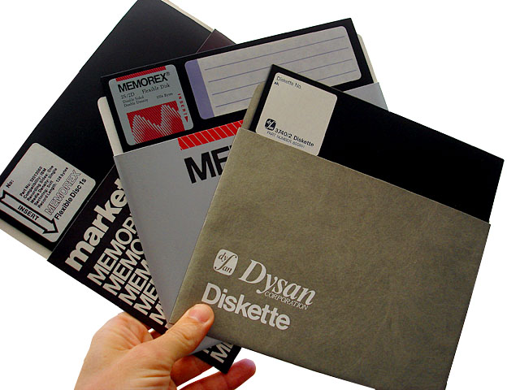
What I learned about CHIRP recently: #4
That old, tattered, ARRL Repeater Directory you have in your glovebox just might be a thing of the past
AL 400+ 35KB
GA 560+ 46KB
FL 800+ 71KB
SC 280+ 25KB
TN 370+ 32KB
All fits on a Single Sided Single Density 5” floppy with 150KB to spare
Imagine what you could store on a thumb drive

Slide 18
Where do I get CHIRP
From the CHIRP website of course
https://chirp.danplanet.com/projects/chirp/wiki/Home

Slide 19
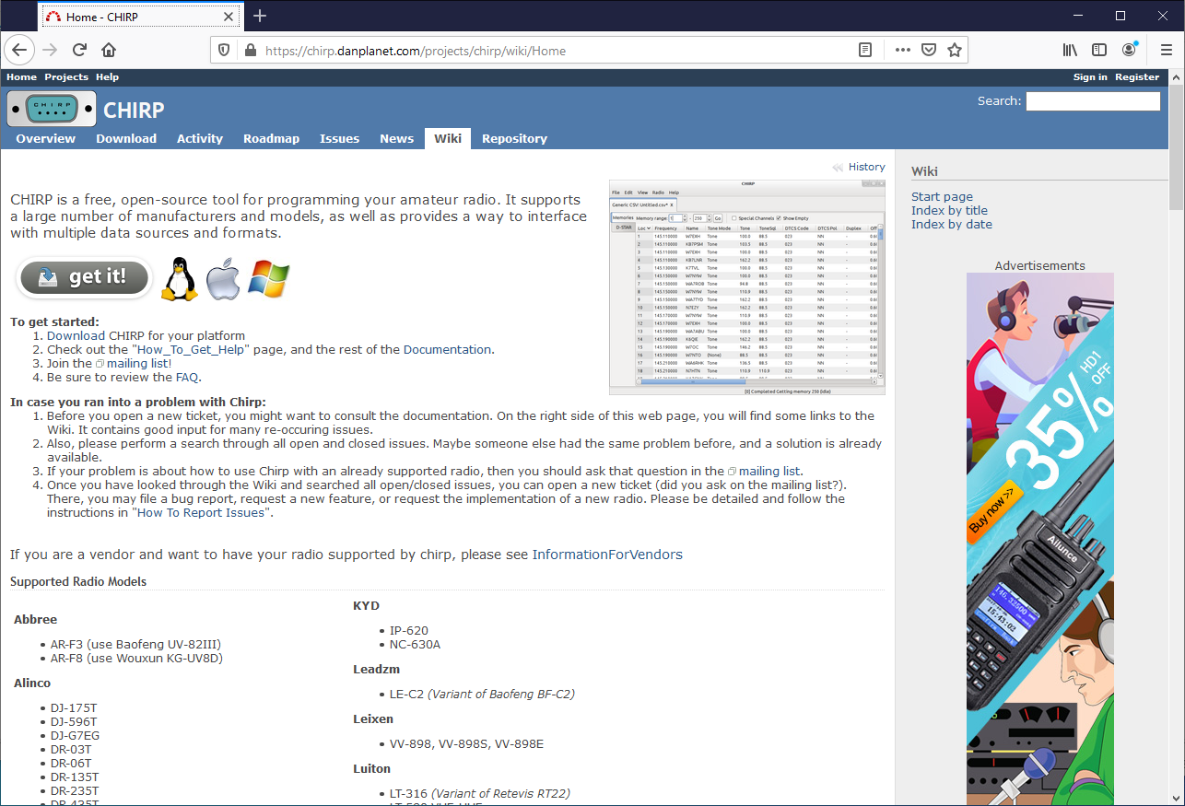
Get ready for a few screenshots
From the CHIRP homepage click on the get it button

Slide 20
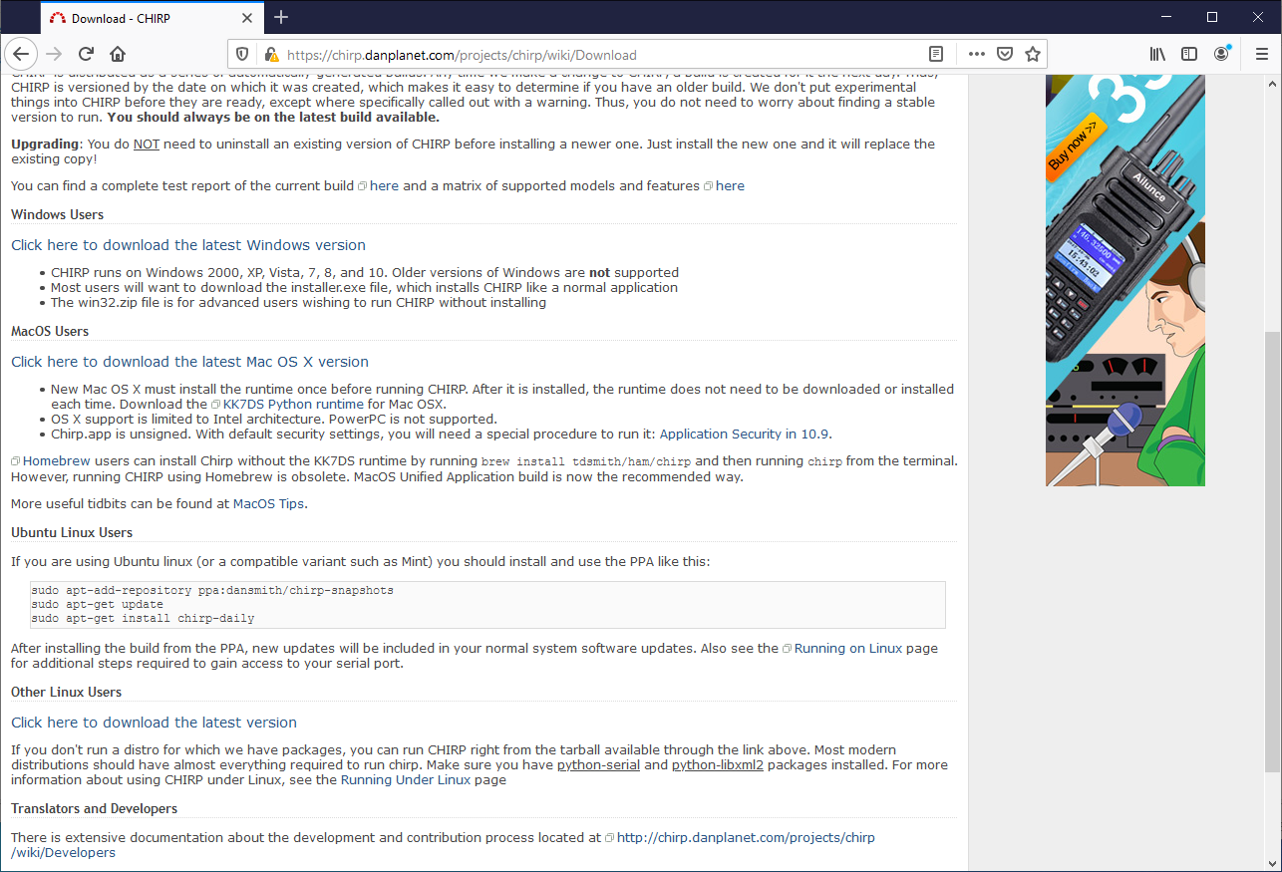
Window 2000 to 10, MacOS, Ubuntu, other Linux
Scroll down to find the version you want:
Windows 2000 to 10
Mac
Ubuntu
Other Linux

Slide 21
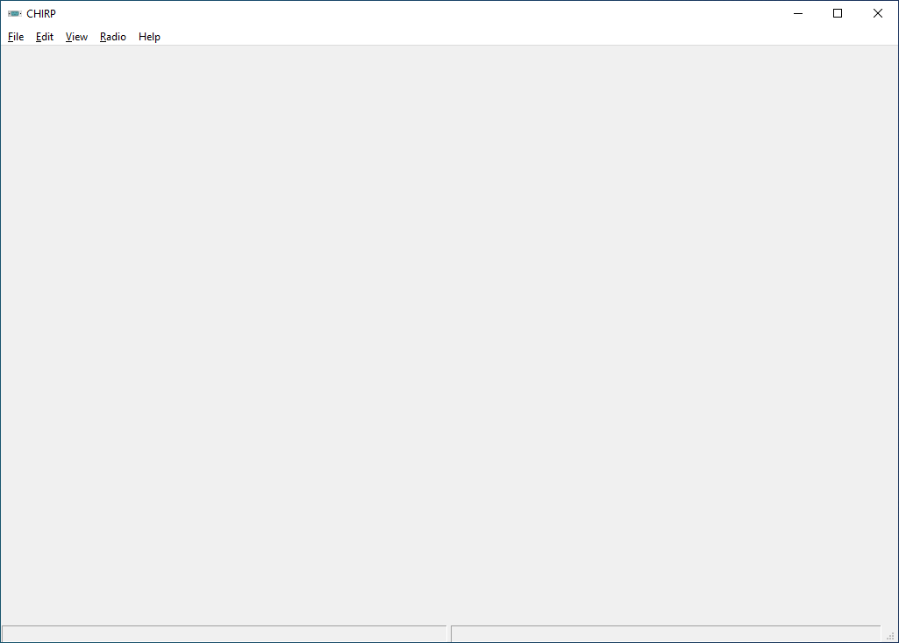
CHIRP doesn’t look like much when started
Just a blank page

Slide 22
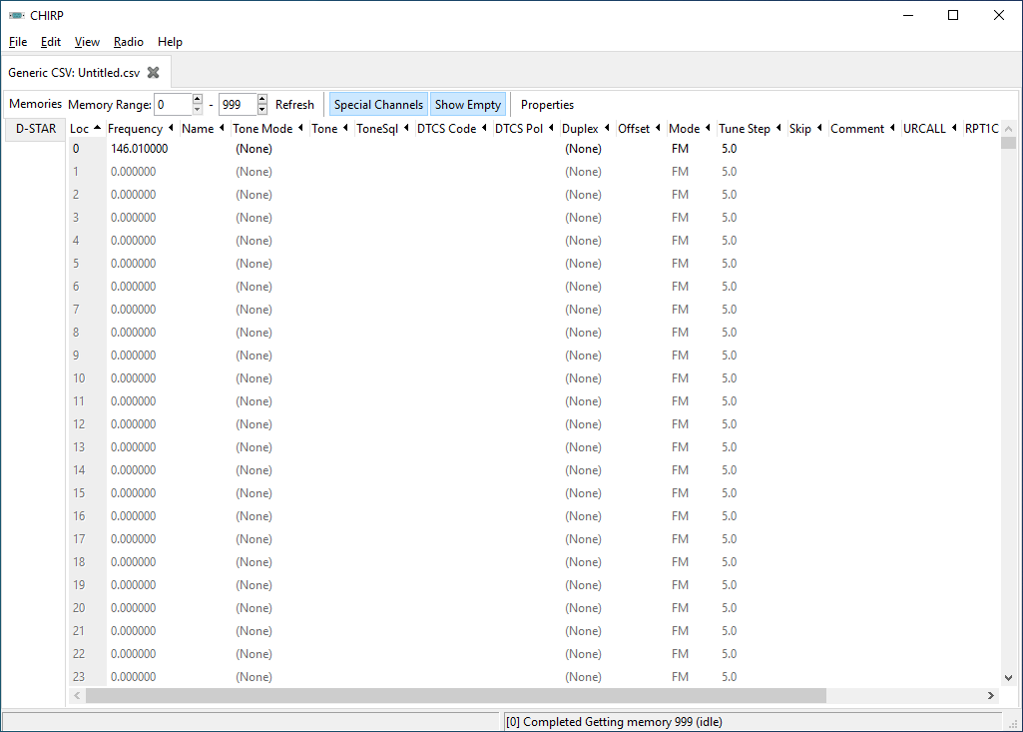
File - New
Not much better but now you can see fields where you can add things.

Slide 23
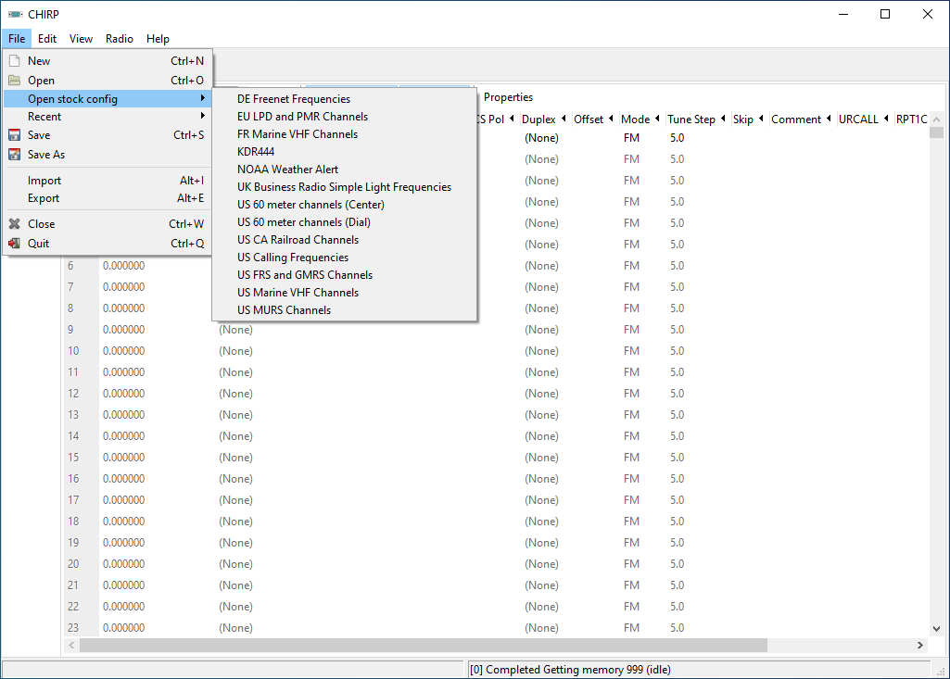
File - Open stock config
Cool stuff to listen to:
NOAA Weather
Railroad Channels
Marine Radio
FRS
GMRS
MURS

Slide 24
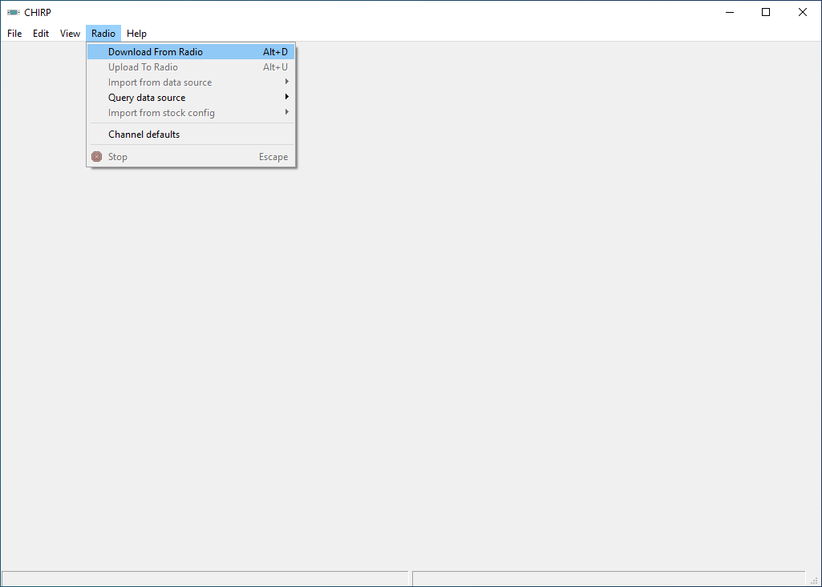
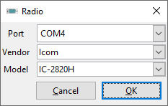

Radio - Download from Radio
Set COMM Port
Set Vendor
Set Model
Press OK
(Note 3 screen shots)

Slide 25
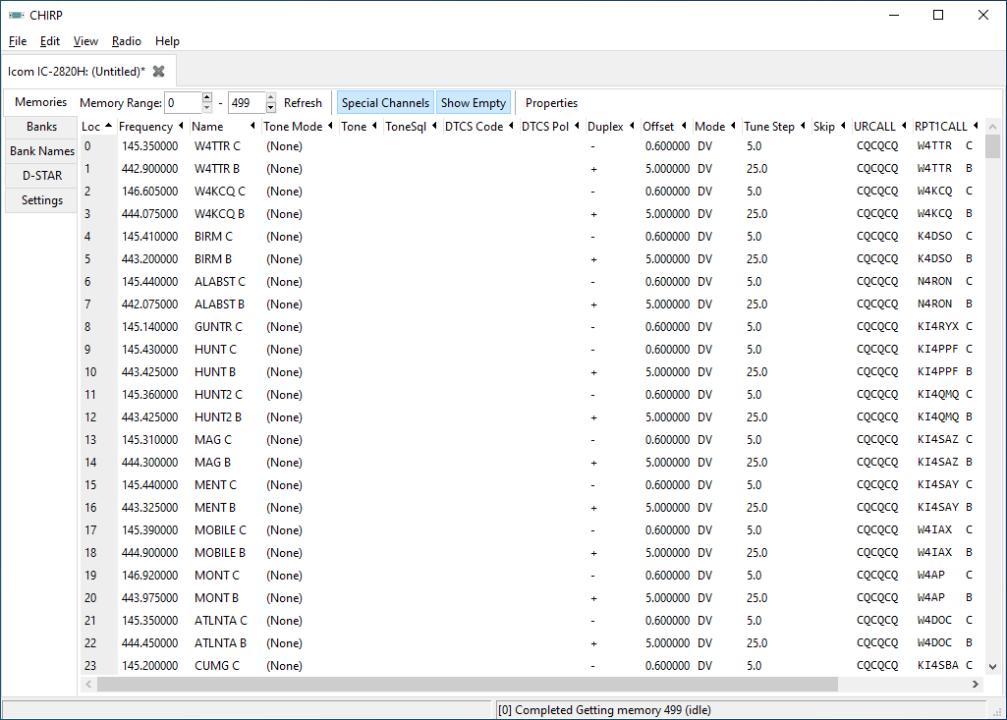
My IC-2820
53 D-Star memories from a road trip I took from TX to SC
8 Central TX repeaters
12 Local 2m and 70cm repeaters
I’ve proven I can READ from my radio

Slide 26
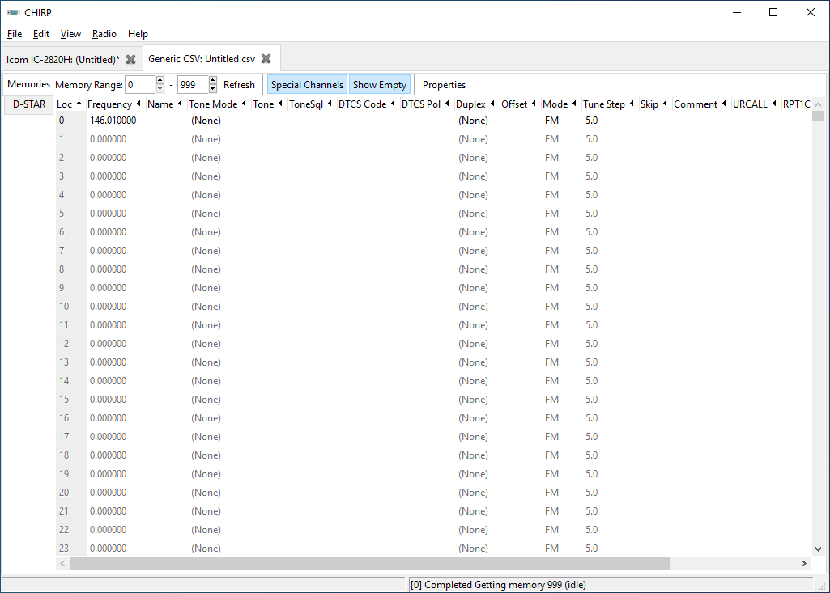
File - New

Slide 27
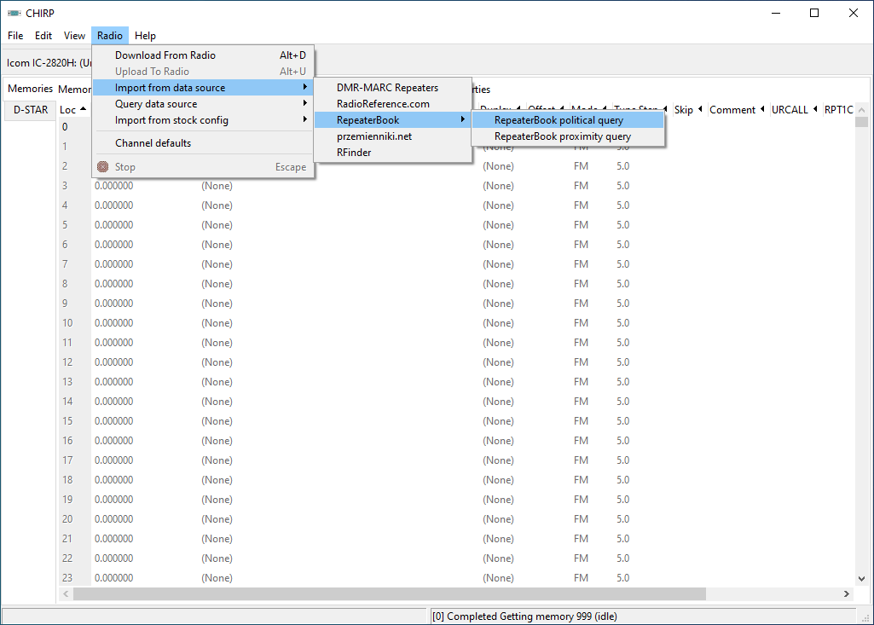
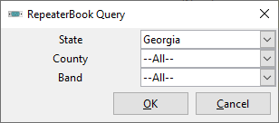
Radio - Import from data source - RepeaterBook
Make sure to select
RepeaterBook political query
Then in the popup fill in the State (Georgia)
Then press OK

Slide 28
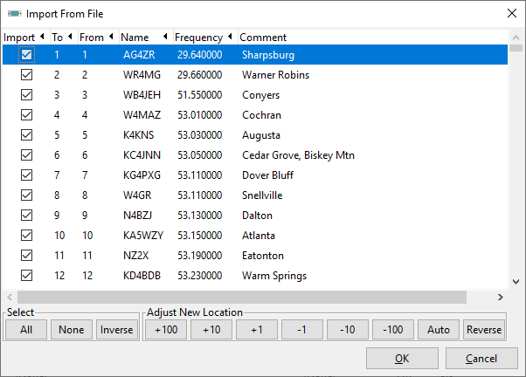
Things to watch for
If you started from a new file pressing OK works fine…
IF you are on an active spreadsheet you need to Adjust where to dump these as it wipes out your previous settings.
OUCH!

Slide 29
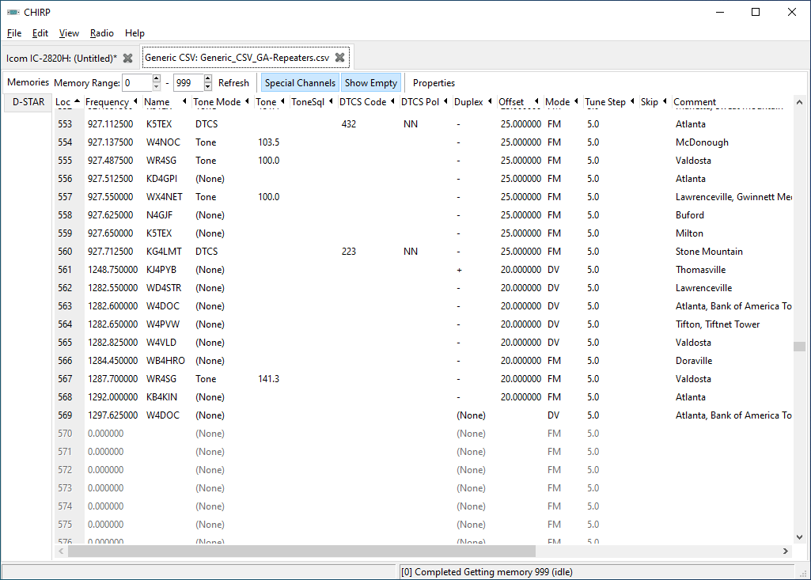
Save often with meaningful names
This eye-chart shows 569 memories
Some memory channels are skipped

Slide 30
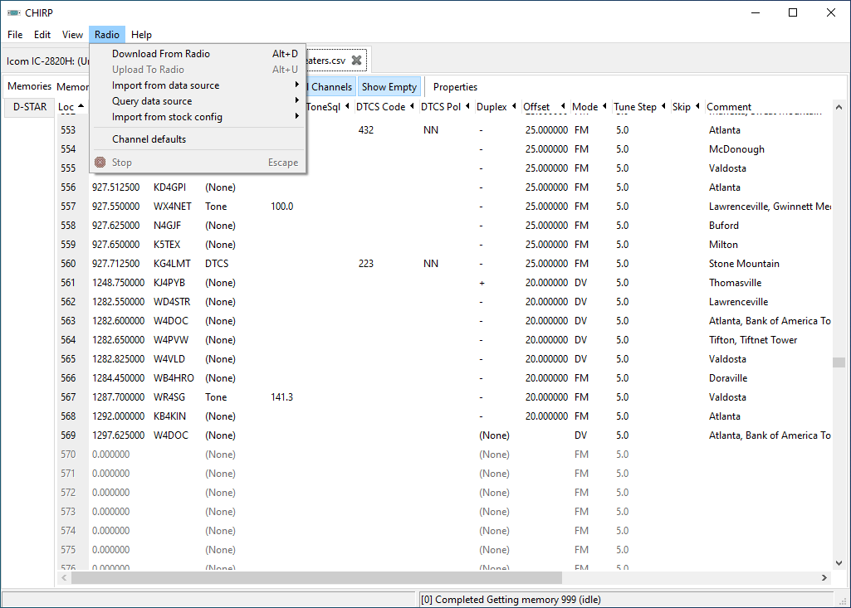
Let’s try to WRITE this list to my IC-2820
Note that Upload to Radio is grayed out
You have to READ before you can WRITE
So I’ll RE-READ from my radio or select a file I read from my radio

Slide 31
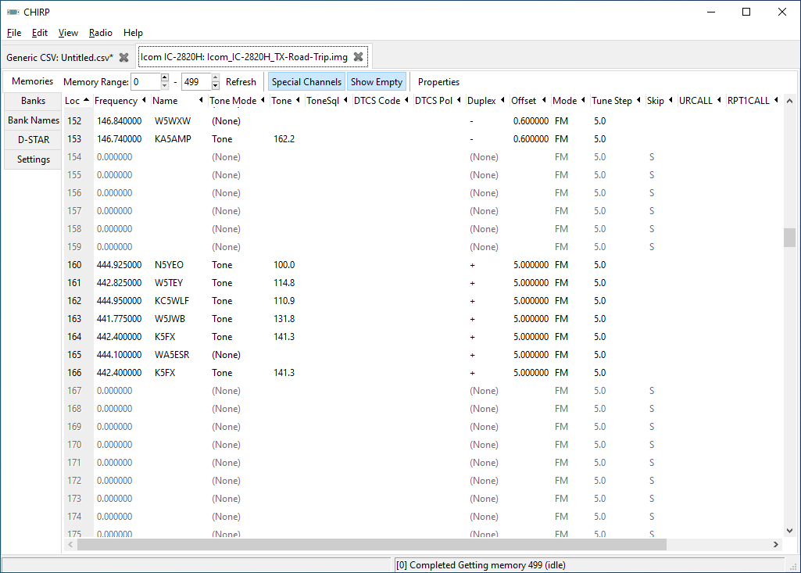
But what if I added the GA repeaters to my TX file
I have 166 memories used

Slide 32
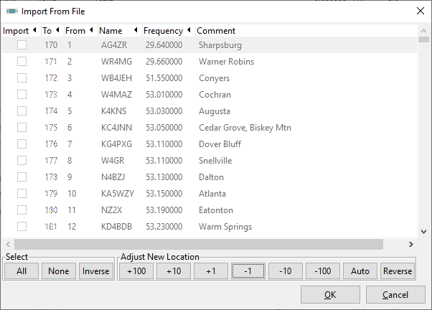
Here is the Import From File screen shot
Using the Adjust New Location buttons I set the import to 170
Use the +100 +10 +1
-1 -10 -100 to set the From start point
Looks good
See what happen

Slide 33
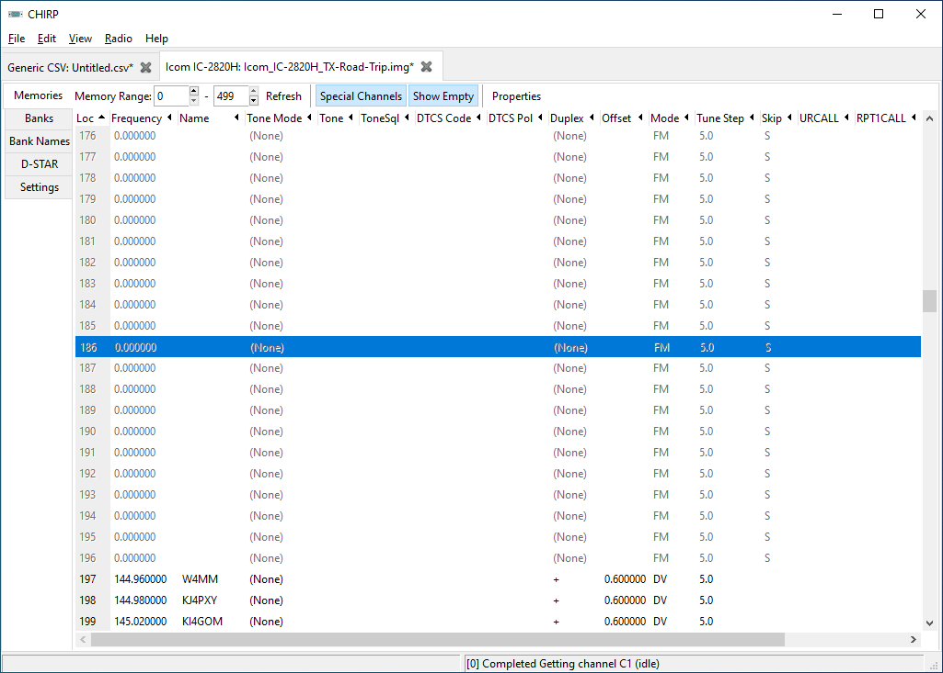
Not what you were expecting - But it's OK
The memories start at 197 because the input file listed 27 10m and 6m repeaters that the IC-2820 can’t use.
170+27=197
Remember to save your file with a meaningful name

Slide 34
Frequencies out of my radios range are removed.
10m
6m
2m
1.25m (Receive Only)
70cm
33cm
23cm

Slide 35
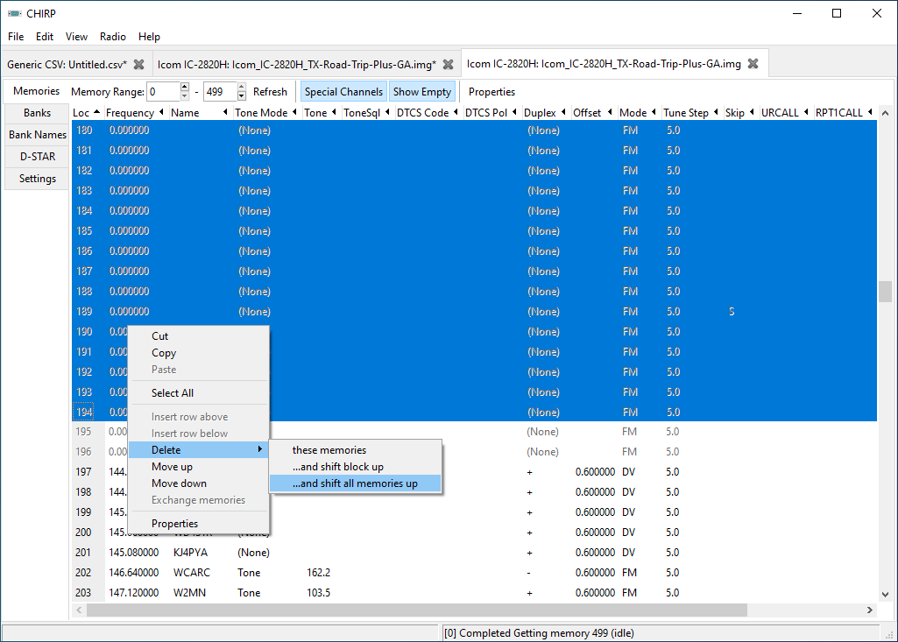
Select memories to delete
Use the RIGHT Mouse button to select
Delete ...and shift all memories up

Slide 36
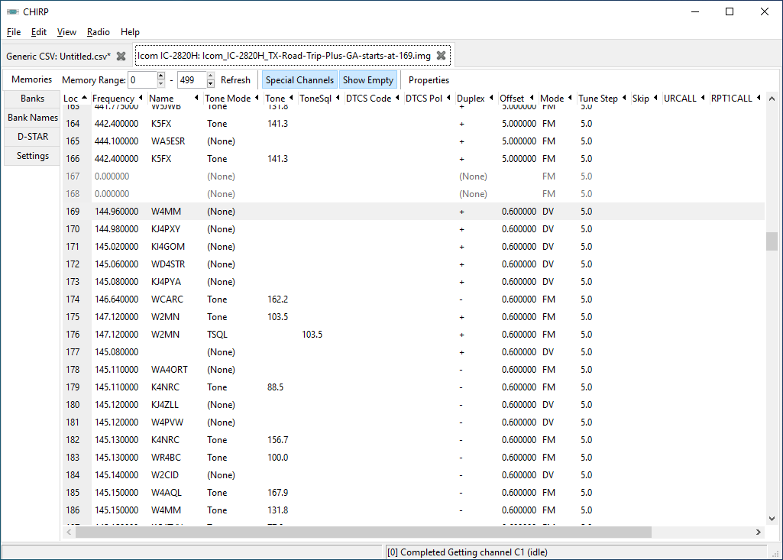
CHIRP does not get awards for deleting and moving
That was fun to watch CHIRP deleting and moving memory channels
Remember to save your file with a meaningful name

Slide 37
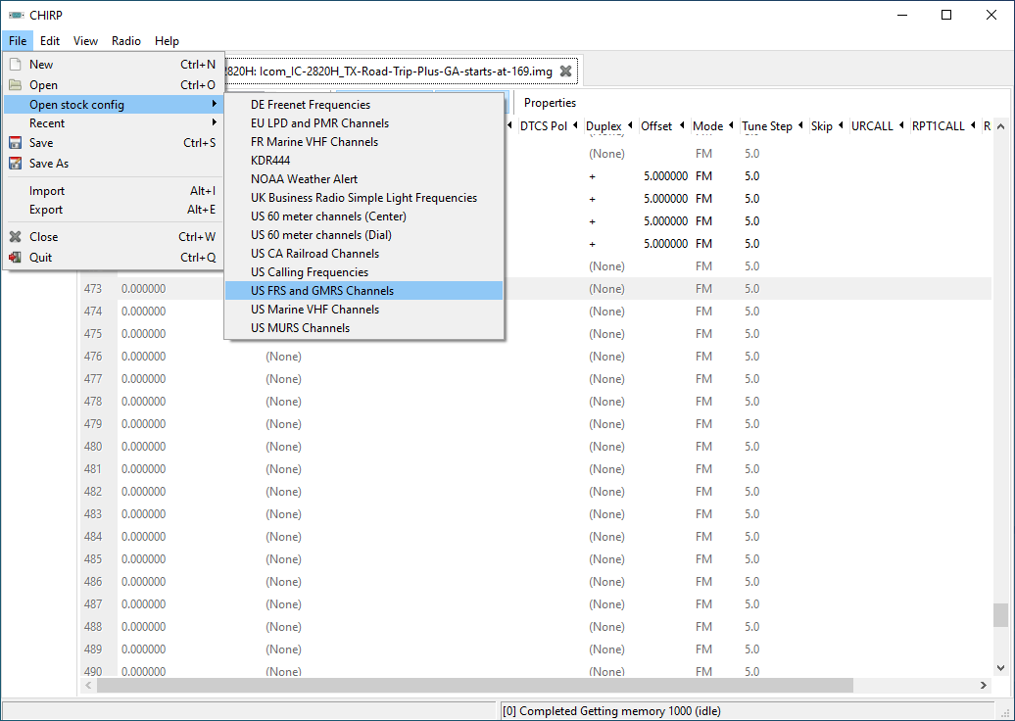
What if you want to monitor FRS and GMRS
File - Open stock config
US FRS and GMRS Ch
Note this creates a new TAB but you have to click on it to open/see it

Slide 38
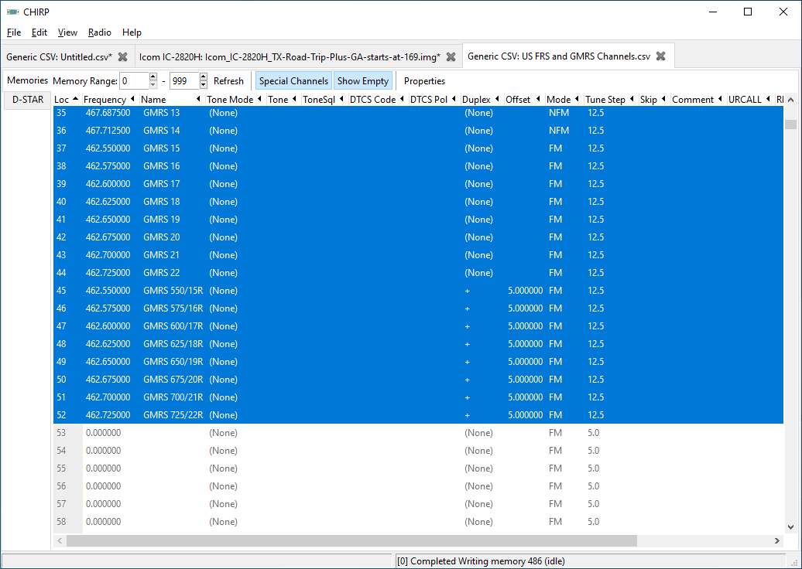
Cut-n-Paste from one Tab to the Next
Select the 52 channels to Copy and Paste them to your radio’s file
Remember to save your file with a meaningful name
Do not transmit out of the ham bands

Slide 39
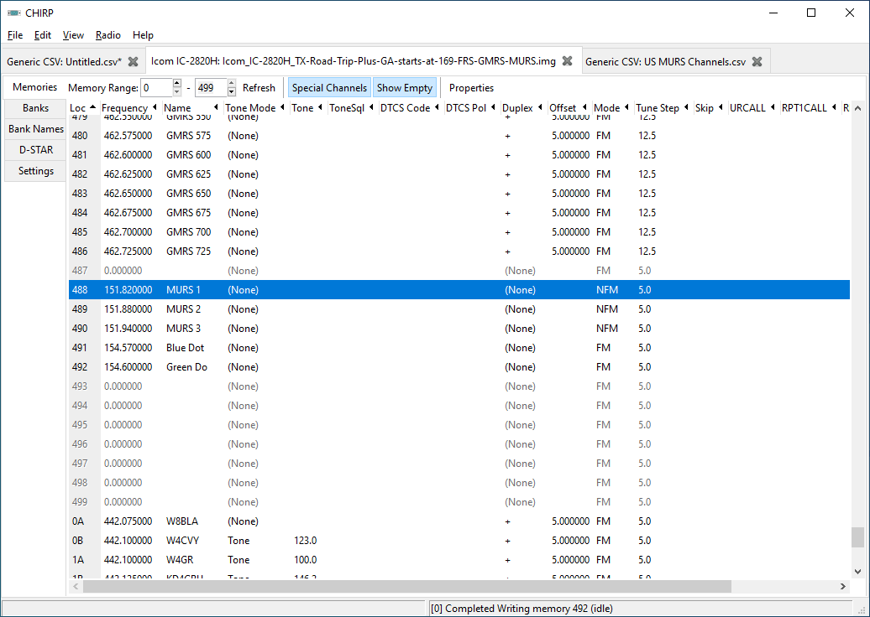
You can do the same to add MURS too
Select the 5 MURS channels and Copy Paste the to your radio’s file
Remember to save your file with a meaningful name
Do not transmit out of the ham bands

Slide 40
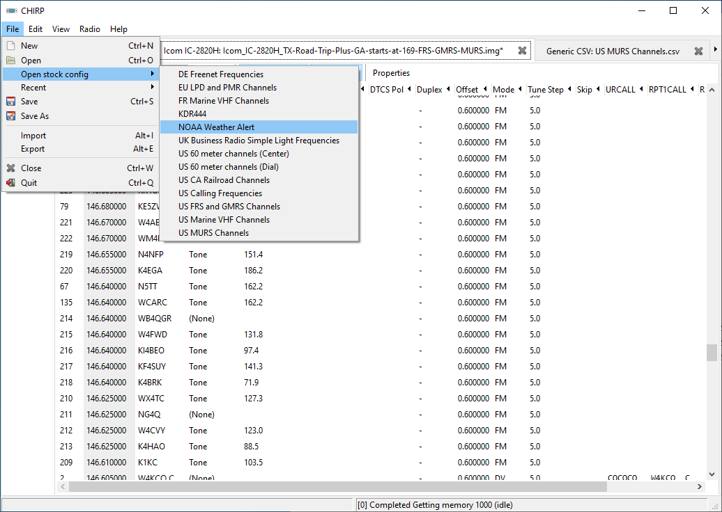
If your radio didn’t come with NOAA frequencies
Simply make room with the shift commands and add them
Remember to save your file with a meaningful name

Slide 41

So there is my high altitude overview of CHIRP

