Slide 1
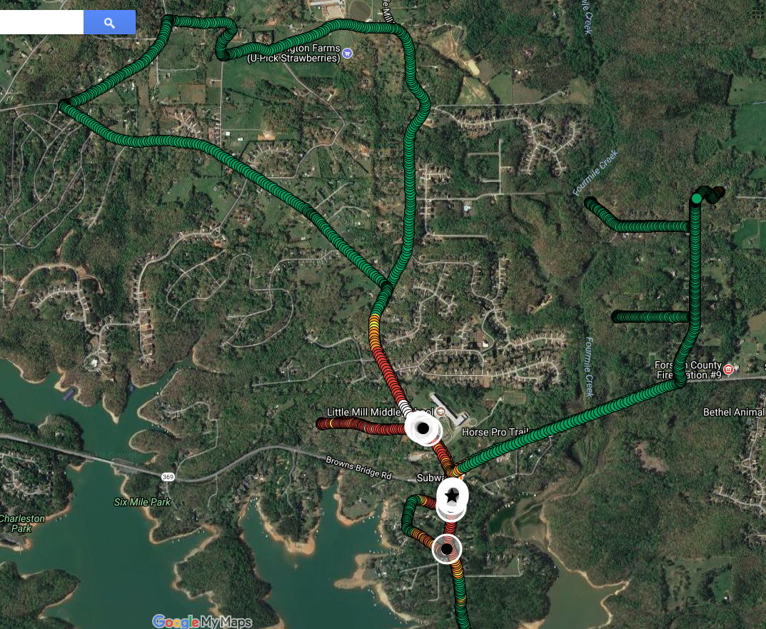
LOCATING POWER LINE NOISE
(and other RFI)
Jeff, W4DD
Feb 11, 2020

Slide 2
Discussion Topics
WHAT IS PLN?
WHY DID I NEED A NEW APPROACH?
HOW DOES THE RFI Mapper (RFIM) OPERATE?
DOES RFIM WORK?
Another Tool in the Tool Box (HT/Yagi)
Common Noise Sources inside your QTH
Additional Slides

Slide 3
1. What is Power Line Noise (PLN)?
Radio Frequency Energy generated by high voltage arcing. It is usually caused by (unintended) arcing between two metal conductors on a power pole.
Arcing is basically a “Spark Gap” transmitter
Transmitter “effectiveness” is dependent on:
  The size of arc
  The antenna (power lines) connected to it
It can range from undetectable to well over S-9
Many hardware causes but three most common seem to be:
  Defective insulators (bells or pole top) or wrap wires
  Defective lightning arrestors (these can be real loud)
  Metal to metal arcing

Slide 4
How Do You Know If you Have PLN?
Power up HF radio
Pick band and antenna of choice
Find unused frequency
Set Mode to AM, 6KHz
Do you hear a raw 60Hz buzzing noise or something other than a low level white noise? (Make note of the S-meter reading)
If you do, you may have PLN or other RFI. Further investigation is needed!
ALWAYS make sure the noise is not coming from inside your home by turning off each ckt breaker, one at a time.

Slide 5
Example of PLN

Slide 6
Common Methods Used to Find PLN
Step | METHOD | COMMENTS | FREQ
1 | Rotate HF Antenna | Provides only general direction, not exact location or absolute strength. | HF
2 | AM Car Radio | Provides a rough idea of location and strength in the AM broadcast band. | 1 MHz
3 | Handy-Talkie and Yagi | 137MHz (aircraft band) or 430MHz, Mode = AM. Can usually narrow down to the pole. (Local area tool) | 137/440 MHz
4 | Ultrasonic Dish | Locates defective item on a pole (Local area tool) | Ultrasonic audio
All of these are good tools (but note only one is HF).
Basically, a one-by-one “Search and Document” operation.
Difficult to quantify the magnitude/impact of each source.
Slow process for an environment with many noise sources, of varying levels, and spread over a wide geographical area.
They work well if there are only a couple noise sources and they are close to the receiving location.

Slide 7
2. Why Did I Need A New Approach?
10 years of experiencing PLN
Some big, some small
Some sources constant, some intermittent
Some active when cold, hot, wet, dry, etc. It is no fun hunting PLN in very cold or hot weather.
HF beam provided only general direction.
Very tedious and time consuming walking roads with the 137MHz Yagi and HT, evaluating, comparing, and documenting pole noise one by one.
VHF noise (137MHz) does not always correspond with HF (1.8-30MHz) noise.
After years of work, I could never get the noise under control for any length of time, just too many sources over too large an area.
The final straw was a persistent S-9 + 10dB noise to the SE and a S-6 noise to the West that I could not locate.
By December 2015, I was frustrated. I needed a new approach or give up radio.
During Christmas break 2015, I bought a GPS and started writing beta code to collect data.

Slide 8
The Solution: The RFI Mapper
How about a color coded Map
Showing the location and strength (S-Meter reading) of the noise
On the HF band of choice
Can usually identify down to the problem pole or +/- 1 pole.
Laptop records levels and “announces” levels above S-9 as you drive and every 10 seconds.
The map can be sent to the power company. It is powerful visual evidence there is something wrong.
You then confirm the trouble poles with a HT/Yagi.
Once fixed, a re-drive map shows the source was fixed and noise is gone. Green is good!

Slide 9
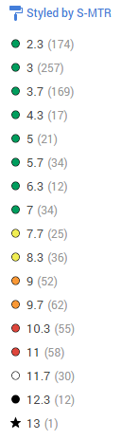
We Will Look At Some Examples Mapping Scale
The S Meter scale is extended above S-9 for simplicity (1 S-Unit = 6dB).
  S-9 = S-9 plus 0dB
  S-10 = S-9 plus 6dB
  S-11 = S-9 plus 12dB
  S-12 = S-9 plus 18dB
  S-13 = S-9 plus 24dB
Numbers in ( ) after the S Meter levels are the number of samples at that level during the run.
Anything above a S-9 deserves attention
Anything above S-11 is a red flag!
“Cold” colors
“Hot” colors

Slide 10
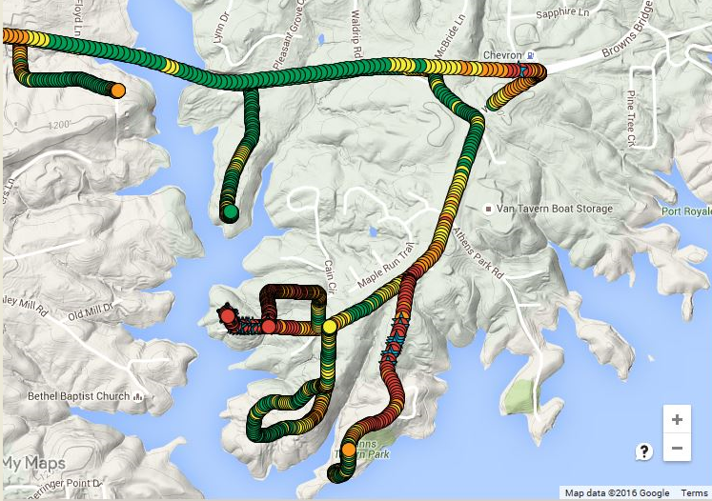
Example #1
MY QTH: S-9 noise source to the SE, a distance of 1.7 miles.
This is the problem that motivated me to make the RFI Mapper system.
Lots of nasty stuff on this high ridge line.
These are big noise sources also, but I can’t hear them. They are behind the ridge line.

Slide 11
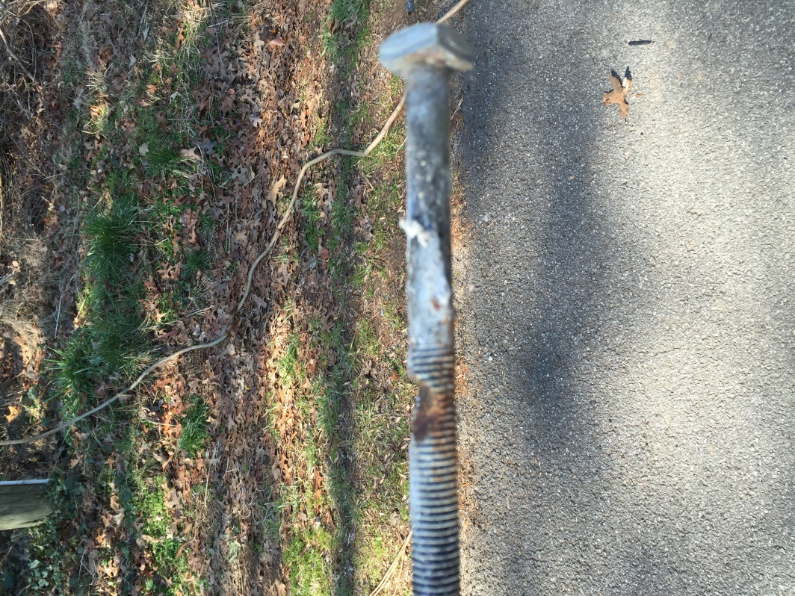
Example #1 - What was the Cause?
This bolt was arcing to a bracket. Note the bolt is 50% eroded.
The lineman said he could smell something burning when he got near the top of the pole.
My SE S-9+10dB noise level dropped to S-3, a big improvement!
Most common causes are pole top insulators, bell insulators, or lightning arrestors but sometimes there’s an odd one like this bolt.

Slide 12
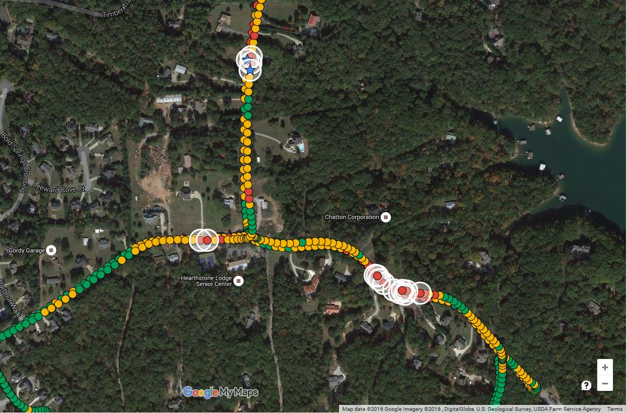
Example #2 (Overview Map)
We will zoom in on this area in the next slide.

Slide 13
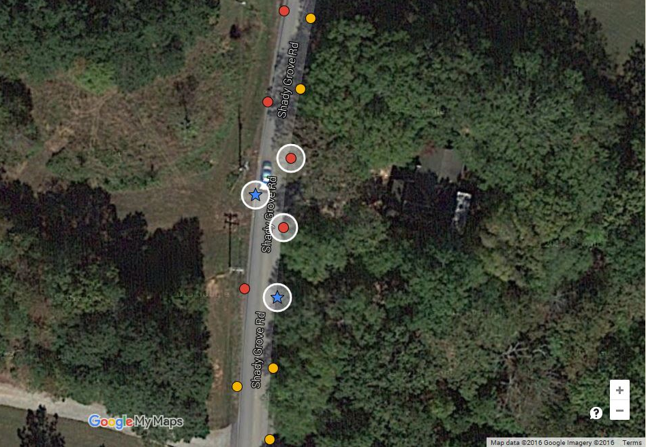
Example #2 Zoom-In
Signal tapers off either side of the peak signal.
The blue stars are S-12 (S-9 plus 18dB). The pole between two blue stars was highly suspect and was the problem (pole top insulator).

Slide 14
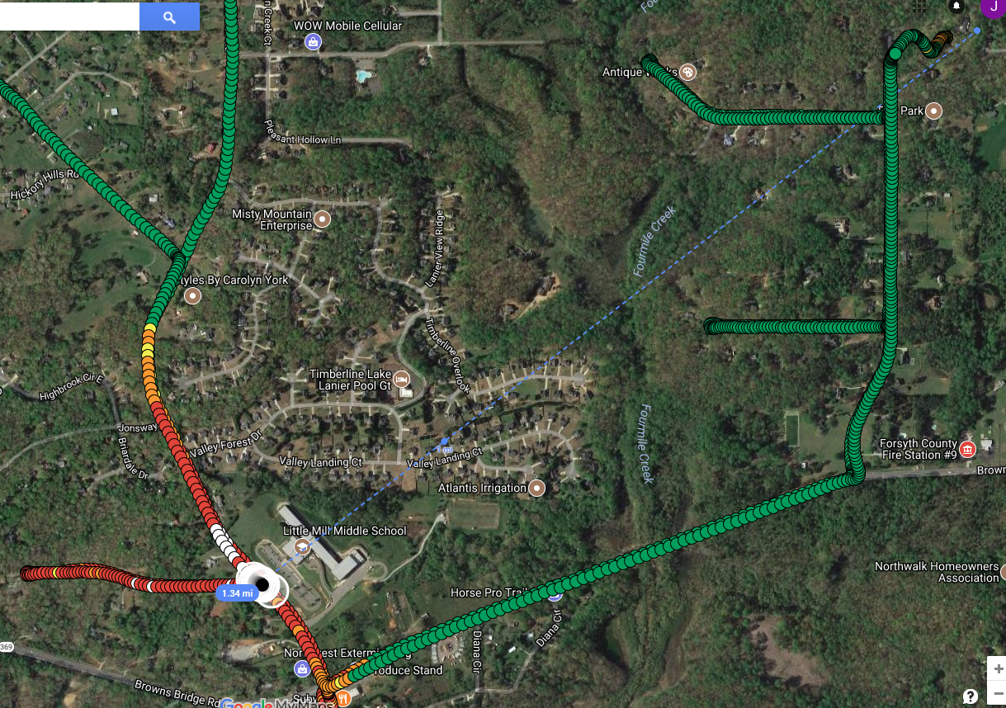
Example #3
Noise to the SW direction during wet weather. Goes away after several days of dry.
Replaced lightning arrestor, now all green.
Defective lightning arrestors can be VERY loud. Note the size of the area it polluted.

Slide 15
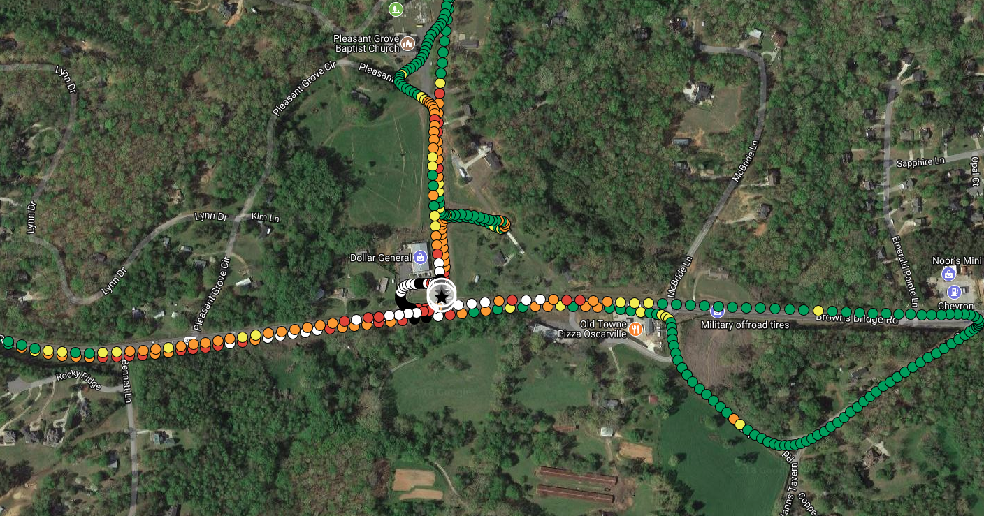
Example #4
Area quiet until mid June 2018 lightning storm.
Noise originating on pole at corner of 2 intersecting roads.
Two Pole Top insulators plus recloser (a recloser is basically a ckt breaker).

Slide 16
3. How Does the RFI Mapper Operate?
Similar to what Cellular companies have done for 30 years except uses common hardware (aka your HF radio and your laptop).
Data collected as you drive
Process:
  Every one second the GPS sends the lat/long to the laptop
  This triggers the software to read the radio S-Meter (radio set to a quiet frequency on 10M)
  The program writes the lat/long and S-Meter data to the Hard Drive
60 samples/min x 30 minutes = 1800 data points in 30 min
30 minutes @ 20MPH = 10 road miles of data (that can find a lot of noise sources!)
Mapping
Mapping done with Google “MyMaps” (not Google Maps).
Very easy to learn.
Once learned, mapping takes less than 10 minutes.
Up to 10 maps (layers) are retained on-line and can be used for comparison.
Each layer can contain 2,000 data points (33 minutes ~ 10 miles)
Hardest Part – Installing Microsoft Visual Studio (patience and persistence).

Slide 17
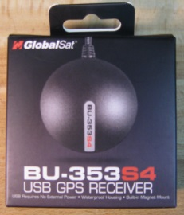
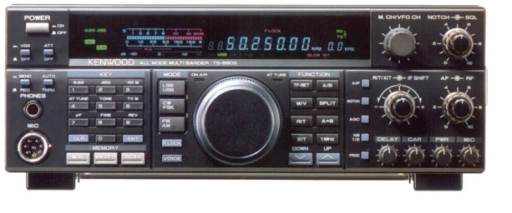
RFI Mapper Block Diagram
Internet
Google MyMaps
3
1
GPS
BU-353s4
USB Ext Cable
Laptop Computer
Map Image
USB
Set to:
28.325MHz.AM mode, AGC fast,
NB off
USB to RS-232 Conv
2
RS-232
HF Transceiver
TS-690 or K3
TTL Output
RS-232 to TTL Conv
S
.5A
S
2A
12V

Slide 18
What Do I Need and How Much Does It Cost?
Good News! You may already have almost everything you need to make a RFI Mapper and start mapping your PLN.
ITEM | DETAILS | COST
1. Laptop Computer | Win 7 or 10 | I had it
2. HF Radio | Kenwood TS-690/K3 | I had it
3. Mobile Antenna | Ham Stick for 10M | I had it
4. GPS Module (USB) | BU-353-s4 | $29 on Amazon.com
5. Microsoft Visual Studio 2017 (Visual Basic) | Download from the Microsoft site | Free
6. RFI Mapper Software | 900 lines of VB code | Free
TOTAL: |  | $29
* The Kenwood TS-690 transceiver works really well. It does not like PLN!
* Elecraft K3 works too, but more forgiving of PLN (turn preamp on).

Slide 19
A Few Extras
Because my TS-690 is 20+ years old and does not have RS-232 or USB, I also needed the following two items to convert TTL (0-5V) levels into USB.
ITEM | DETAILS | COST
TTL to RS-232 Converter | The TS-690 only has TTL output | I had it (homebrew, check FAR Circuits)
RS-232 to USB Converter | Sabrent SBT-FTDI | $14 on Newegg.com
The Sabrent USB to RS-232 Converter is very RF quiet. Don’t buy the low cost RS-232 units available on discount sites !!! They generate a lot of RF hash (guess how I know this).
The base noise level in your mobile should be less than S-5. If more than S-5, you need to explore causes (see me for more info).

Slide 20
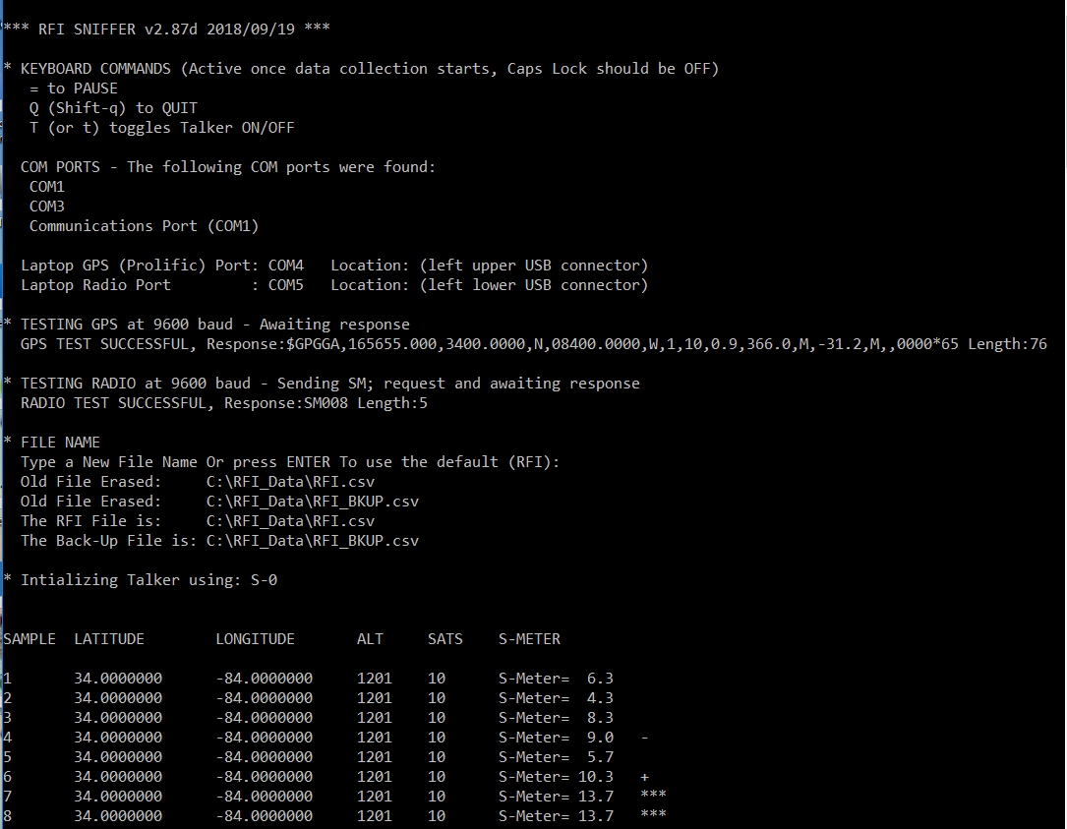
Recording Data
As simple as driving the roads in the suspect area (RFIM shown in simulator mode).
Never, Ever look at your laptop while driving. It’s best to bring along a helper (aka spouse or friend).

Slide 21
What Do I Do With the Data?
Plot your data with Google MyMaps (not Google maps)
  Very simple to do
  You will need a Google login if you don’t already have one.
  Import the csv file
  “Style By” S Meter level
  Change Icons to circle type
  Color the circles (aka color by S Meter level)
  Pick the base map type you want to use (satellite or terrain/elevation view).
Then:
  Identify issues close to your QTH first.
  Pay special attention to noise sources over S-9!!!
  Pay attention to geography, especially noisy poles on hills.
  Rank the top 3-4 noise sources considering strength and distance to your QTH.

Slide 22
Clearing Distance Guidelines
Antenna System | Distance
Wire antennas at 30ft | Clear to .25 miles
3 el beam at 50ft | Clear to .5 miles
Multi Element Yagi at 100ft or more | May have to clear to 1 mile and beyond depending on terrain
My setup on 10M: 5el Yagi at 90ft. Ambient noise level runs between S-1 and S-2 depending on direction.
If not blocked by terrain, I routinely hear (large emitter) noise sources out to 1+ miles.
Longest confirmed distance was 1.7 miles (down a creek valley). It was S-9+ at my QTH and S-13+ on the RFI Map.
Longest suspect issue was pole on a 200 ft hill 3.0 miles out. Since they cleared it, the noise has not been back.

Slide 23
Who Do I Contact?
Open a Trouble Ticket with your power company
When contacted by the power company engineer, send them an email with your maps and other details. I find an overview map and a detailed map with the suspect pole(s) highlighted very effective.
Don’t overwhelm them with 20 things to chase! I usually pick the 3-4 worst poles at a time. A line crew can usually clear 4-5 issues in a day.
The power company engineer will visit the area and usually use an Ultrasonic Detector (Radar Engineers RE-250) to identify the arcing hardware on the poles.
The power company engineer will schedule a line crew to work the issues.
Offer to be on site (this is when a HT/Attenuator/137MHz Yagi come in handy).
Over time, you will build credibility and a good working relationship with your power company engineer. The local EMC’s have been very cooperative and great to work with. GA Pwr has a contractor who is great to work with.

Slide 24
4. Does RFIM Work?
Yes, very well.
Identified thousands of PLN and other noise sources.
Fixed >100 of the most significant ones (small ones far away don’t matter).
A map saves the power company engineer a lot of time.
My power company engineer says he usually only needs to check the pole identified on the map +/- one pole.
Once the trouble is cleared, the noise level at your QTH should go down significantly (If not, you didn’t identify the right noise source).
A new map run should show green.
After 10 years of little progress, the RFIM reduced my noise from S9+ to S-2 or less.
My NE direction towards Europe is now ~ S-1 (28MHz, AM, 6KHz). That’s S-0.5 in SSB mode!
I am working mostly “intermittents” now, things that pop up during hot, cold, wet, or dry weather…. and occasional lightning strikes.

Slide 25
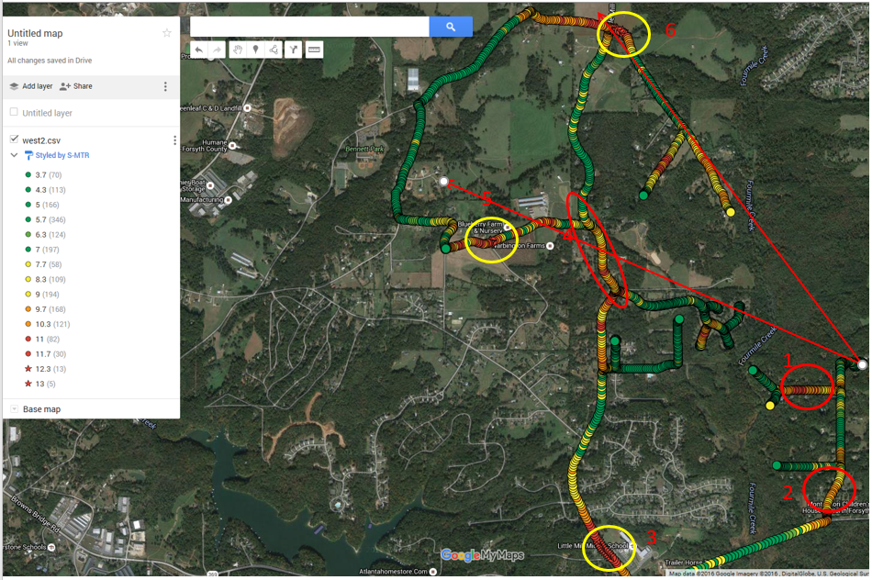
January 2016

Slide 26
August 2018
Replaced 2 lightning arrestors in late August. This area now green.

Slide 27
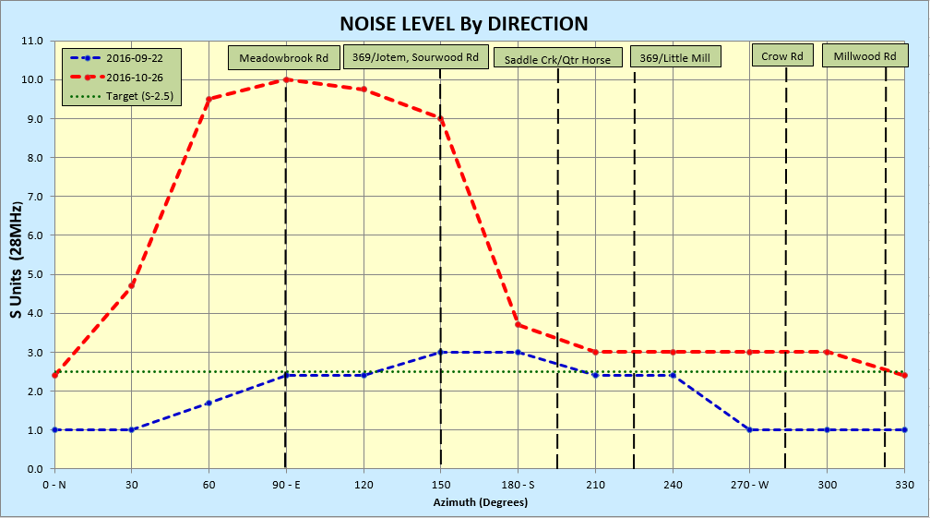
Noise Snapshot - 2016
5 el 10M Yagi @ 90ft, Mode = AM, Filter = 6KHz
Divide S Meter level by 2 for SSB at 3KHz, Divide by much more for CW

Slide 28
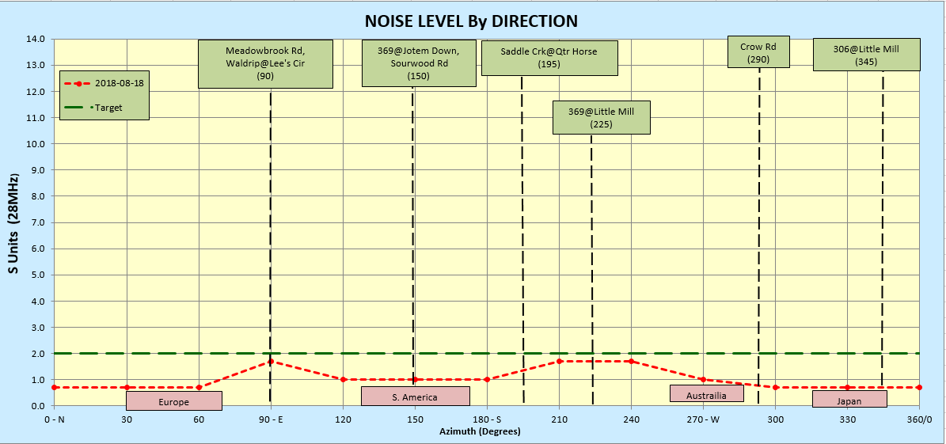
Noise Snapshot - Aug 2018
5 el 10M Yagi @ 90ft, Mode = AM, Filter = 6KHz
Divide S Meter level by 2 for SSB at 3KHz, Divide by much more for CW

Slide 29
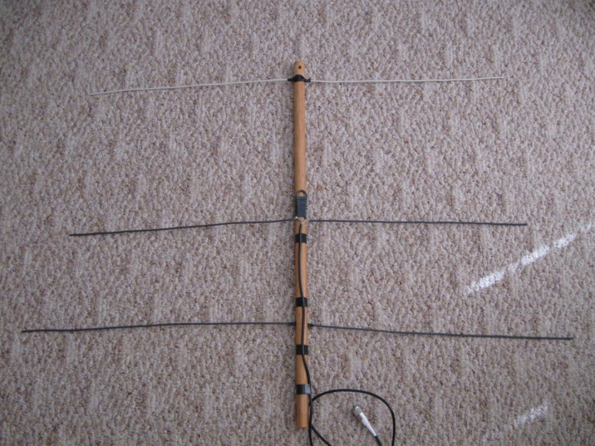
5. Another Tool in the Tool Box
A simple RFI hunting tool is a HT (Yaesu VX5r set to AM mode) and a 137MHz Yagi.
Essential for finding local noise (one at a time) or field assistance with the power company.
A 3el 137MHz Yagi can be built on a broomstick or PVC pipe and 10GA solid copper wire (aka 10-3). Cost near zero. This combo works very well. Email me for a copy of plans.

Slide 30
Hints for Using the HT/Yagi
A must have for working with the power company in the field. It confirms what pole they should be working on.
Noise “loudness” is not always indicative of RF level. Go by RF level.
An attenuator (0-45dB) is a necessity (4 slide switches and 12 resistors). Use it to “rate” the noise by attenuating until the noise just goes away.
  0-12 dB = Small
  13-24 dB = Medium
  25-40 dB = Big
  > 40 dB = Monster
Poles with lots of lines on them may seem to cause the noise but an adjacent pole with just one HV wire may be the real culprit.
When deciding which pole is causing the noise, ALWAYS stand midway between 2 poles and do an A/B comparison (I’ve had to relearn this lesson too many times!).

Slide 31
My QTH Internal Noise Sources
# | Source | 137MHz Noise Level @ 5ft | Comments
1 | Router Group (Cable Modem, Router, VoIP) | +21dB | S-7+ on 80M (see Note 2 on next page)
2 | Mr. Coffee LCD Clock Coffee Pot | +18dB | Unplug when not in use
3 | Dynex (Best Buy) 32” LED TV | +12dB | Unplug when not in use
Rate the noise sources and clear the most dominant ones first.

Slide 32
Lessons Learned
Wall Wart Switching Power Supplies - Wall Wart Switching Power Supplies (aka, small and light weight) can produce lots of noise, especially on 80M and 160M. If noisy, change Switching Power Supplies to Linear type, same voltage and larger current rating.
Routers - Your cable modem is grounded via the RG-6, but your router likely has no ground. Use shielded cable (Cat5e or Cat6A) between the cable modem and router. A shielded Ethernet cable will extend the ground to the router which is usually floating (aka, no connection to ground and emitting RFI). Same with any VoIP unit or add-on Ethernet switch. Extending shielded cable all the way to the PC does not seem necessary.
  Do not use shielded Ethernet cables from the common Internet sites.
  The shield is not soldered to the metal shell. I measured 2-10 ohms on a group of 5 cables shell to shell. Mouser Electronics has Amphenol Ethernet cables with the drain wire soldered to the shell at both ends (view the spec sheet on Mouser.com). Resistance was less than 1 ohm for each of 5 cables measured.
I reduced my 80M noise level from S-7 to S-5 (a 12dB improvement) by doing the two things above. With some more work, I think S-3 is achievable on 80M.

Slide 33
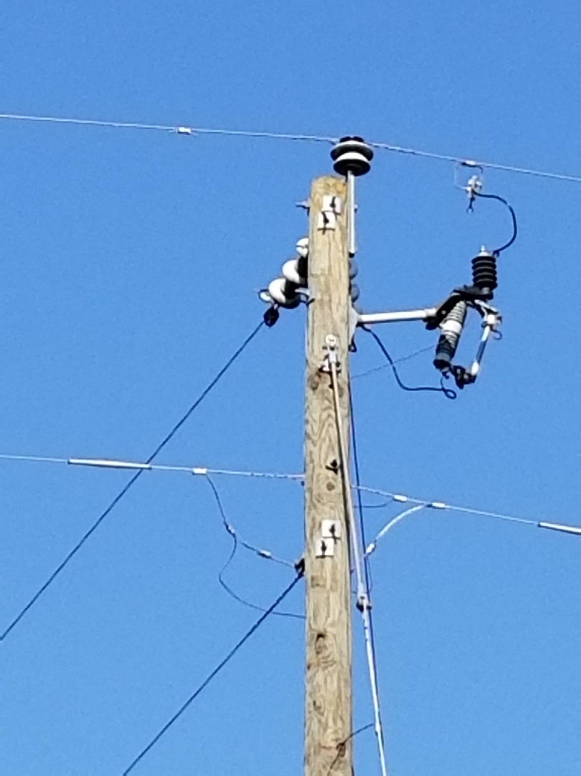
Power Pole Hardware
HV Line, 14KV, single phase
Pole Top Insulator
Lightning Arrestor
Insulator (gray) that supports a Fuse (white). The fuse can be pulled to de-energize the local circuit.
Bell Insulator
Neutral Wire
Most common problems highlighted in red.
Never touch power pole hardware.

Slide 34
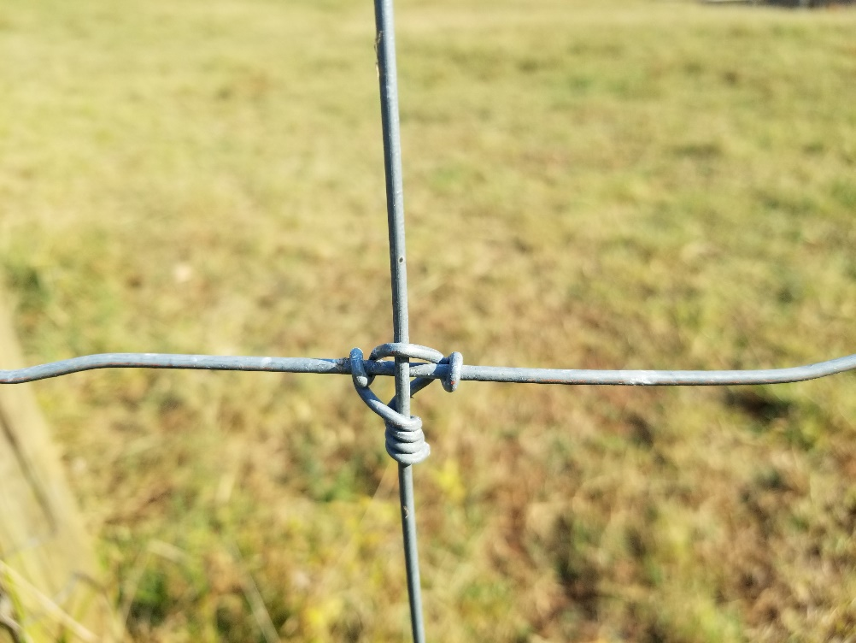
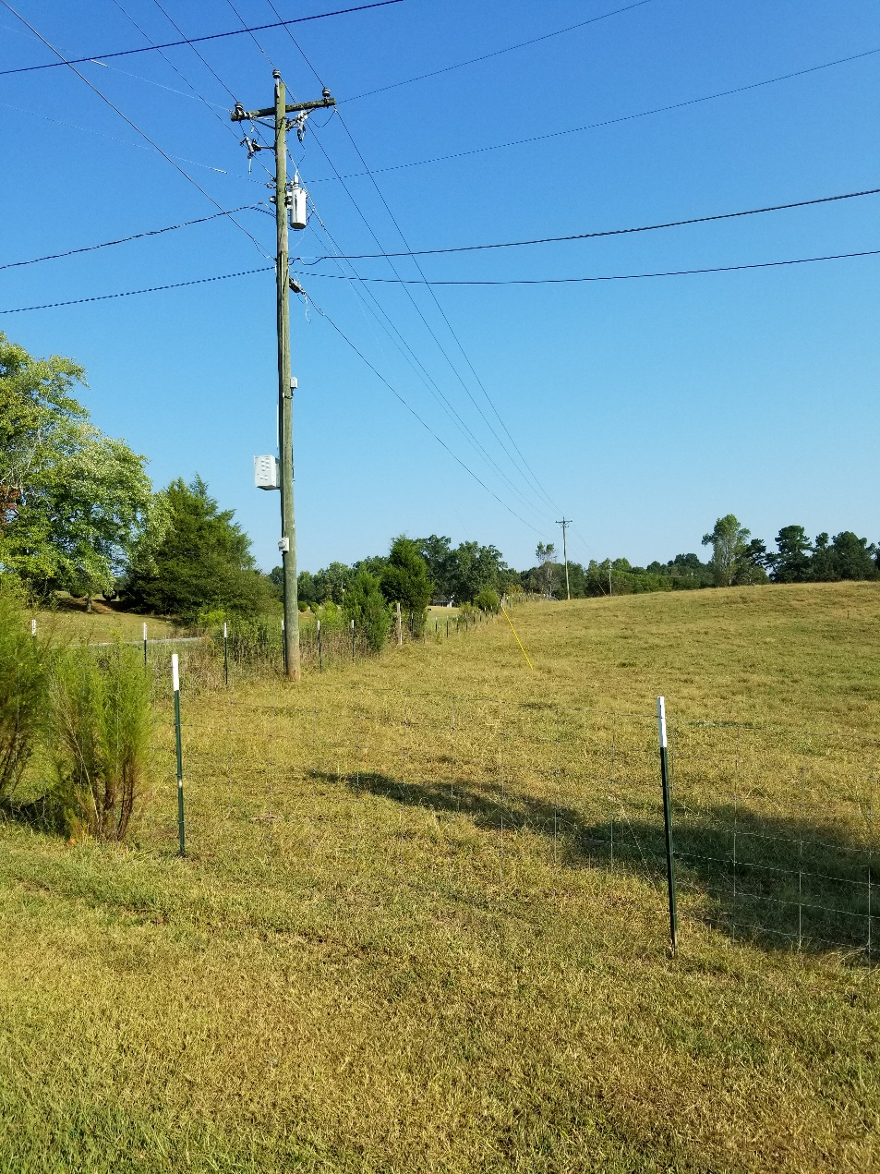
Another Noise Source
Galvanized steel fence with wraps for each joint
100 yards long running under power line
Metal posts every 10 ft
Voltage induced in the log horizontal runs
Zinc is oxidized forming a poor connection
Very dry summer so posts become poorly grounded
Dozens of joints emitting noise

Slide 35
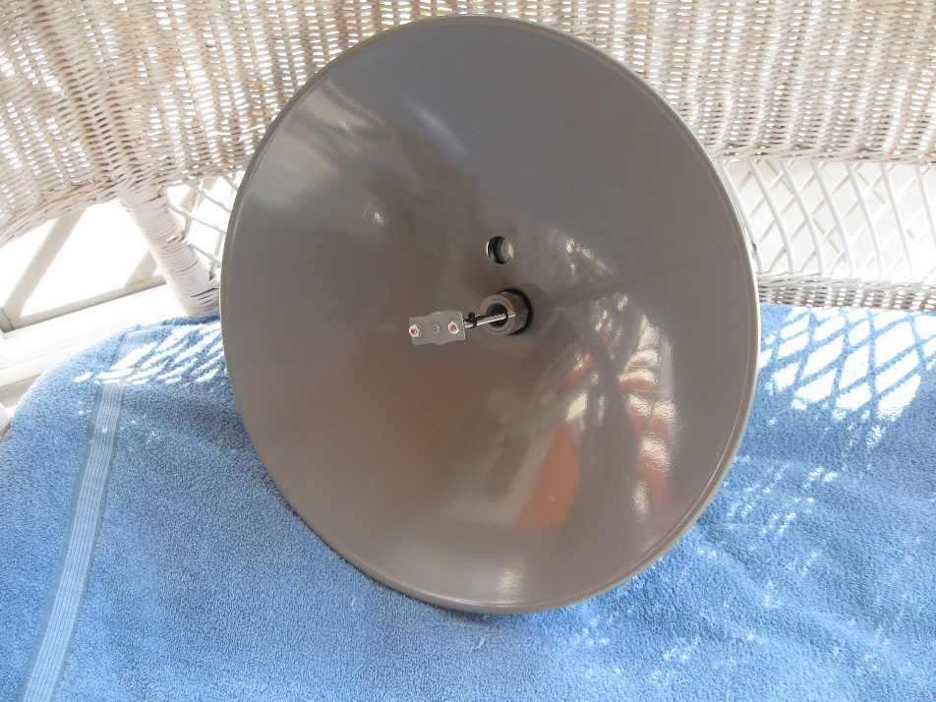
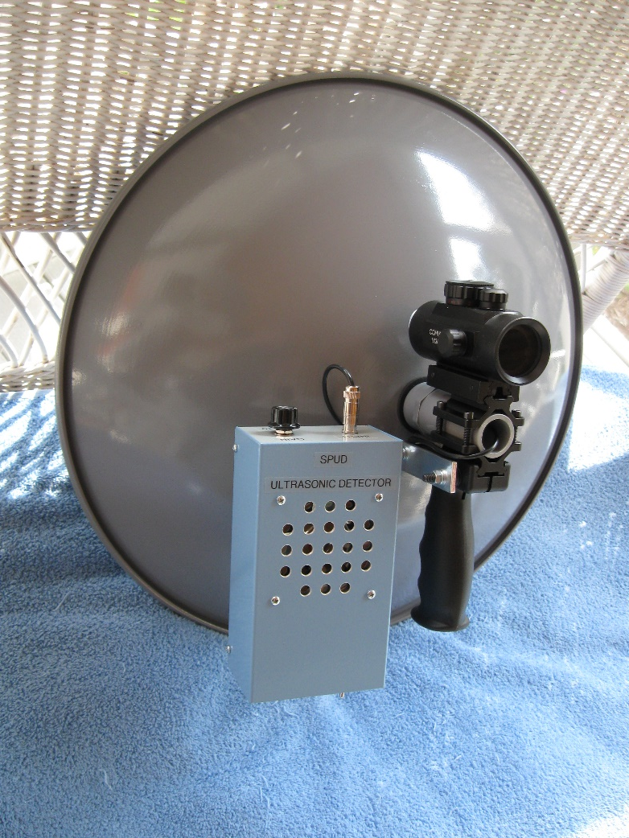
Ultrasonic Dish
1x Scope
Hand Grip
Transducer
Electronics
The ham will typically handle the “RF” locating and the power company will handle the Ultrasonic Dish, but a dish can be useful at times (several designs available including QST Apr 2006).
I added a scope and a hand grip to make pinpointing the arcing component more accurate.

Slide 36
Free Space Path Loss
FSPL(dB) = 10 log ((4πdf) ² /c² )
  ^{FSPL - Free Space Path Loss}
  ^{d - distance in meters}
  ^{f - frequency in MHz}
  ^{c - constant of 27.55}
Distance is a squared variable.
  Cut the distance in half and the signal goes up by 6dB.
  Or double the distance to the noise source and the noise goes down by 6dB. Use that to your advantage by moving your antenna away from the source if possible.
Another form of the same equation:
FSPL(dB) = 20 Log (d) + 20 Log (f) – 27.55

Slide 37
RFI Locating Summary
A Three Step Process
Clear Local Area Noise (LAN): Use a 137MHz Yagi/HT/Attenuator to locate noise inside your QTH and then near your QTH.
Clear Wide Area Noise (WAN): If noise persists, use the RFIM for wide area locating.
Pole: Work with the Power Company and Use an Ultrasonic Dish (theirs and/or yours) to locate the pole hardware causing the noise.
Good (RFI) Hunting
de W4DD, Jeff
W4DD @ arrl.net

Slide 38
Additional Slides

Slide 39
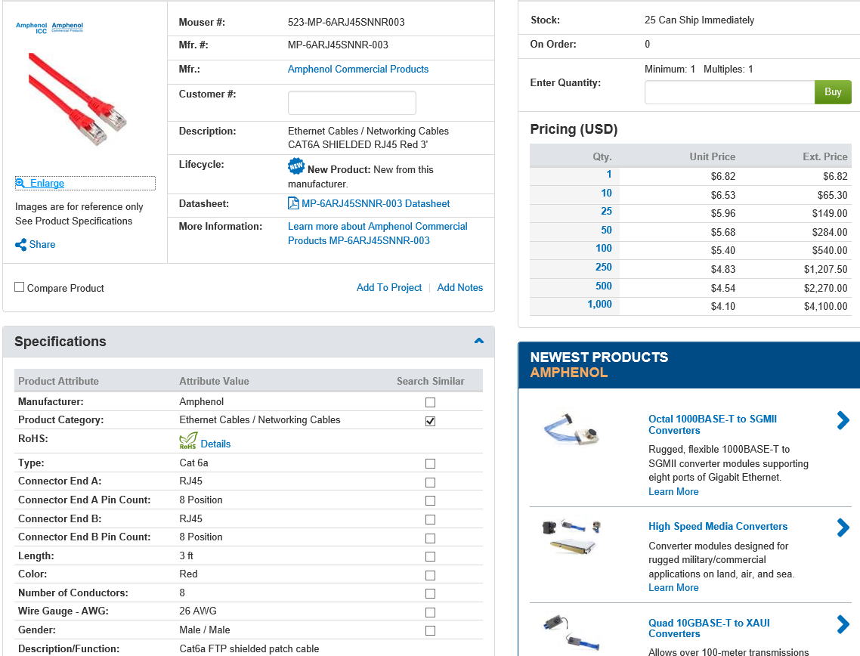
High Quality Cat 6a cables are available from Mouser.com. The drain wire is soldered to the metal shell at each end.

