Slide 1



What is it, and how can I get the most from it?
By Dave Slotter, W3DJS

Slide 2
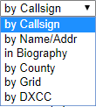
QRZ
QRZ is “Q” code for “Who is calling me?”
First created in 1992 by Fred Lloyd, AA7BQ
Houses nearly every callsign in the world (FCC + Foreign)
Originally a database on tape, then on a CD, then converted to website.
Likewise, the QRZ.com site’s primary function is to look up a person from a callsign.
  Allows lookup using:
    Callsign
    Name/Address
    Biography
    County
    Grid
    DXCC

Slide 3
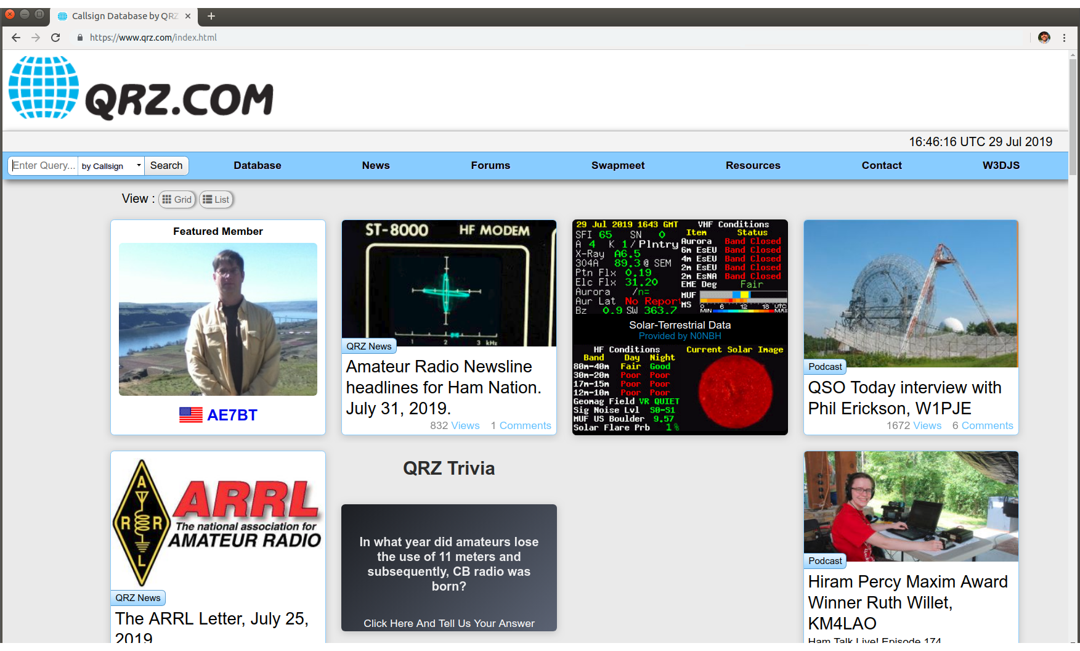
QRZ Home Page

Slide 4
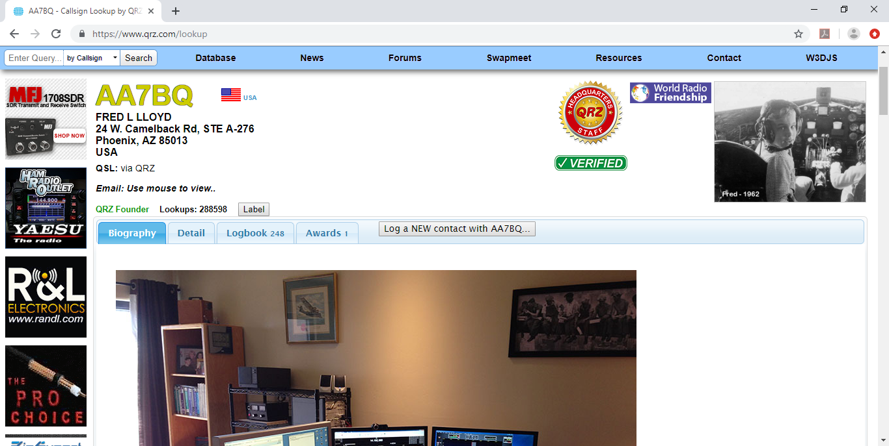
Query by Callsign

Slide 5
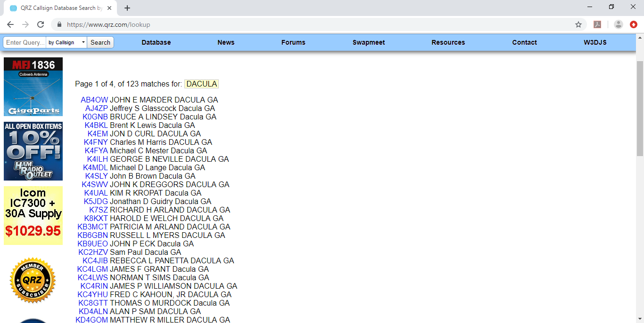
Query by Address

Slide 6
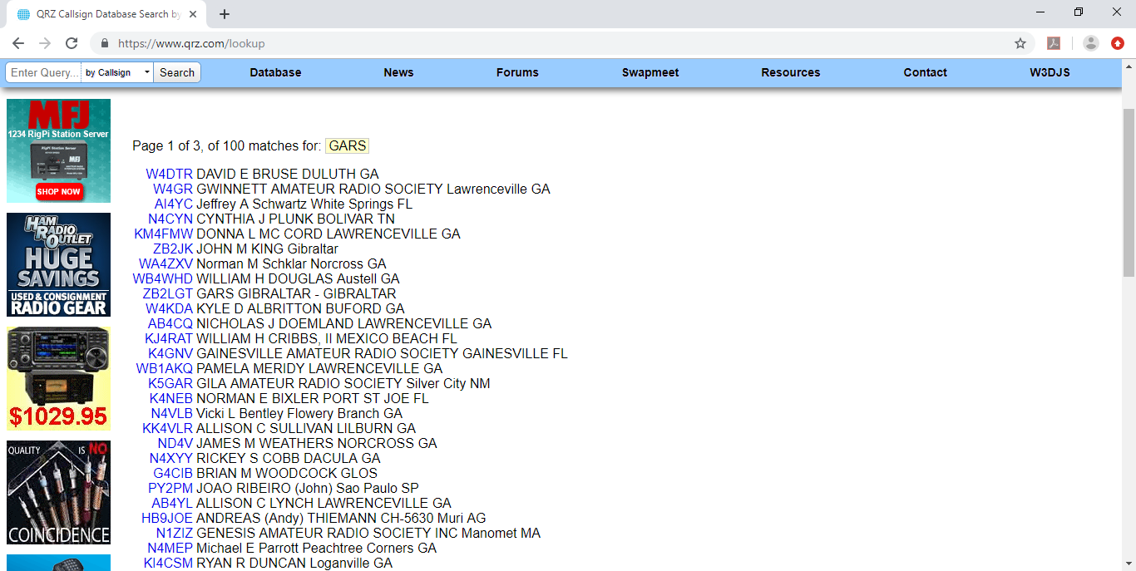
Query by Biography

Slide 7
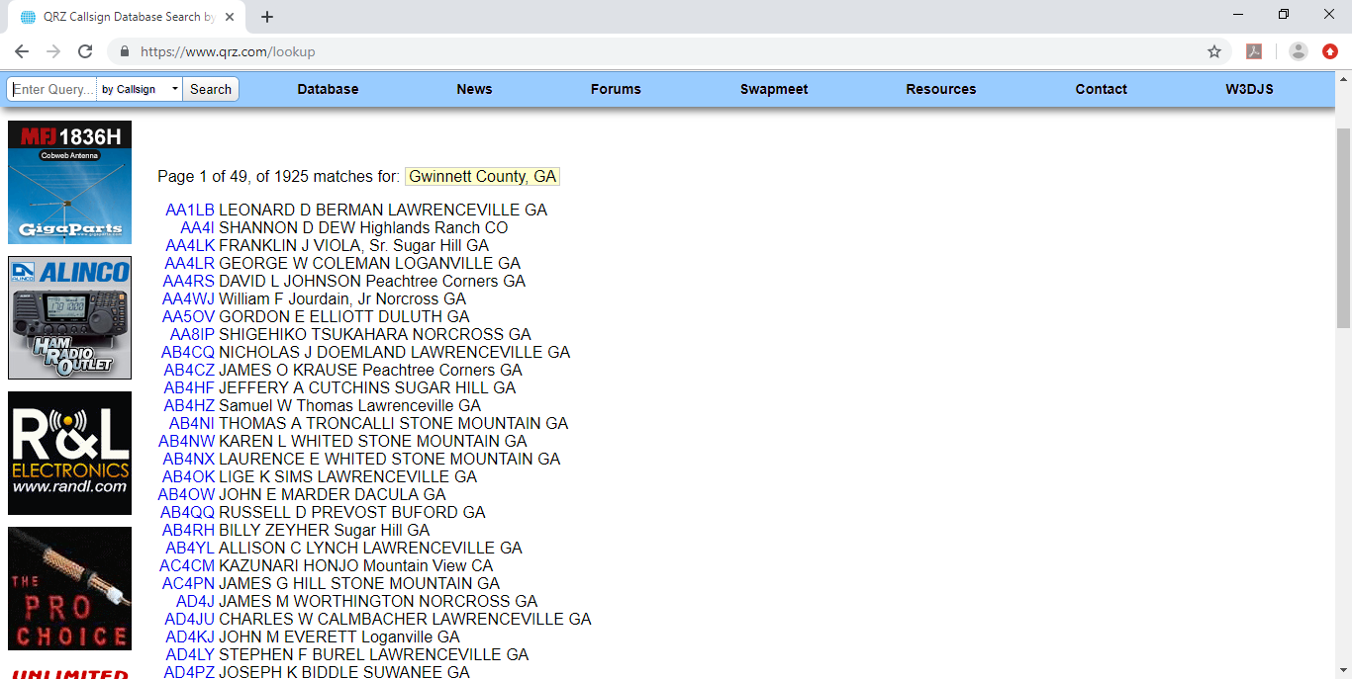
Query by County

Slide 8
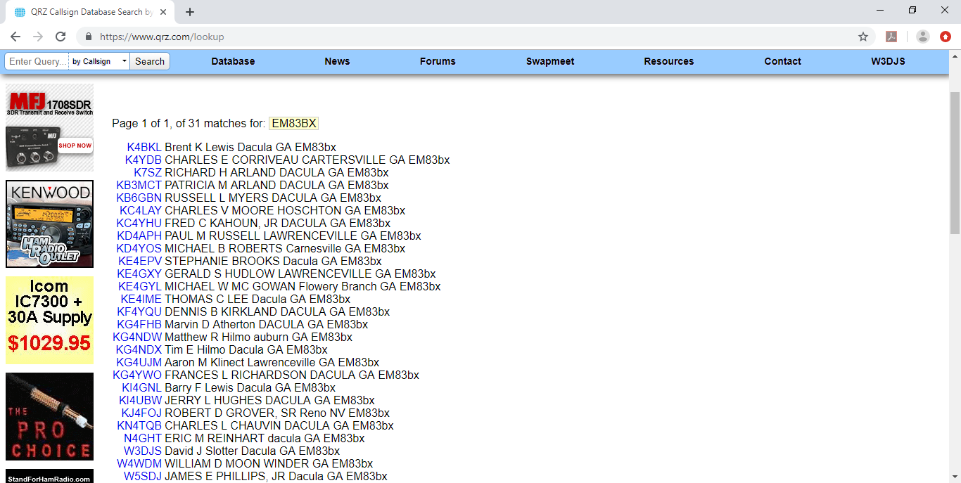
Query by Grid Square

Slide 9
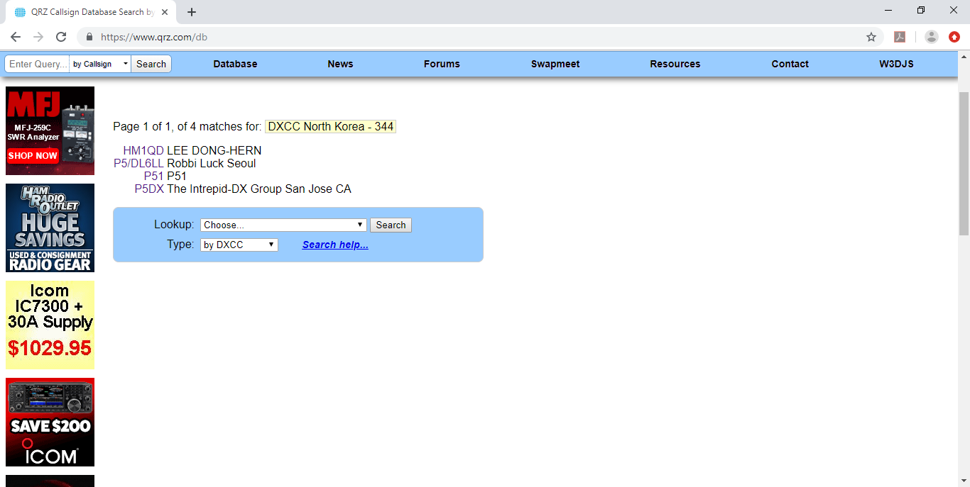
Query by DXCC

Slide 10
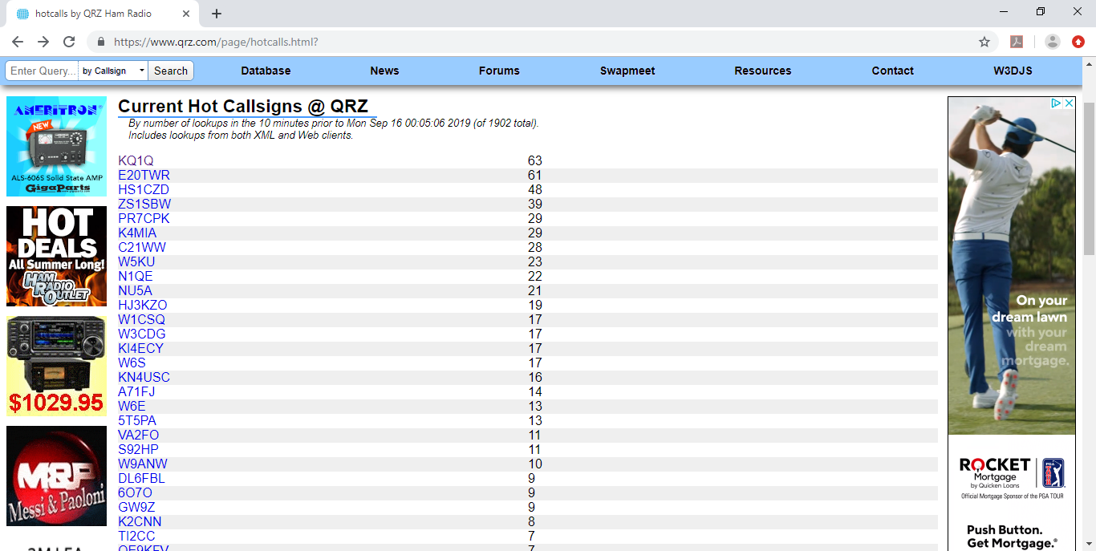
“Hot” Callsigns

Slide 11
QRZ Advanced Lookups
XML Logbook Data Service (for programmers)
QSL ListMaker (create custom mailing lists from QRZ’s database)
Ham Club Database (search by geographical region) https://www.qrz.com/clubs/
QSL Manager + QSL Bureau Lookup + QSL Card Designers & Printers + QSL Tips <https://www.qrz.com/page/qsl-corner.html>
Top Web Contacts (Brag list) <https://www.qrz.com/page/webcon.html>
Expired Callsigns (Will expire within 30 days or have expired within past 30 days) <https://www.qrz.com/page/expired.html>
New Callsigns (Added to QRZ in past 24 hours) <https://www.qrz.com/newcalls>
Random Callsign <https://www.qrz.com/random-callsign>
PicSafari (Explore Pictures on QRZ) <https://www.qrz.com/pictures/all/_none/1>

Slide 12
Using QRZ’s XML Programming Interface
There are many code examples available via GitHub.com
qrz_callsign_reader by W3DJS @ https://github.com/dslotter/qrz_callsign_reader

Slide 13
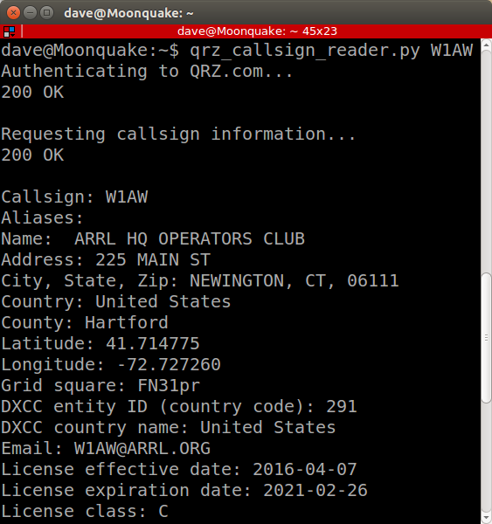

Slide 14
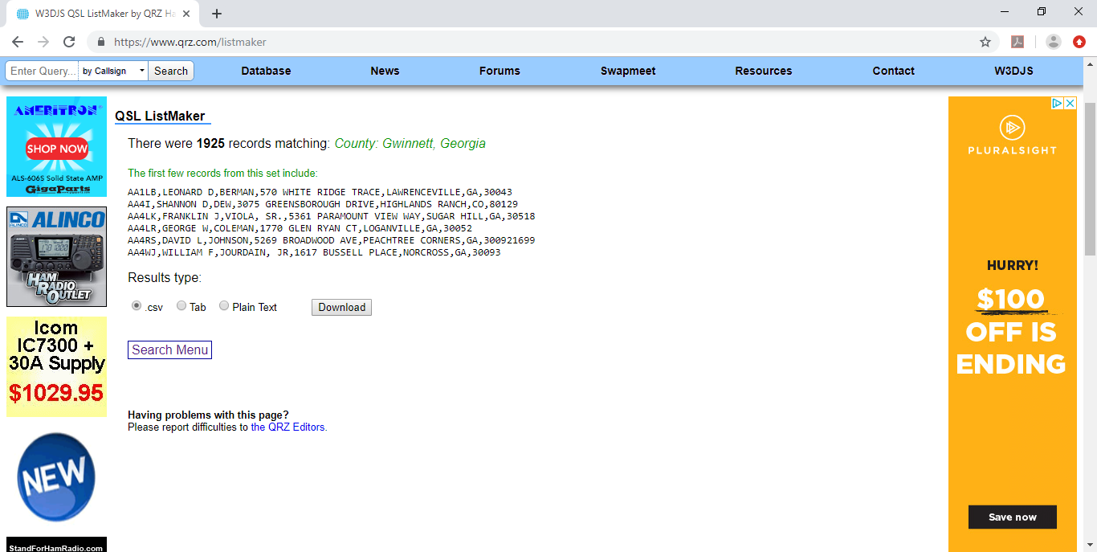
QSL ListMaker

Slide 15
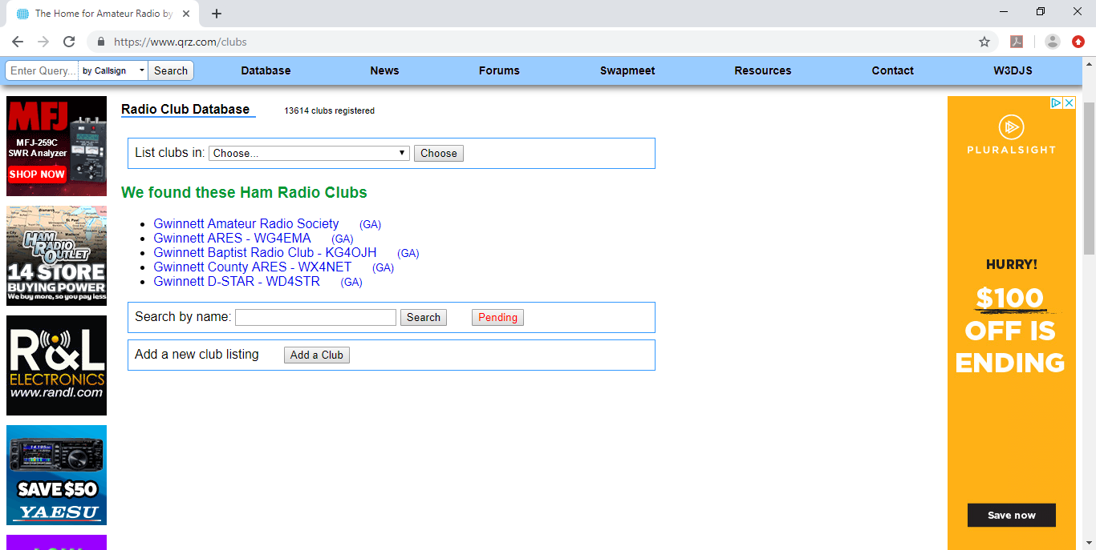
Ham Club Lookup

Slide 16
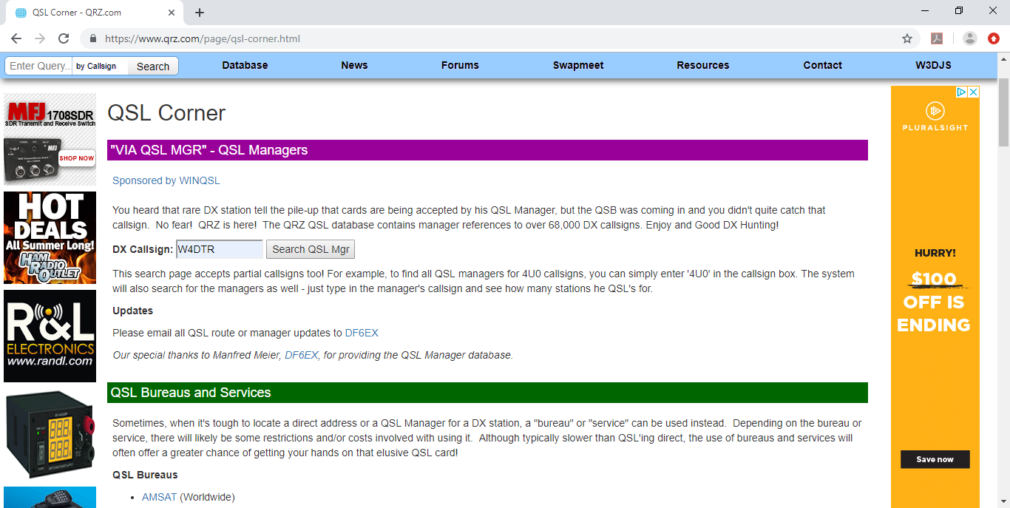
All Things QSL

Slide 17
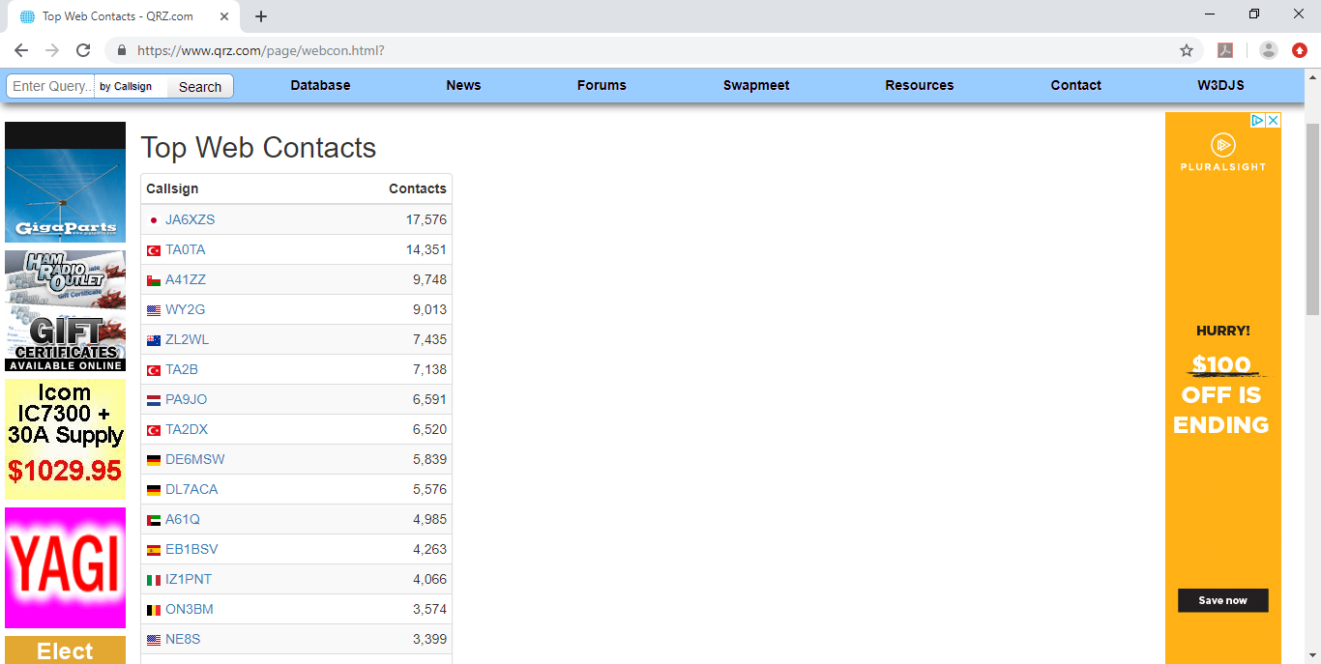
Top Web Contacts

Slide 18
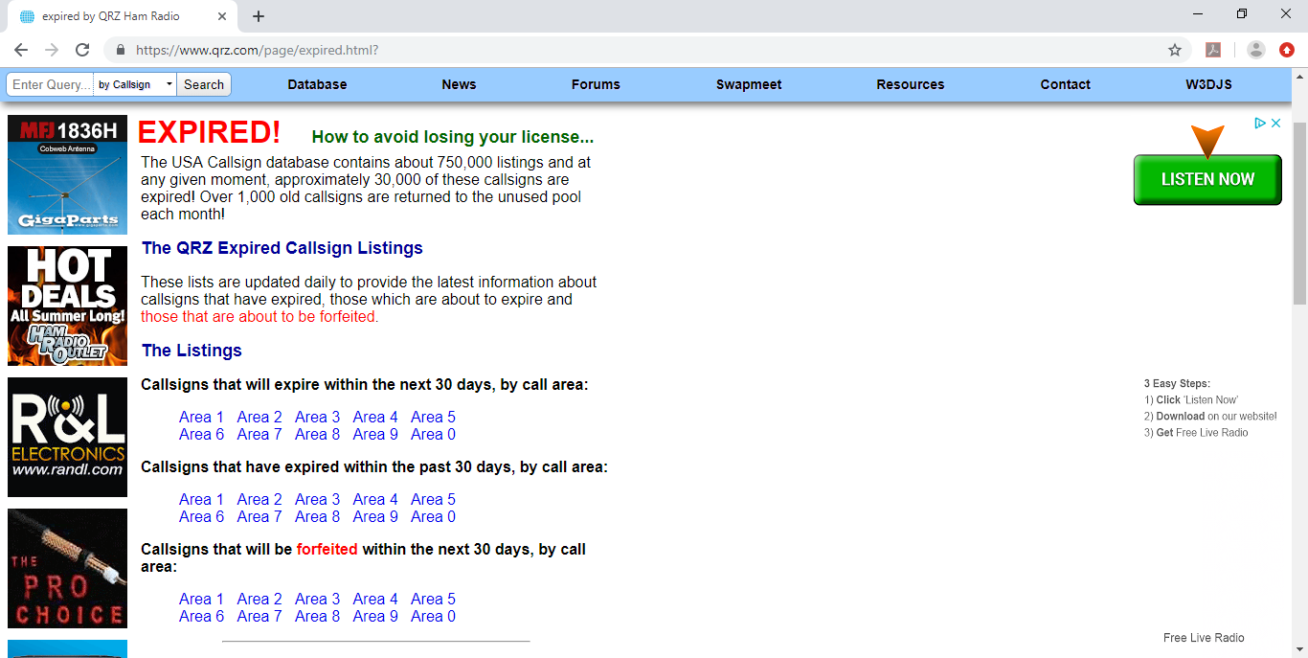
Expired Callsigns

Slide 19
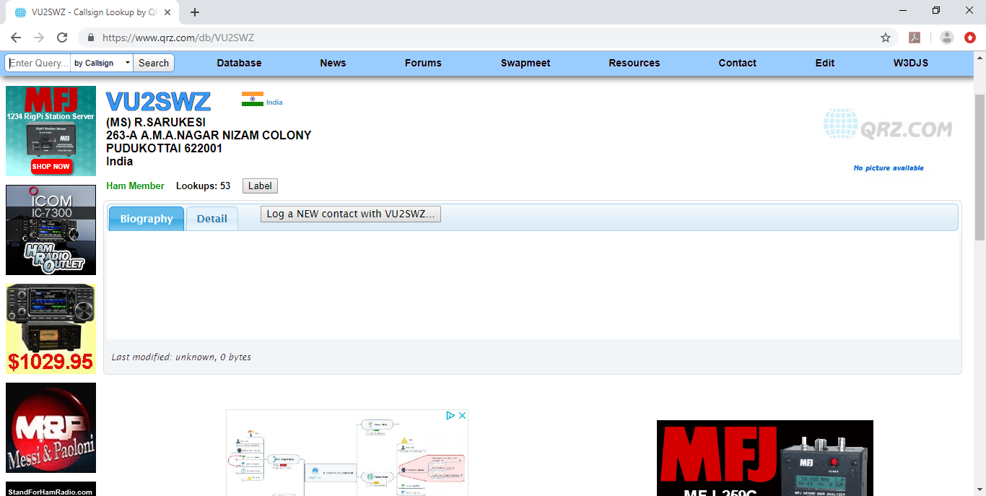
Random Callsign

Slide 20
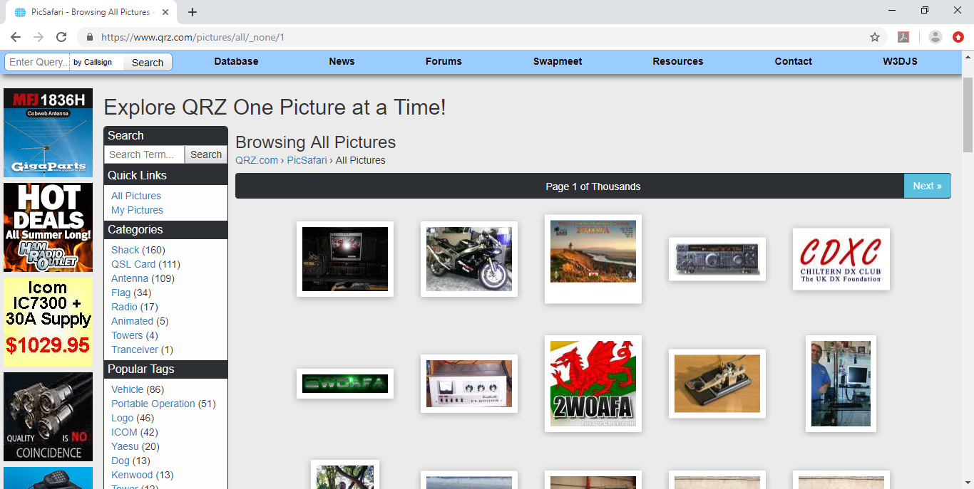
PicSafari

Slide 21
QRZ Message Forums
Amateur Radio News
General Announcements
Special Events + Contests
Hamfests + Conventions
Silent Keys Remembered
Ham Radio Discussions
Technical Forums
Logging and Contesting
RV + Mobile

Slide 22
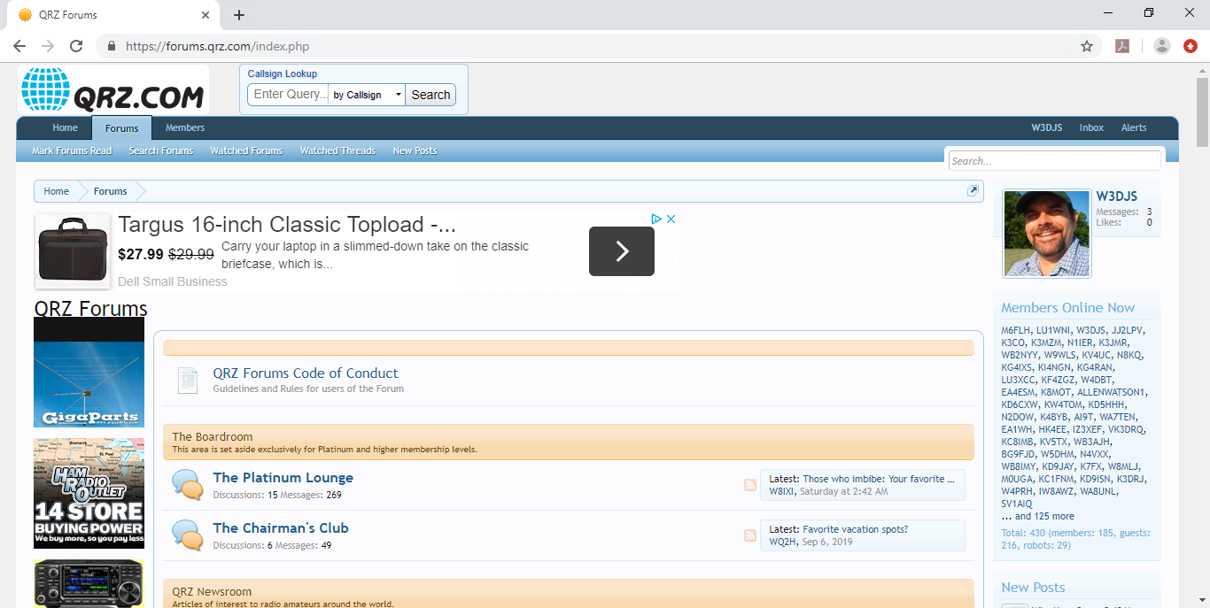
Message Forums

Slide 23
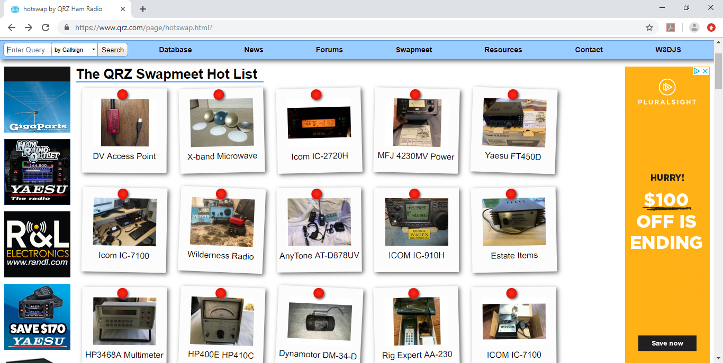
QRZ Swapmeet

Slide 24
Additional Resources
Practice Amateur Radio Exams
Amateur Radio Study Guides
Online License Renewals
License Wall Certificates
Commercial Ham Radio Links
DX Country Atlas
GridMapper
Ham Radio Trivia Quiz
QRZ Life Member Honor Roll
Help Desk
Subscription Services
Frequently Asked Questions (FAQ)
QRZ en Espanol
About QRZ
Donate to QRZ
Contact Us

Slide 25
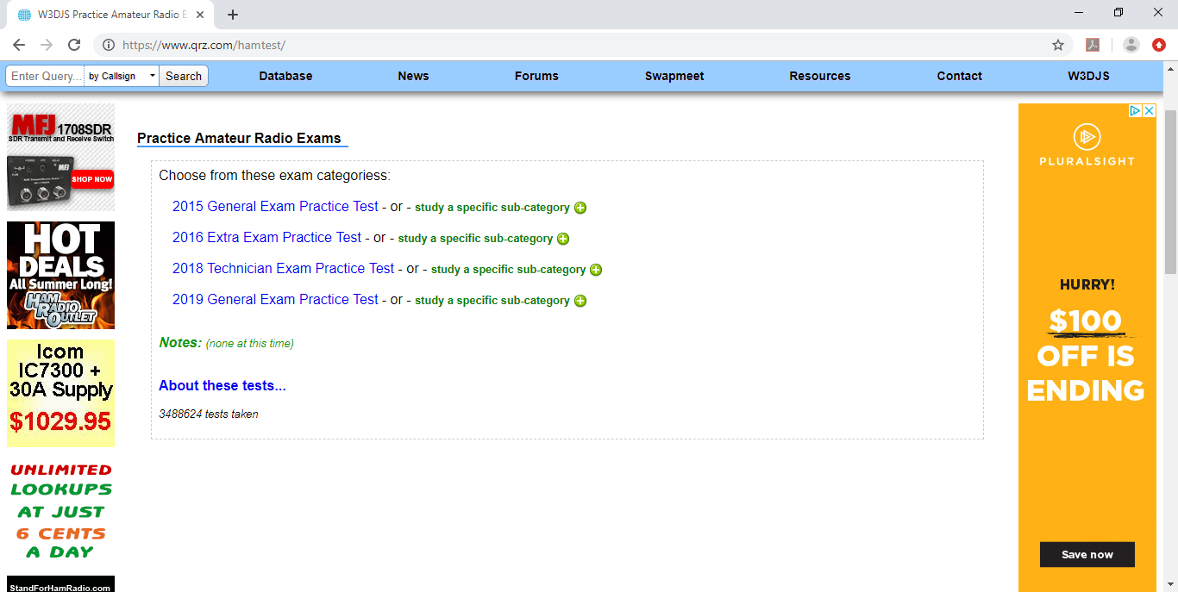
Practice Amateur Radio Exams

Slide 26
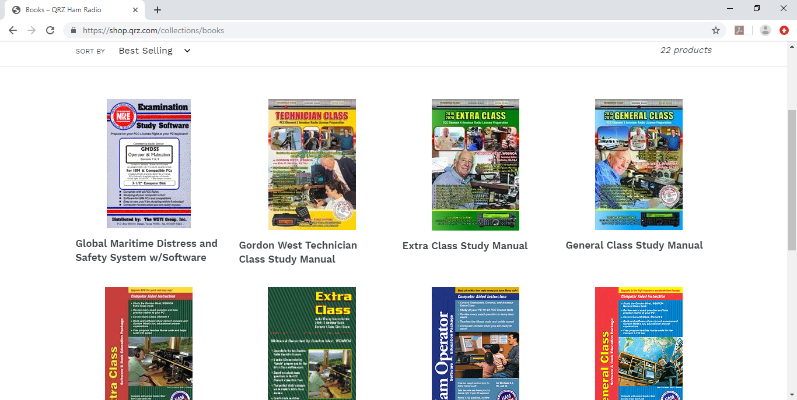
Amateur Radio Study Guides

Slide 27
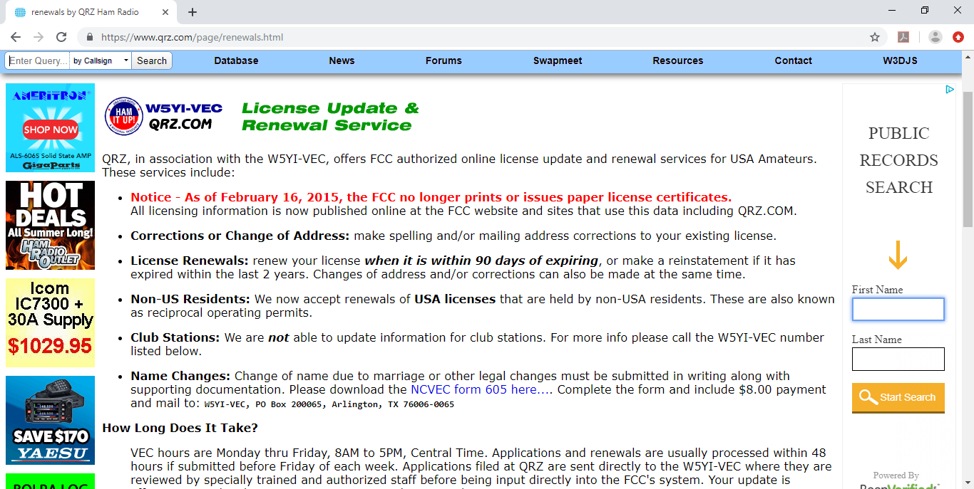
Online License Renewals

Slide 28
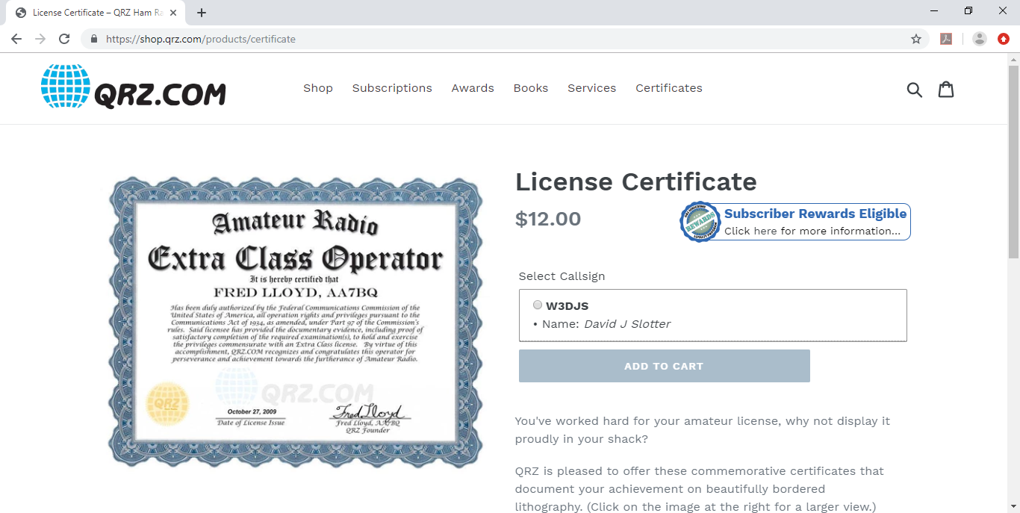
License Wall Certificates

Slide 29
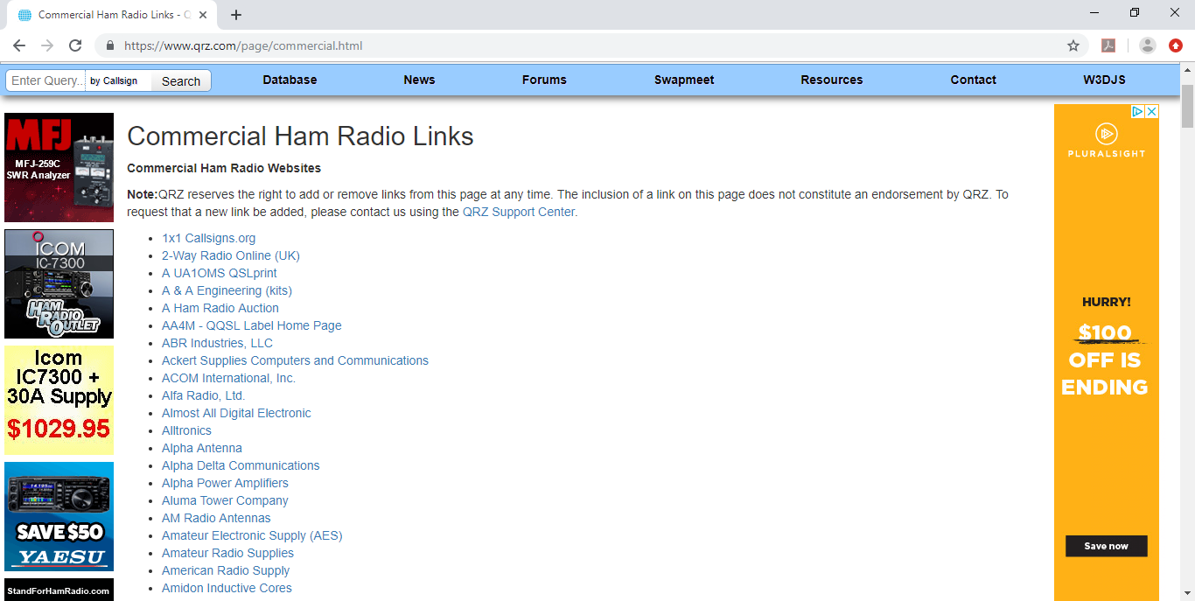
Commercial Ham Radio Links

Slide 30
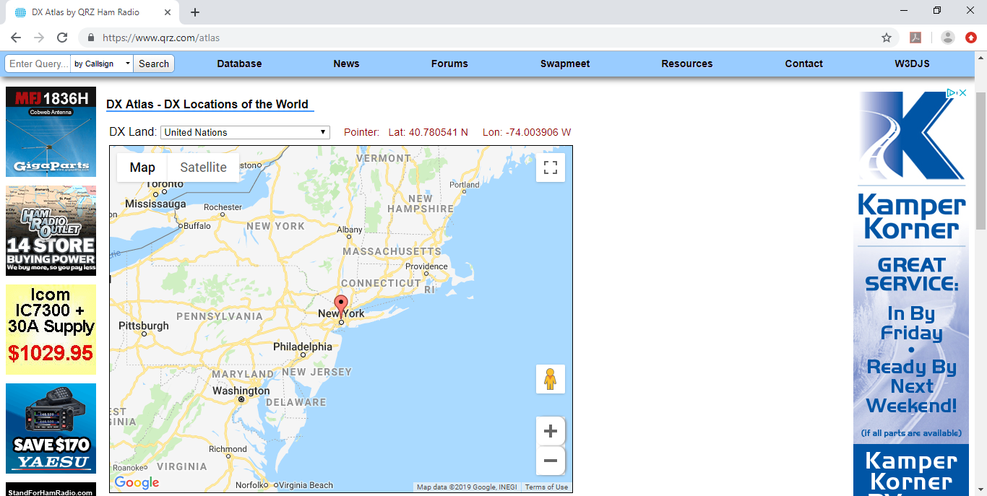
DX Country Atlas

Slide 31
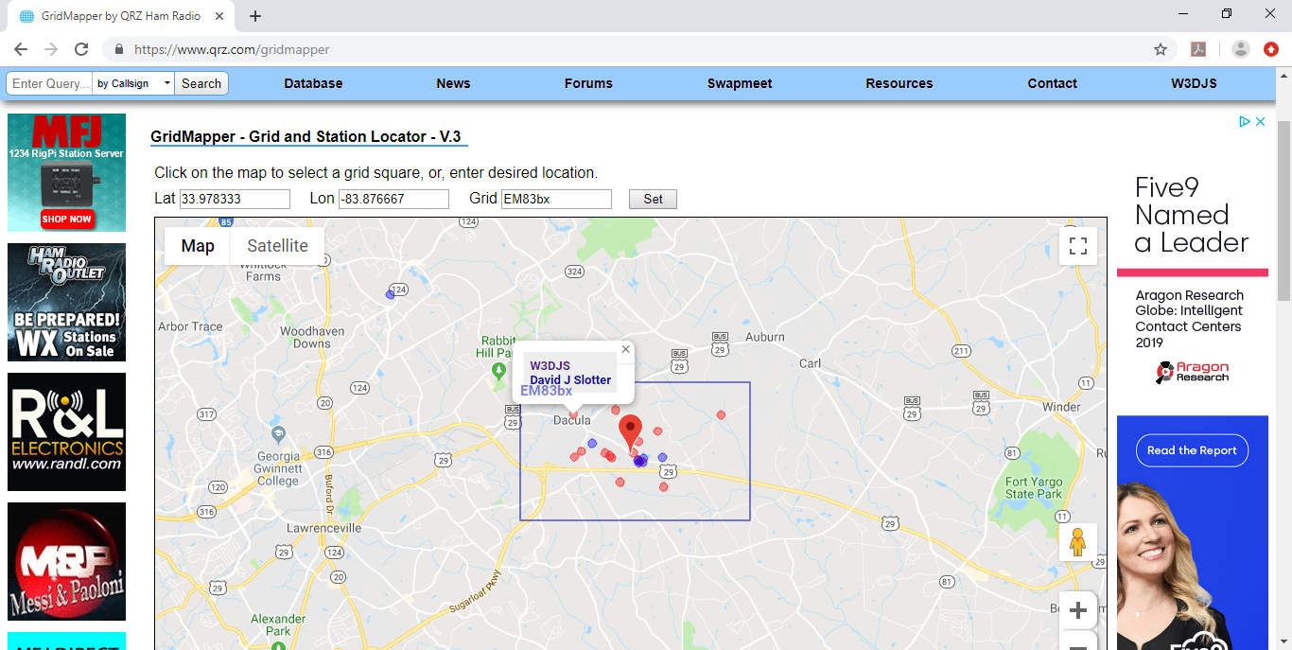
Grid Mapper

Slide 32
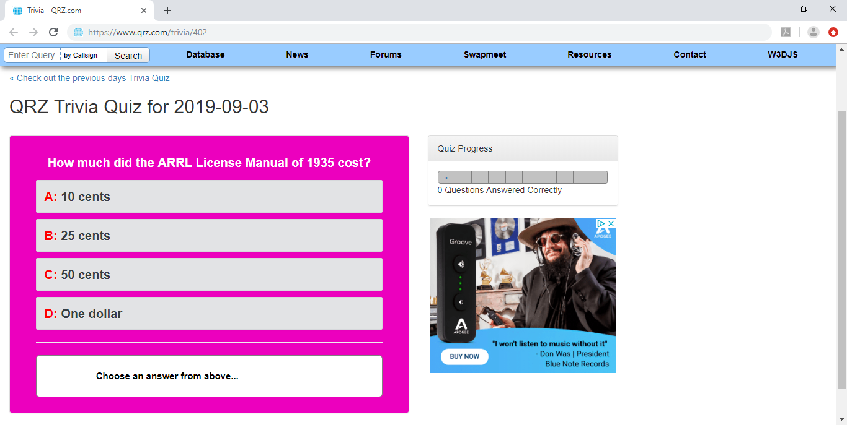
Ham Radio Trivia Quiz

Slide 33
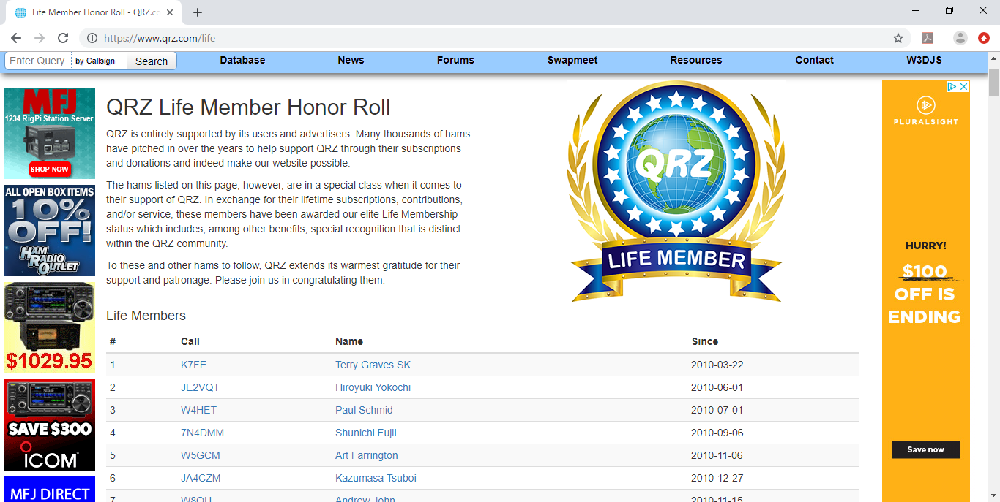
QRZ Life Member Honor Roll

Slide 34

Subscription Services (QRZ Store)

Slide 35
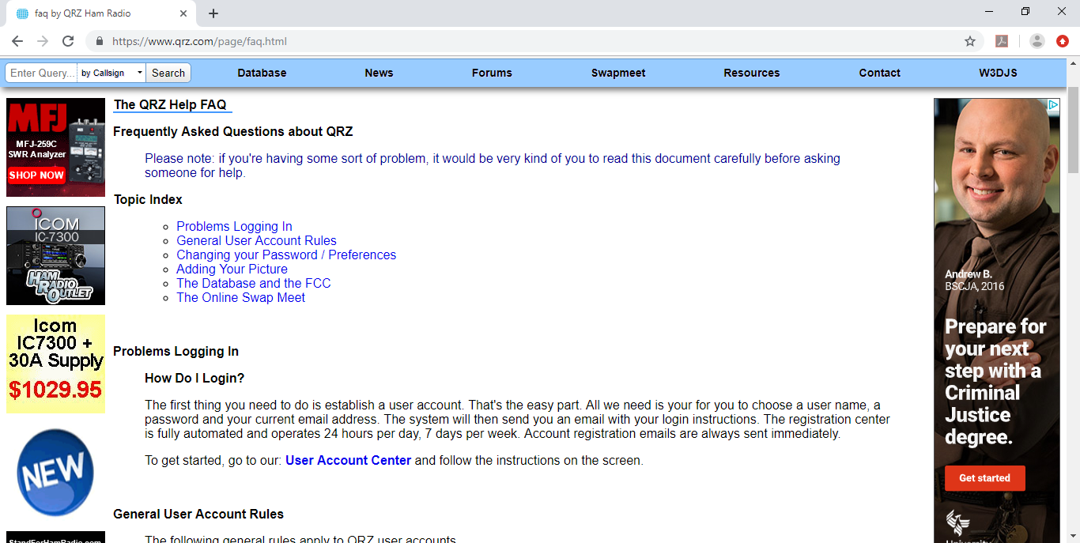
Frequently Asked Questions (FAQ)

Slide 36
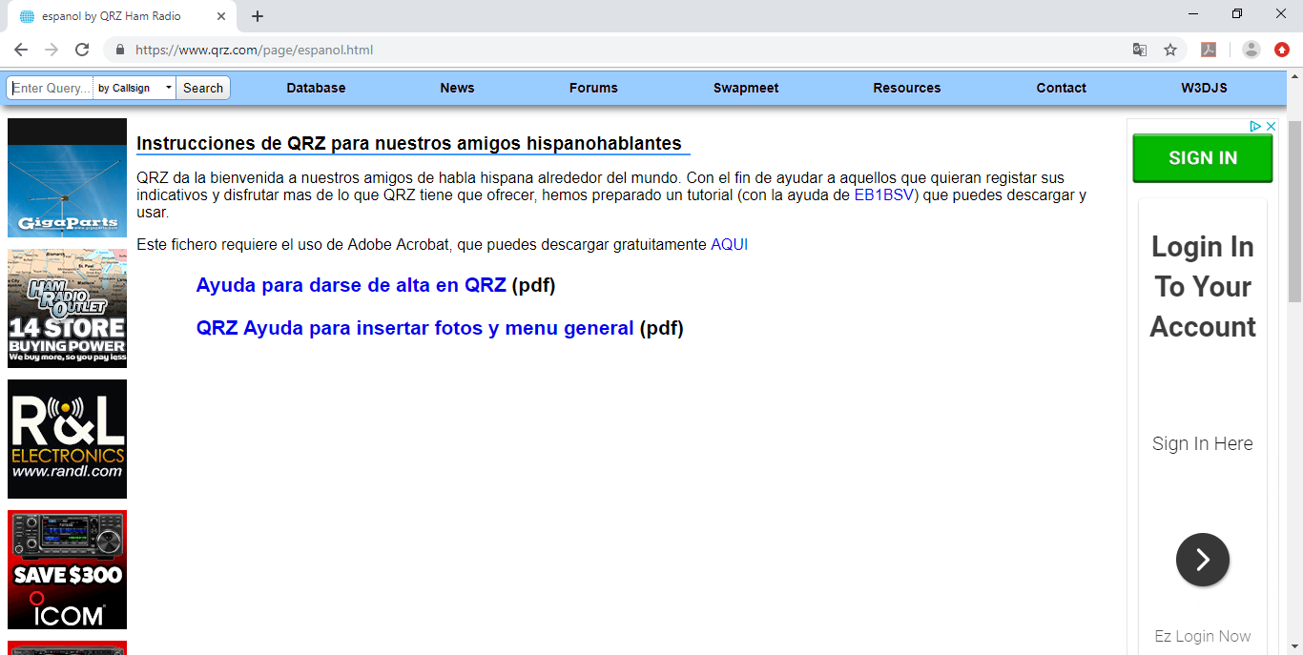
QRZ en Espanol

Slide 37
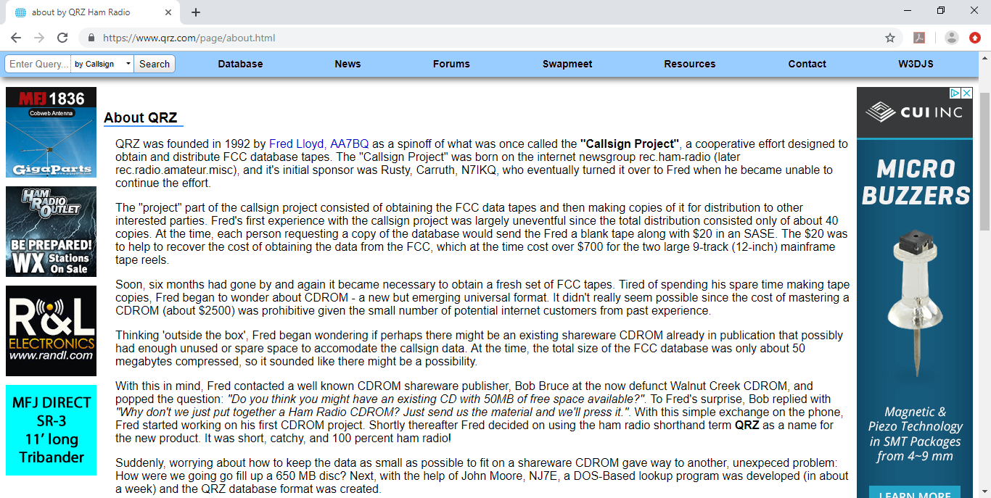
About QRZ

Slide 38
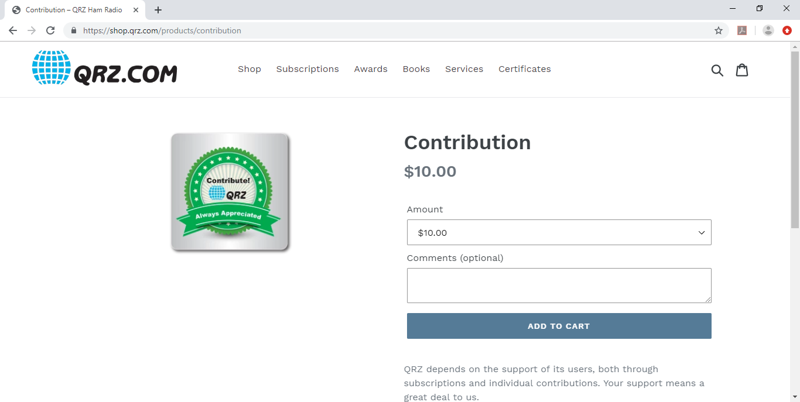
Donate to QRZ

Slide 39
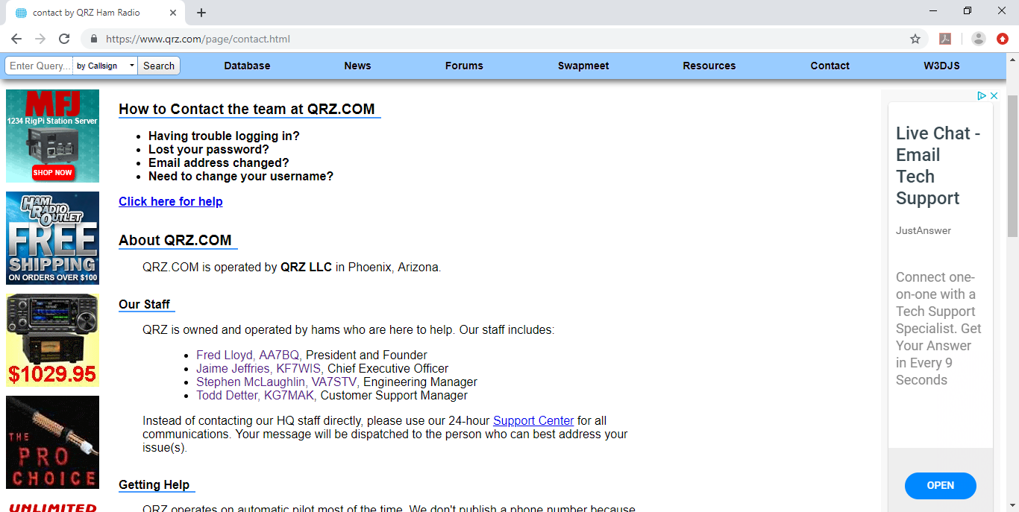
Contact QRZ Team

Slide 40
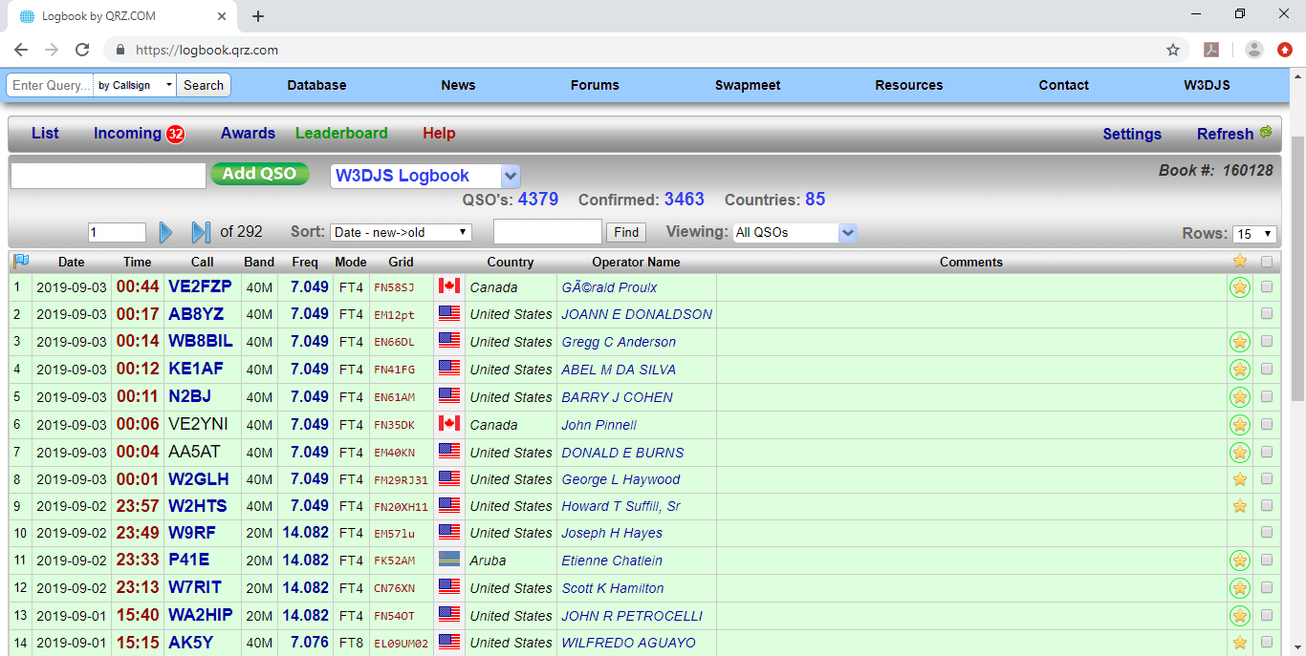
QRZ Logbook: List

Slide 41
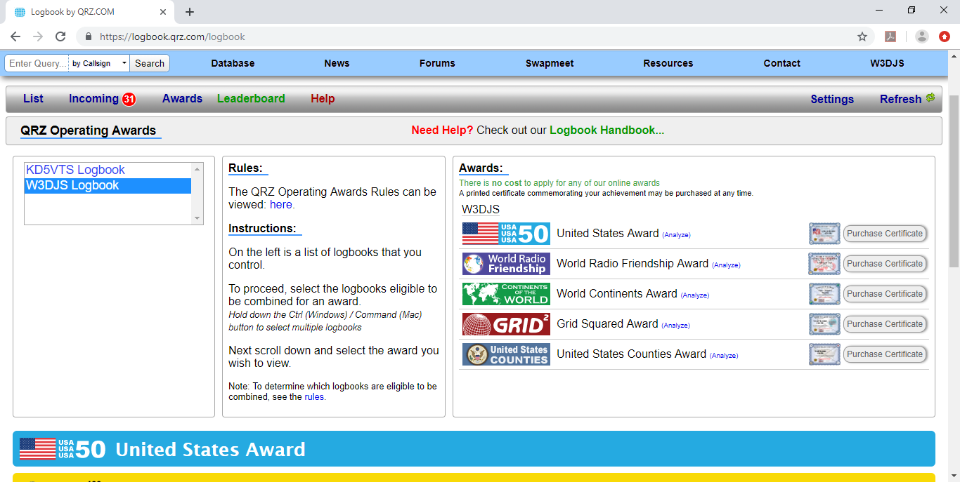
QRZ Logbook: Awards

Slide 42
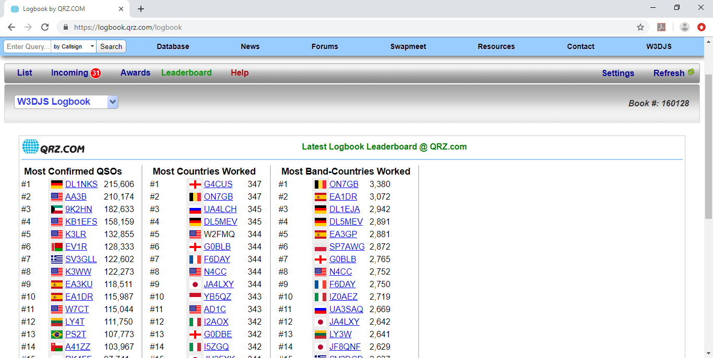
QRZ Logbook: Leaderboard

Slide 43
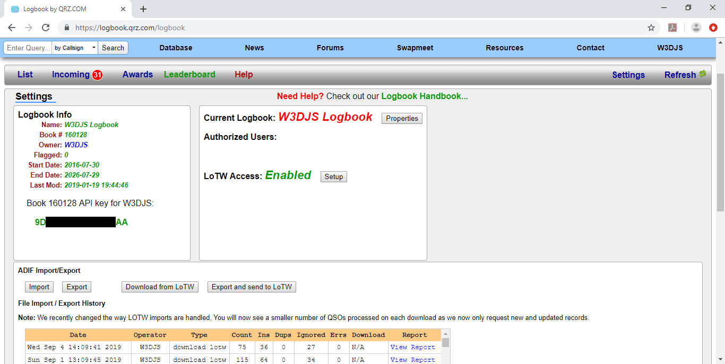
QRZ Logbook: Settings

Slide 44
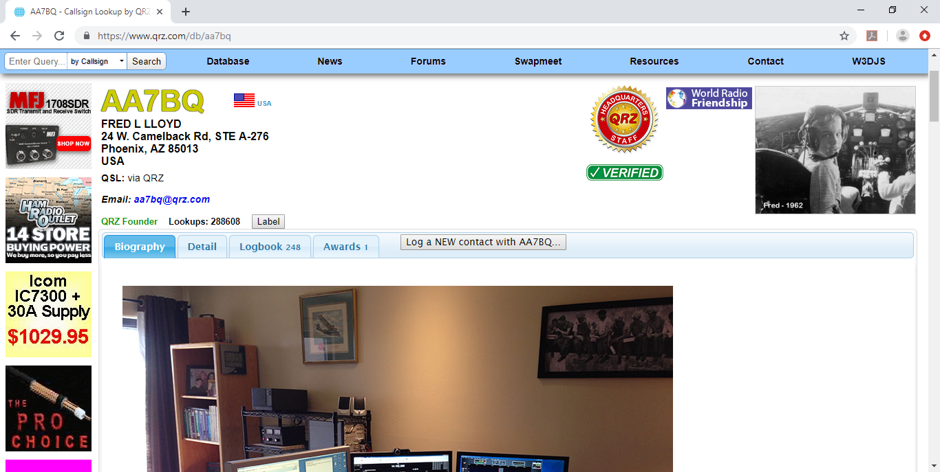
QRZ Profile

Slide 45
QRZ Callsign Colors
Black – Not QRZ Member
Light blue – Registered Member
Green – Subscriber (XML or Premium)
Red – Platinum Subscriber
Orange – Managed Callsign (special event stations)
Yellow – Lifetime Platinum Member
Dark Blue – QRZ Staff, Moderator
Gold – QRZ Headquarters Staff
Grey – Silent Key

Slide 46
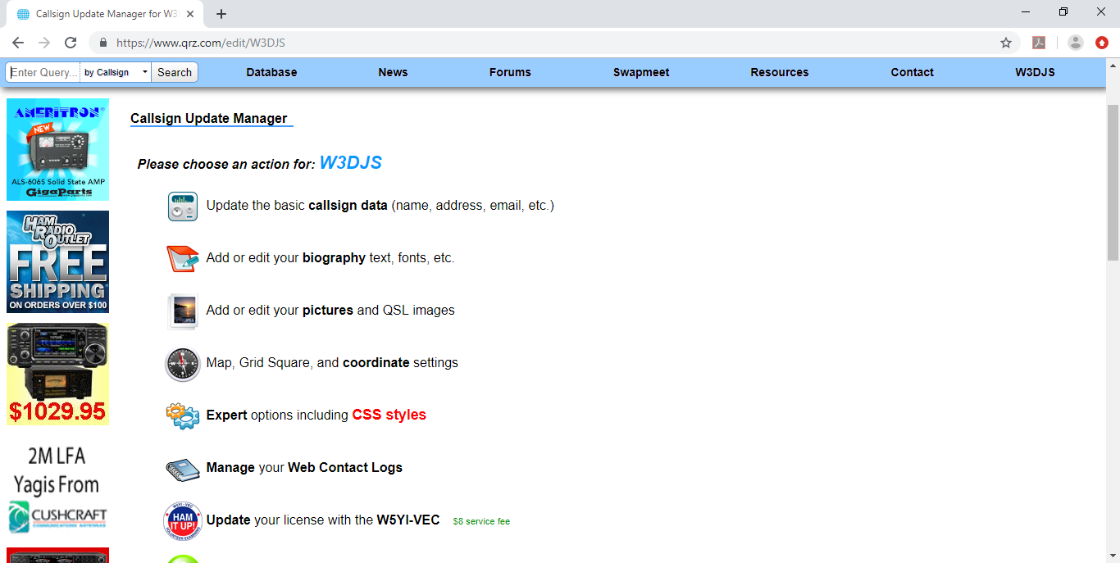
QRZ Edit Profile

Slide 47
Tips on Profile Creation
Suggested Topics:
  Your Job
  What Clubs You Belong To
  Your Other Hobbies
  Bands + Modes Used Most Often
  What Makes Your Station Special
  Radio Facets You Like
  How Do We QSL
Tips:
  Add Pictures to your QRZ Profile Page
  Be Accurate: Don’t Exaggerate (But Don’t Sell Yourself Short Either)
  Avoid Humor (Doesn’t Always Translate Well To Hams From Other Countries)
  Don’t Write About Yourself In Third Person
  Keep Your Profile Simple
  Keep Your Email Address Current
  Keep It Up To Date (Update Annually At Least)
Kyle Albritton, W4KDA, wrote an informative article on How to Write a QRZ Page:
<http://www.directdirt.com/2014/08/how-to-write-a-qrz-page/>

Slide 48

Questions?

