Slide 1
Goin’ Mobile!
Mobile Radio Installations
Alex Kowalchuk, W4KYW

Slide 2
Who is W4KYW?
Grew up around cars
6 Years, Chevrolet Dealerships
General Motors-Certified Automotive Technician
Corvette Specialist

Slide 3
Why Go Mobile?
Ability To Communicate While Traveling
Pass Time Commuting
Backup Station (Emergencies, No Commercial Power)

Slide 4
Key Planning
Power
Routing (Power Harness, Coax, Optional Head Unit)
Trimwork
Radio Mounting
Antenna Selection & Mounting

Slide 5
Planning the Installation
Finding Your Best Location for Radio
  Factory Mounting Bracket, Aftermarket Mounts
Where’s My Battery?
  Trunk
  Engine Bay
  Rear Floorboard, Under Rear Bench Seat
Locate “Pass-thru” in Firewall
  Grommet, Wiring Harness
Antenna Mounting
  Trunk/Hood Lip
  Roof/Rack
  Truck Bed

Slide 6
What Types of Radios?
VHF/UHF Mobile Radio
HF Mobile Radio
HT with External Antenna
HT without External Antenna
  Faraday Cage Effect

Slide 7
What Types of Antennas?
Dual-band 2m/70cm
  Diamond Antenna NR or SG Series
Monoband
Magnetic Mount (Avoid, if possible...)
  Damages paint over time
  Could be blown-off at high-speeds , passing oncoming trucks
  Not the best ground coupling
Coax Length

Slide 8
Battery Connections
Disconnect Ground (-) Cable First
Use Chassis Ground (-) if possible!
  Negative Current Monitor Sensor on Negative Battery Cable
  Easy to find - should be a short cable run to chassis
  Radio current could trick alternator to run too often, setting DTCs
12V Battery Positive (B+) Terminal
USE ONLY Fused Ground (-) and Positive (B+) Power Harness
“If it looks good, it is good.”

Slide 9
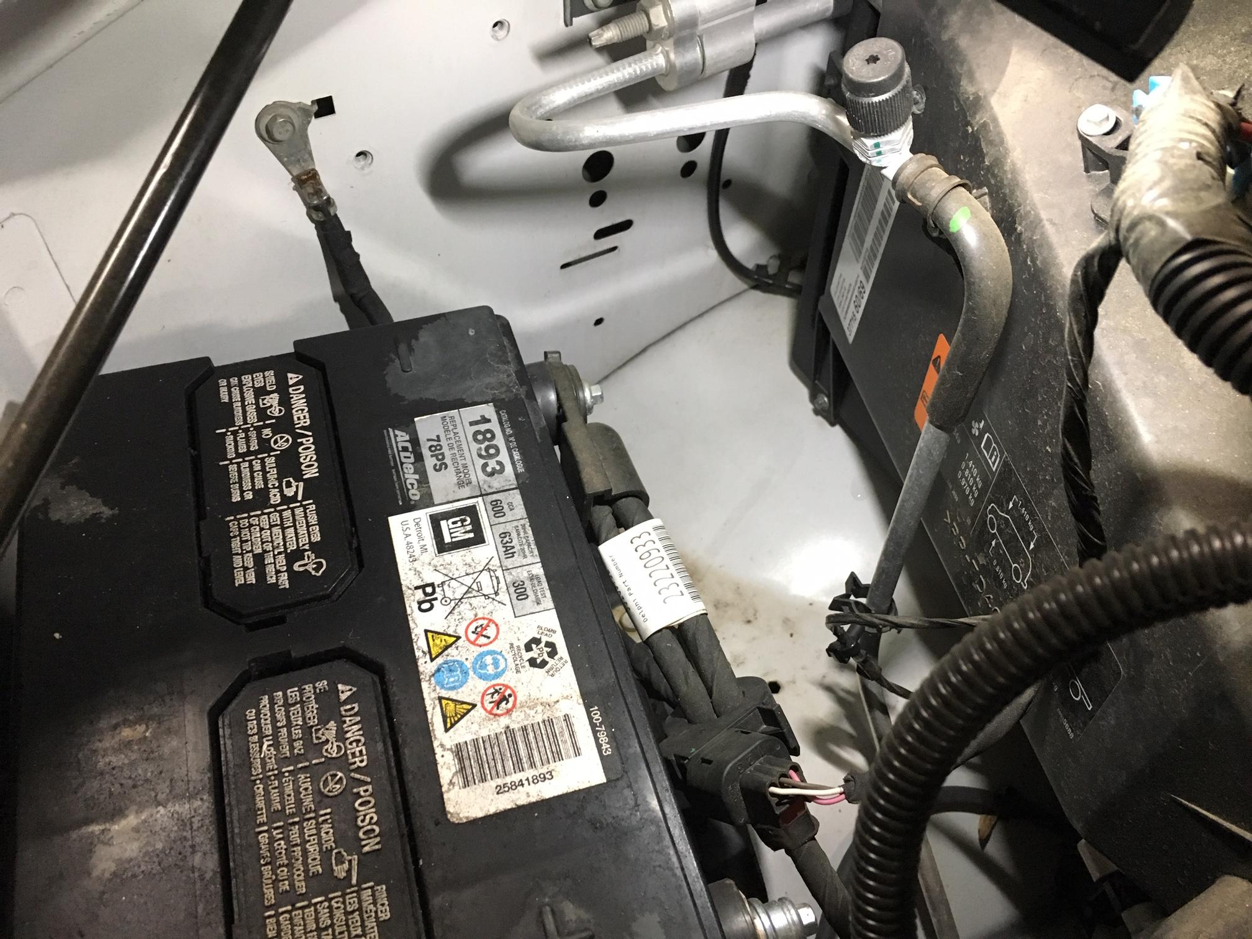
Negative (-) Chassis Ground

Slide 10
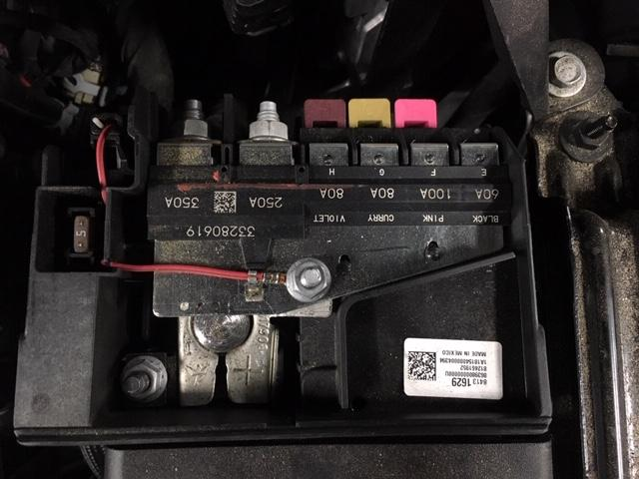
Battery Positive (+) Fuse Block

Slide 11
Firewalls
Search for harness pass-through grommet from engine bay first.
Search under instrument panel for same harness.
Make a slit in the pass-through grommet for harness.

Slide 12
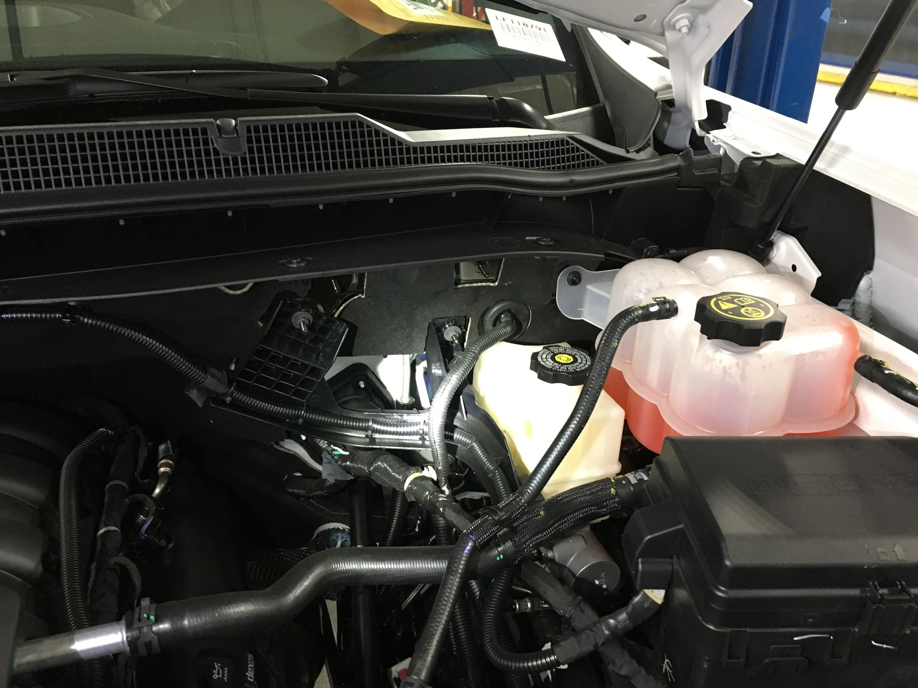
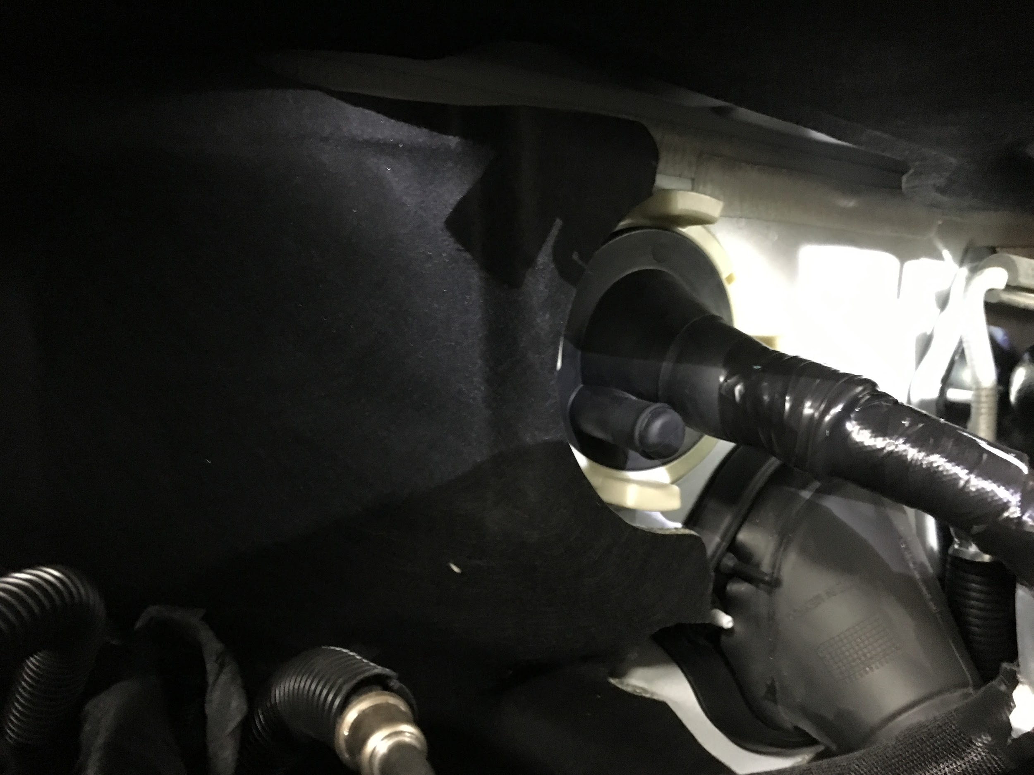
Firewall / Engine Bay

Slide 13
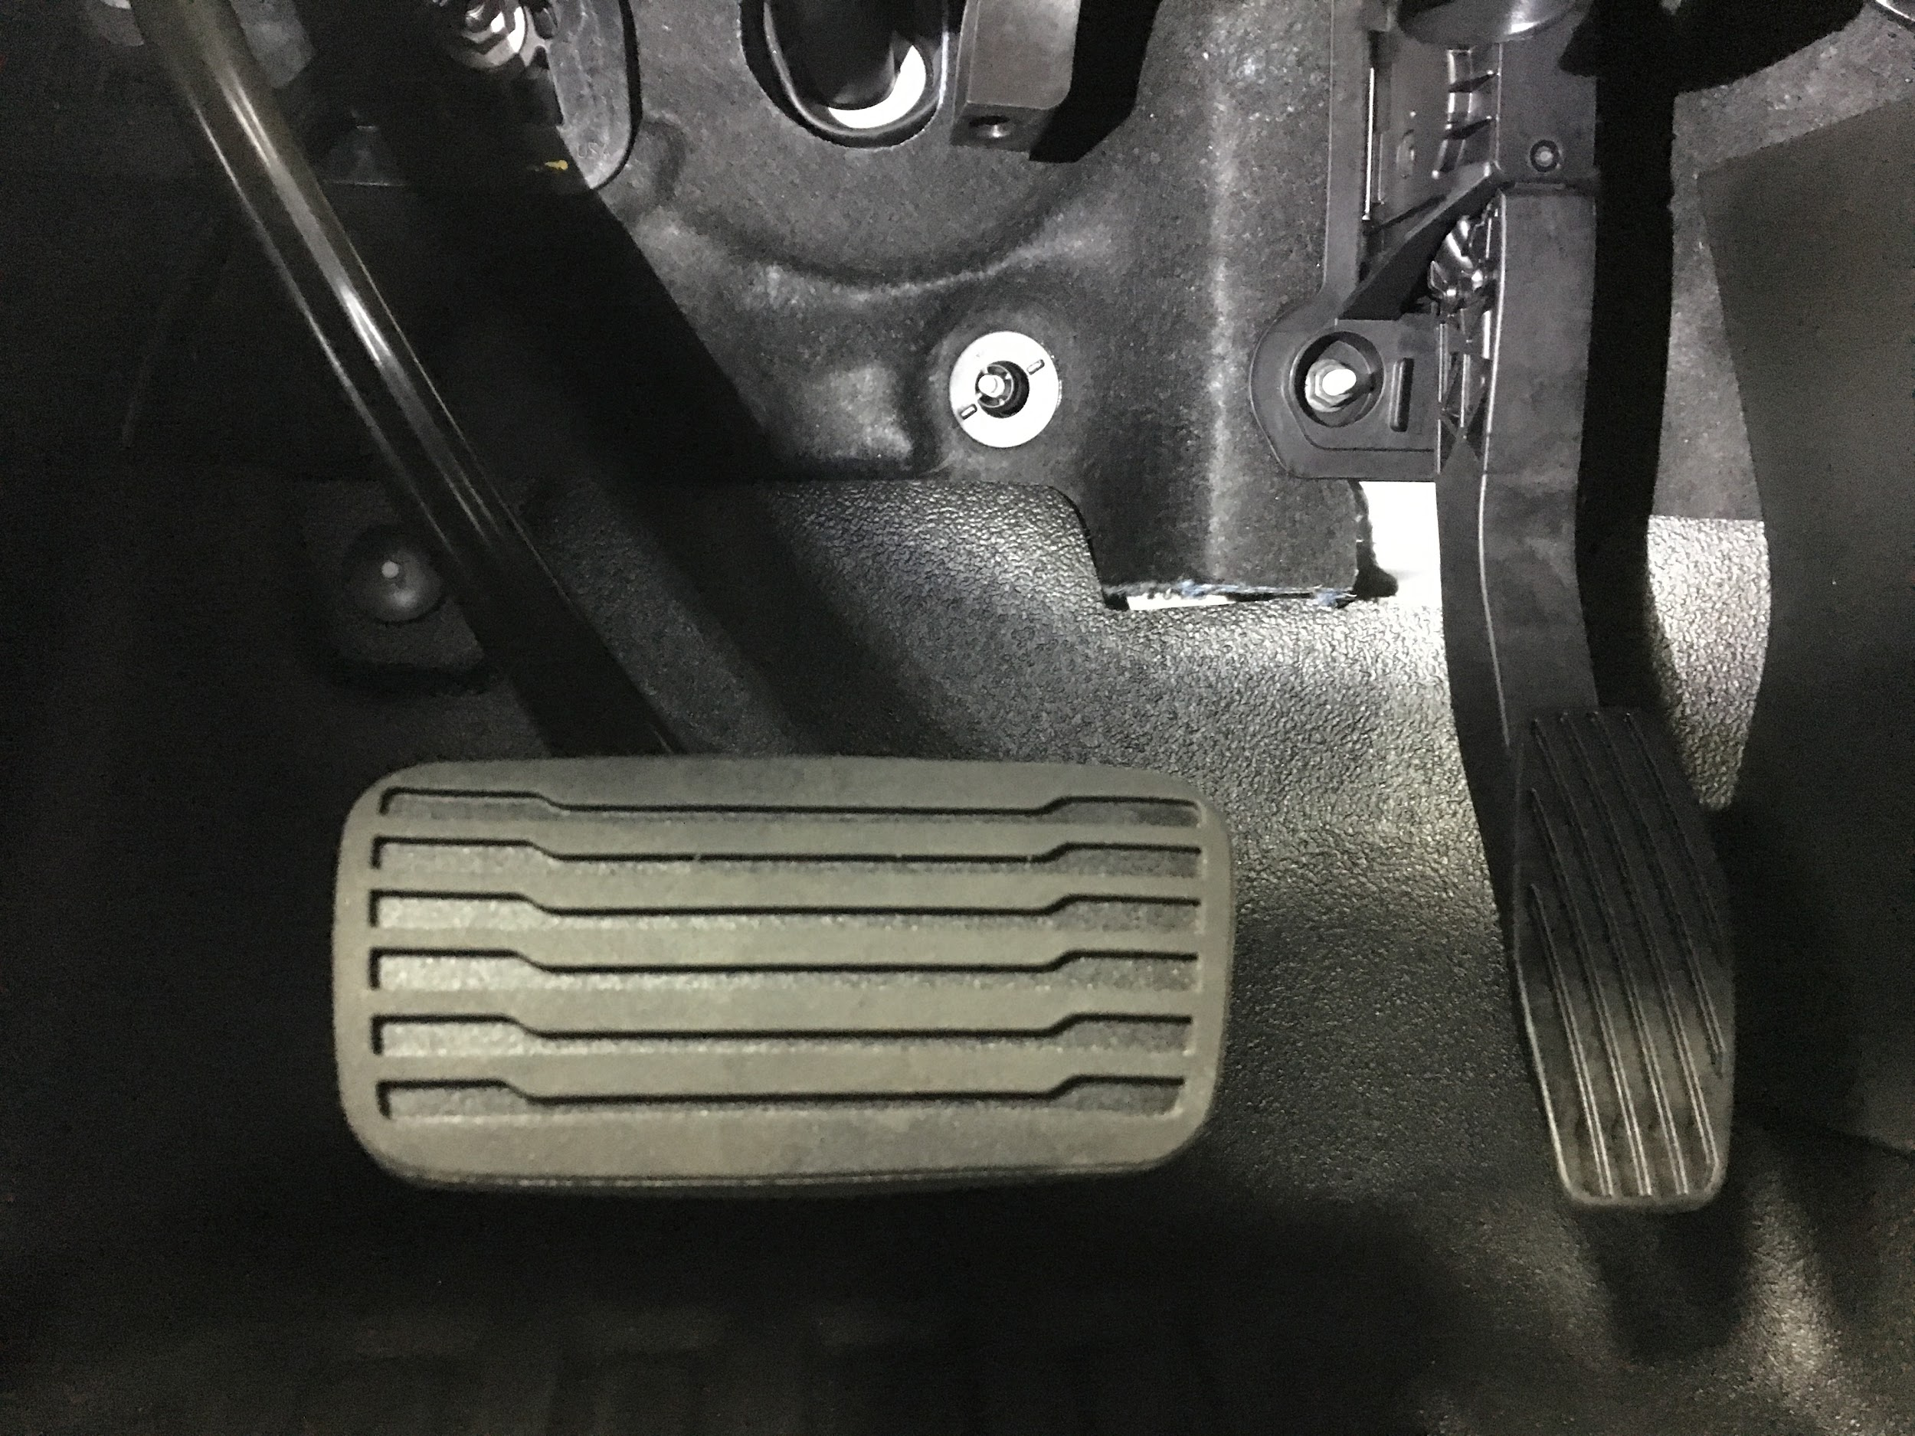
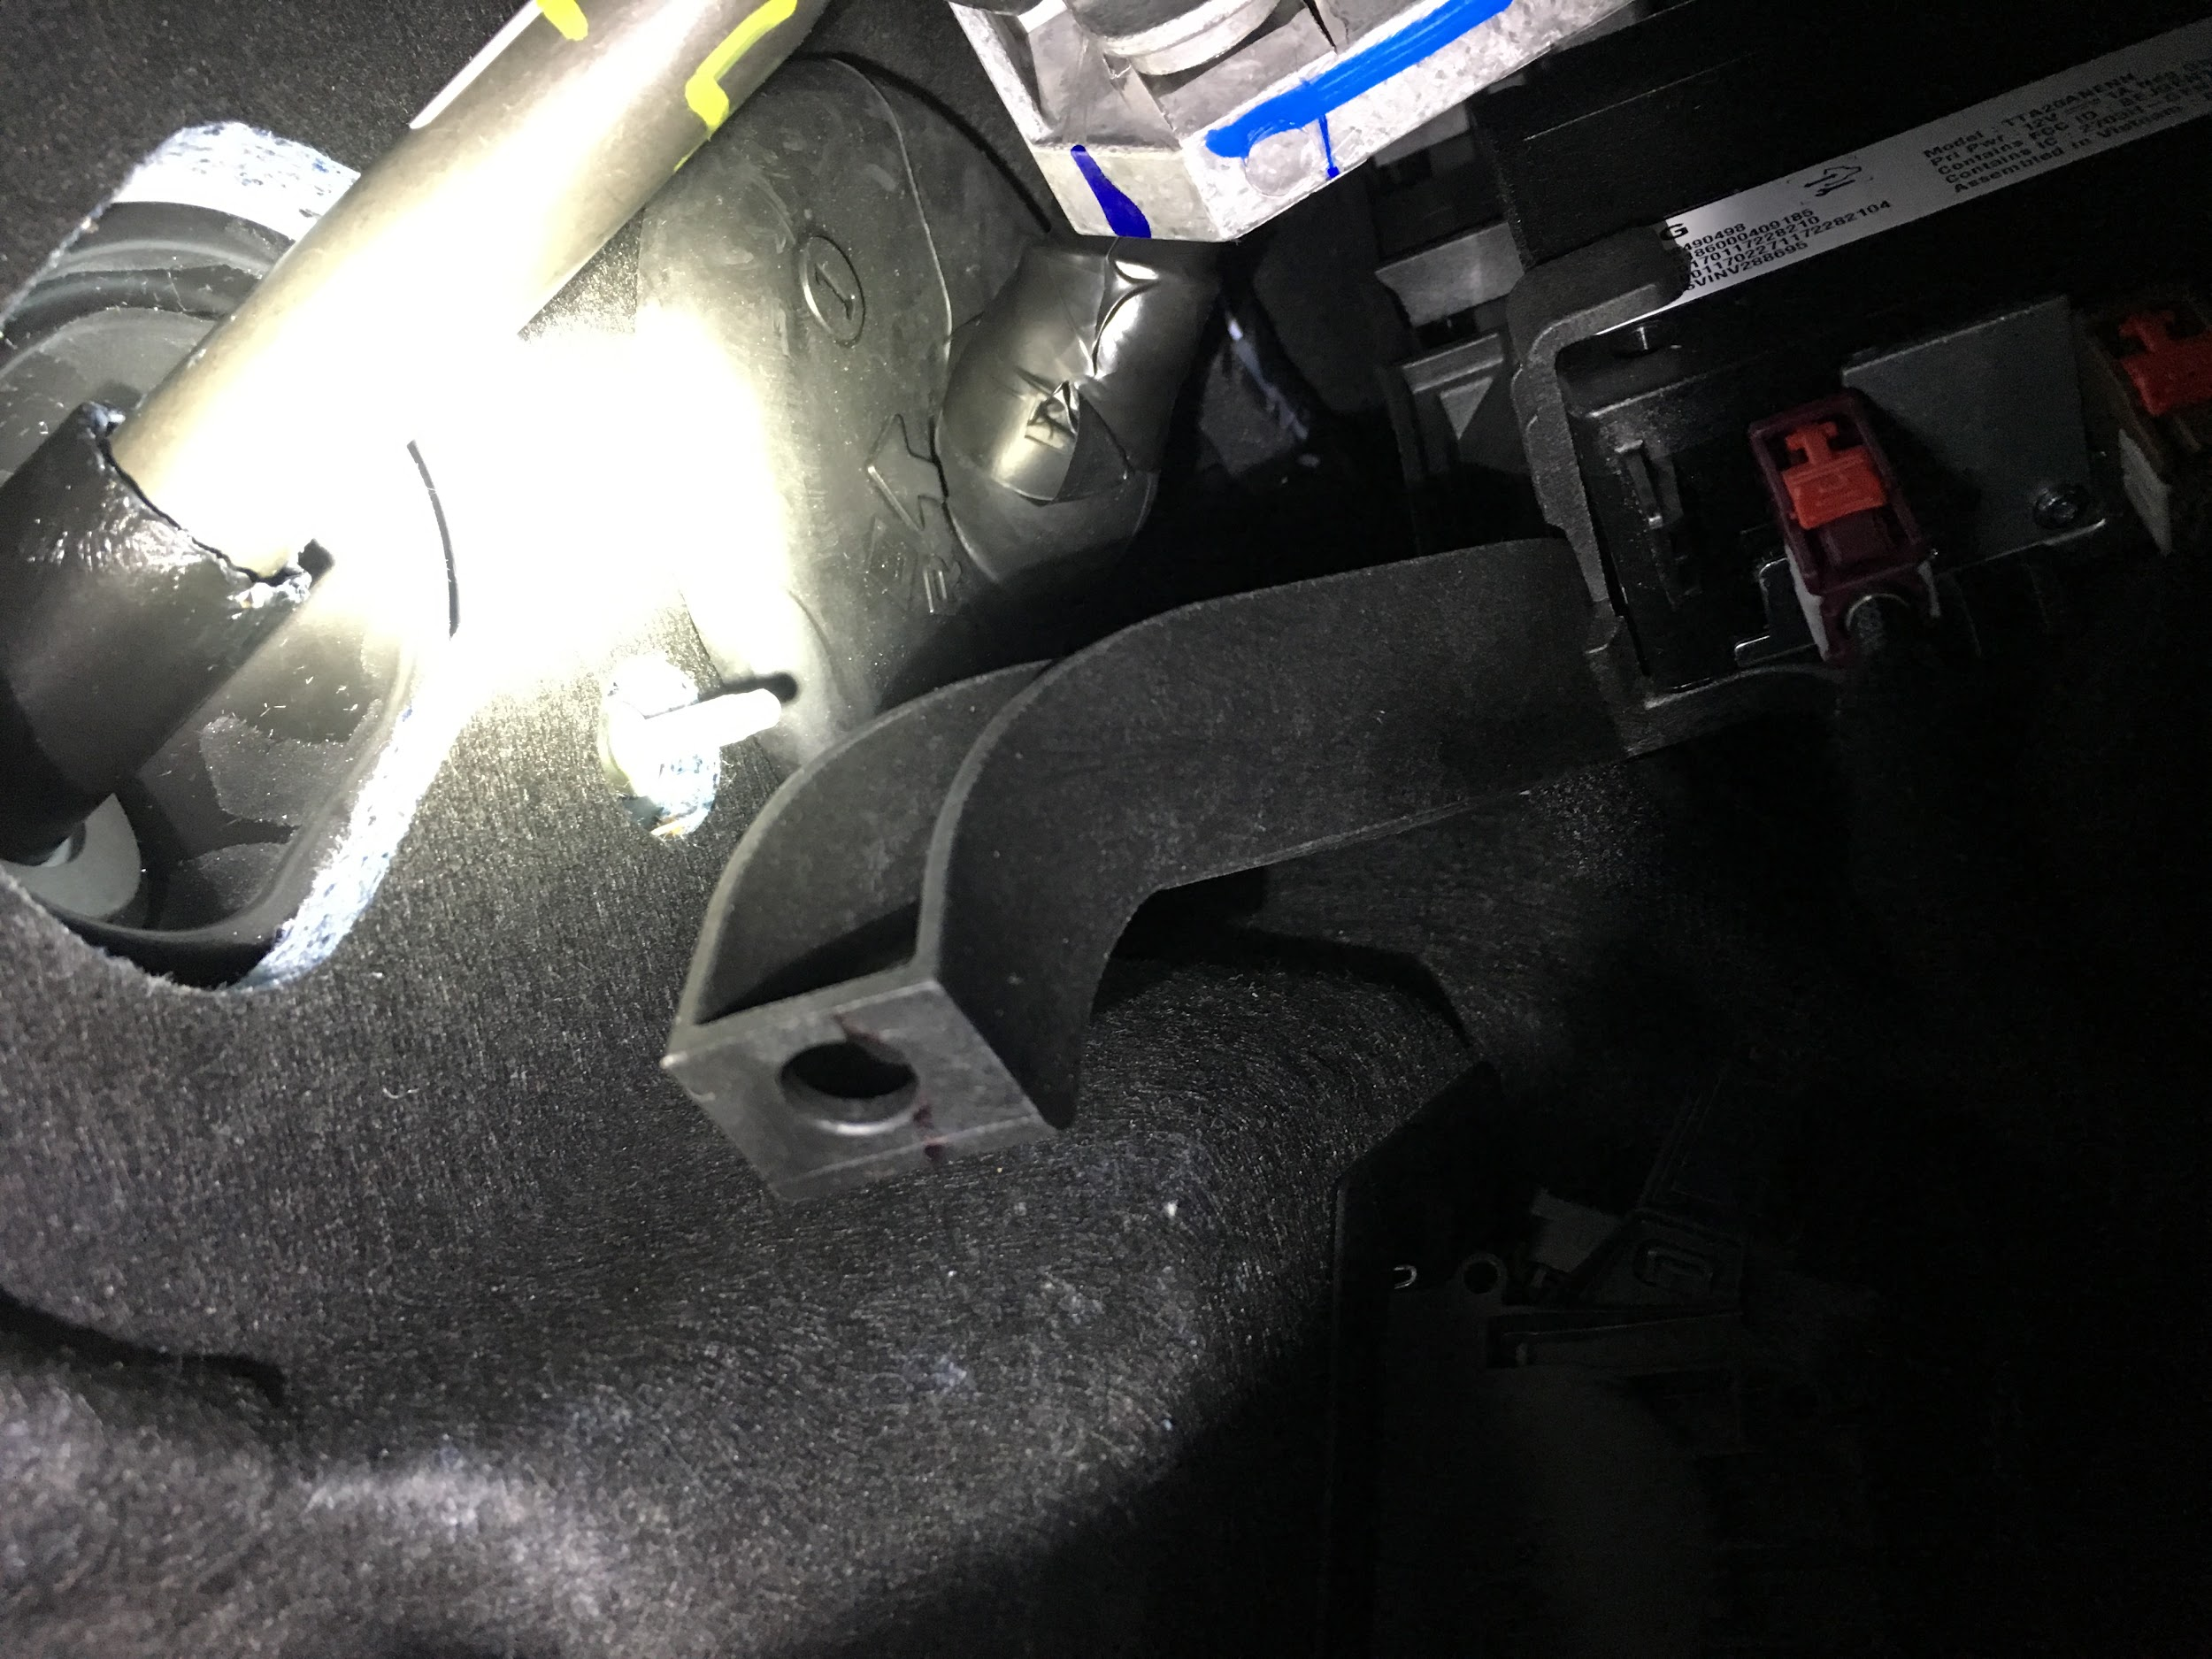
Instrument Panel Area

Slide 14
Radio Mounts
Mount Control Head/Radio In Most Ergonomic Area
Utilize OEM Bracket
Use A Mounting System For Multiple Radios
External Speaker
Mount Suppliers
Havis
Lido Radio (No Holes!)
Walcott Radio

Slide 15
Coaxial Cable Routing
No more than 15-20’
Utilize the least used door or find a stress-free exit area to route
Depending on antenna mount, RG-316 jumper over weatherstripping

Slide 16
Antenna Mounts
Diamond Antenna Mounts - Trunk Lid, Luggage Rack
Comet Antenna Mounts
Laird Mobile Mounts
If drilling for antenna mount, use body-seam sealer to weatherproof mounting location.

Slide 17
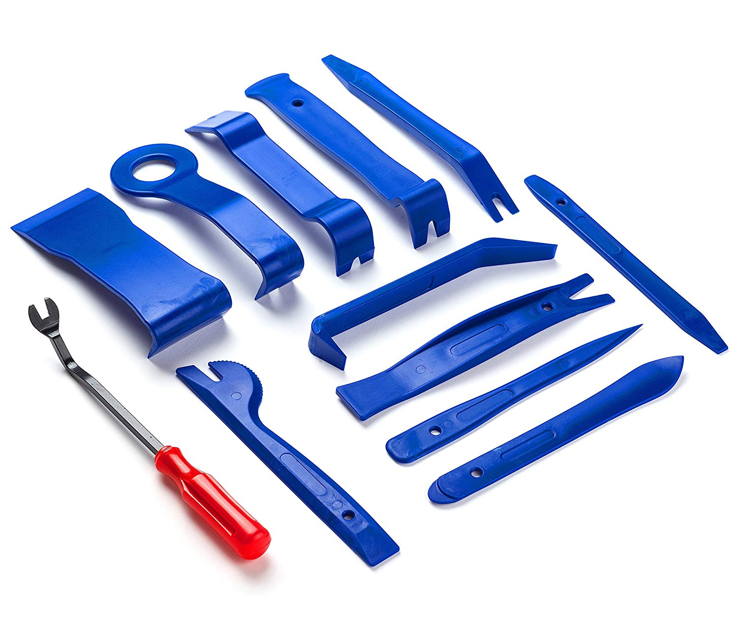
Trimwork
Easier than you may think - but consider vehicle age…
  Plastic trim becomes brittle over time - especially in colder weather
  Trim retainers are somewhat one-time use ...
Tucking coax, power harness
Plastic Trim Tools
  Available at any parts store

Slide 18
Radio Frequency Interference (RFI)
20+ modules with power, data, and wireless RF
  Bluetooth, Enhanced Cell Phone Connectivity, Tire Pressure Monitoring System (TPMS), Wireless Charging, Vehicle Proximity Sensors, Lane Departure Systems, A/C Power Sockets, etc…
Improve the ground-plane and maintain antenna resonance
  ½ λ or ⅝ λ
  Don’t seek out an (electrically) short antenna, if possible.
Common Mode Chokes
Bonding Exhaust Tailpipe
Shotgun-blast approach rather than endless trial and error.

Slide 19
Radio Mounting Examples

Slide 20
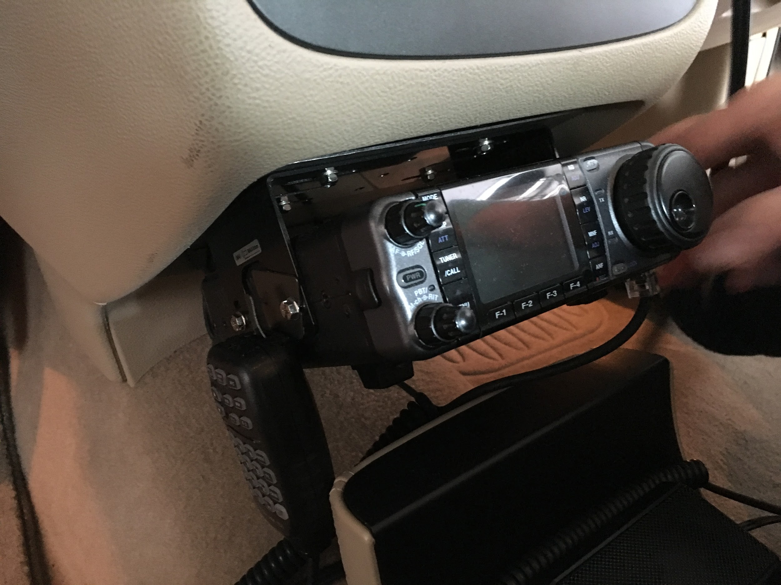
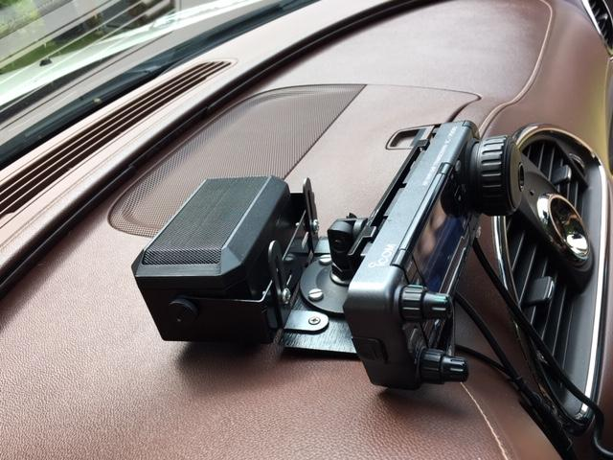
N4GYN

Slide 21
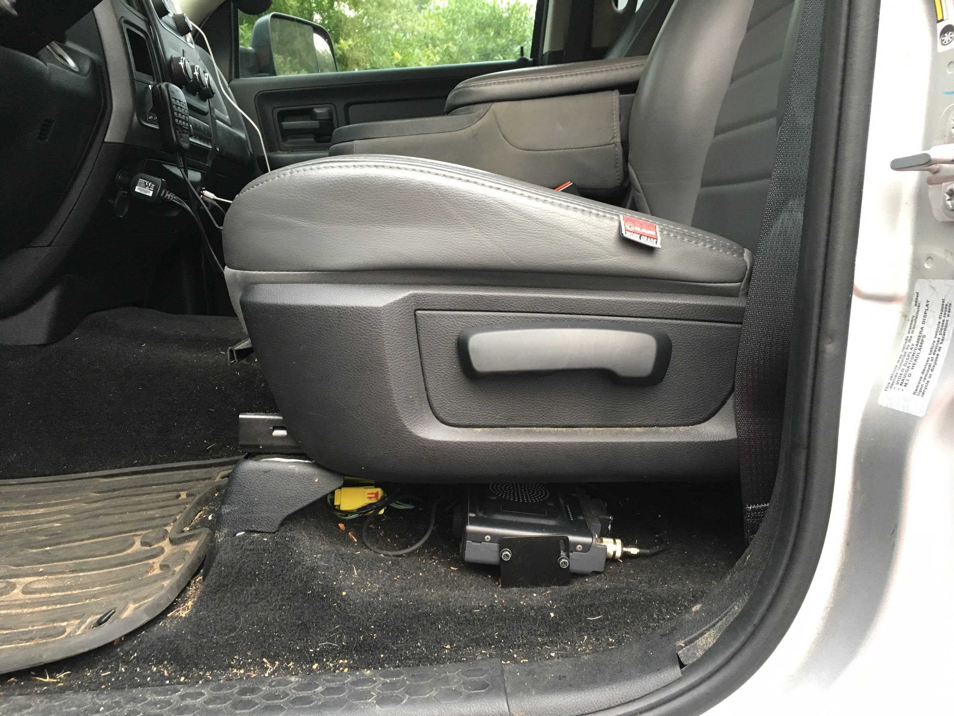
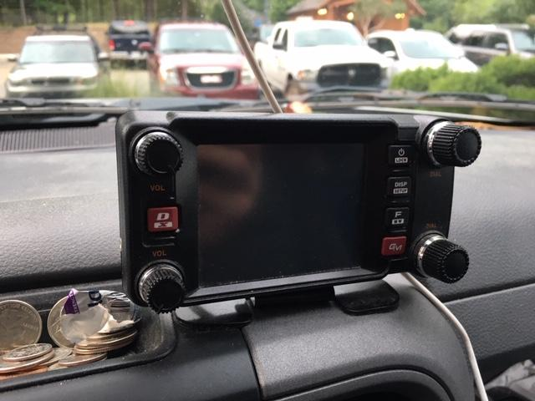
W3DJS

Slide 22
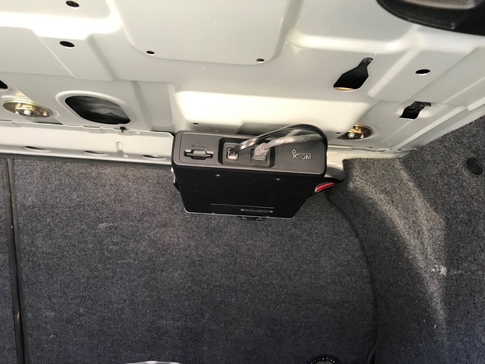
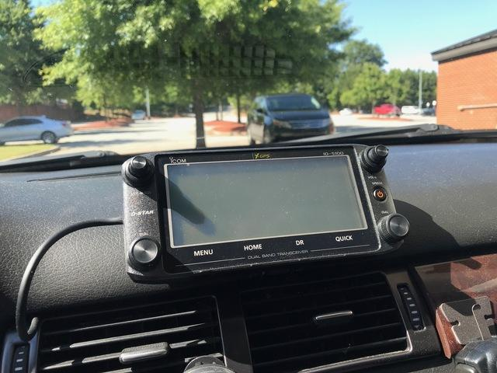
W3WWT

Slide 23
Antenna Mounting Examples

Slide 24
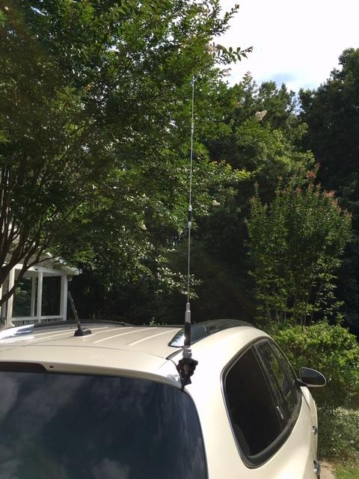
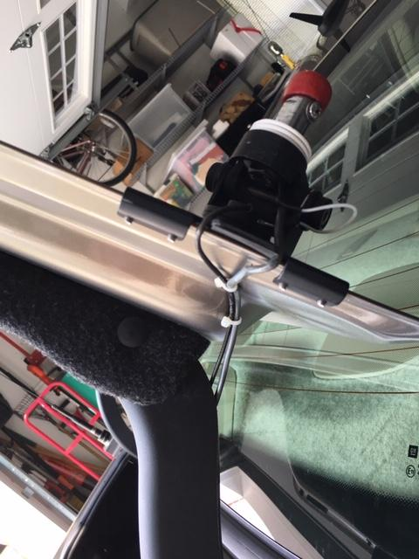
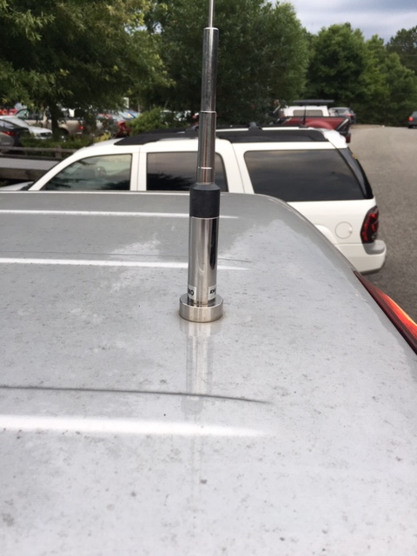
Antenna Mounting Options

Slide 25
Thank you!
73 DE W4KYW

