Slide 1
DIGITAL CLIENTS AND MODES
an overview
Bill Hawkins WR1TR
Notes:
Files and questions after

Slide 2
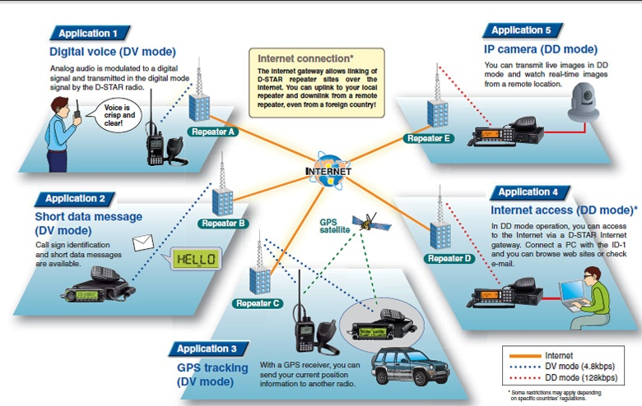
Notes:
What we are not going to do
Not deep in the Dstar network or Dstar voice

Slide 3
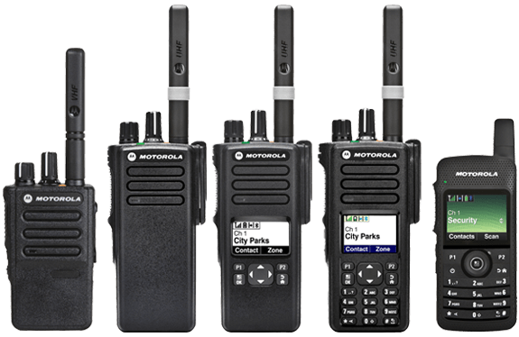
Notes:
No DMR , Fusion, or other digital voice modes

Slide 4
WHY WORK DIGITAL?
Notes:
Somebody tell me?

Slide 5
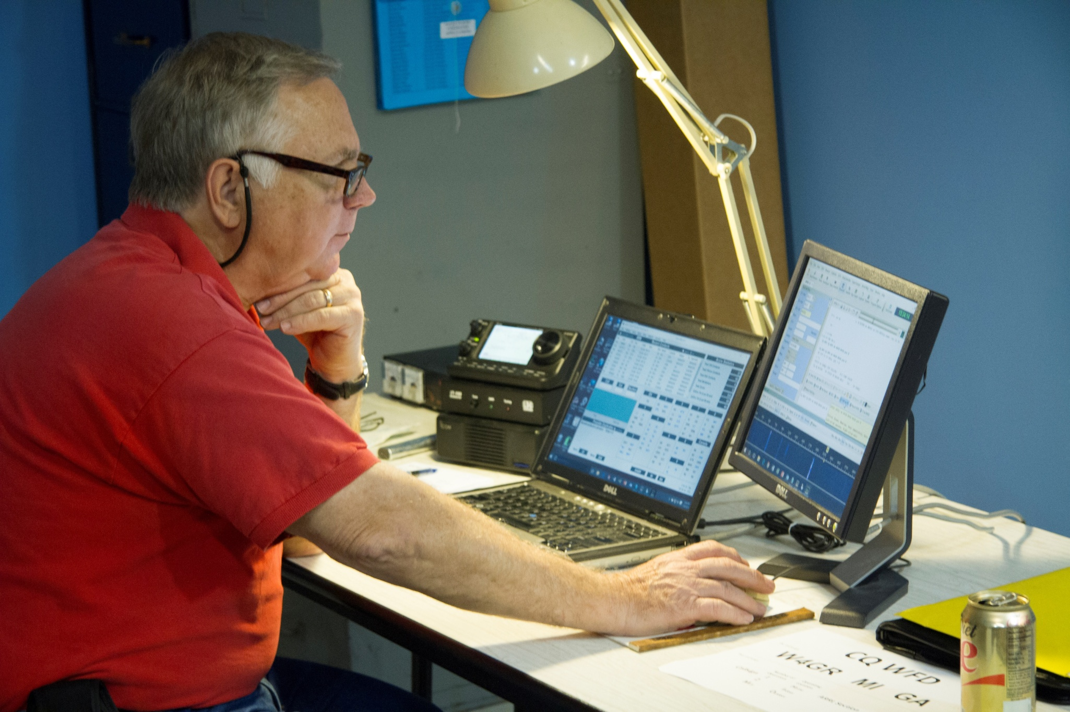
Notes:
Easy to do
Works in poor band conditions
Uses tiny bandwidth compared to ssb
Good for contesting

Slide 6
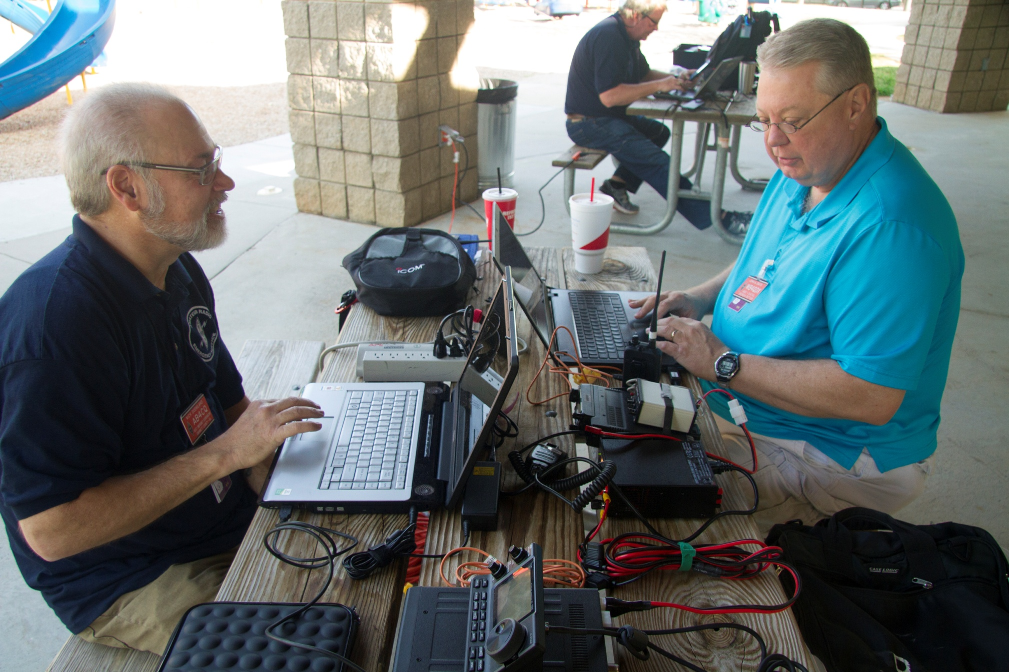
Notes:
Supports forms and Good for emergency use

Slide 7
WHY NOT WORK DIGITAL?
Notes:
audience

Slide 8
Notes:
It’s scary
Hard to set up and get started

Slide 9
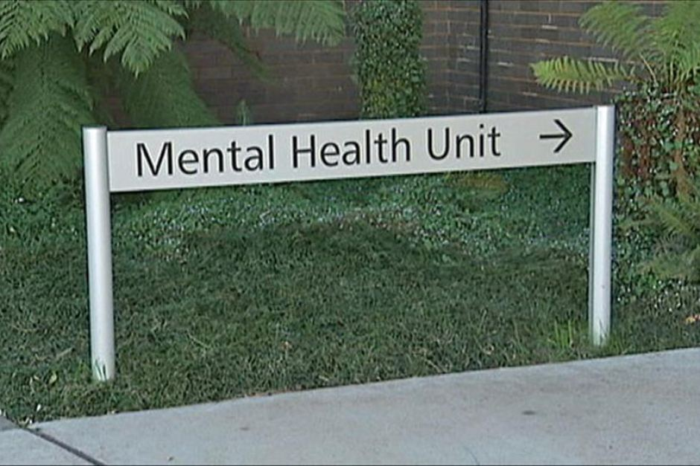
Notes:
We are here to help
Tonight – after the presentation and …

Slide 10
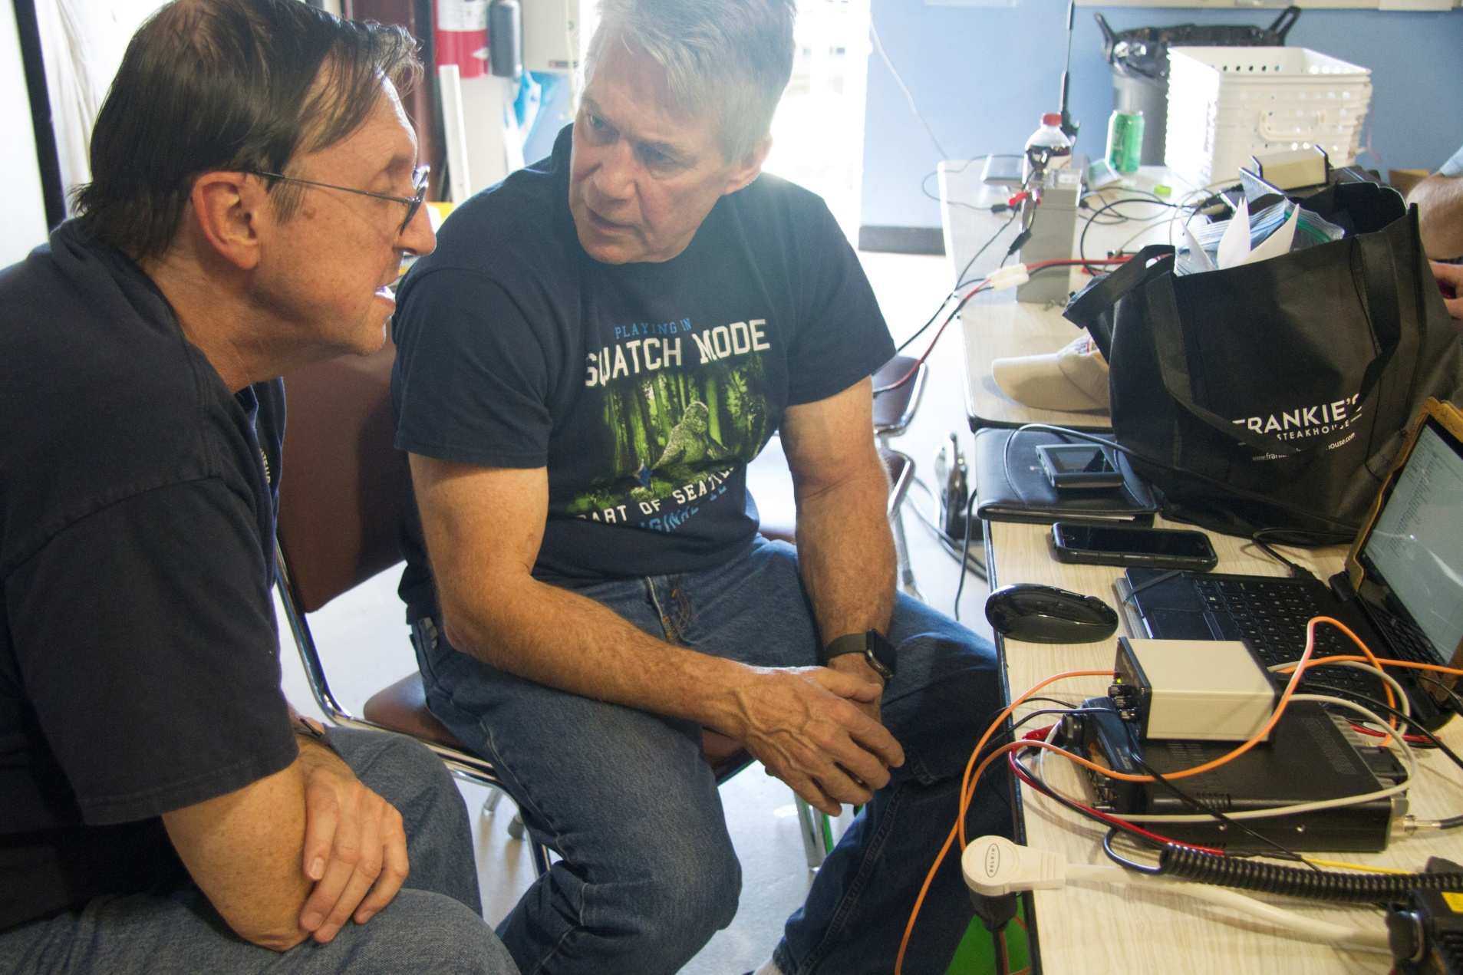
April 14 - Georgia QSO Party

Slide 11
DIGITAL CLIENTS AND MODES THEY SUPPORT

Slide 12
MODE – The way a signal is modulated
CLIENT – The program or app that provides the communication interface

Slide 13
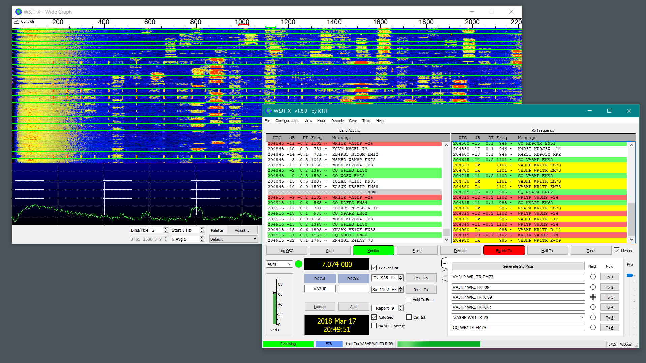
WSJT-X
Notes:
Supports a number of modes, including FT8

Slide 14
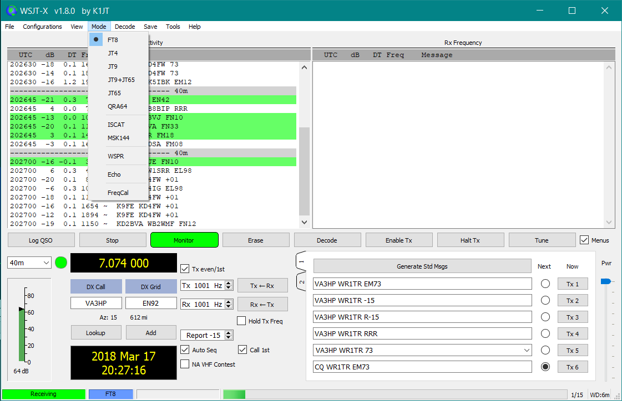
Notes:
( Read the modes)
Explain JT65 and WSPR
All of the modes are for extreme weak signals
Not for rag chewing

Slide 15
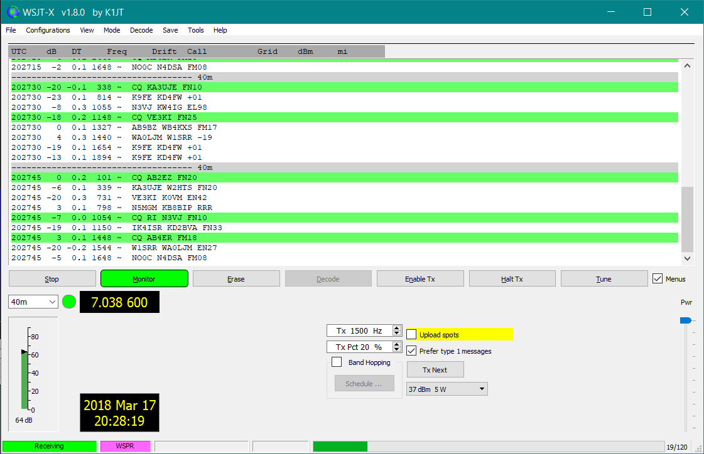
Notes:
WSPR –
The client interface changes with the mode

Slide 16
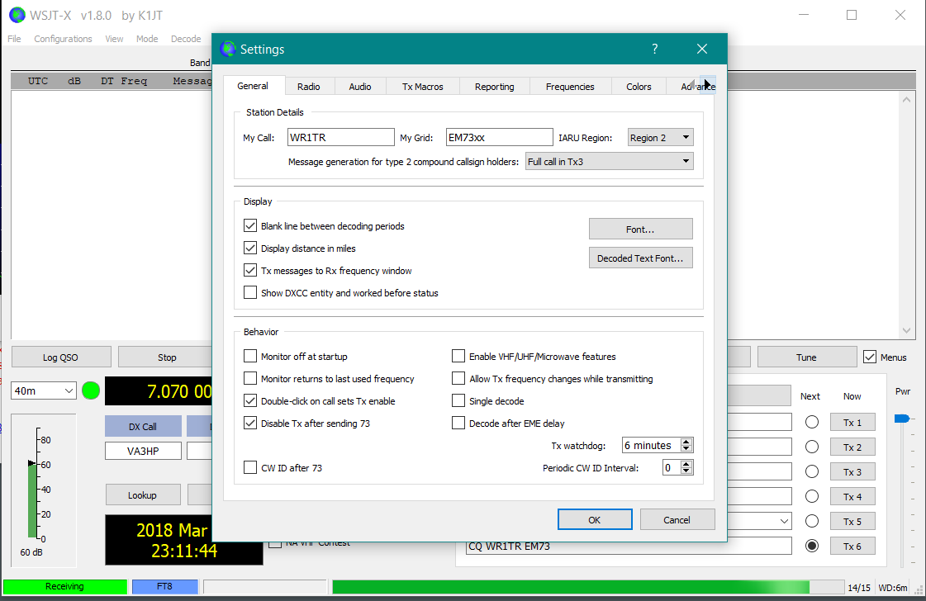
Notes:
Setup is super easy
Call sign and location
Then your radio settings.

Slide 17
WINLINK EXPRESS/RMS EXPRESS

Slide 18
Notes:
Winlink Express is an email client for the WINLINK RADIO EMAIL SYSTEM
Originally developed for Maritime Mobile

Slide 19
WINLINK EXPRESS
Peer to peer or, regular email
Supports attachments, multiple addresses, tactical addresses
HF radio, or VHF/UHF radio, internet

Slide 20
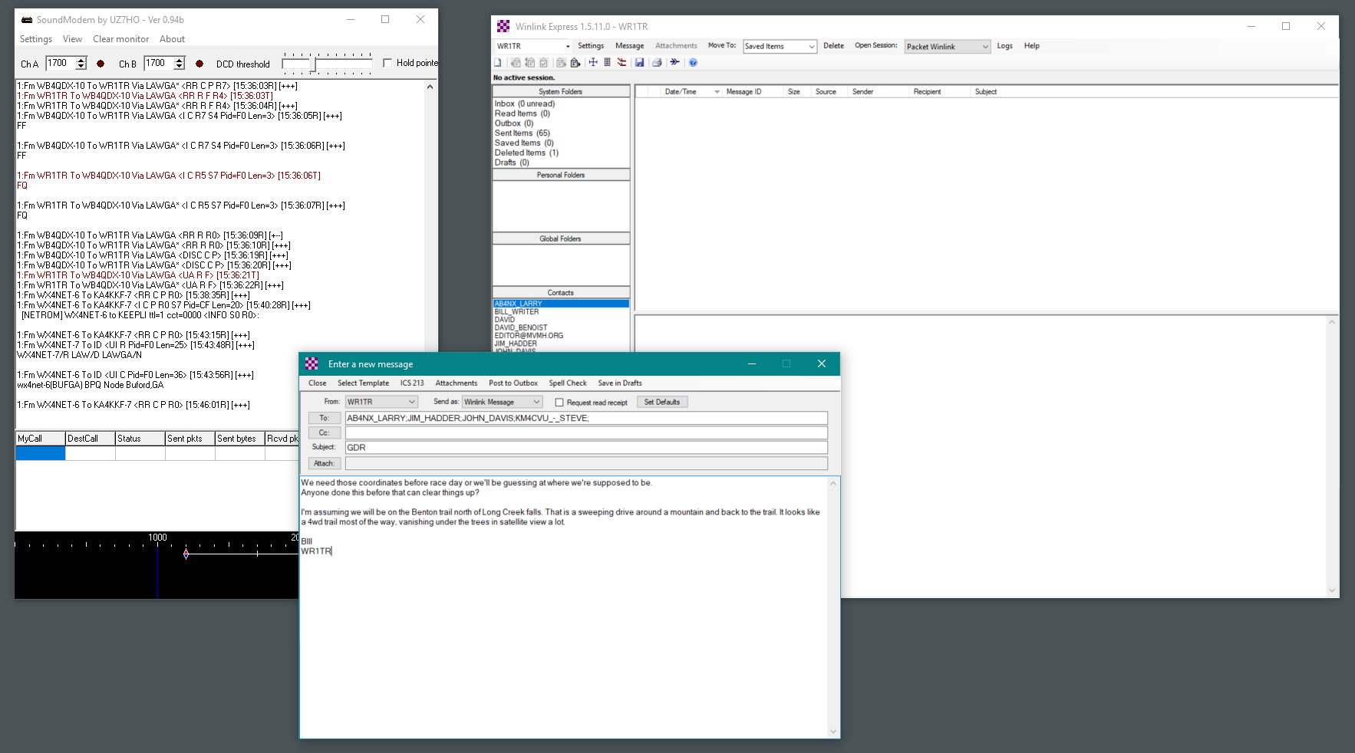
Notes:
Winlink is Email
You decide how the message is transmitted (What mode) based on need.
A login is required.
You must create an account.
Free to hams

Slide 21
Winlink Modes
•Telnet (Internet, LAN, MESH...)
•Packet: ARQ, Single Speed (1.2/9.6 KB)
•Pactor: (ARQ+FEC) Multiple Speed Hardware TNC
•Winmor: (ARQ+FEC) Multiple Speed Soundcard
ARQ – Automatic Retransmission Request
FEC – Forward Error Correction

Slide 22
Notes:
Example:
If you have a local RMS Gateway in range.
Message > New Message - Prepare a message and
POST TO OUTBOX
Just like Email

Slide 23
WAIT!

Slide 24
What’s an RMS Gateway?

Slide 25
Notes:
Glad you asked
Gyped a perfectly good slide
Bottom – your radio and computer with a tower that has a leg in each of your neighbor’s yards
Connect to RMS Gateway to Internet
To CMS
To email
Your email address is a Winlink email address
When you sign up you get an email address.
Mine is WR1TR@winlink.org

Slide 26
Notes:
You have opened and prepared a message
Post the message to Outbox

Slide 27
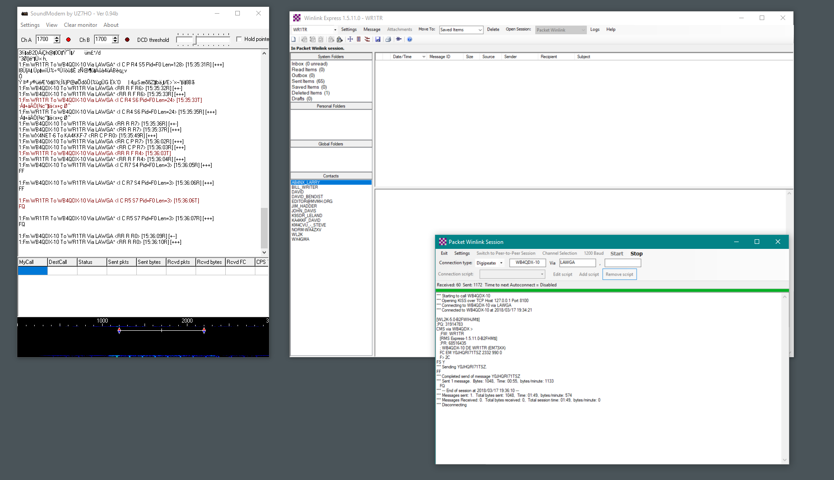
Notes:
Open a Session of Packet Winlink

Slide 28
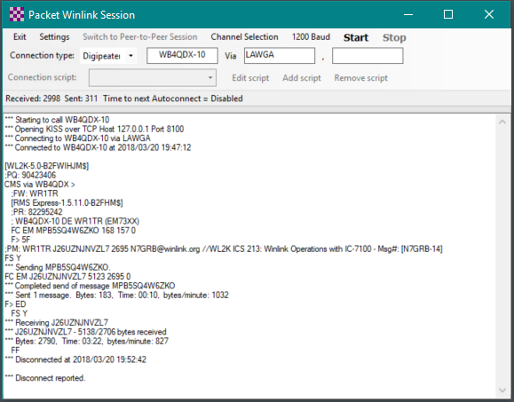
Notes:
Insert the address of the RMS Gateway
Digipeater if you have one
START
(Point out the routing information in sent and received message)

Slide 29
WHAT’S THIS
Notes:
We used to need expensive hardware to transmit and receive packet
No longer.

Slide 30
Soundmodem97.zip
Notes:
We have the software and I have a handout with the links

Slide 31
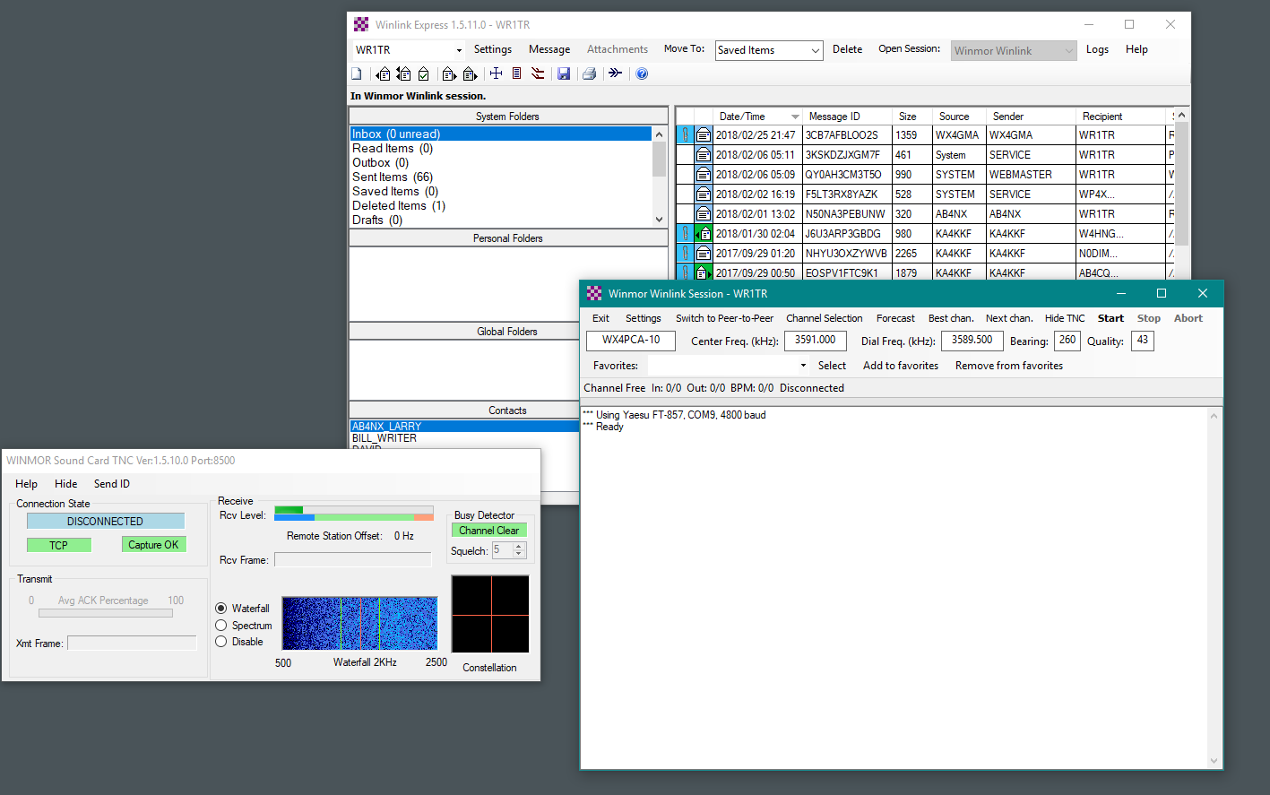
Notes:
What if you aren’t in range of a VHF RMS Gateway?
Then, we have HF Winmor Winlink
Create a message
Post to Outbox

Slide 32
WINLINK WINMOR
Create message
Open Winlink Winmor session
Open Channel Selection
Update Table (RF or internet)

Slide 33
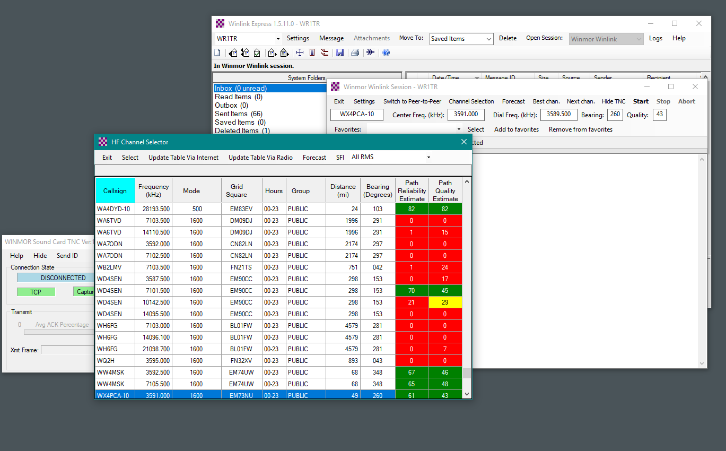
Notes:
Open a WINMOR WINLINK SESSION
Go to CHANNEL SELECTION and UPDATE THE TABLE
Select the Gateway that looks best

Slide 34
WINLINK WINMOR
Create message
Open Winlink Winmor session
Open Channel Selection
Update Table (RF or internet)
Select the RMS Gateway that looks best
Test and set ALC
Transmit message

Slide 35
Notes:
That gateway frequency will automatically go in you settings
Start the Session and send the message.
If it doesn’t connect, try another Winmor RMS Gateway.

Slide 36
Why Winlink?
RF email
Supports message formats required by government and aid agencies.
Worldwide leader in for emergency communication.
Free for hams. Donation recommended.

Slide 37
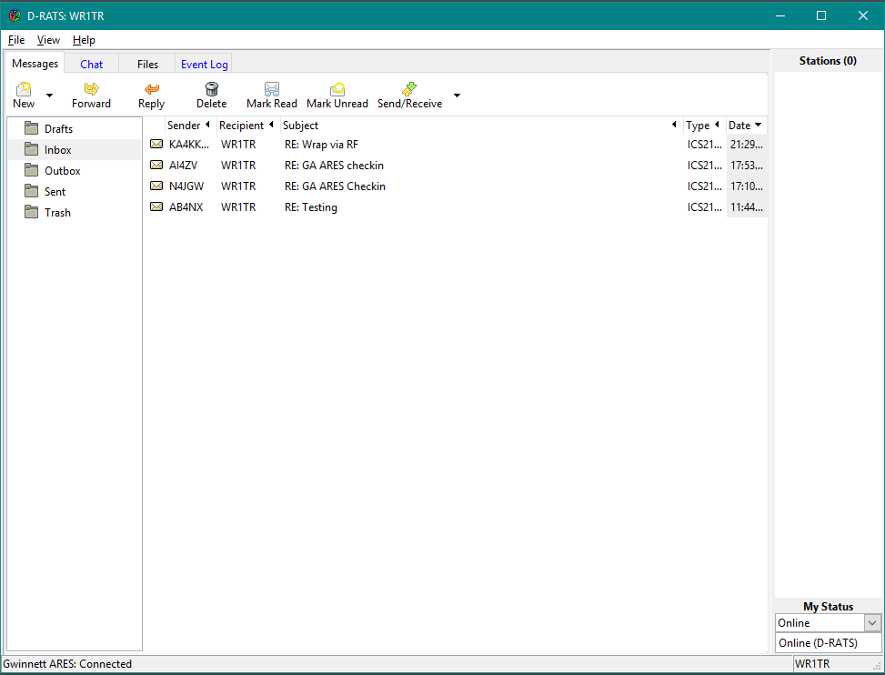
Notes:
Supports - Messaging, Chat, File transfer
Internet or RF Through DSTAR repeaters
Linked worldwide
Easy to set up
Easy to use

Slide 38
DRATS
Messaging, Chat, File transfer
Internet or RF Through DSTAR repeaters
Linked worldwide
Easy to set up
Easy to use
www.dstarinfo.com/drats.aspx

Slide 39
DRATS
To link repeaters, you must be registered with the DSTAR Gateway System
Most configuration is done under Preferences > Radio
64 bit OS replace LZHUF file
www.dstarinfo.com/drats.aspx

Slide 40
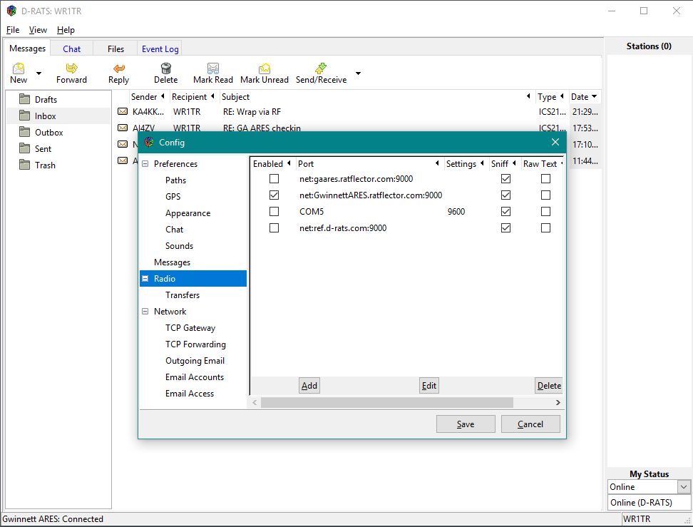
Notes:
The Ratflector addresses of GA ARES and Gwinnett ARES
Com 5 is my radio orange cable to the DSTAR Radio.

Slide 41
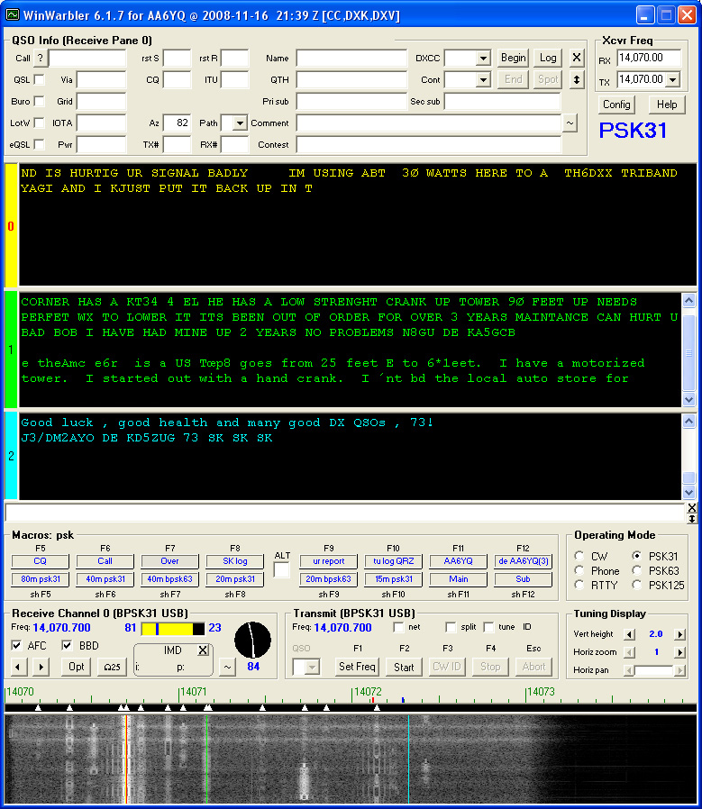
Notes:
WINWARBLER
Free from DX Labs
Last revised September 2016
No messaging component (all keyboard to keyboard)
Installs from DX Lab Launcher (with other programs

Slide 42
WIN WARBLER
Free from DX Labs
Last revised September 2016
No messaging component (all keyboard to keyboard)
Installs from DX Lab Launcher (with other programs)
Supports a limited number of modes

Slide 43
WIN WARBLER - Modes
PSK 31, 63, and 125
RTTY
Notes:
RTTY is the first popular mode used by Hams

Slide 44
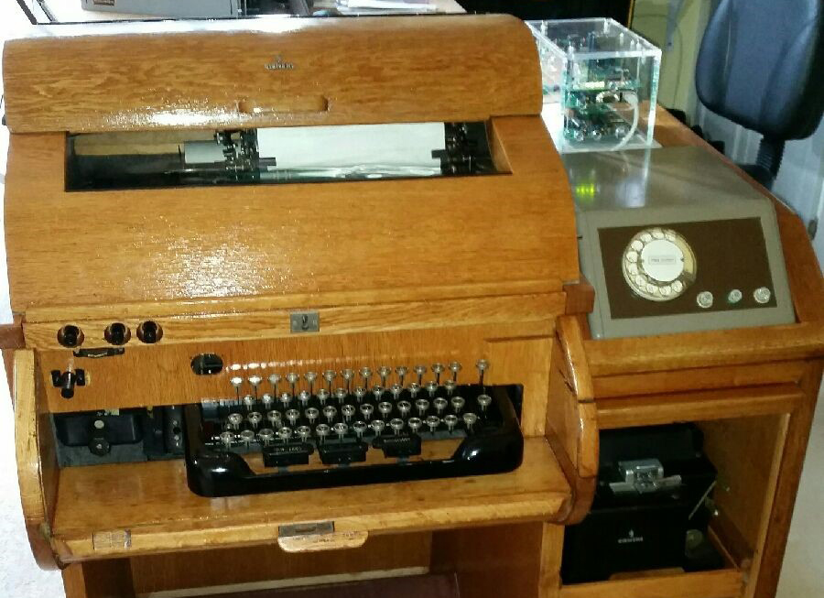
Notes:
Mostly done one computer unless you are like N0NCQ Nick

Slide 45
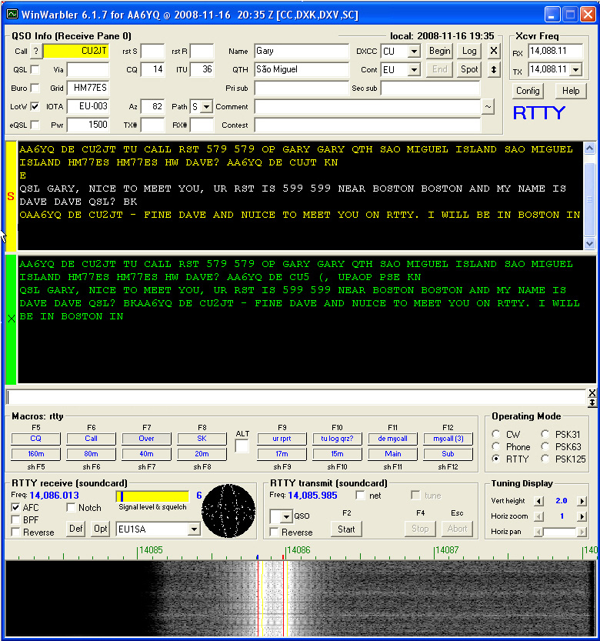
Notes:
WINWARBLER RTTY interface

Slide 46
RTTY
5 bit code
FSK (Frequency Shift Keying) or AFSK (Audio Frequency Shift Keying)
Low Latency (Simple code, no delay to translate)
No error correction.
Still very popular for QSOs and contesting

Slide 47
RTTY RATES
Mode | Symbol Rate | Typing Speed¹ | Duty Cycle² | Bandwidth³ | ITU Designation⁴
RTTY 45⁵ | 45.45 baud | 6.0 cps (60 wpm) | 100% | 270 Hz | 270HF1B
RTTY 50 | 50.0 baud | 6.6 cps (66 wpm) | 100% | 270 Hz | 270HF1B
RTTY 75 | 75.0 baud | 10.0 cps (100 wpm) | 100% | 370 Hz | 370HF1B

Slide 48
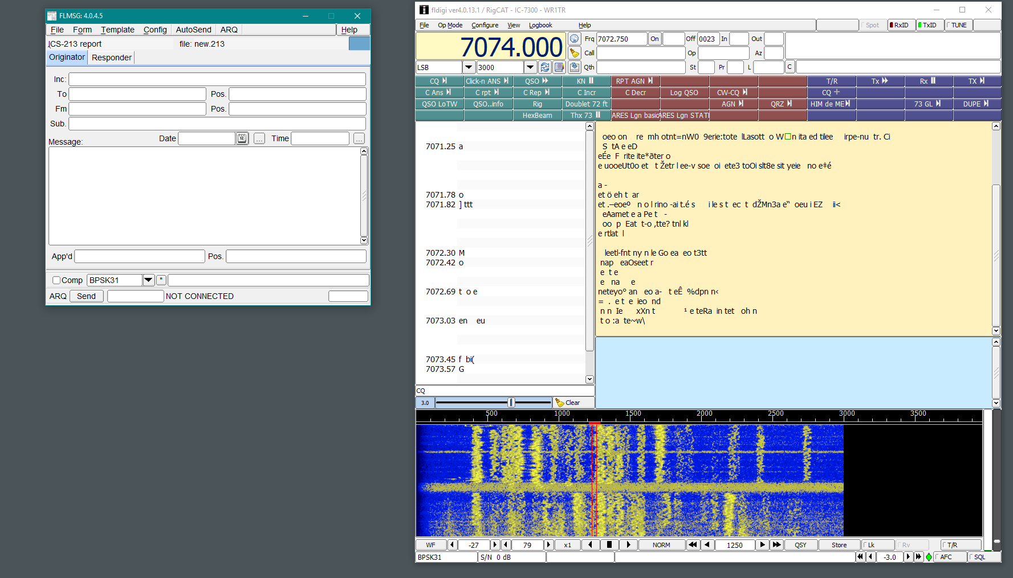
Notes:
FLDIGI AND FLMSG
Updated regularly
FLmsg is connected messaging app
Long list of operating modes

Slide 49
Fldigi and FLmsg
Updated regularly
FLmsg is connected messaging app
Long list of operating modes

Slide 50
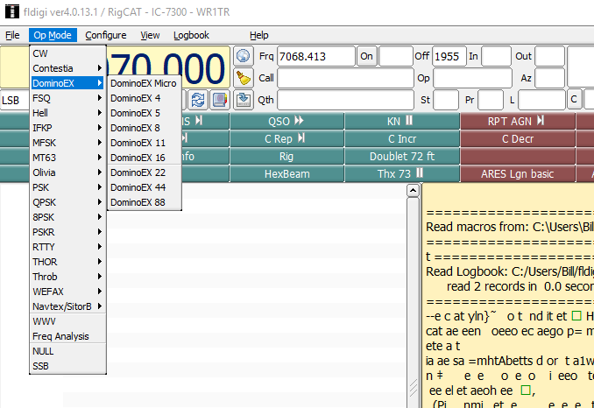
Notes:
I don’t even know what this one is.

Slide 51
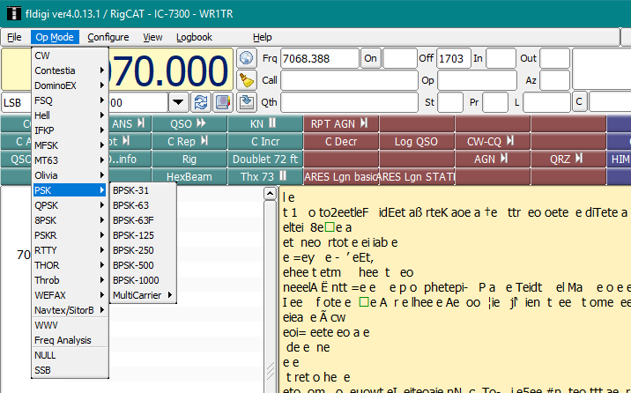
Notes:
One of if not THE most popular modes is PSK31

Slide 52
PSK31
Phase Shift Keying
31 bits of data per second
Introduced in 1998
Very little bandwidth used. About 60 Hz

Slide 53
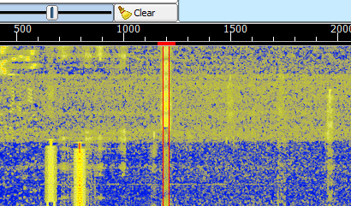
Notes:
You can see how narrow the signal is

Slide 54
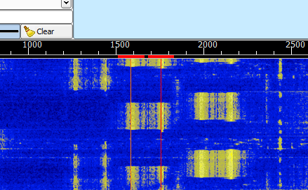
Notes:
Also supports RTTY

Slide 55
Using FLdigi

Slide 56
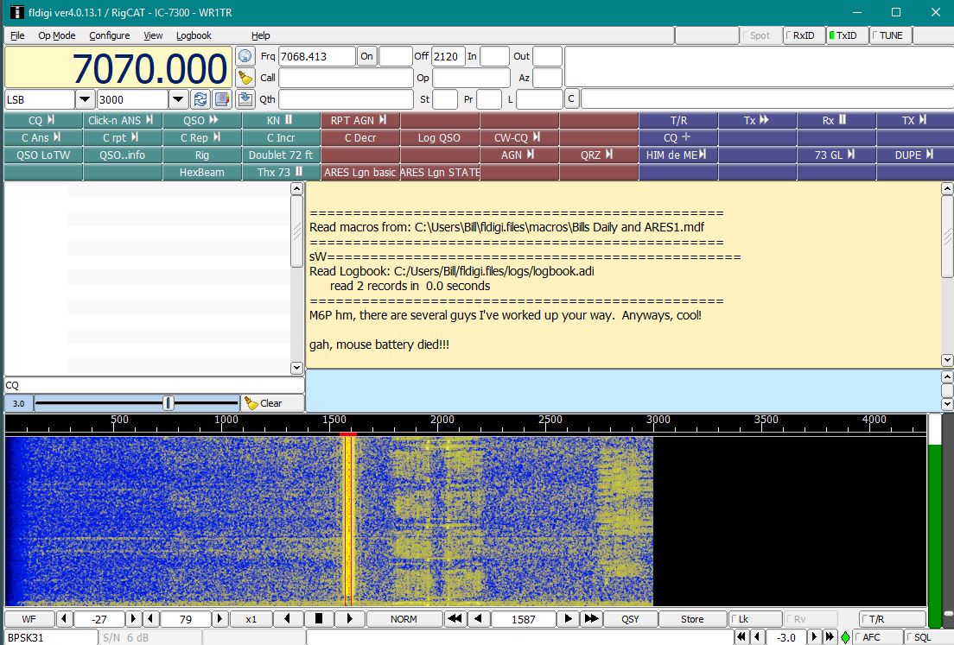
Notes:
USING FLDIGI
Mouse to select signal
Type into the dialogue box
Or
Use Macro
Clean up your macros -

Slide 57
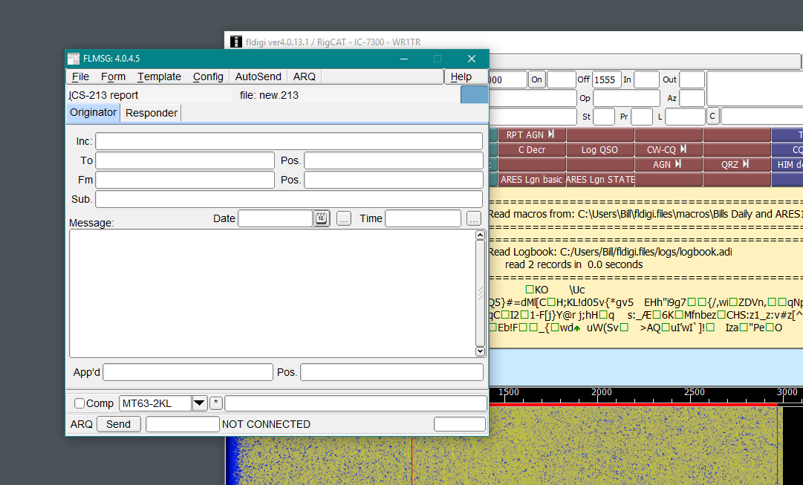
Notes:
FLMSG
Same modes as keyboard to keyboard FLDIGI
Can configured to automatically match modes
Includes forms for message types required by government and other served agencies.
All Peer-to-Peer – No email servers

Slide 58
FLMSG
Same modes as keyboard to keyboard FLDIGI
Can configured to automatically match modes
Includes forms for message types required by government and other served agencies.

Slide 59
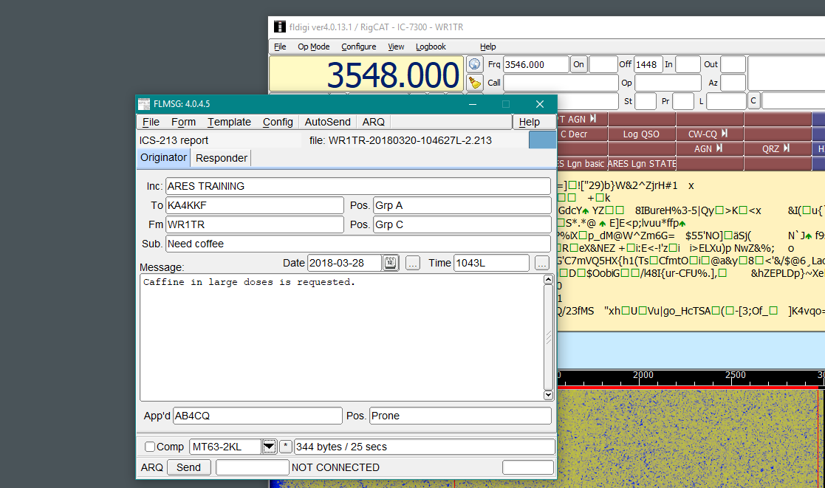
Notes:
To send a message:
Verify the frequency
Create your message
AUTO SEND
Shown is an ICS-213 form. The most common form for events.

Slide 60
How do I know the mode being worked?

Slide 61
BAND PLAN
http://www.ciarc.org/downloads/Digital_Mode_Band_Plan.pdf
SIGHT AND SOUND
http://www.w1hkj.com/modes/index.htm

Slide 62
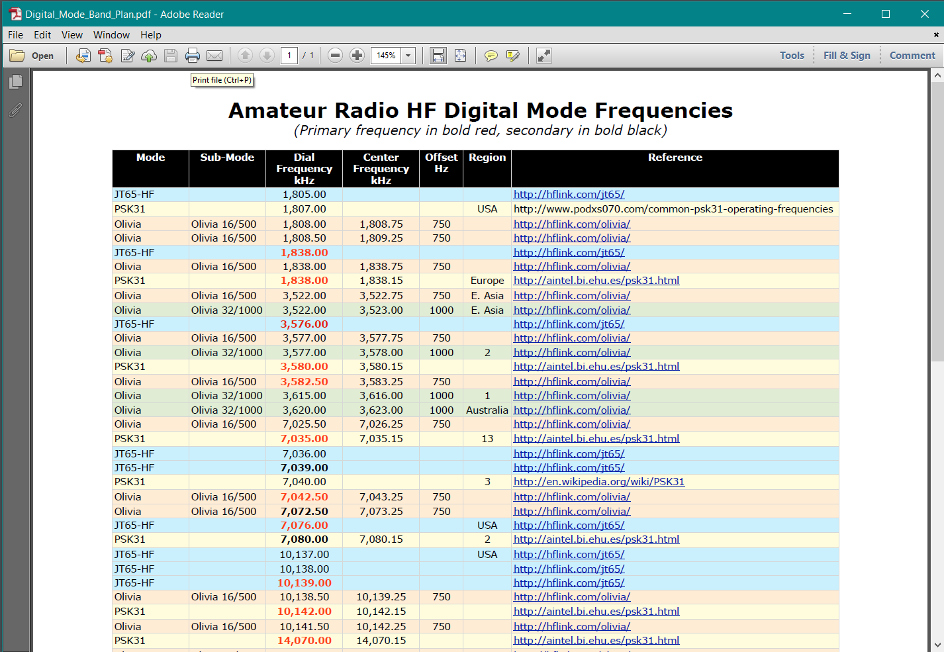
CW: 1'810-1'838, 3'500-3'580, 7'000-7'040, 10'100-10'140, 14'000-14'070, 18'068-18'095, 21'000-21'070, 24'890-24'915 & 28'000-28'070 kHz
PSK31: 1'838, 3'580, 7'040#, 10'140, 14'070, 18'100, 21'080, 24'920 & 28'120 kHz; 1 KHz bandwidth (e.g. 10'140-10'141 kHz) for QRP, +2 kHz (e.g. >10'142 kHz) for PSK63 & PSK125
MFSK16: 1'838-1'842, 3'583-3'600, 7'043-7'050, 10'143-10'150, 14'080-14'099, 18'103-18'109, 21'080-21'120, 24'923-24'929 & 28'080-28'150 kHz
Olivia⁺: 1'843, 3'583, 7'043, 10'143, 14'073, 18'103, 21'073, 24'923 & 28'123 kHz (bandwidth < 500 Hz); 14'107.5 kHz (Olivia 32/1000)
WSPR: 1'836.6, 3'592.6, 5'287.2, 7'038.6, 10'138.7, 14'095.6, 18'104.6, 21'094.6, 24'924.6 & 28'124.6 kHz
Hell⁺: 3'584, 7'044, 10'144§, 14'074, 18'104, 21'074, 24'924 & 28'074 kHz
Fax: 3'735 & 7'165, 14'230, 18'110, 21'340, 24'930 & 28'680 kHz (partially also used by SSTV)
SSTV: 3'735, 7'165, 14'230, 21'340 & 28'680 kHz (also used by FAX)
Digital-SSTV: 3'733, 7'173, 14'233, 18'1625 & 21'340 kHz
FreeDV: 7'190 & 14'236 kHz
Notes:
Ham Radio Digital Band Plan
Google it
Not always up to date or accurate

Slide 63
SIGHT AND SOUND
http://www.w1hkj.com/modes/index.htm
Notes:
Post these at the end

Slide 64
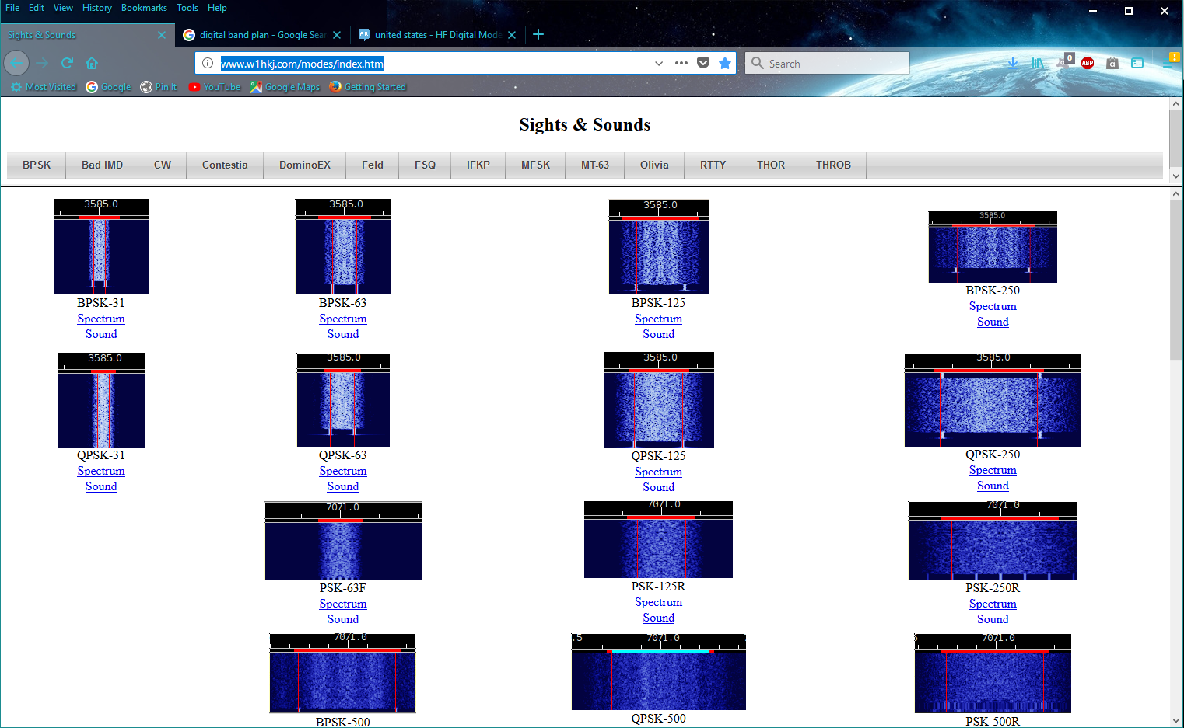
Notes:
Waterfall image of mode

Slide 65
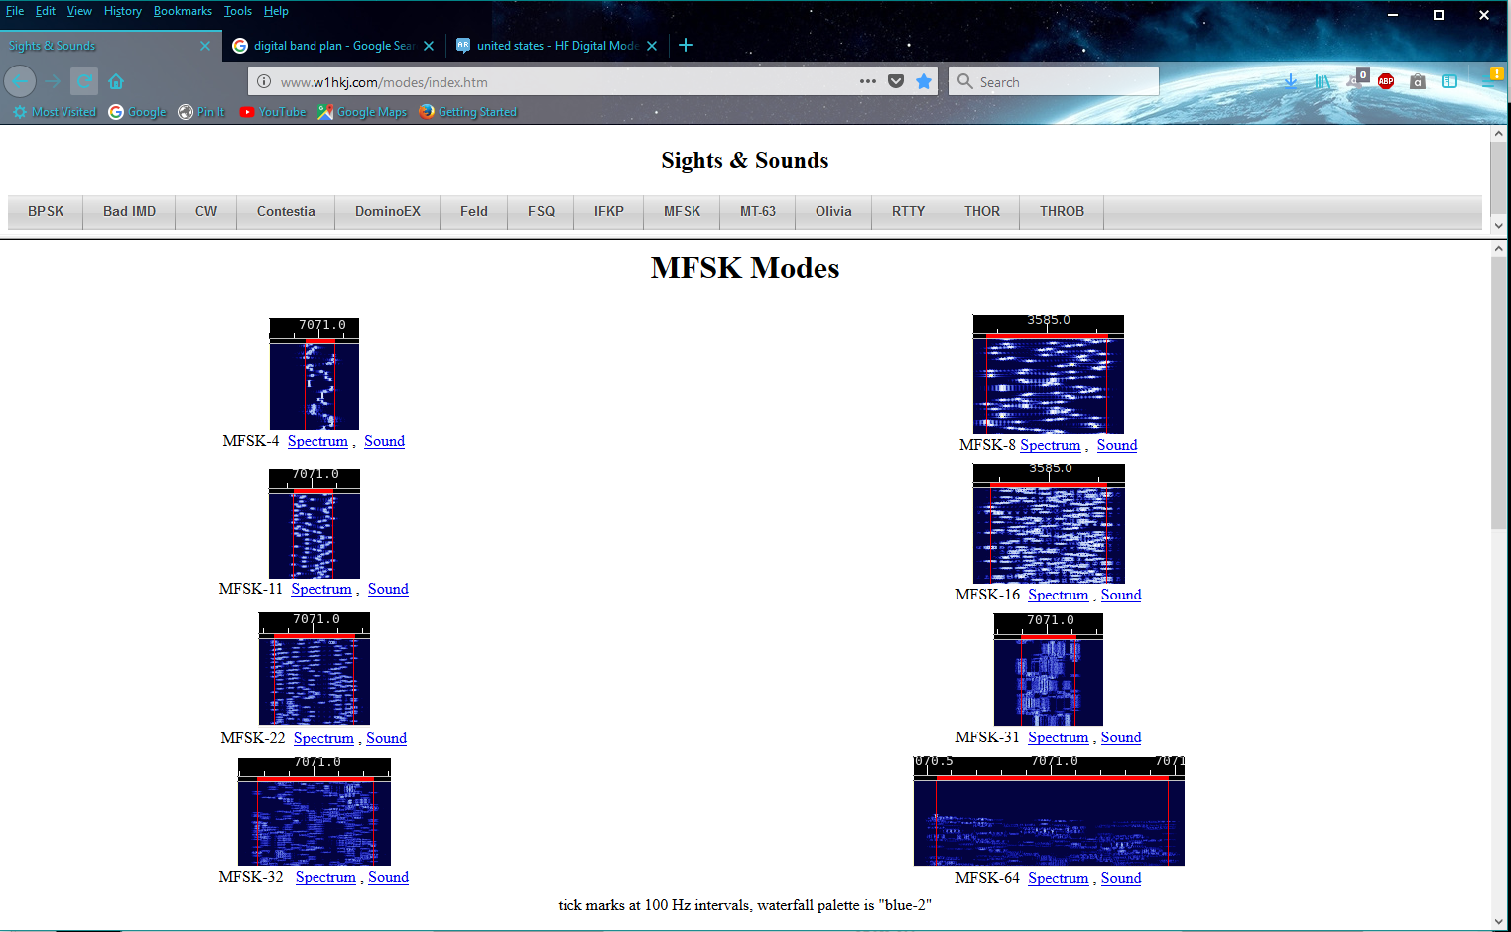
Notes:
Each has a Sound file

Slide 66
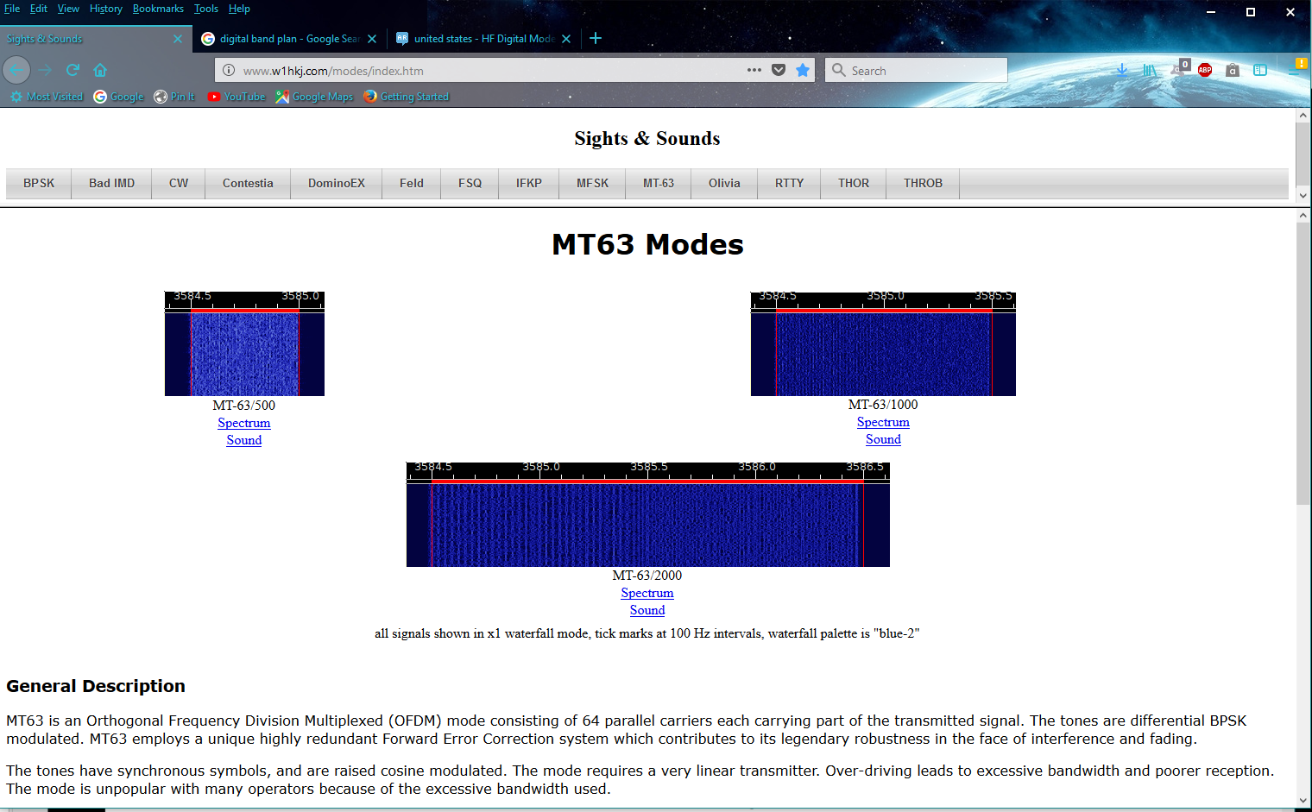
Notes:
At the bottom will be a description of the mode

Slide 67
Notes:
Sometimes digital will make you feel like this.

Slide 68
Notes:
Example:
What mode is this?
Answer: RTTY
Last week I was playing with RTTY
I don’t do RTTY
Everything was scrambled.

Slide 69
QUESTIONS?

Slide 70
LINKS
http://www.w1hkj.com/modes/index.htm
ftp://autoupdate.winlink.org/User%20Programs/

