Slide 1
International Grid Square Chase & LOTW
GARS – 2018
De ND4V

Slide 2
What is a grid square
18 x 18 of the 2 letter grids = 324 (10 degrees latitude x 20 degrees longitude)
324 x 100 sub squares = 32,400 4 letter grid squares (1 degree x 2 degrees)

Slide 3
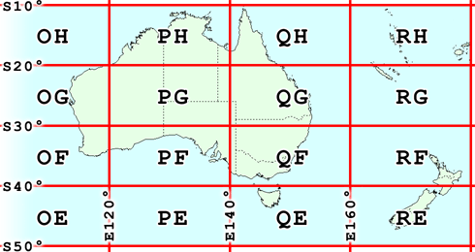
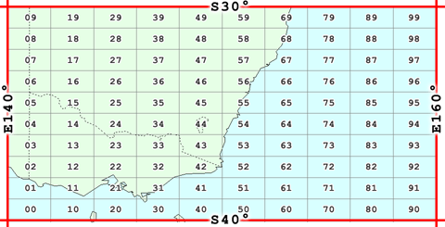
The 2 letter and 4 letter sub-square
Sydney AUS is QF56
Norcross is EM73

Slide 4
Where is WALDO?
http://www.levinecentral.com/ham/grid_square.php
Google GRID SQUARE LOCATOR

Slide 5
CQ GRID SQUARE

Slide 6
What’s the object of the game? Work as many grids on as many bands as possible! EACH MONTH
EM73
 | 160 | 80 | 40 | 30 | 20 | 17 | 15 | 12 | 10 | 6 | 2
Phone |  |  |  | XXXXXXX XXXXXXXX
CW
Digital
 | 32 Points | Available | If you just | Work your | Next door | neighbor

Slide 7
UPLOAD your contact to LOTW and for each match you get 1 point
Your monthly progress is tracked automatically (updated several times a day) at
https://igc.arrl.org/leader-board.php
Demo the website
At the end of the year, the monthly totals will be combined and your overall finish determined. Certificates ? Probably!

Slide 8
What is this Logbook of the World ? How do I get in?
LOTW is a secure website where one uploads an encrypted file.
LOTW compares your file with every other file that has been loaded and tells you when you have a match
These matches are just like QSL cards and can be used to claim awards – DXCC, WAS, VUCC, CQ WPX, and coming soon CQ WAZ
The primary advantages are the savings in postage and time.

Slide 9
LOTW and your logging program
Many logging programs have automated the upload process
LOTW also allows one to download the QSL’s
Many logging programs have also automated the download process.
Facilitates award tracking

Slide 10
Did I mention that LOTW is a secure website?
A program called Trusted QSL (TQSL) is required to be on your computer. GET IT HERE …
http://www.arrl.org/tqsl-download (I found it with google)
STEP 2 – START TQSL AND REQUEST A NEW CERTIFICATE

Slide 11
https://lotw.arrl.org/lotw-help/getting-started-chart/

Slide 12
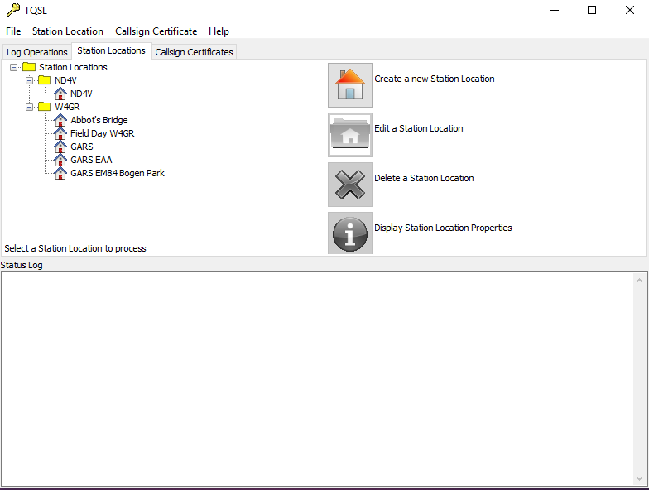

Slide 13
https://lotw.arrl.org/lotw-help/getting-started-chart/

Slide 14
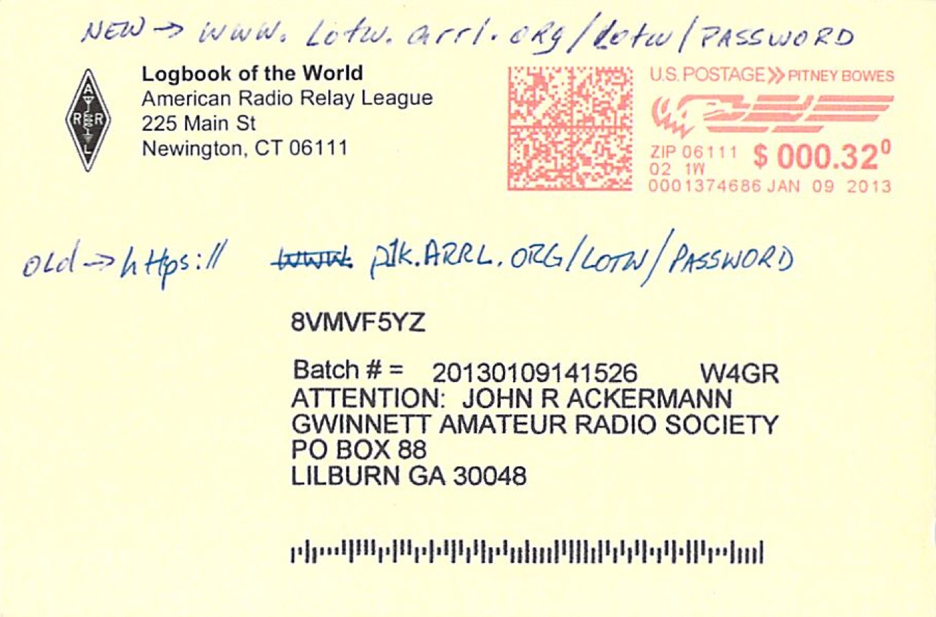

Slide 15
https://lotw.arrl.org/lotw-help/getting-started-chart/

Slide 16
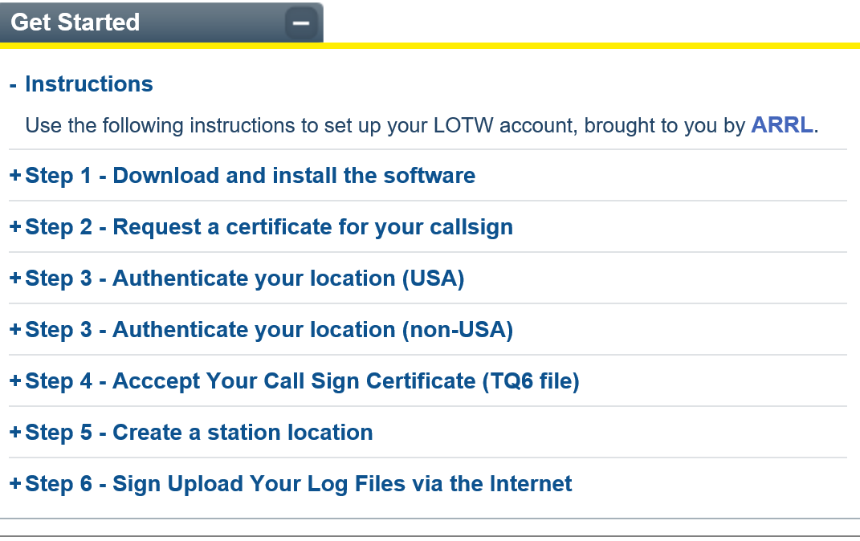

Slide 17
Quick demo of LOTW
Check LOTW for new QSLs
UPLOAD TQ8
RE-Check for New QSLs

