Slide 1
Anderson Powerpoles
Modified by Dave Bruse, W4DTR
Original by Rene “Ren” Ramirez W3BNY

Slide 2
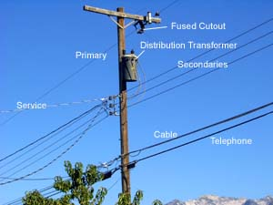
What are Power Poles?

Slide 3
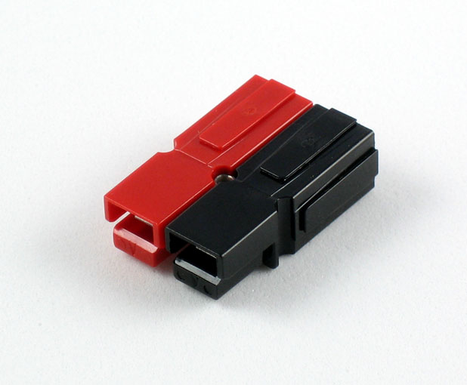
Anderson Powerpoles
Invented by Anderson Power Products – APP
Wide Product Range
  I=15 through 350 amps
  V=600VAC/DC
Silver Plated Contacts
  Offers greatest longevity when using high power, elevated temperature applications
Flat Wiping Contact System
  Allows for minimal contact resistance at high current, wiping action cleans contact surface during connection/disconnection

Slide 4
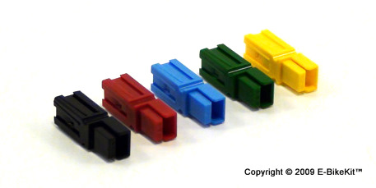
Anderson Powerpoles (continued)
Colored Modular Housings
  Provides visual identification of proper mating connector
  11 different colors!
Molded-in Dovetails
  Secures individual connectors together
Interchangeable Genderless Design
Polarized Housings
  Prevents damage to connectors (and equipment) from being mated incorrectly

Slide 5
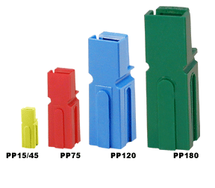
Powerpole Identification
4 different sizes
PP15/30/45
PP75
PP120
PP180
Only PP15/30/45 are interchangeable. All others are not!

Slide 6
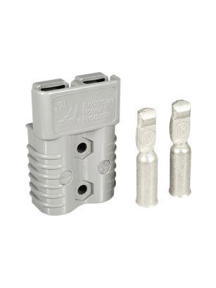
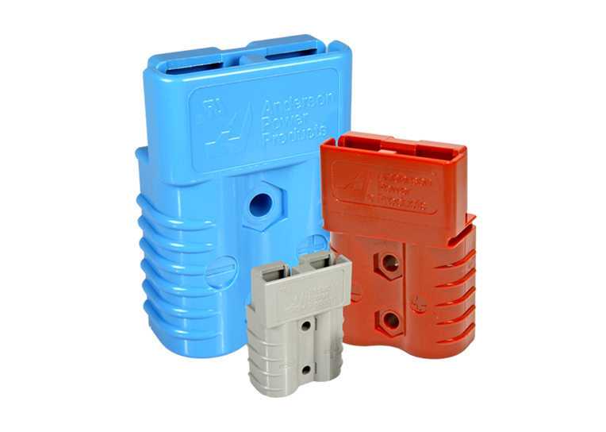
Powerpole Identification
Additional Powerpole Connector Types
(SB50, SB120, SB175, SB350)

Slide 7
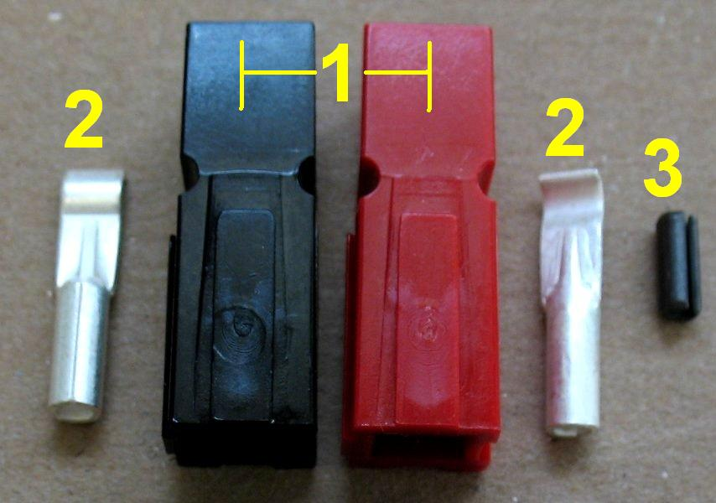
Powerpole parts breakdown
Housing
Contacts
Locking pin
(EVIL)

Slide 8
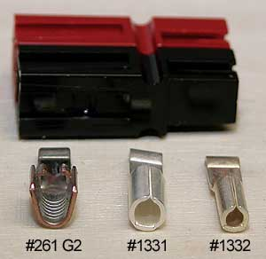
PP 15/30/45 Differences
15 & 30 - Only difference is the size of the wire barrel on contact
45 - Style of wire mount is different than the 15/30
When connected, hard to distinguish other than wire gauge used.

Slide 9
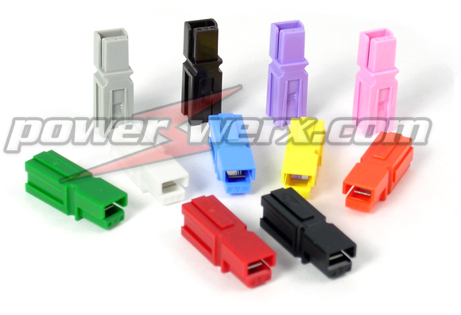
Housing Selection
Remember, 11 different colors
(Red, Black,
Blue, Green,
White, Orange,
Yellow, Grey,
Brown, Violet,
PINK!)

Slide 10
Housing Selection
Is there a standard color code?
Amateur Radio uses red/black to indicate +12vdc.
Industrial powerpoles have an industry standard color scheme.
BE VERY CARFULL when mating to non amateur power sources!
ASK FIRST or CRY later

Slide 11
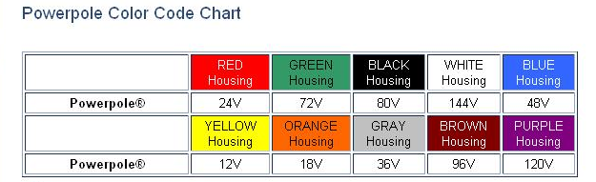
Housing Selection
(Industry Standard)

Slide 12
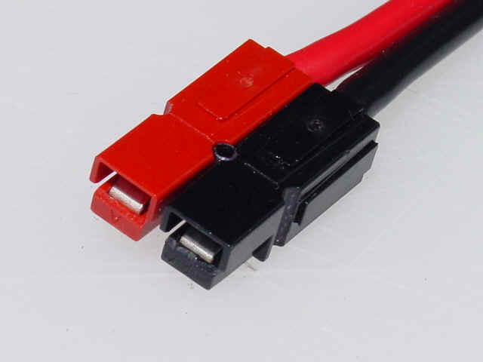
Housing Selection
(For AMATEUR RADIO FOLKS)
RED +12vdc
BLACK negative
If you use any other combinations, YOU BETTER DOCUMENT IT!

Slide 13
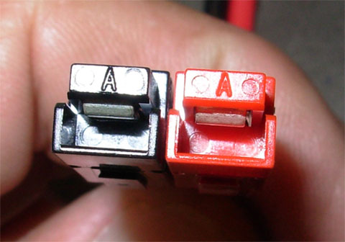
Housing Assembly
Shell orientation VERY important.
As you are looking at the connector.
Tongues up
“A”s up
Red on right ***
Black on left

Slide 14
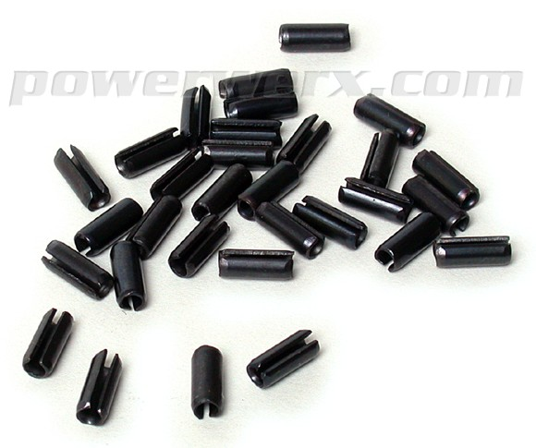
Housing Assembly
Locking pins…
EVIL!!!
THROW THEM AWAY OR RECYCLE!
Chances of pin coming out under vibration very good
Steel and electricity not good partners
Just glue it!

Slide 15
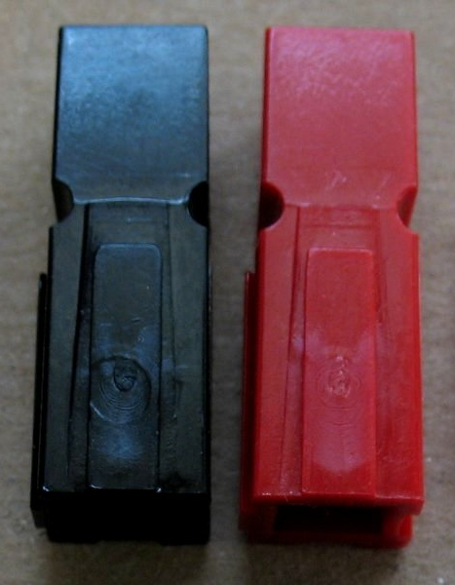
Housing Assembly
Get correct orientation.
ONE DROP of CA (don’t need much) on the inside dovetail
QUICKLY and with a little force, slide them together till they are both level
DONE!

Slide 16
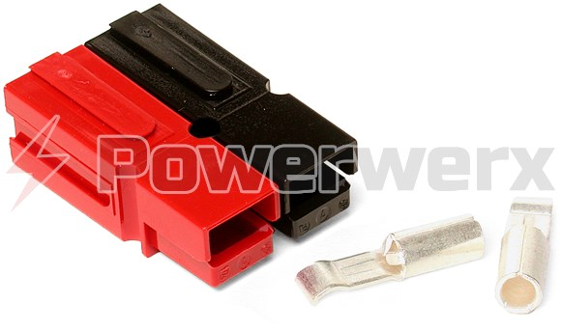
Housing Assembly
Permanently Bonded Powerpole Connectors
(Ultrasonically welded sets save assembly time, guarantee correct configuration, eliminate the need for a roll pin)

Slide 17
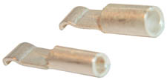
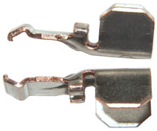
Contactor Selection
15/30/45???
What is the wire size?
15 = 16~20ga
30 = 12~14ga
45 = 10ga

Slide 18
FAQ’s
“I’m using 15A connectors and the wire is just too small. What do I do?”
Easy, double it then crimp it!
“I’m not going to double the wire. That’s just now how I roll. Any other options?”

Slide 19
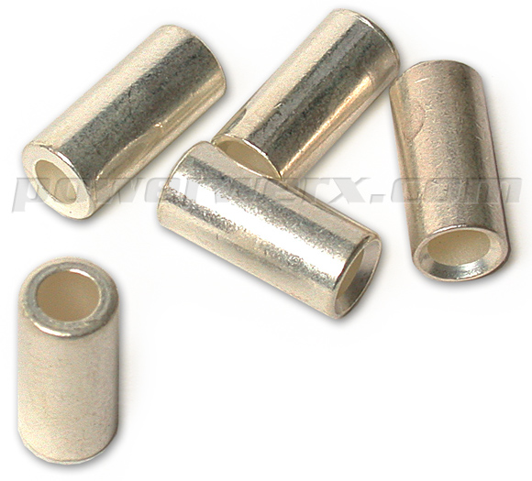
FAQ’s
Reducing bushings!

Slide 20
FAQ’s
“I’m a non-standard type-o-guy and none of my installations are standard…can these things make a non-standard configuration?”

Slide 21
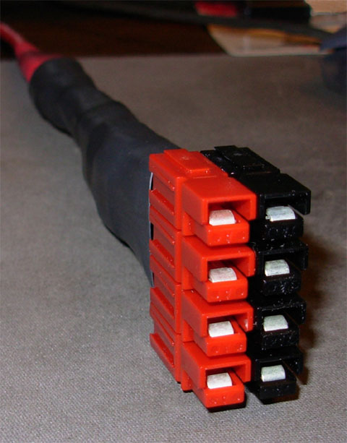
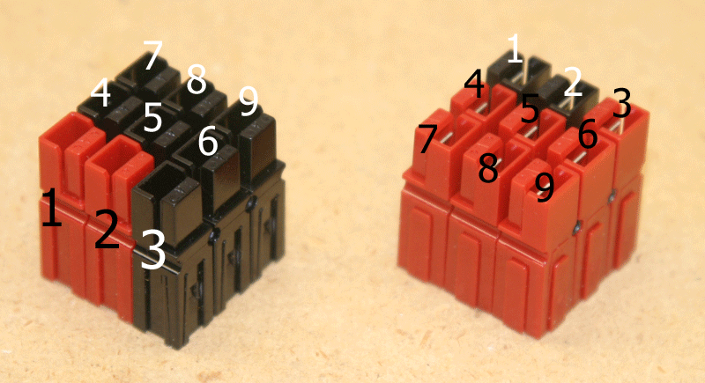
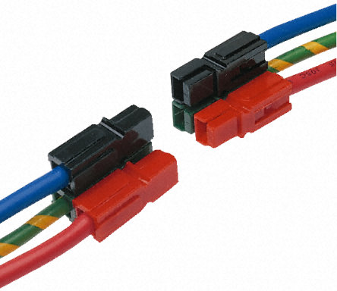
Yes they can! Use your imagination and document your work!

Slide 22

How to Install Powerpoles

Slide 23
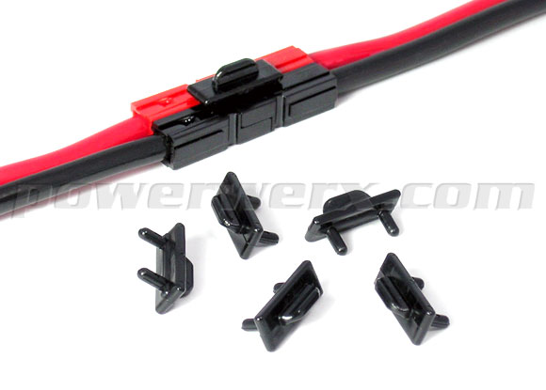
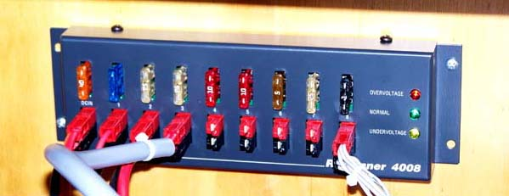
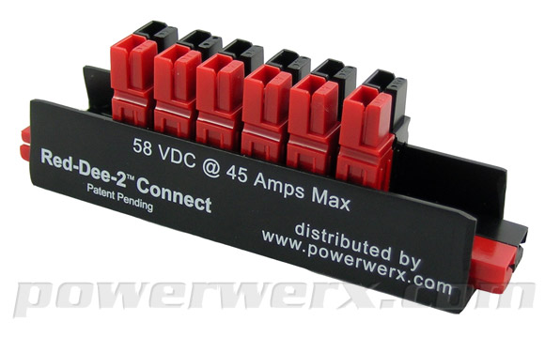
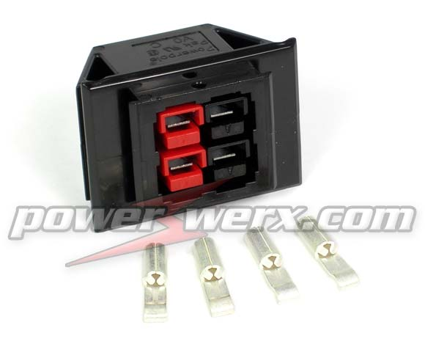
Some accessories for your new powerpole family

Slide 24
Some Vendors
Ham Radio Outlet
(www.hamradio.com)
PowerWerx
(www.powerwerx.com)
West Mountain Radio
(www.westmountainradio.com)

Slide 25

Questions?

