Slide 1
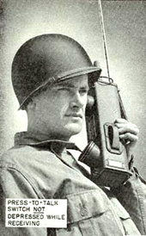
Programming Your Radio
John Davis WB4QDX

Slide 2
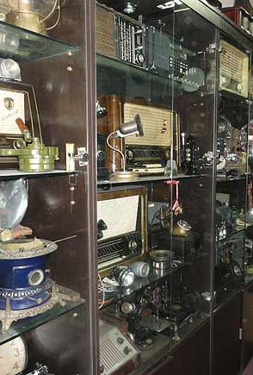
Decisions, Decisions
Mobile or portable/HT?
What type of radio am I programming (FM, D-STAR, Fusion, DMR, NXDN,P25)?
Front panel programming versus programing software?
How many memories do I need?

Slide 3
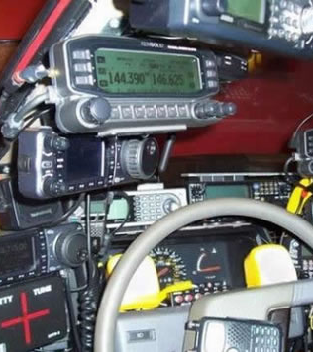
Mobile vs Portable Considerations
How many memories do I need?
Can I store and select different memory loads?
How easy is it to change memories?
How do I want to organize memories (banks, areas, bands)?
Same memory order for portable and mobile

Slide 4
Front Panel vs Programming Software
You should always know how to program directly on the radio for fast changes and quick additions in the field
Initial setup is easiest with programming software
Requires programming cable
Software allows easy changes and additions
Easy to save multiple versions
Keeps backup copies
Free and purchased programming software available

Slide 5
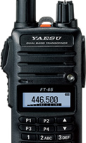
Basic Programming for FM
What I need to know for programming
Output frequency of repeater
Duplex direction (+ or -)
Offset (usually 600KHz for 2m/5 MHz for 70cm)
Tone frequency (Hz)
Tone on TX or tone squelch (TSQ)

Slide 6
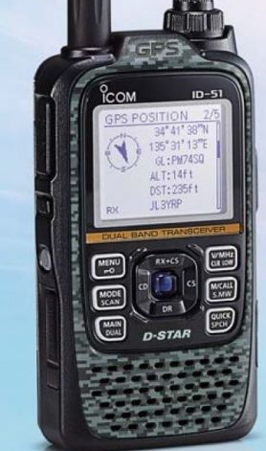
Basic Programming for D-STAR
What I need to know for programming
Output frequency of repeater
Duplex direction (+ or -)
Offset (usually 600KHz for 2m/5 MHz for 70cm)
Tone frequency (Hz)
Tone on TX or tone squelch (TSQ)
Plus
My callsign
Local repeater callsign
Module (B for UHF, C for VHF)
Enter own callsign
Turn on GPS
Nearest Repeater
OR

Slide 7
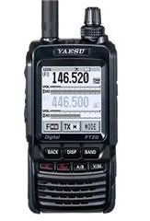
Basic Programming for Fusion
What I need to know for programming
Output frequency of repeater
Duplex direction (+ or -)
Offset (usually 600KHz for 2m/5 MHz for 70cm)
Tone frequency (Hz) for FM
Tone on TX or tone squelch (TSQ) for FM
Plus
Change mode to DN or DW (digital narrow or wide) for C4FM digital mode

Slide 8
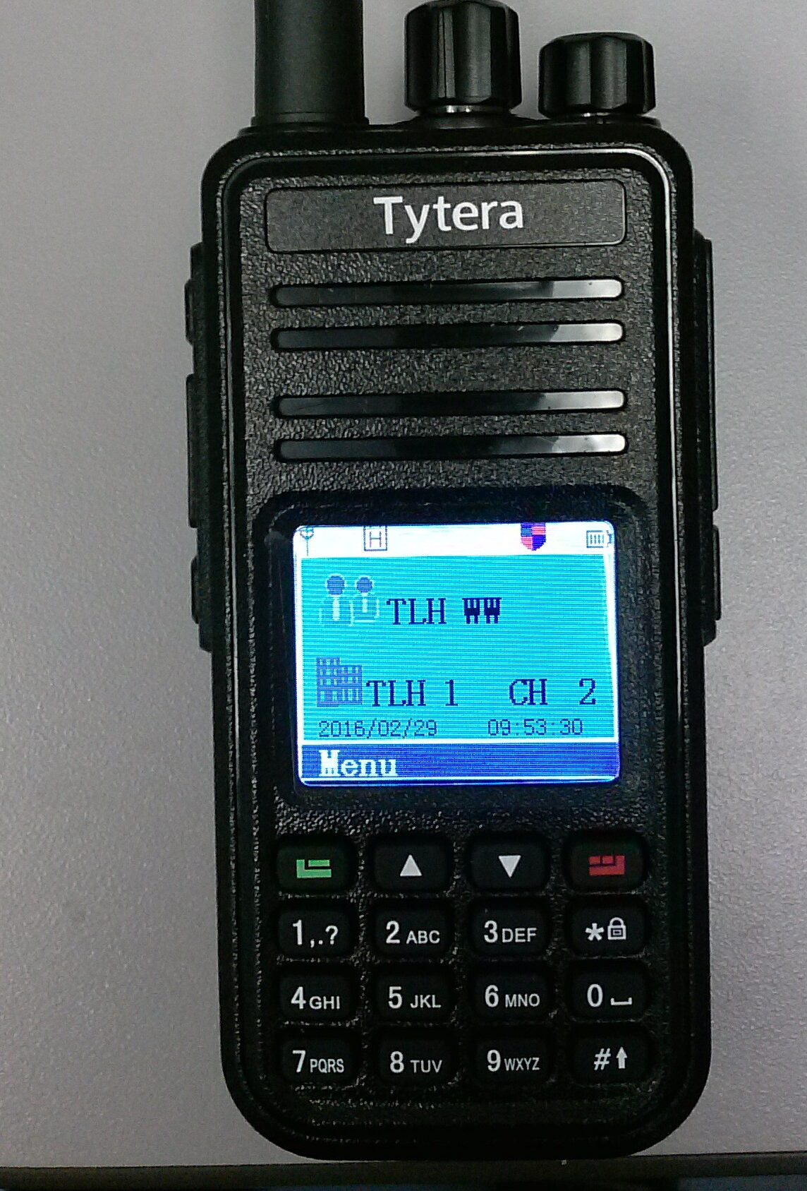
Basic Programming for DMR
What I need to know for programming
Output frequency of repeater
Duplex direction (+ or -)
Offset (usually 600KHz for 2m/5 MHz for 70cm)
Tone frequency (Hz)
Tone on TX or tone squelch (TSQ)
Plus
Color code
Talkgroup number by repeater
Create Zone

Slide 9
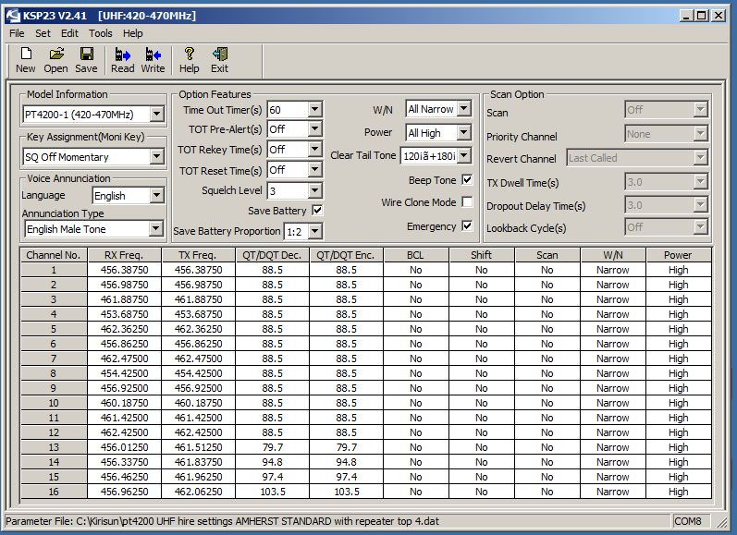
Programming Software
Free software (still need programming cable)
Chirp (available for most radios)
Some manufacturers (usually for specific models)
Purchased Software
RT Systems
reasonably priced
allows easy copying from one radio to another
Sells programming cables

Slide 10







