Slide 1
Choosing Your First Radio
Ed Woodrick, WA4YIH

Slide 2

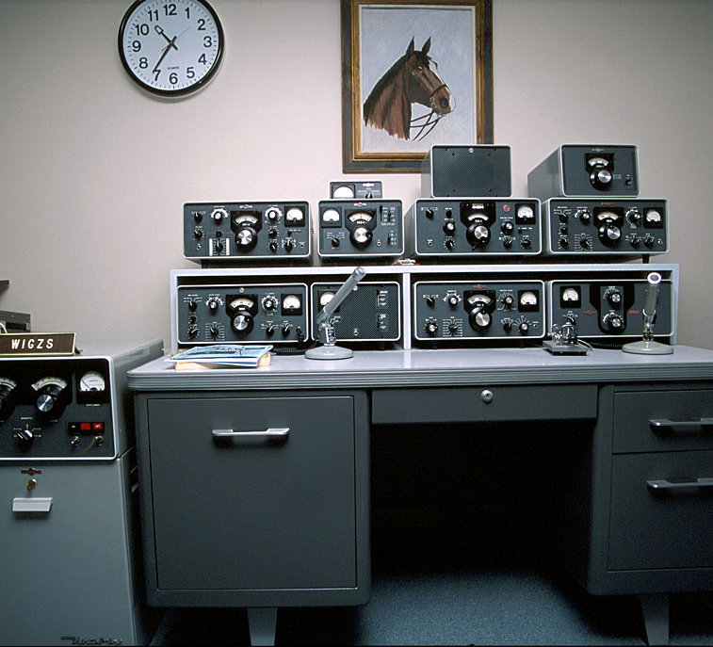
Why do I need a radio?
In the past, there were no other options
Today there are options
  Echolink
  DVDongle
  Remote Bases
Internet is not the best way to experience Amateur Radio

Slide 3
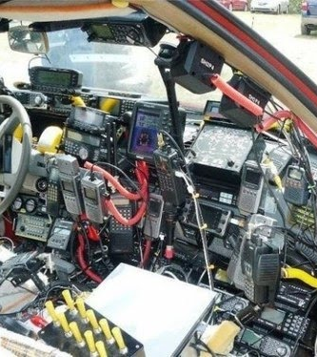
How many radios do you have?
0
1
2-5
6-10
11+

Slide 4


I’m Weird
My Choices of radios will be different from yours

Slide 5
What Do You Want To Do?
Talk to folks near you
Talk to people far away
Send CW/Code
Digital Modes with a Computer
Digital Modes with Voice

Slide 6
Other Things To Do
Talk on Satellites
Bounce Signals off the Moon
Travel and Operate on DX-peditions
Contest
Experiment
Many, Many Others

Slide 7
What Do you need to operate
HF
Antenna – $50+
Power Supply - $100
Radio - $700+
VHF/UHF
Radio - $50+

Slide 8
What Band Are you going to use?
High Frequency (HF)
Historically known as Amateur Radio
Talk around the state, around the world
Propagation impacts operation
Very High and Ultra High Frequency (VHF/UHF)
Popular since the 70’s
The same type of radios that many workers have on their belt
Generally uses repeaters and range of about 40 miles

Slide 9
Electromagnetic Spectrum
3 – 30 kHz
100 – 10 km
VLF
30 – 300 kHz
10 -1 km
LF
300 kHz – 3 MHz
1 km – 100 m
MF
3 – 30 MHz
100 – 10 m
HF
30 – 300 MHz
10 – 1 m
VHF
300 MHz- 3 GHz
100 cm – 10 cm
UHF

Slide 10

VHF/UHF Operation
Recommend VHF and UHF Radio
Programming Cable and Software
Radio should come with
  Battery
  Charge
  Antenna
Line of Sight Communications

Slide 11

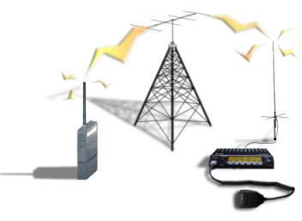
Repeater Operation
You talk to the repeater
The repeater repeats your signals from a better location
The repeater listens and talks at the same time
Most repeaters require tone to reduce interference

Slide 12
VHF/UHF Operation
Programming Your Radio
Receive Frequency
Offset Frequency/Direction
CTCSS/PL/Tone
Programming Software
Operating
Listen Before You Talk
General Call
Joining a Conversation
FCC ID Requirements
Each amateur station must transmit its assigned call sign on its transmitting channel at the end of each communication, and at least every 10 minutes during a communication.

Slide 13
GARS Repeaters
Frequency | Tone | Location | Notes
147.075 +0.600 | 82.5 | Snellville | Skywarn and Gwinnett ARES Primary
147.255 +0.600 | 107.2 | Snellville
444.525 +5.000 | 82.5 | Snellville | Yaesu System Fusion and FM
442.100 +5.000 | 100.0 | Norcross
442.325 +5.000 | 100.0 | Buford
53.110 –1.000 |  | Snellville
224.580 –1.600 | 100.0 | Grayson

Slide 14
Differentiators
Modes (APRS, Data Port, D-STAR, Fusion)
Programmability
Size
Familiarity
Cost

Slide 15
Radio Dealers
Retail
Ham Radio Outlet
GigaParts
Mail Order
Ham Radio Outlet
GigaParts
Universal Radio
MTC Radio

Slide 16
Radio Manufacturers
United States
Japan
Icom
Kenwood
Yaesu
Alinco
China
Baofeng
Wouxun
Others
Ten-Tec
Elecraft

Slide 17
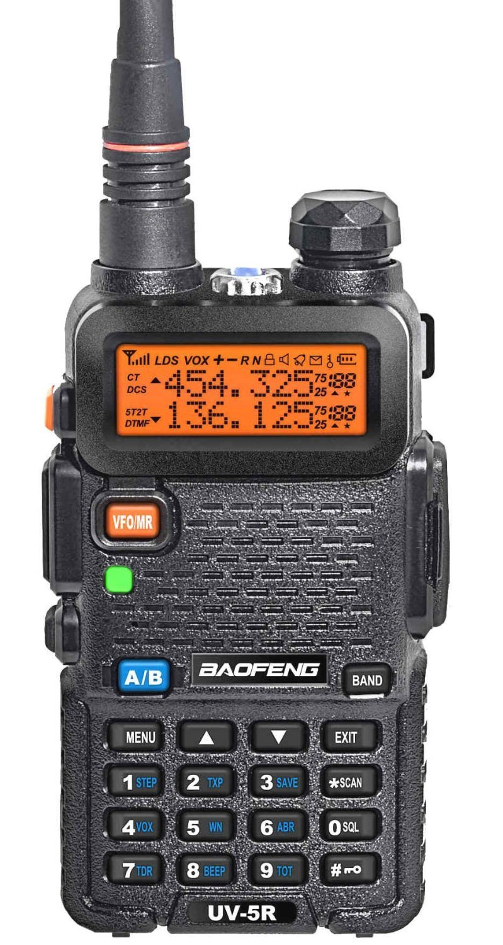
Baofeng (And Other Chinese Manufacturers)
Cheap, Commodity Radios, Often Rebranded
Quality and Support Debated
User Interface not a priority
CHEAP!

Slide 18
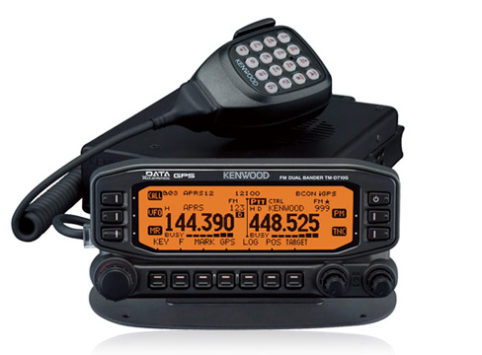
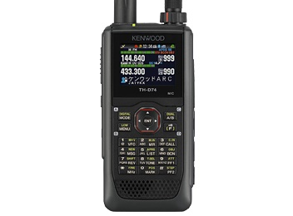
Kenwood
Focus on APRS
New entry into JARL D-STAR
TH-D74 Tribander with D-STAR Handheld
TM-D710GA Dual Band Mobile

Slide 19
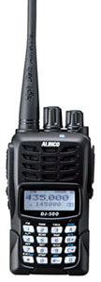
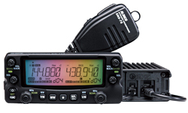
Alinco
DR-735T Dual Band Mobile
DJ-500T Dual Band Handheld

Slide 20
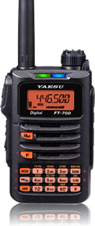
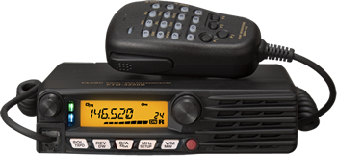
Yaesu
Yaesu System Fusion Digital Mode
FT-70DR Dual Band Handheld - Fusion
FTM-3200DR Dual Band Mobile - Fusion

Slide 21
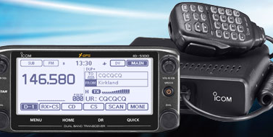
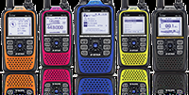
Icom
JARL D-STAR
ID-51A PLUS Dual Band D-STAR
ID-5100 Dual Band D-STAR

Slide 22
Prices - HRO - 9/19/2107 Retail
Manufacturer | Model | Description | Price | Functionality
ALINCO | DJ-500T | 2m/440 Dual band 5 Watt Handheld Transceiver VHF/UHF (Li-Ion 1500 mA) | $129.99 | Handheld
ALINCO | DJ-G7T | 2M/440/1.2 HT with Wide Band RX (No Cell) | $259.95 | Handheld
ALINCO | DR-635T | 2M/440 MHz 50 / 35 Watt Crossband Repeat 200 Mem Optional TNC | $289.95 | Mobile
ALINCO | DR-735T | Alinco Dual Band 2M/70CM Mobile Transceiver | $329.95 | Mobile
ICOM | IC-T70A-HD-15 | 144 / 430 MHz Dual Band Hand Held FM Transceiver - Analog - 5 Watts - w/ BP-265 & BC-193 | $199.95 | Handheld
ICOM | ID-51A PLUS2 Gray Camo | 144 / 430 MHz UHF/VHF D STAR Digital / Analog Hand Held Transceiver | $484.95 | Handheld
ICOM | IC-2730A DELUXE | 144 / 430 MHz Dual Band 50 Watt FM Transceiver with MBA-5 Remote Head Bracket | $349.95 | Mobile
ICOM | IC-7100 | HF / VHF / UHF Mobile Multimode Transceiver – D-STAR - Touchscreen - DV | $1,019.95 | Mobile
ICOM | ID-4100A | DUAL BAND VHF UHF DSTAR GPS MOBILE TRANSCEIVER | $389.95 | Mobile
ICOM | ID-5100A DELUXE | 144 / 430 MHz Dual Band D STAR Mobile - W/ MBA-2 Mounting Bracket | $499.95 | Mobile
KENWOOD | TH-D72A | 144 / 430 MHz Dual Band FM Hand Held with Integrated GPS / APRS | $439.95 | Handheld
KENWOOD | TH-D74A | 144/220/440MHz Tri-Band Handheld With D-Star & APRS | $589.95 | Handheld
KENWOOD | TM-281A | 144 MHz 65 Watt FM Mobile Transceiver - 200 Memories - with Weather Alert | $157.95 | Mobile
KENWOOD | TM-D710G | 144 / 430 MHz FM Transceiver / APRS / TNC - Built In GPS / Echolink Ready | $599.95 | Mobile
KENWOOD | TM-V71A | 144 / 430 MHz Dual Band 50 Watt FM Transceiver with Echolink Interface | $359.95 | Mobile
Wouxun | KG-UV6X | 136-174 / 375-512 MHz Commercial Dual Band VHF/UHF 200 Channel Portable Radio - 5W VHF / 4W UHF | $159.95 | Handheld
Wouxun | KG-UV9D-Plus | KG-UV9D Plus 999 Channel Dual-Band Handheld - 7-Band Receive | $179.95 | Handheld
YAESU | FT-60R | 144-148 / 430-450 MHz Dual Band Hand Held FM Transceiver - 5 Watts - 1000 Memories - Wideband RX | $154.95 | Handheld
YAESU | FT-65R | 2 Meter/70cm Dual Band FM Handheld - Compact, Light and Very Rugged | $139.95 | Handheld
YAESU | FT-70DR | C4FM/ FM 144/ 430MHz Dual Band 5W Handheld Transceiver | $199.95 | Handheld
YAESU | VX-6R | 144 / 220 / 430 MHz 5 Watt / 1.5W (220) Hand Held FM Transceiver - JIS7 Submersible | $239.95 | Handheld
YAESU | FT-8900R | 29 / 50 / 144 / 430 MHz Quad Band FM Mobile Transceiver - Cross Band Full Duplex - 50 W (35 W UHF) | $329.95 | Mobile
YAESU | FTM-100DR | 144 / 430 MHz Dual Band C4FM Digital / Analog FM Mobile Transceiver - 50 Watts | $309.95 | Mobile
YAESU | FTM-400XDR | 144 / 430 MHz Dual Band C4FM Digital / Analog FM Mobile Transceiver - Improved GPS - 50 Watts | $605.95 | Mobile

Slide 23

Questions

