Slide 1
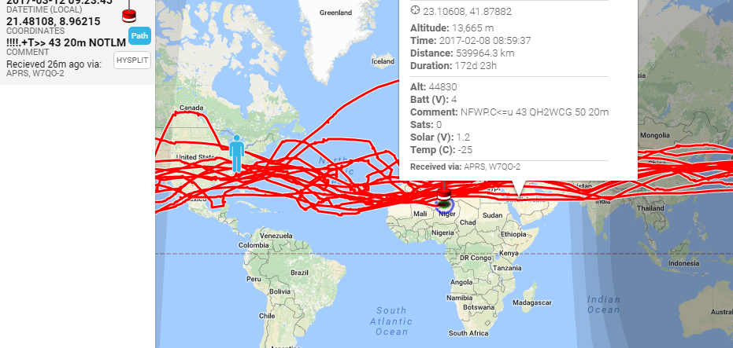
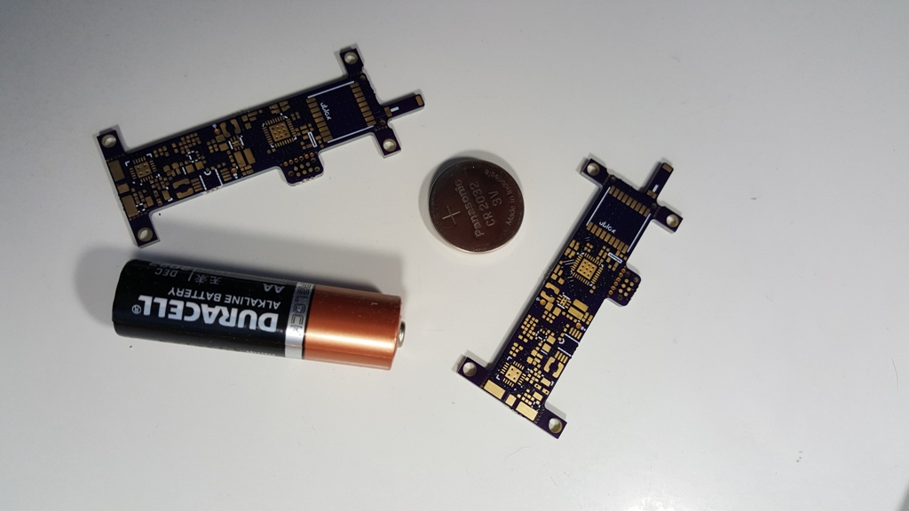
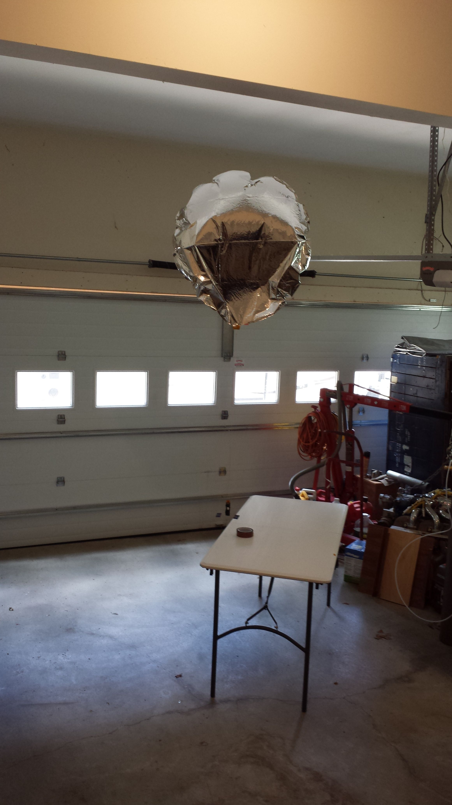
Balloons Carrying Ham Radio
321+ Days, 20 times Around the world
Alan Adamson – W7QO Atlanta, GA

Slide 2
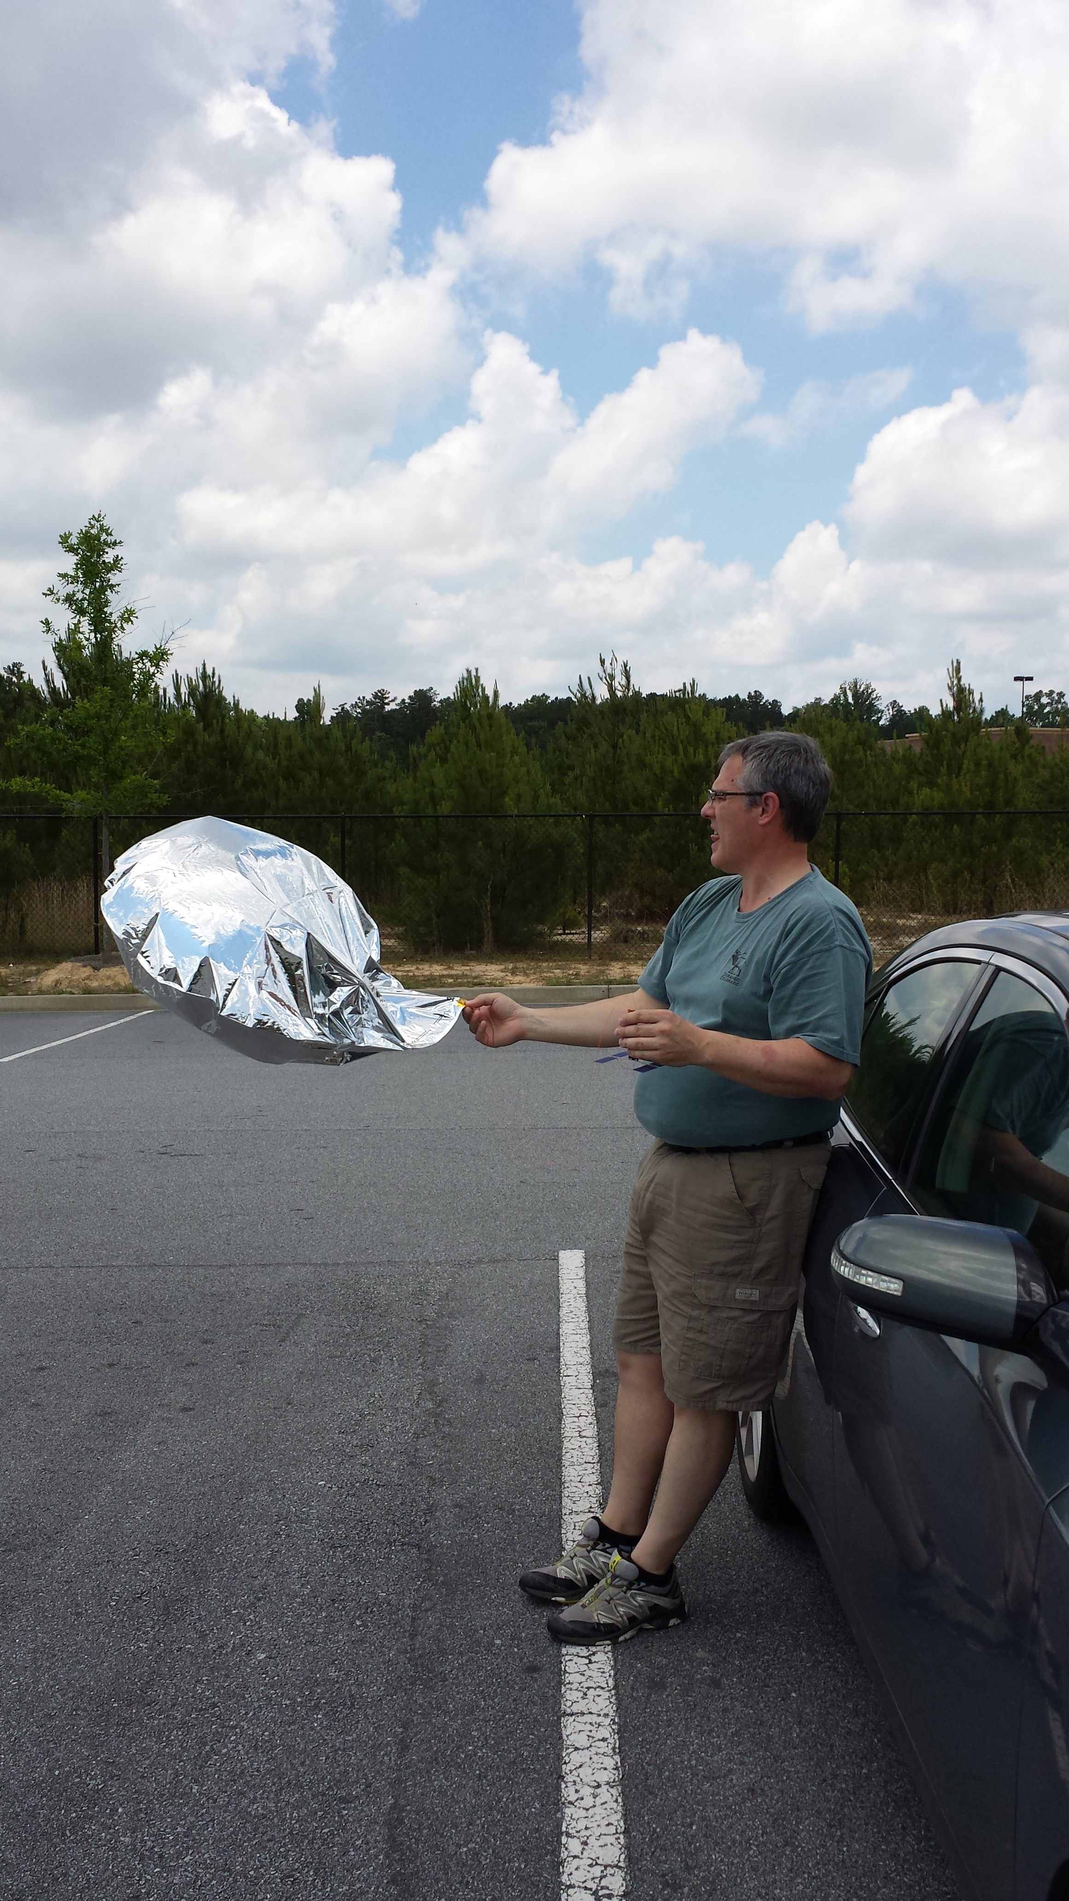
topics
What Started It All – natural evolution
What Is Needed – a Lesson in CRAM (This Stuff is HARD)
HW/SW Test Flight – Day 1
The First 15 Days
Status of Current Record Flight(s)
Managing Expectations
Where Does It Go From Here
Records to be Attained

Slide 3
About Me
Grew up in Utah, moved to Atlanta, via California in 1994 after surviving all kinds of natural disasters (Floods, Fires, Earthquakes and Riots)
Retired from BellSouth in 2005. Started 2 companies that same year (RF management for buildings, and contract consulting on embedded computing designs)
Designed and developed one of the first ARM based Arduino Mini compatible boards including an APRS compatible, FM radio module
Designed and developed Commercial High Altitude Balloon flight controllers

Slide 4
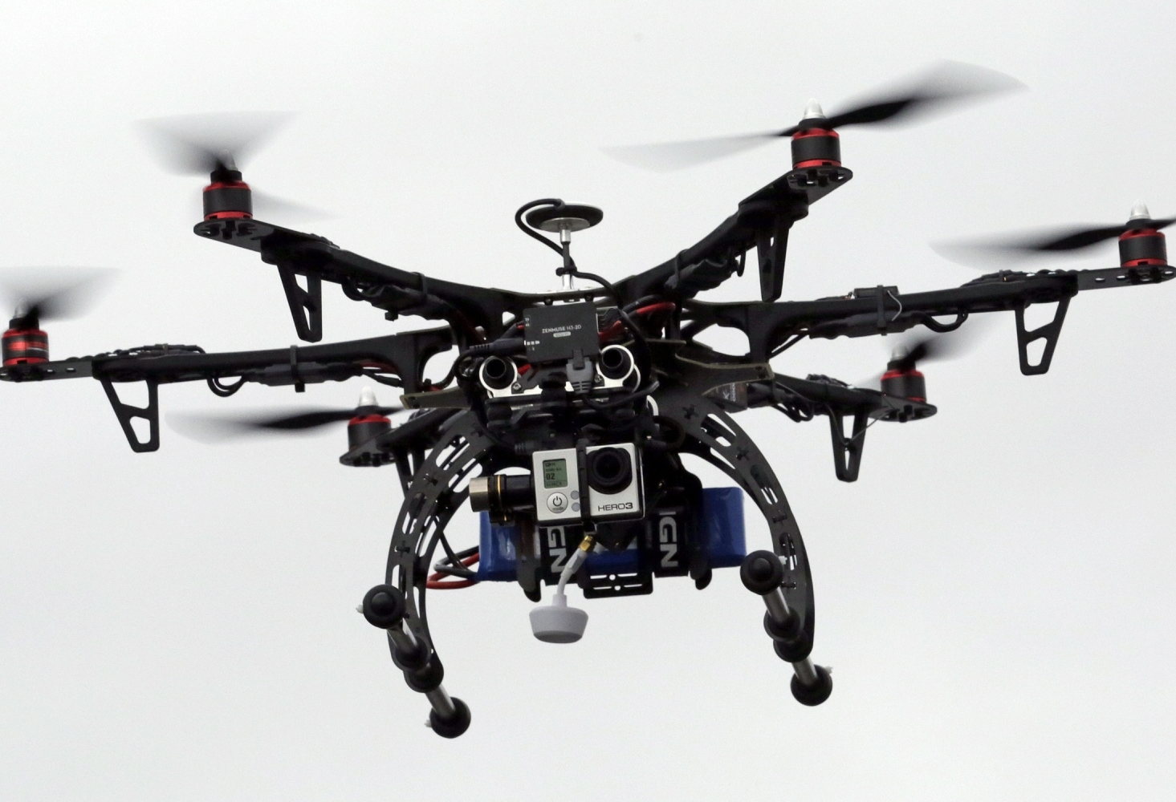
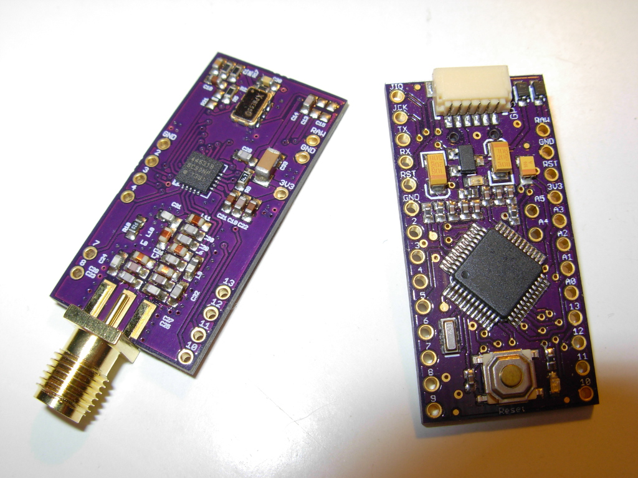
What Started this adventure – Drones!
Early Drones had flyaway problems
how to track and locate?
Miniature Radio for APRS with small processor as a tracking device
Designed and developed using Hobbyist tools and off-the-shelf components
Evolved to become the first balloon controller

Slide 5
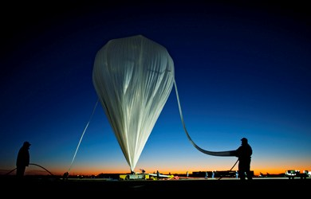
Types of Balloons carrying Ham Radio
Up and Down flights
Latex Balloons in various volumes to reach different altitude, carry different weights of payload
Used for Imagery, experiments, research and data gathering
Duration is typically 2-3hours. Floaters don’t last - with a few exceptions (due to UV deterioration of the latex)
Ends in a “Fox Hunt” to find and recover the Payload – typically via APRS

Slide 6
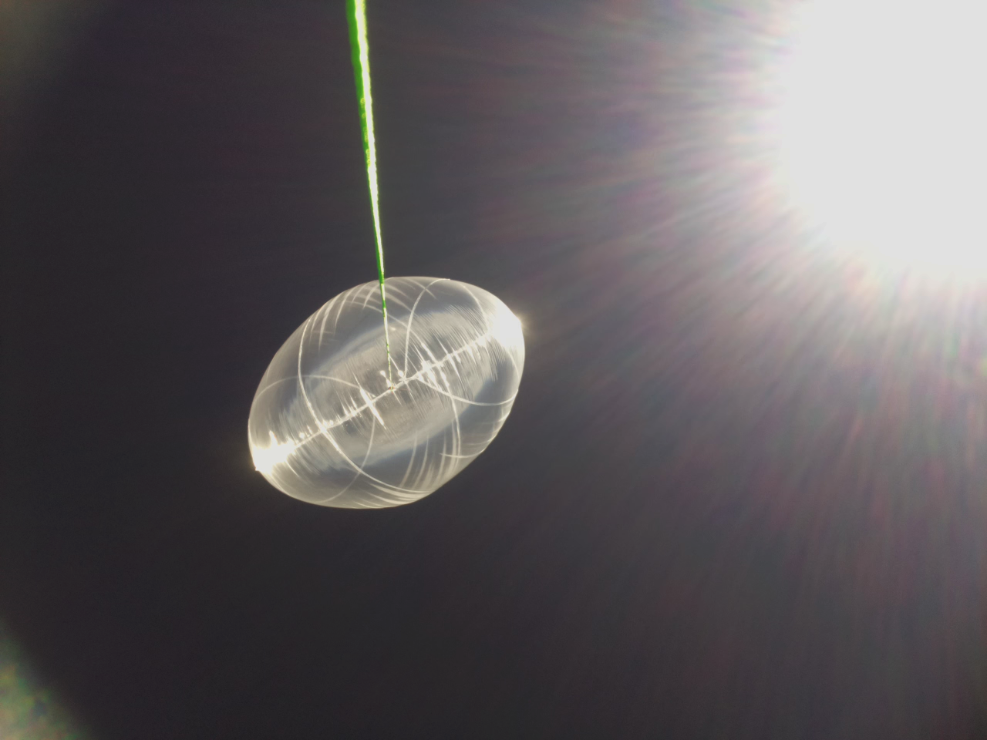
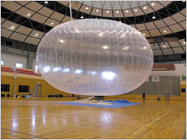
Types of balloons carrying ham radio (cont.)
Floating Balloons (Super Pressure)
High Altitude Long Duration – days, weeks, years
Balloon – plastic material (Envelope size directly proportional to altitude and weight carrying capability)
Extreme challenges
Material & Construction of envelopes
Environmental
Power & Power consumption
Fire and forget – at the whims of the winds

Slide 7
Super pressure balloon dynamics
FreeLift – amount of lift after you lift all the below plus the weight of the lifting gas
Zero freelift would hover the balloon and payload
2-3grams of freelift would allow the balloon to lift an addition 2-3 grams of weight back to a hover
Balloon – weight of material
Payload + tether weight

Slide 8
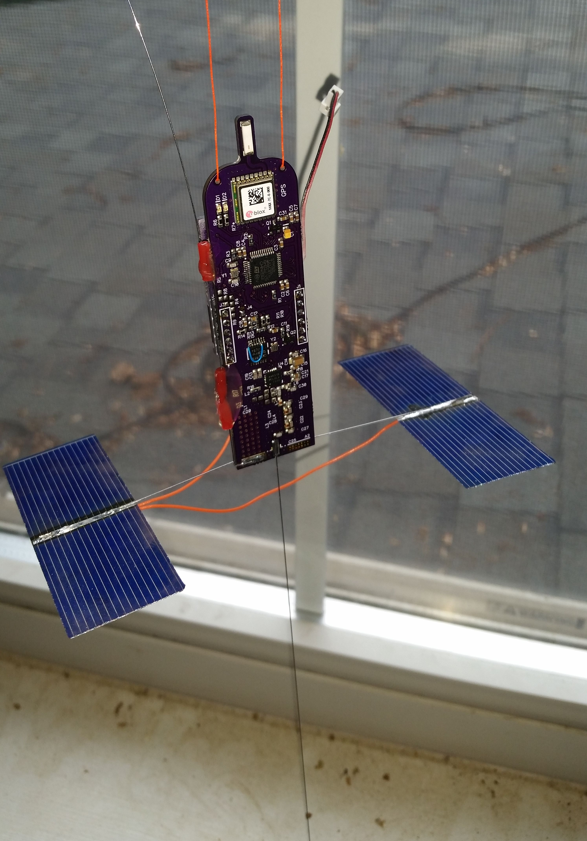
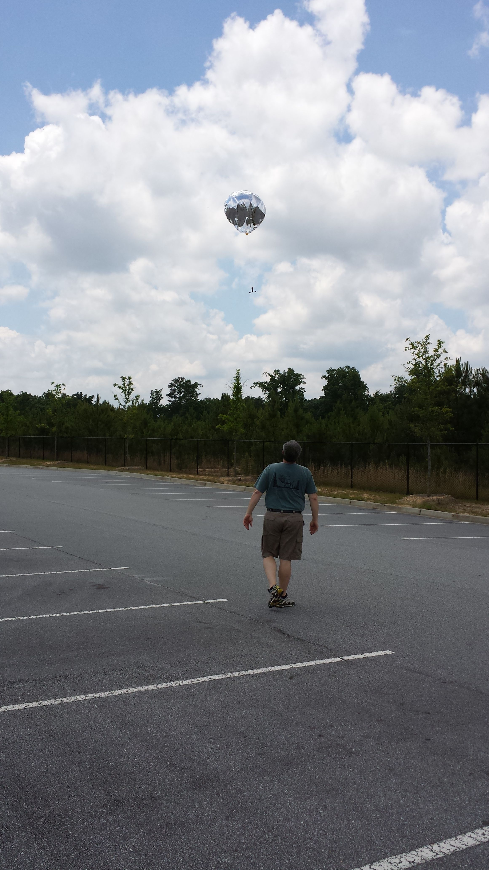
What Started it all
Can we get an inexpensive party balloon around the world?
3+ years ago – first flight
Custom Flight Controller
Ultra low power ARM based microprocessor
142-1050Mhz frequency agile radio
Used true FM to make APRS tones
Modulated the LO
10-100mW output (flew at 10mW)
GPS needs to work up to 50km
Solar – MPPT controller/SMPS
Single Cell – Boost Power supply
Software geofence for frequency control
Internal or external temperature sensor
Floated at 25-28k Feet
Weighed almost 25 grams (heavy)
Needed ESD/Lightning protection

Slide 9
That First Launch

Slide 10
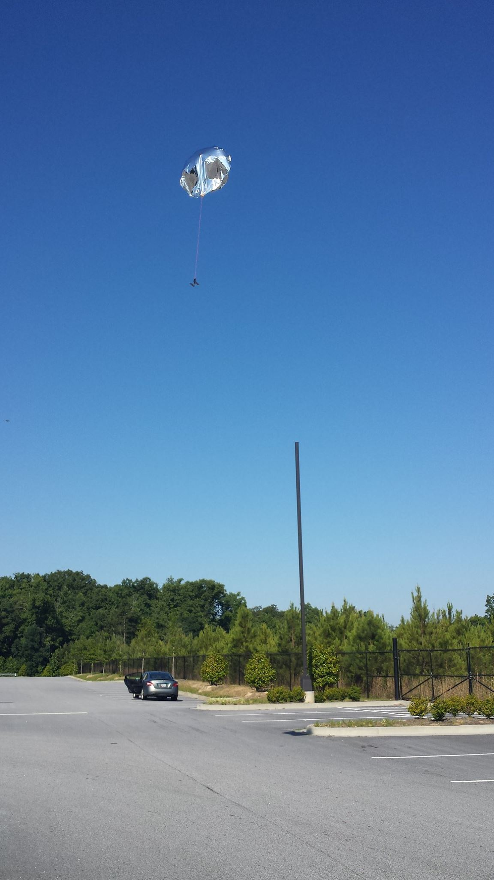
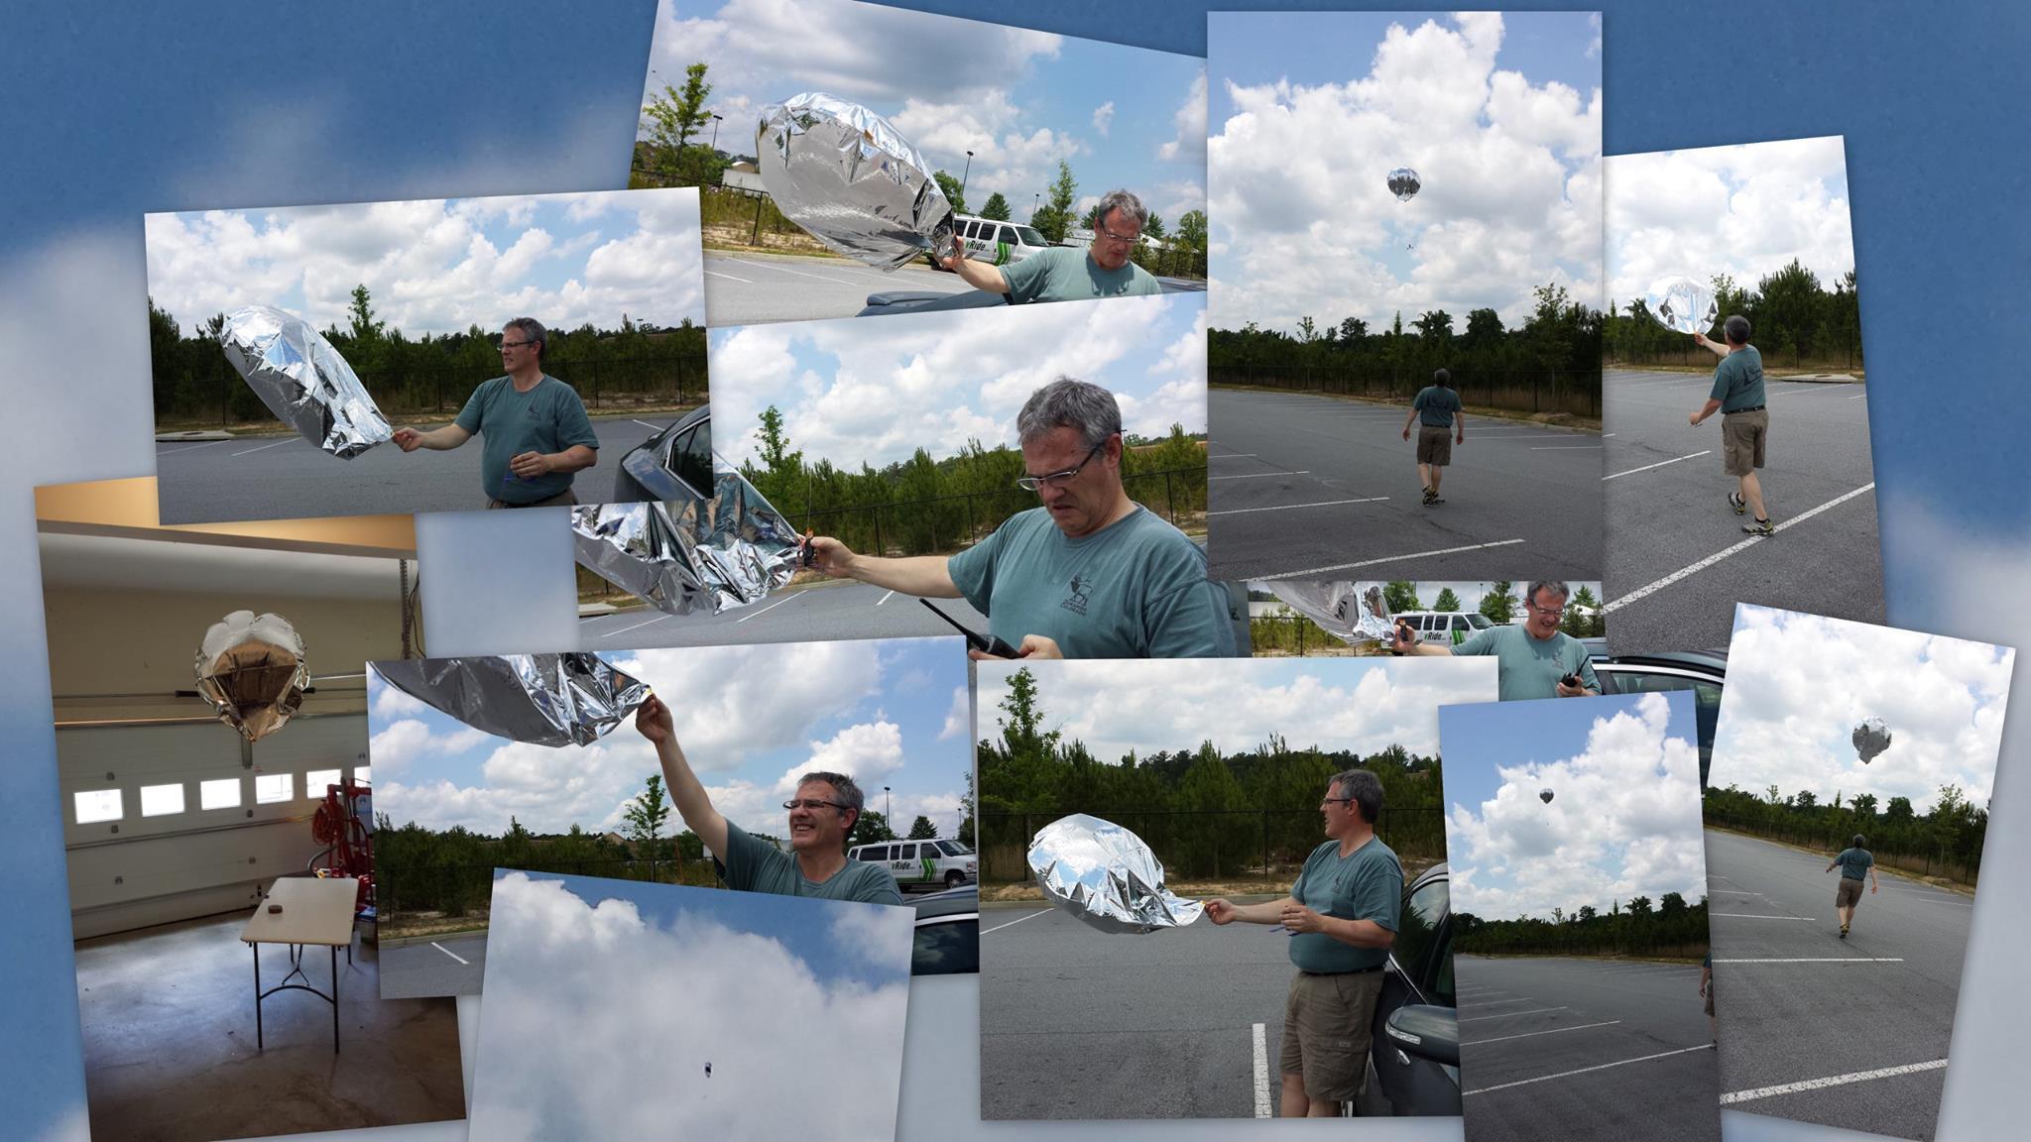
UP and downs of that first launch!

Slide 11
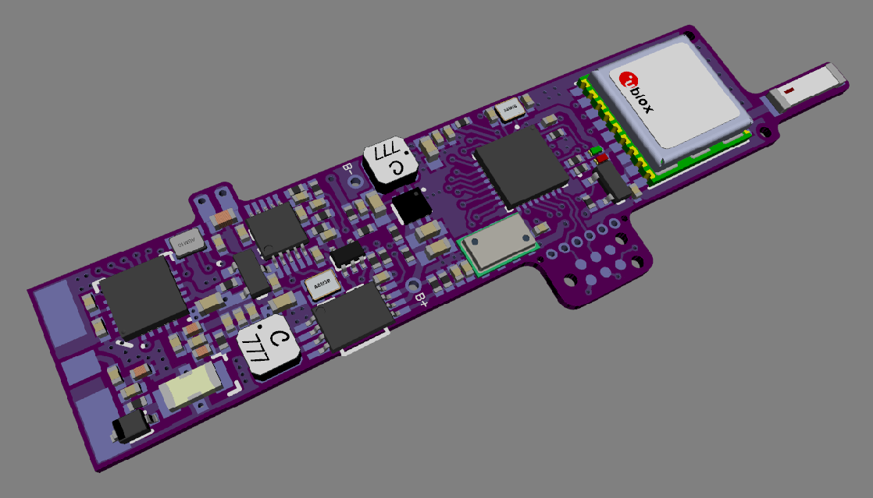
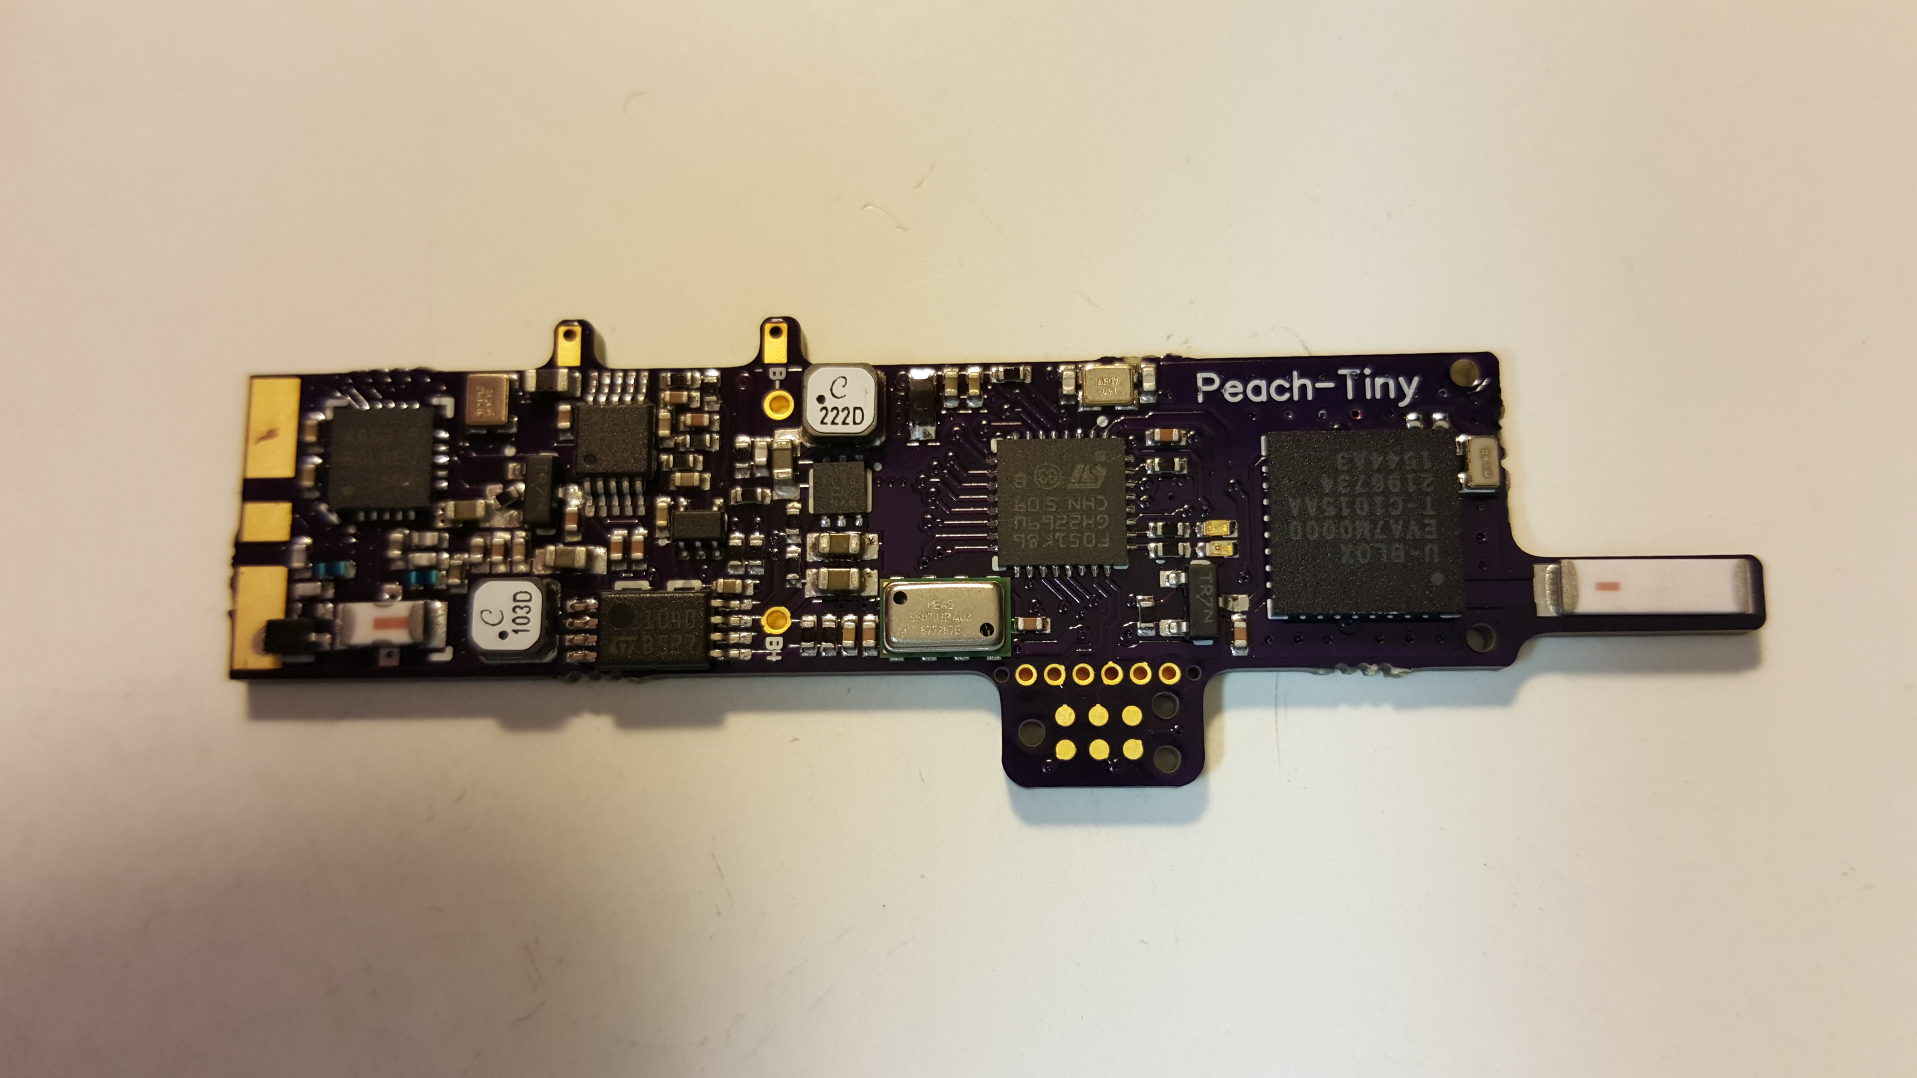
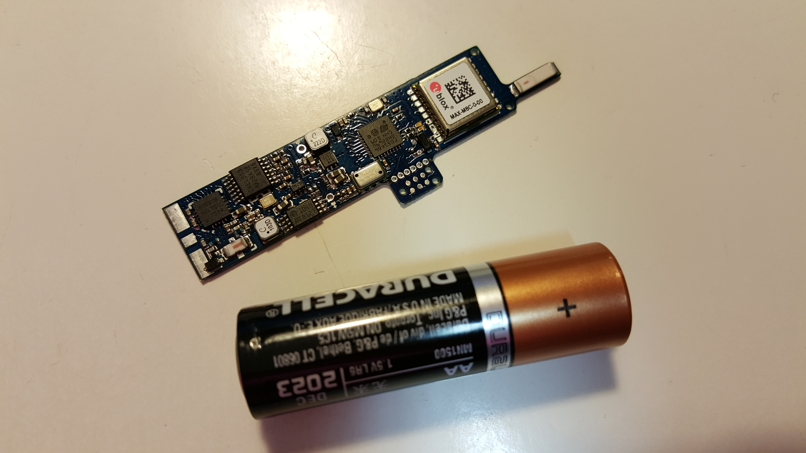
What is needed
Extreme low weight
~1.5 grams or less
Integrated Solar MPPT/SMPS
Extreme low power consumption
Can run from a Supercapacitor/Solar
Sensors
Position
Temp
Baro Pressure
Anywhere Communications
APRS & WSPR (dual radios)
Frequency agility 2.5khz to 1050Mhz
Frequency Stability - TCXO
Geofenced QSY based upon local operating practices w/lockout
ESD/Lightning protection

Slide 12
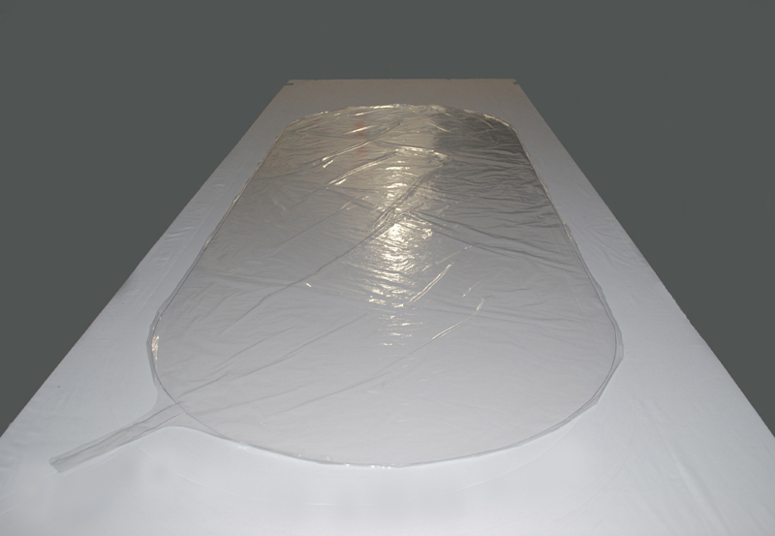
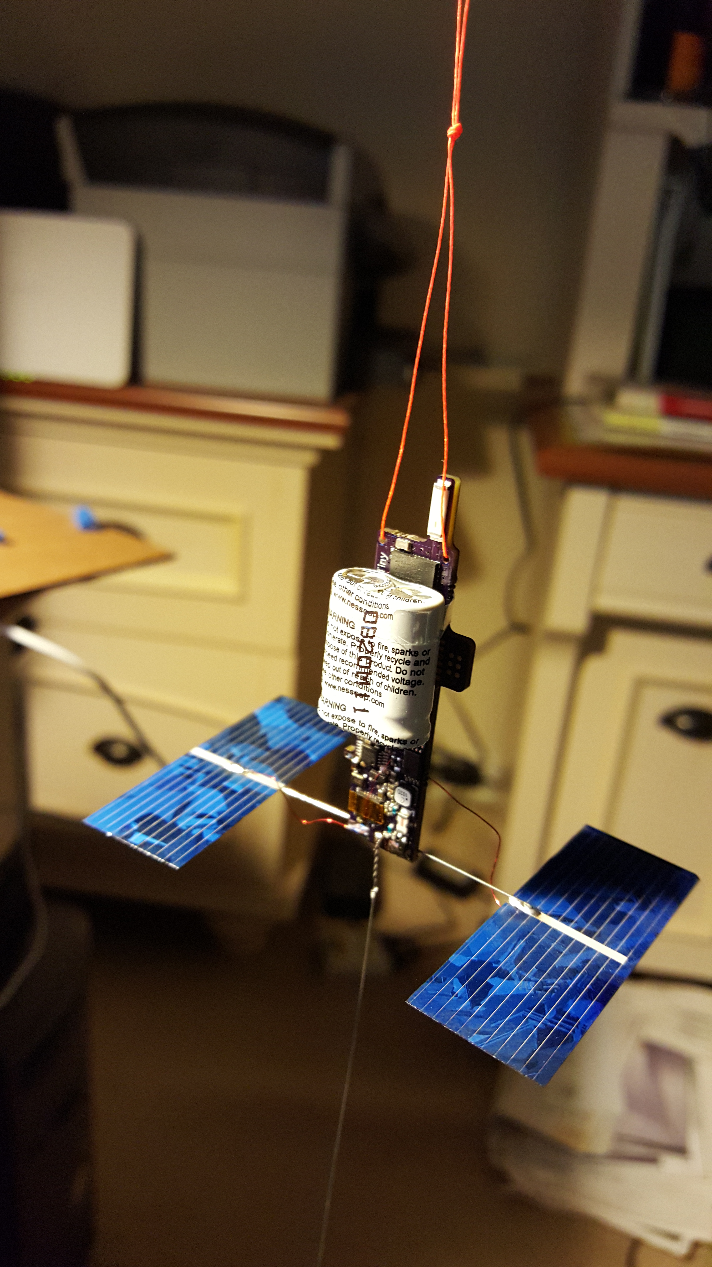
Hw/SW Test Flight – Day 1
Everything's New
Tracker
9 grams total weight
No battery, uses a Supercapacitor/Solar
Prototype board with *blue wires*
Envelope
http://www.scientificballoonsolutions.com
SBS-13 – 7.5’ x 3’, Approx. .5cu meter volume
Radios (10mW output each)
APRS – geofence frequency selection for WW coverage
WSPR – 14.0956Mhz with telemetry overlay
APRS and WSPR antennas (vertical dipoles)
Process
Fill to total payload/balloon weight PLUS 4-5grams (free-lift)
Bird could poop on it and it’s coming down!!!
Launch
7.5’ long balloon with very small freelift
20’ tether above the tracker with 5mtr dipole below
YOU WANT TO DO THIS IN NO WIND!!!

Slide 13
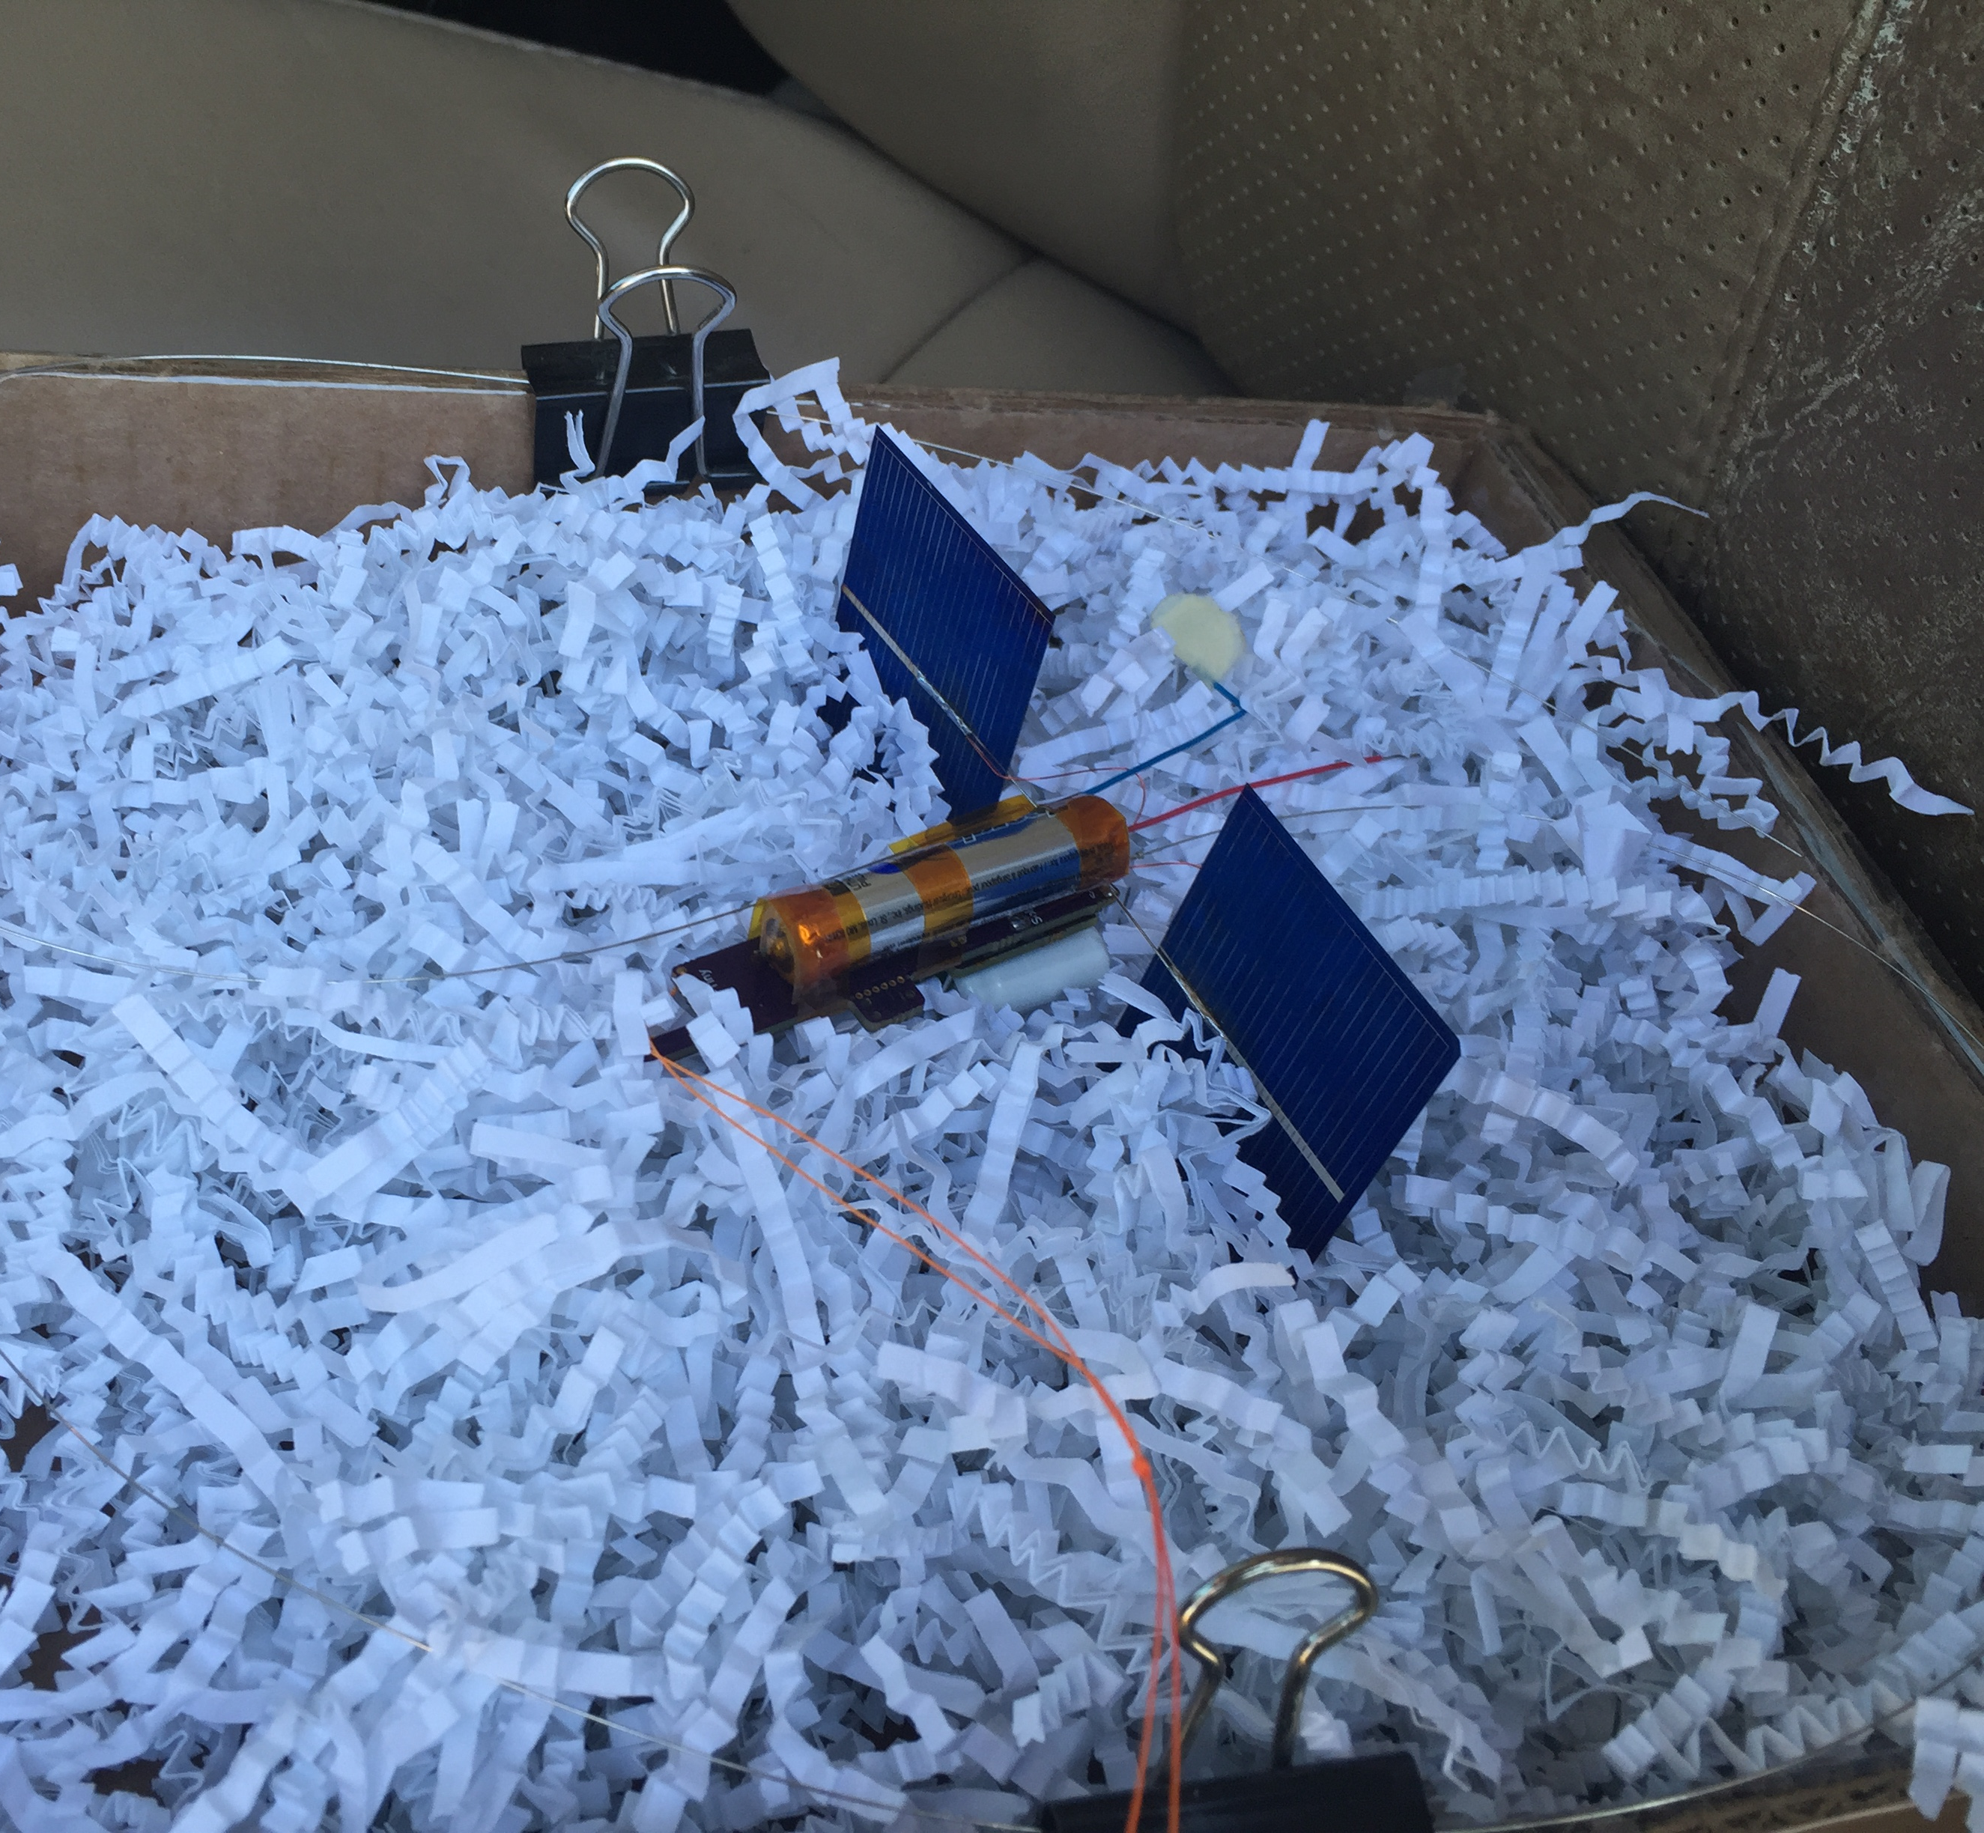
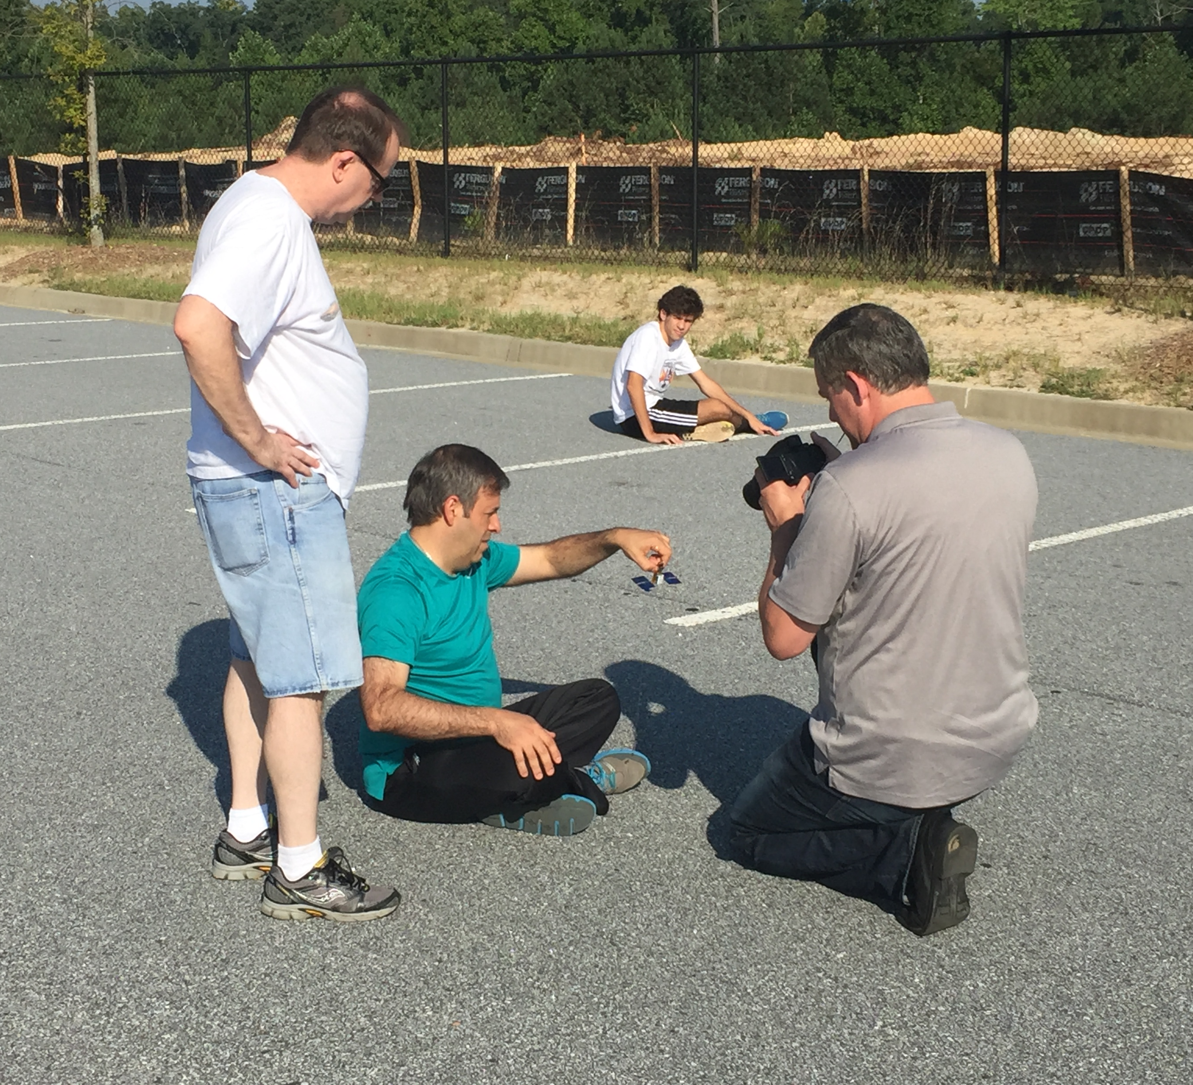
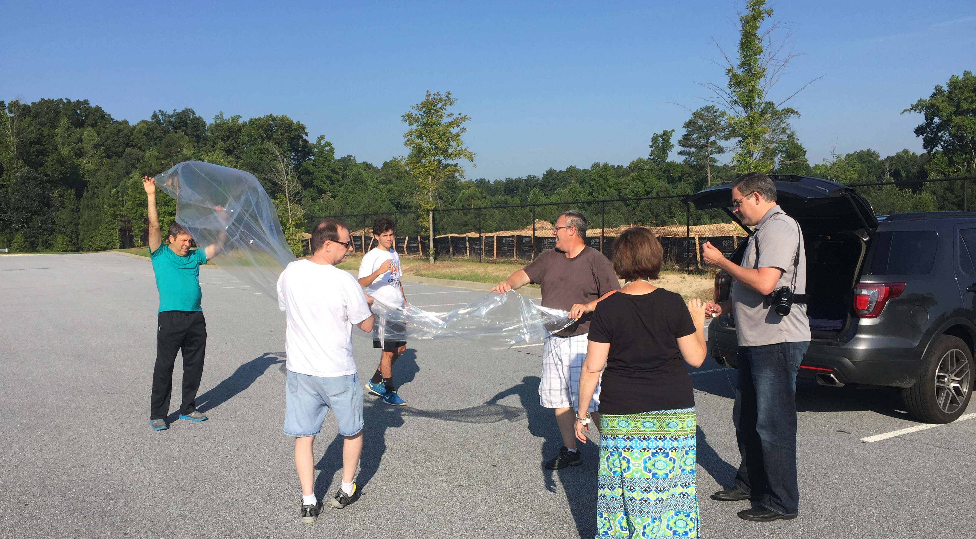

Slide 14
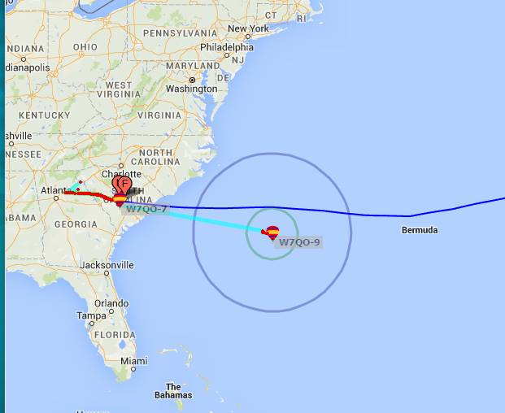
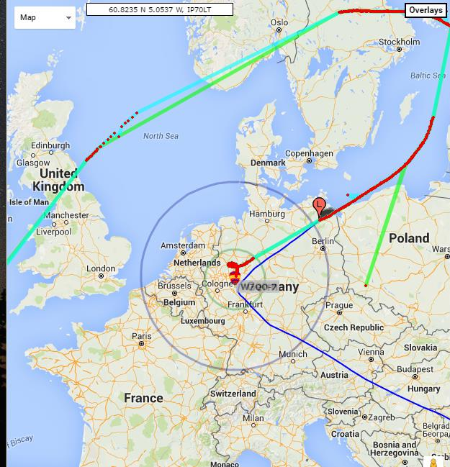
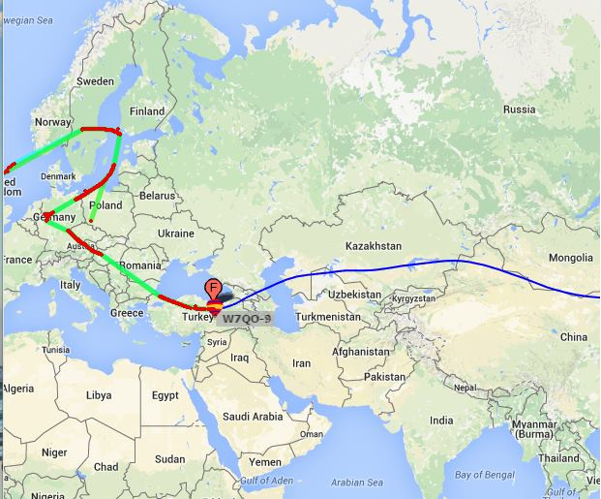
The first 15 days – which seemed like forever!
41500’ Float
Almost 10 days to cross
Supposed to take 4 to Greece
6 Digit Maidenhead works great
WSPR WW Network made this possible

Slide 15
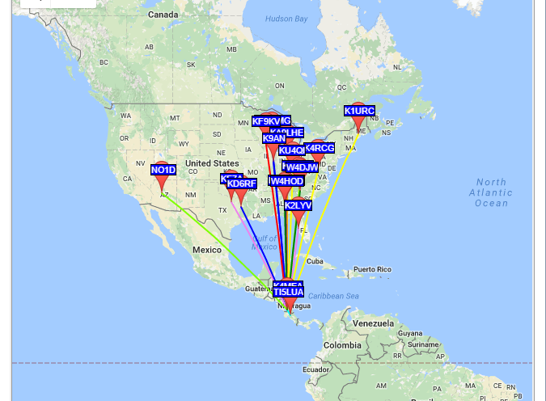
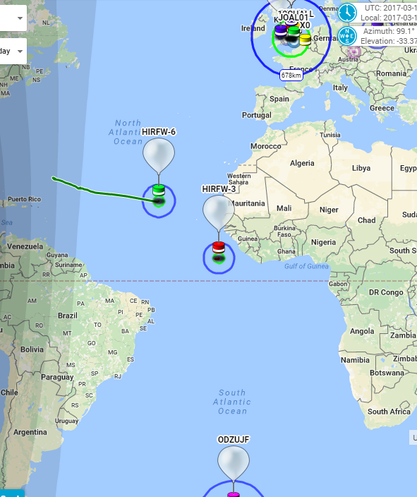
From 15 days to Over 277!
HIRF(w)-3
Launched 8/22/2016
WSPR every 10 minutes (K4MEA)
APRS every 2 minutes (HIRF-3)
Altitude ~46000 ft., no signs of permeation!
Coming into spring in the Northern Hemisphere means challenges with storms

Slide 16
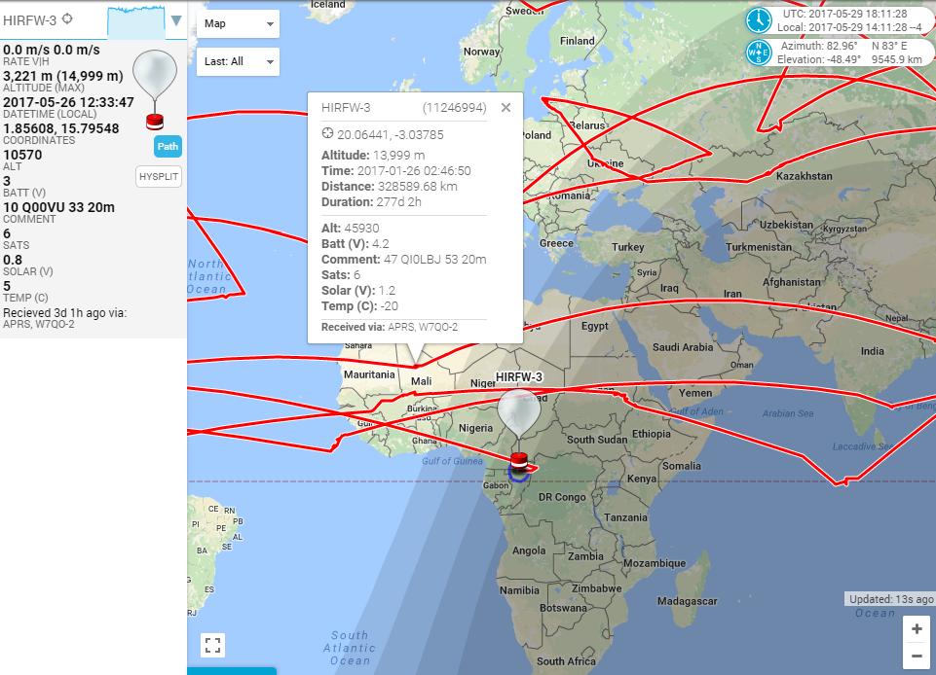
HELD Amateur Records & broken Commercial Records
Exceeded Google Loons records
277+ days (just over 9 months)
700,000+ Km distance travelled
> 200kts speed
< -83C temperature survival
Ultimate QRP - Multiple major continents in one WSPR transmission – from the middle of the Pacific Ocean!

Slide 17
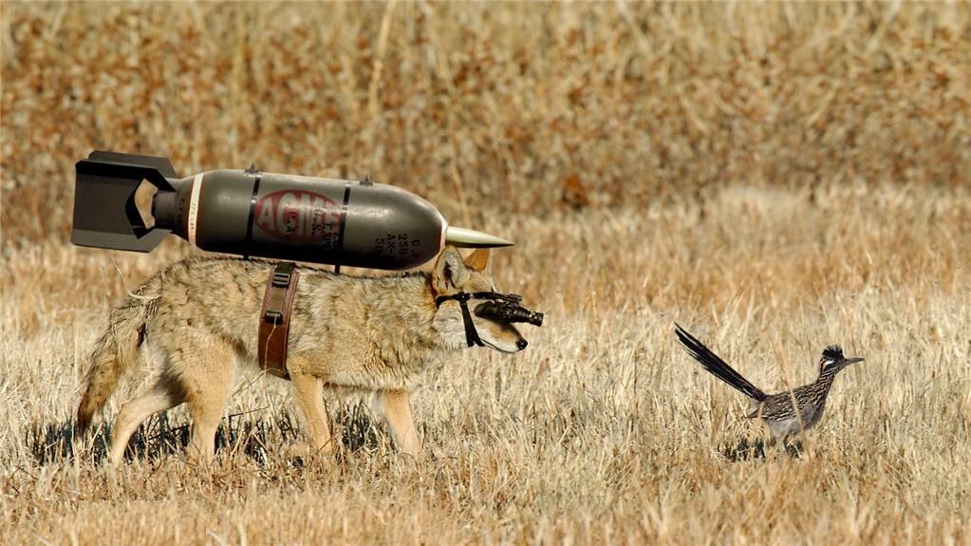
Managing expectations
This stuff is HARD!!!
It takes patience and perseverance
First Flight may be a disaster, but don’t give up
Every flight reveals a learning (either positive or negative)
HIRF(w)-3 has a cold startup issue where it doesn’t start every morning
Explore new protocols/RF utilizations and how they can be learned and utilized (WSPR for moving objects)
What is it about the $100 Bill?
Airplanes, Boats, Cars, you name it
Open your wallet, pull out a $100 bill, attach it to a string, attach string to Balloon and let it go!

Slide 18
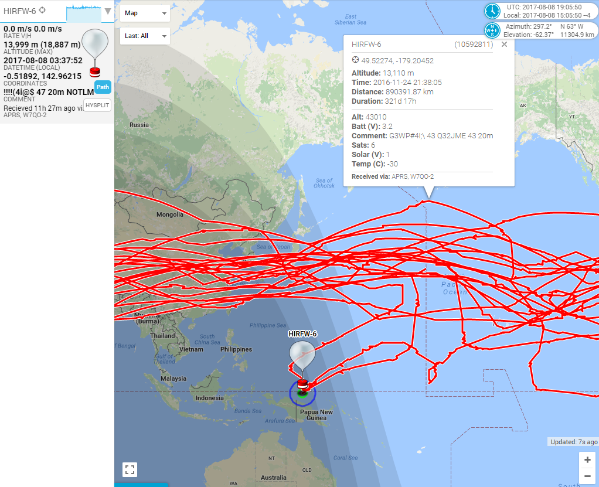
When it all comes together – NEW RECORDS
HIRF(w)-6 (321+ days)
Launched 9/20/2016 (28 days behind -3)
WSPR every 10 minutes (K4JCW)
APRS every 2 minutes (HIRF-6)
Altitude ~46000 ft
Successes – new records
Finished 19th Circumnavigation, started 20th
Traveled 890391+km – in effective distance it has traveled to the Moon and just returned!!!
WSPR and 20 mtrs proved a completely effective tracking method for daytime ops
Since launch has reported its position every day but 4!

Slide 19
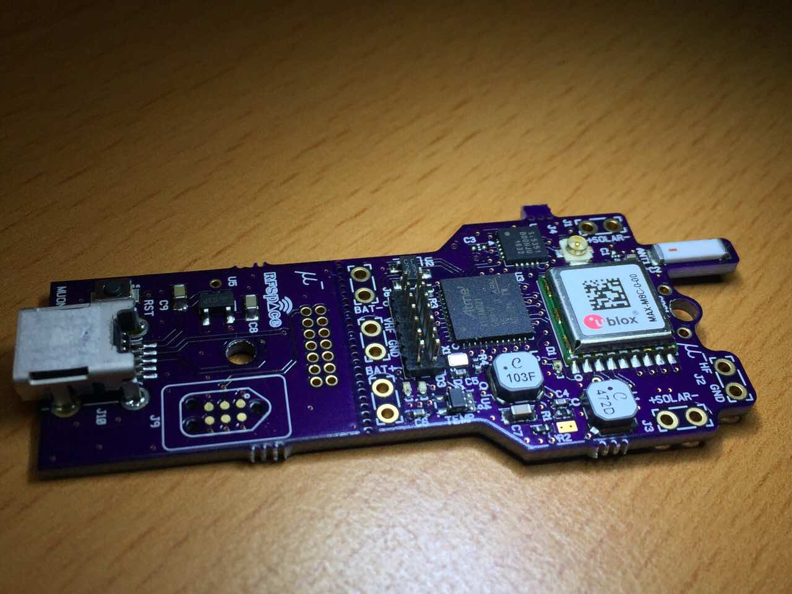
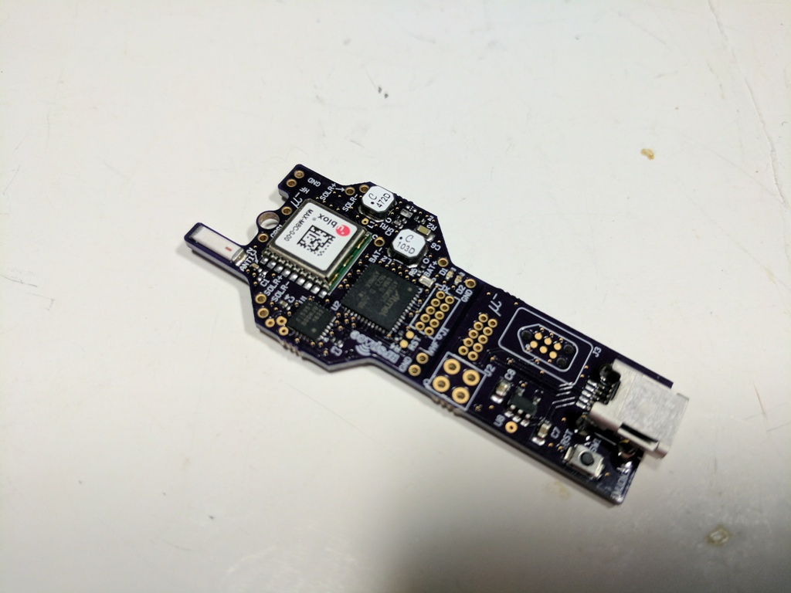
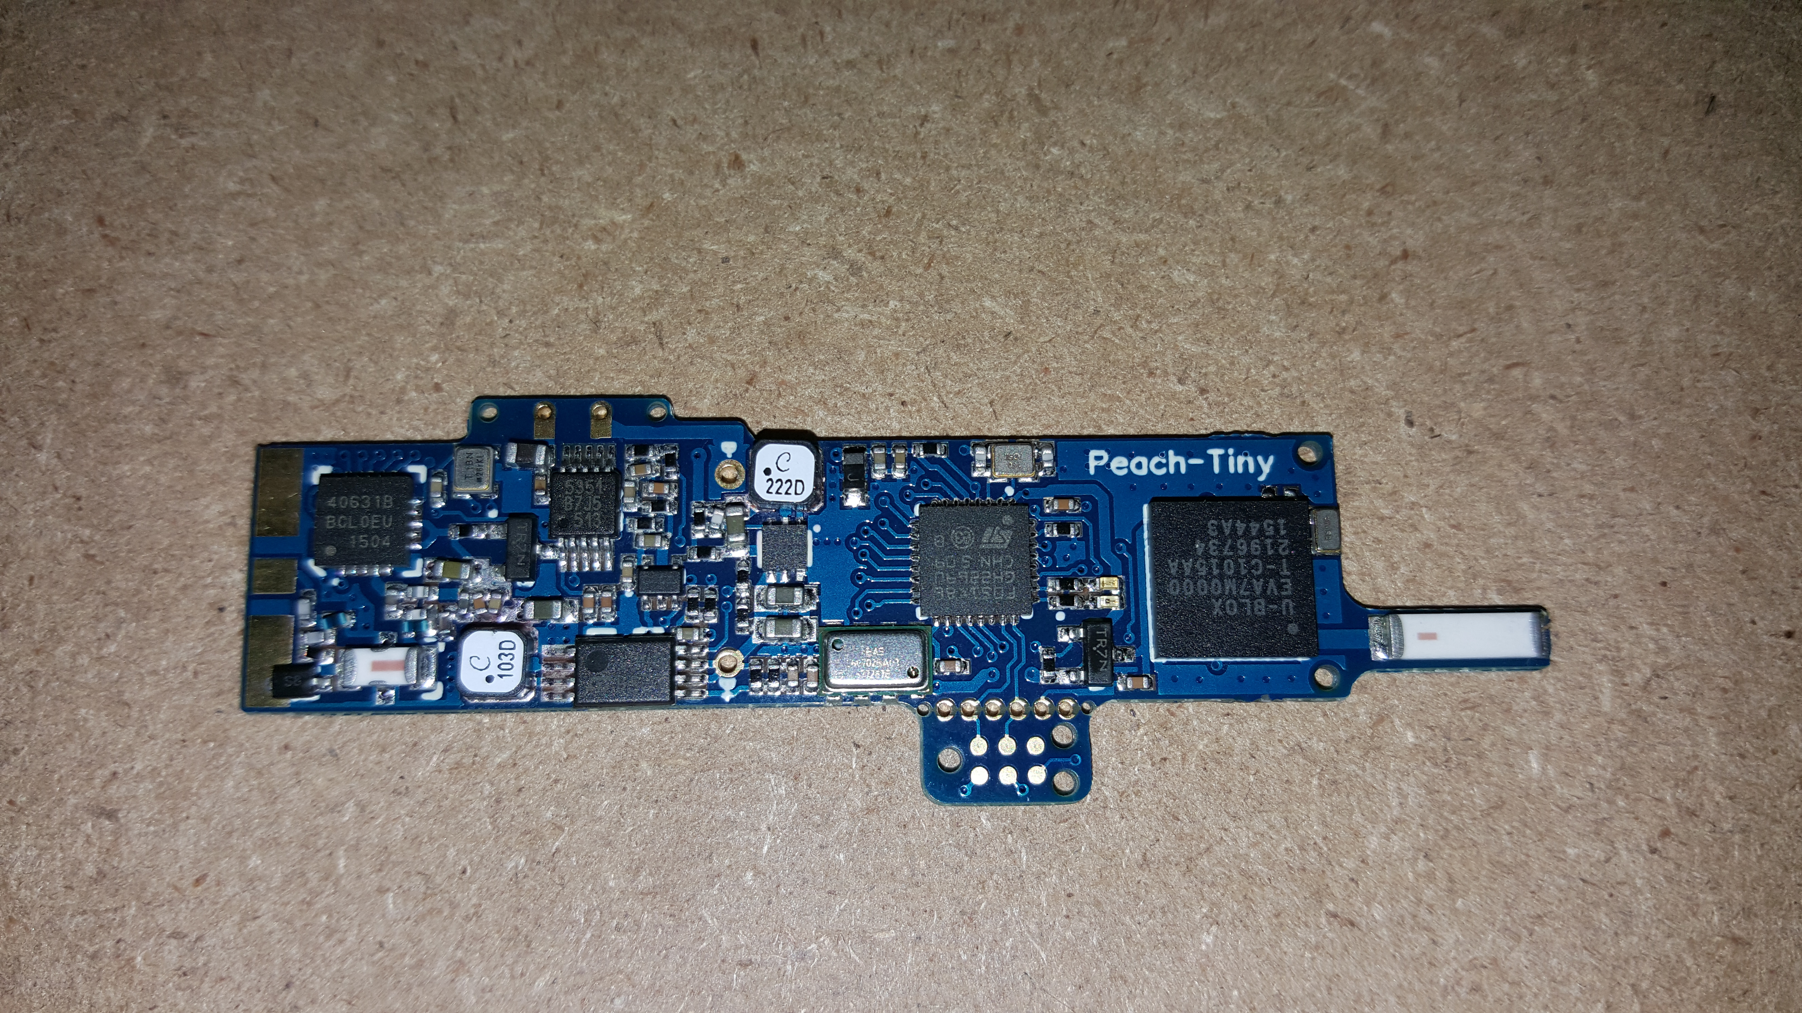
Where does it go from here
The Sky is the Limit – Literally
Improving areas
Envelope designs/material to get above aviation's 43k altitude
Battery chemistry to survive in -60C temps
Software enhancements to provide historical logs of the entire flight path
Other Top Secret stuff in the works ☺
Final Board - ~1.5 grams

Slide 20
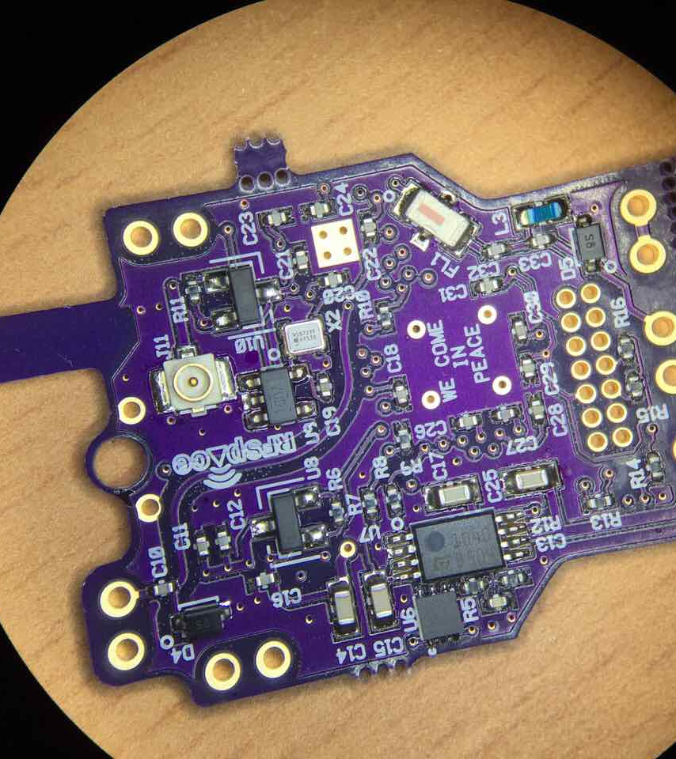
Meet Muon the quarter sized Global Tracker
Arduino Zero compatible w/bootloader
256K Flash, 32K ram, ARM M0+ ultra low power processor
GPS with 1PPS, chip antenna and 50km altitude support
Solar/Battery power supplies
2.5khz to 300Mhz frequency agile radio with VC input for true FM
DAC or PWM modulation available to support WSPR and or APRS + others
HF/VHF/custom/GPS external antenna connections
Multiple programmable LEDs
External header with GPIO, SPI, I2C, debug
USB->Serial support built in
Includes its own SWD/Arduino programing adapter with bench power supply
Coming Soon!

Slide 21
Sky’s the Limit
2017 the year of the Solar Eclipse
August, maximum occlusion in the Eastern states
Next Milestone
Ultimate Record
1 year duration
Night time operations
Project Ghost
744 days aloft for a commercial Balloon (NASA)
Share the fun

Slide 22
Simple Formula for success
36” Qualatex foil party balloon
< 25gr Tracker with APRS
Solar capability if long duration attempt
Battery if short duration, but with overnight capability
Use .013” nickel plated Ernie Ball guitar string for APRS antenna
Fill Balloon to 3grams of freelift
He or H2, H2 will give you ~+1km in float altitude
100” tether between balloon and payload
Expect 24-28k feet and multiple day reporting
Double balloons can get you to 30k ft or close to 10km
Each balloon lifts ½ payload + ½ freelift
Remember to include all the tape, string, etc. weights

Slide 23
Additional Resources
Large group in the UK, very active, with prediction, tracking, open and public information
https://ukhas.org.uk – WIKI, general information
https://tracker.habhub.org – online tracker
https://habhub.org – prediction, SSDV images, database information
APRS.fi online – http://aprs.fi
Amateur Radio High Altitude Ballooning – http://arhab.org
Freenode IRC
#highaltitude
#habhub
Great Plains Super Launch – once a year – http://superlaunch.org

